Slide 1
Supporting SAIs in developing professional competencies for performance audit
Jade Quarrell – IDI Senior Manager
Maria Lucia Lima – IDI Senior Manager
08/06/22
Notes:
Show this slide 3 mins before the meeting starts.

Slide 2
Developing Professional Competencies
IDI’s Professional Education for SAI Auditors
Other IDI Initiatives for PA

Slide 3
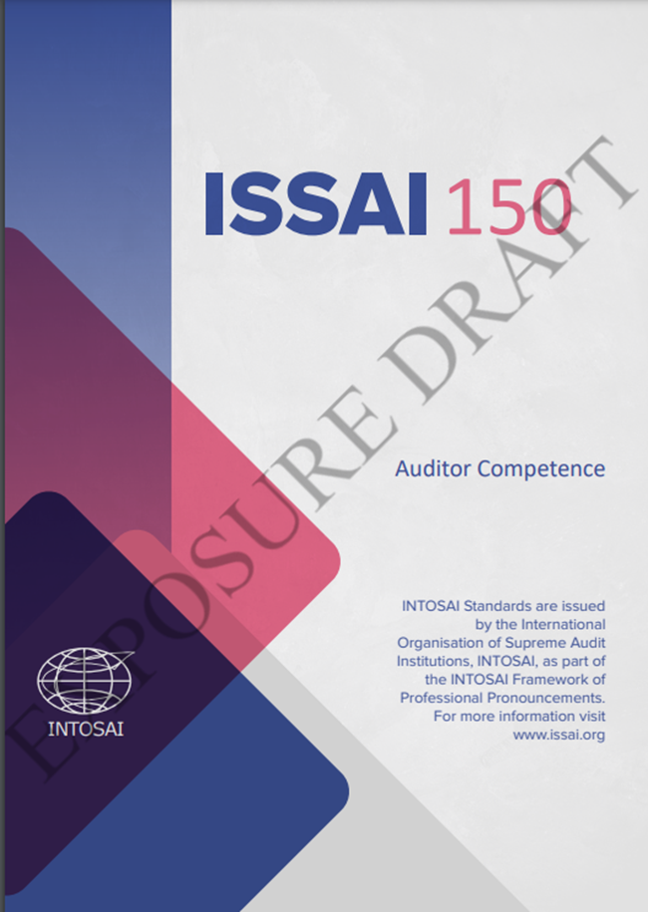
Developing Professional Competencies
2013 TFIAP began work on Professional competencies
Developed ISSAI 150: Auditor Competence (exposure Draft)
GUID 1950: Guidance on the development of competency frameworks for auditors
GUID1951: Guidance on the development of pathways for professional development of auditors

Slide 4
How was ISSAI 150 developed?
Bottom-up approach
Principles based approach
Uniquely INTOSAI

Slide 6
ISSAI 150
The purpose of ISSAI 150 – Auditor
Competence – is to set out the principles that a SAI should follow in determining auditor competencies, as well as the recruitment, development, maintenance and assessment thereof.

Slide 7
Requirements
A SAI shall determine and document relevant competencies required for all auditors.
A SAI shall have appropriate human resource management processes and practices to ensure that its auditors have the relevant competencies determined by the SAI.
A SAI shall establish dedicated pathways for professional development of auditors, specifically tailored to the SAI’s mandate, regulatory framework, organisation structure and needs.
A SAI shall develop and implement the means for assessment of competencies and monitoring of auditor development progression or self development on a periodic basis.

Slide 10
Unique
First global Performance Audit Certification
Create Community SAI Auditors
SAI Inputs
SAI Examples

Slide 11
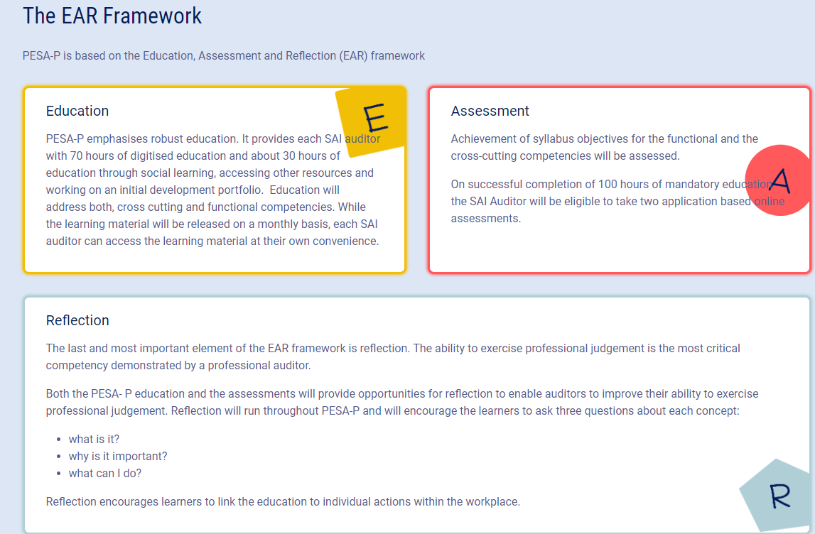

Slide 12
PESA-P PA numbers
8 INTOSAI regions
71 countries
264 auditors
136 SAI coaches
48% female

Slide 13
Cross Cutting Competencies
Provide Value and Benefits for All
Behave Professionally
Functional competencies
Performance audit: concepts, principles and process
Performance audit: tools and techniques
Performance audit planning
Conducting a performance audit
Performance audit report and follow-up for impact
Education

Slide 16
Assessment
IDI SAI Audit Specialist (PA)
Complete Education
Complete IPDP
Take two assessment exams
IDI partnered with Pearson Vue to offer exams at an exam centre
Focus on making professional judgements in SAI context

Slide 17
What’s Next?
Finish Pilot 2022
Special Edition for SAI Coaches
Roll out in four languages (Arabic, English, French, and Spanish)

Slide 18
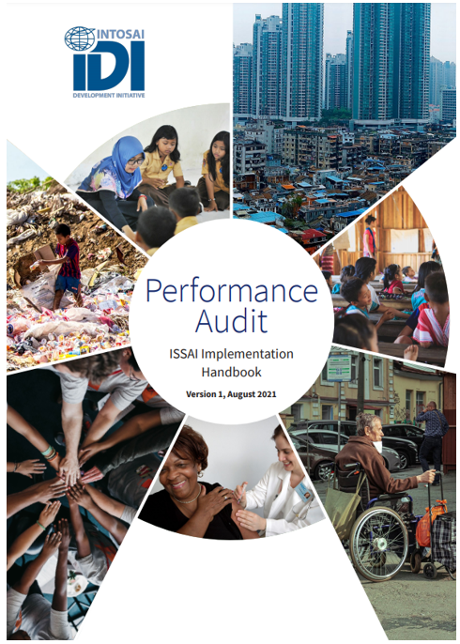
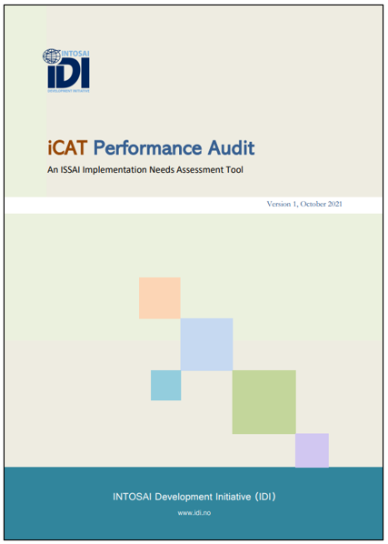
IDI documents

Slide 19
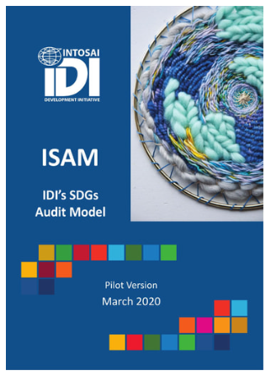
Other PA initiatives
40 SAI from ARABOSAI, ASOSAI, CAROSAI, OLACEFS and PASAI
14 SAI from OLACEFS
SAI Uganda

