Slide 1
Remarks on the history of PAS
London, June 2022

Slide 2
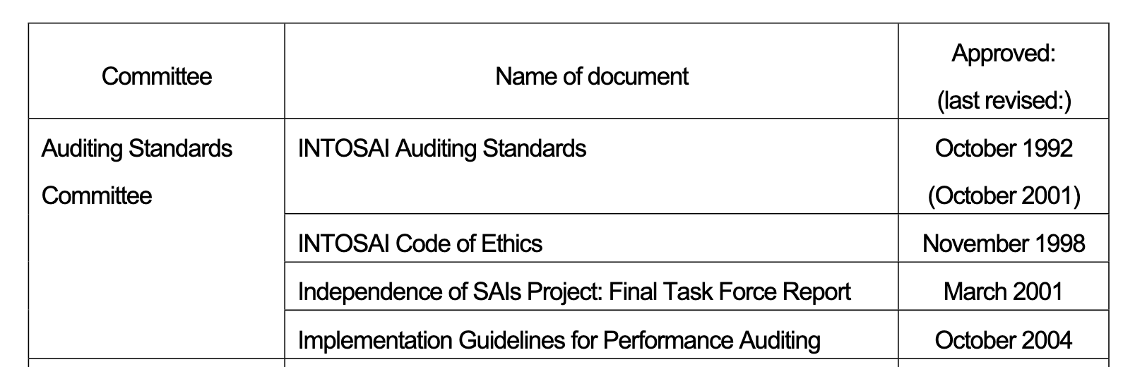
Beginnings…
 | INTOSAI
1977 | Lima Declaration
1984 | Auditing Standards Committee
1992 | Auditing Standards
2004 | Goal Structure (PSC)

Slide 3
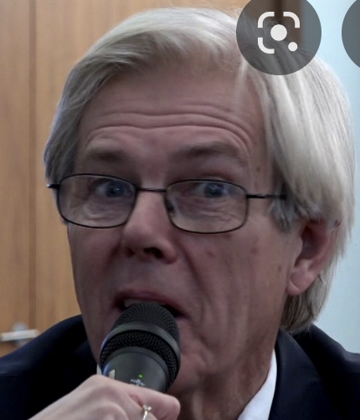
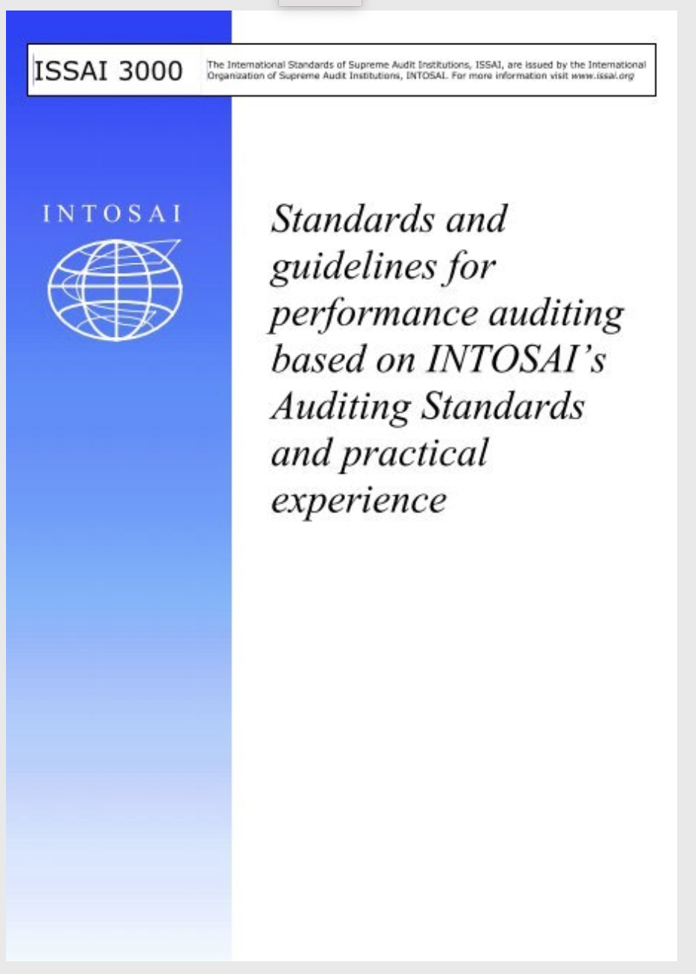
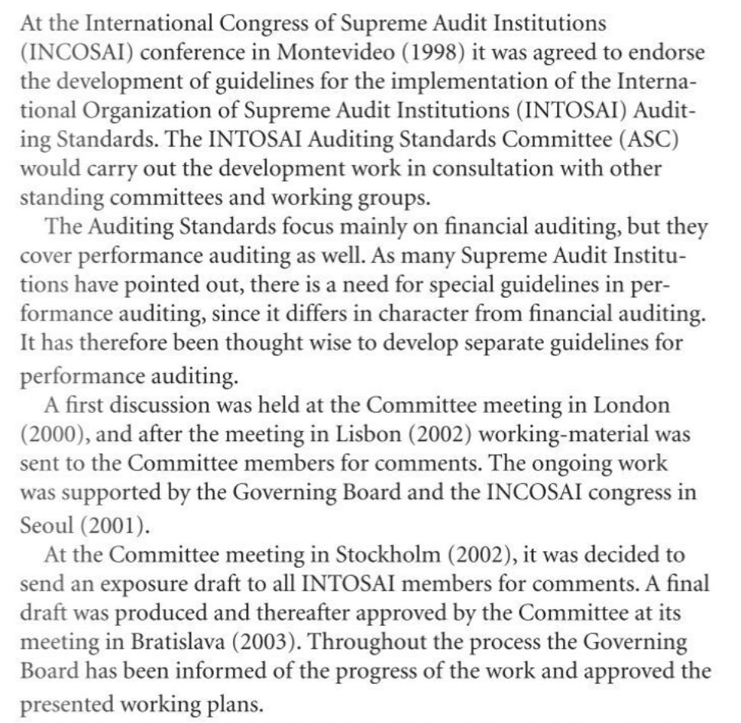
Implementation Guidelines

Slide 4
Historical Overview
 | INTOSAI | PAS
2004 | Goal Structure (PSC) | Implementation Guidelines for Performance Audit
2005 |  | First meeting Brasilia, ToR
2007 | ISSAI framework | Brasilia, Oslo - ISSAI 3.100 ("essence"), implementation guidelines, "practical documents"
2010 | South Africa Declaration | Brasilia, Vienna - ISSAI 300
2013 | China ISSAI 100 - 400 | Ottawa, Amsterdam, New Deli - 3.000, 3.100, 3.200
2016 | Abu Dhabi ISSAI 3.100 | Lima, Oslo, Budapest
2019 | Moscow - IFPP | Johannesburg 19, 21 (online)
2022 | Brazil - ? | London

Slide 5
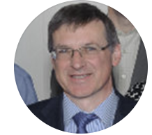
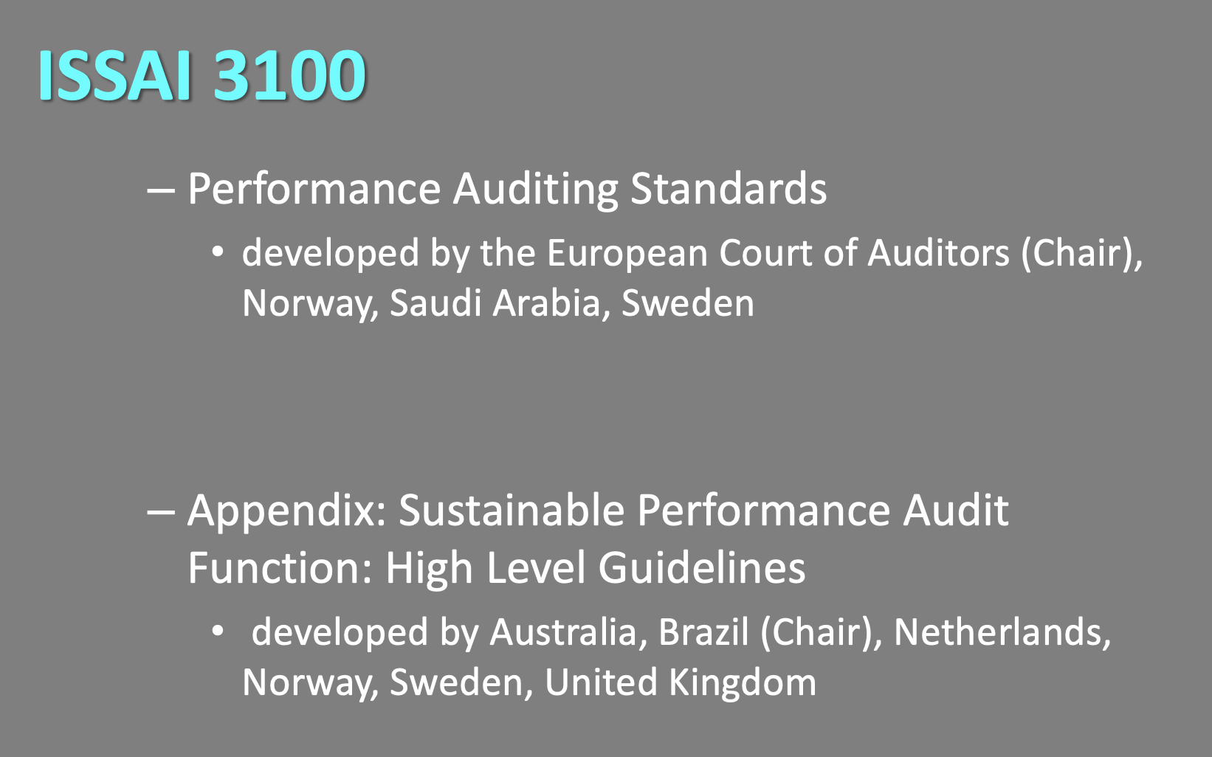
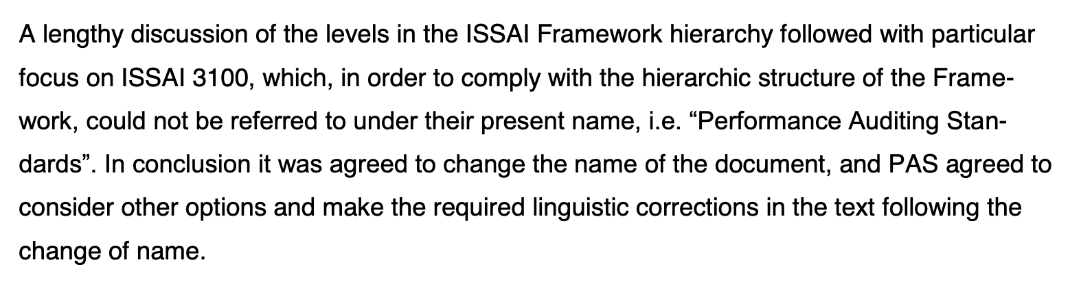
First effort
Didn´t fit the framework

Slide 6
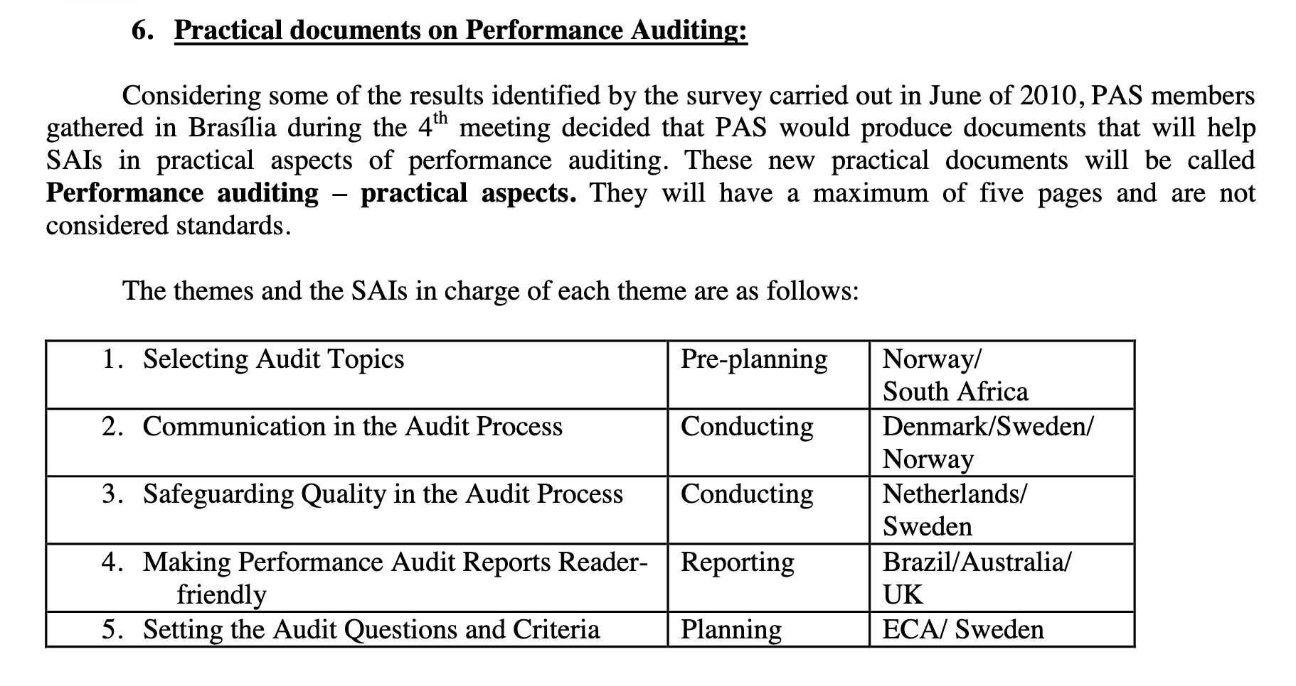
2nd effort
Didn´t fit the framework

Slide 7
Current papers
2012: Harmonization Projekt (300)
2016: ISSAI 3000 (PAS)
3.100 and 3.200 – good but fit into the framework?
Did we fulfill the framework?

Slide 8
Recent efforts
Our experience
Combined Audits?
Internal Controls?
Review of Govs
Not started: 3Es
others
What happened to Accounting Standards? Practice Notes in Financial Audits?

Slide 9
Future
Minimize Reduplication 300/3000?
What to do with 3.100 und 3.200?
How can we do it?
New Strategic Plan (PSC)

Slide 10
Lessons 1
Potential for frustration in producing the kind of paper that PSC wants (do they know what they want?)
little really new content since 2004?
„The PA committee“ or „not knowledge sharing, not capacity building?“
tools: liaison with FIPP/PSC; working groups with other subcommittees for specific purposes
but: build a sustainable function, Handbook IDI, lots of knowledge sharing (analytics, digital)
Do it nevertheless?

Slide 11
Lessons 2
Membership: All SAIs? Changing SAIs? Continuity? Structure?
Representatives? QS people? PA – people? Continuity?
Resource Commitment?
Internal Consensus in SAIs - Why do SAIs have different positions in PAS, PSC und FIPP?
Find the right mix
Find the right mix
?

Slide 12
Thank you for your attention
Historisch

Slide 13
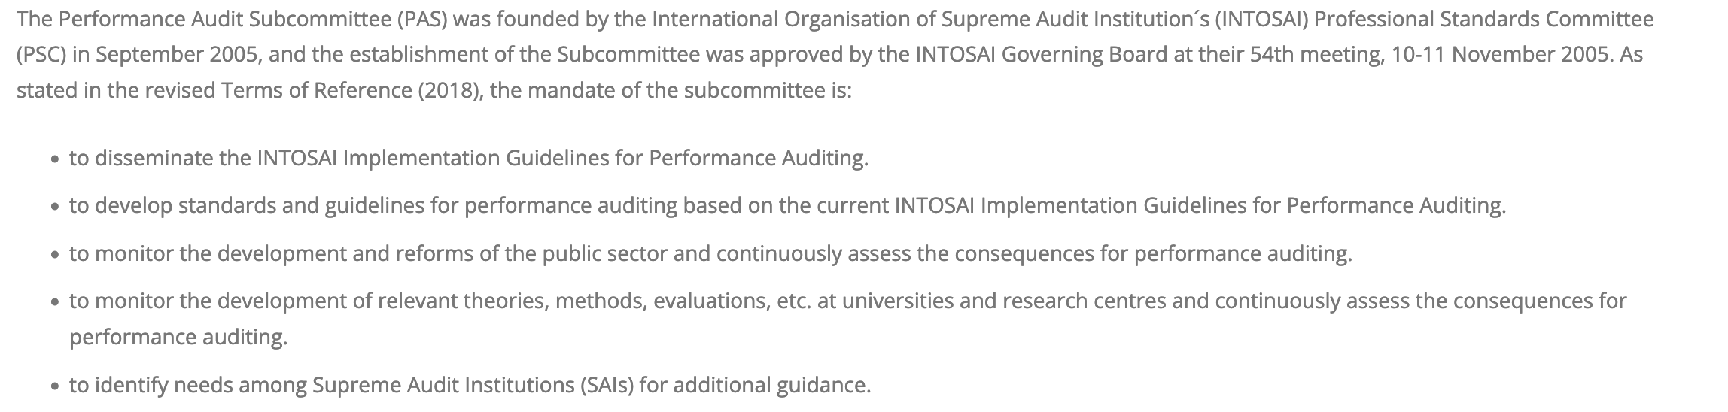
The foundation

Slide 14
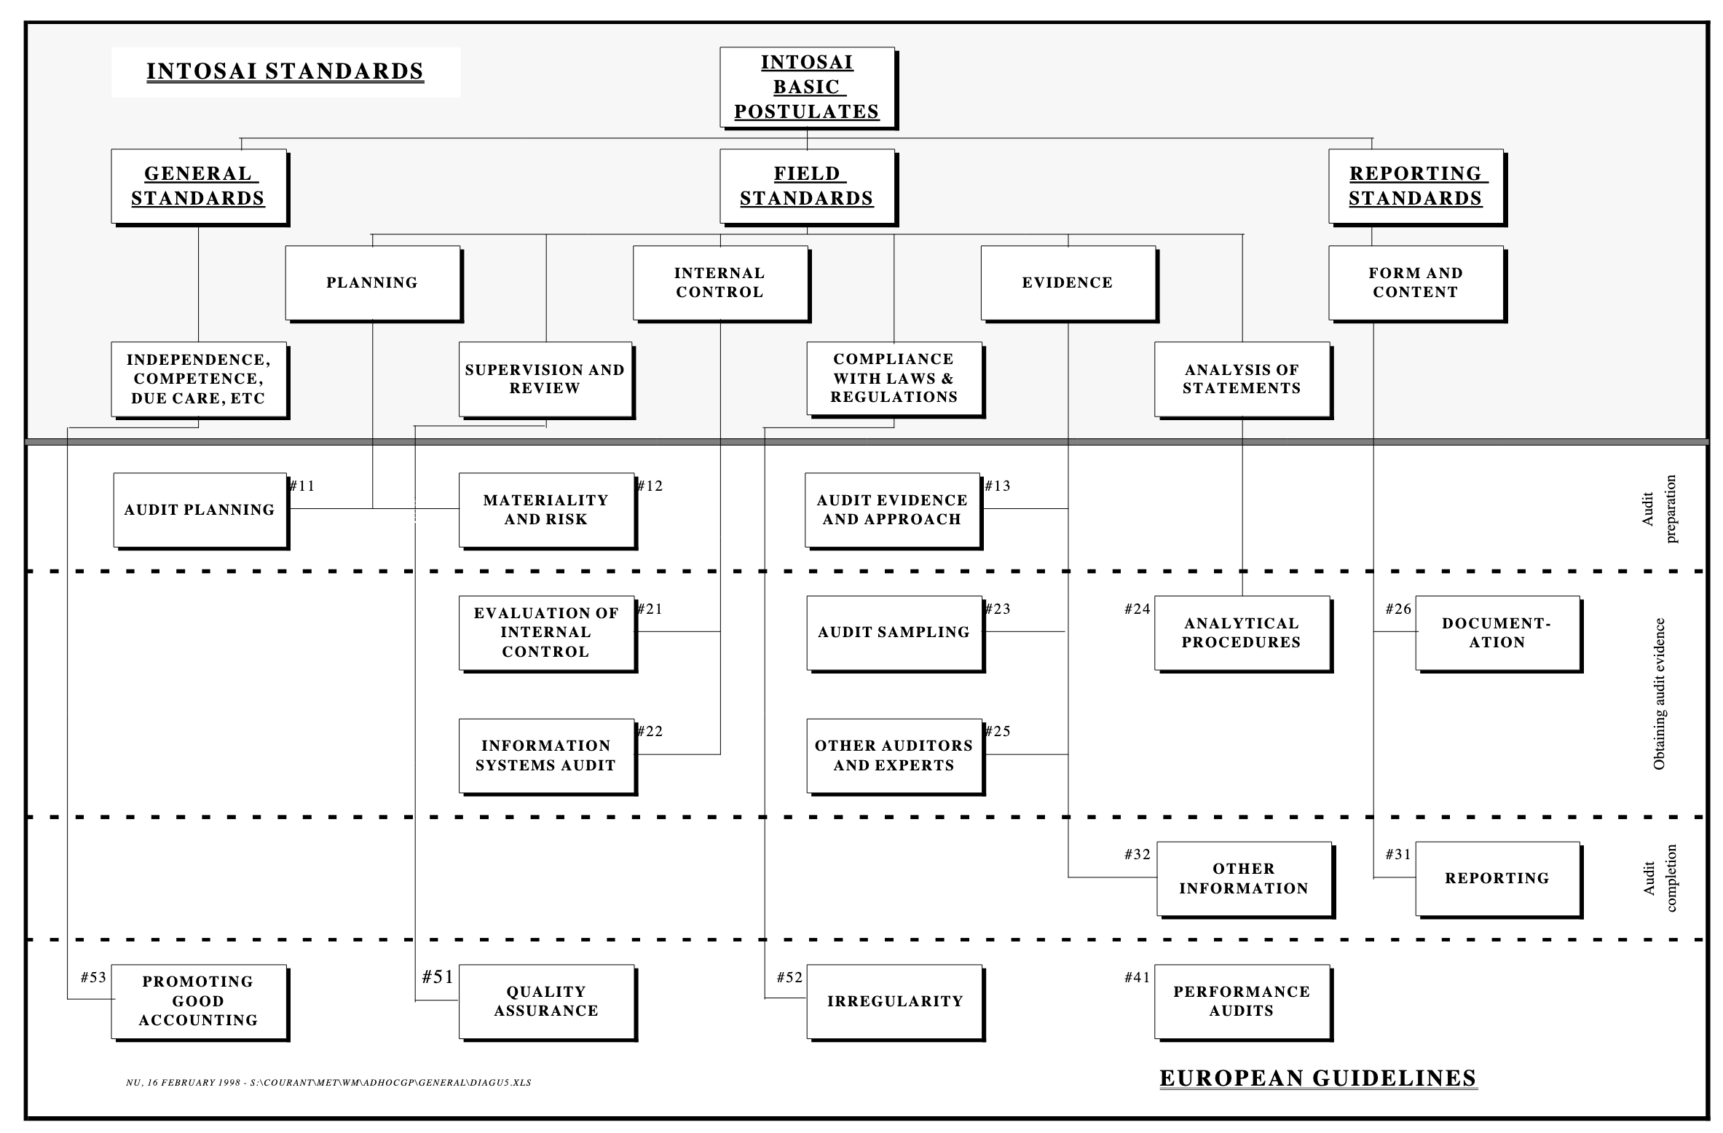
Regional Versions

