Slide 1


Dedicated capacity to address rapidly evolving science & technology oversight challenges

Slide 2

Overview of GAO’s Science Technology Assessment and Analytics Team (STAA)
Presentation Roadmap
Historical and macro-level contexts to STAA’s work
Overview of the GAO Innovation Lab
Demos of Innovation Lab solutions
Q&A

Slide 3

Science Technology Assessment and Analytics (STAA)
Provide Congress with critical foresight, oversight, and insight into science and technology issues to ensure continued innovation, competitiveness, security, and well-being in a rapidly changing world.
BEST PRACTICES
OVERSIGHT
ENGINEERING SCIENCES
FORESIGHTS
SCIENCE &TECH AUDITING
TECHNOLOGY ASSESSMENTS
INSIGHTS/ADOPTIONS

Slide 4
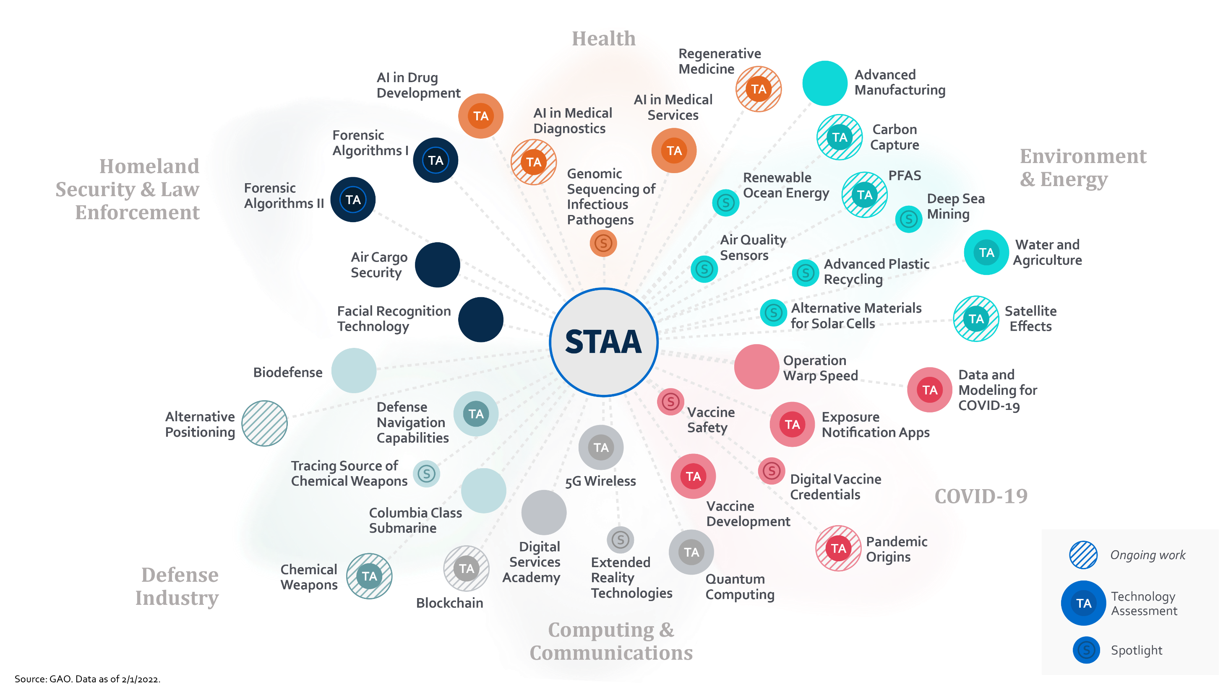

Slide 5
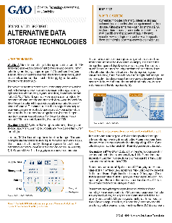
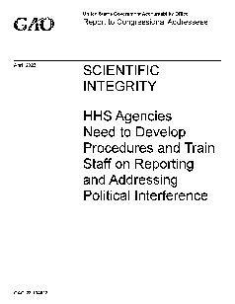
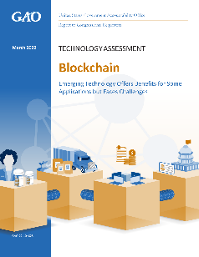
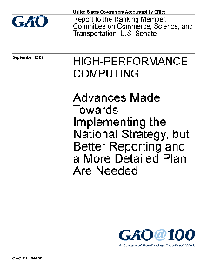


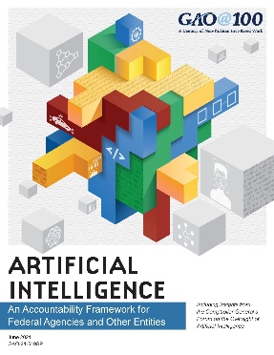
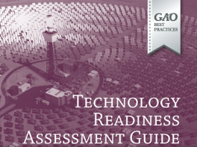
Technology Assessments
S&T Oversight
STAA’s Portfolio
Spotlights
Two-page overviews that describe an emerging S&T development, the opportunities and challenges it presents, and the relevant policy context.
Audits
Conduct congressional oversight to ensure federal agencies efficiently fund and implement programs and policies in science and technology in four areas:
Research programs
Intellectual property
Innovation programs
Policy implications
A team of 140-strong specialists and analysts
We have unique statutory access to federal agencies and information
We have the trust of Congress
We are practitioners of technologies ourselves
Technology Assessments
Analyses on the latest developments in science and technology, draw attention to the accountability implications, and provide options that policymakers could consider.
How do we continually enhance absorptive factors?
Engineering Sciences
Best Practices Guides
Best practices to evaluate the readiness of technology, develop and manage program costs, and adopt and implement new tools and frameworks
Advanced Analytics
Audit-Adjacent Solutions
Emerging Technologies
www.gaoinnovations.gov

Slide 6

WE EXPLORE WICKED PROBLEMS THAT EXIST IN GOVERNMENT OVERSIGHT, AND HELP STRENGTHEN CAPACITY THROUGH EMERGING TECHNOLOGY AND DATA SCIENCE.
Our work impacts audits of tomorrow
#futureofaudit

Slide 7
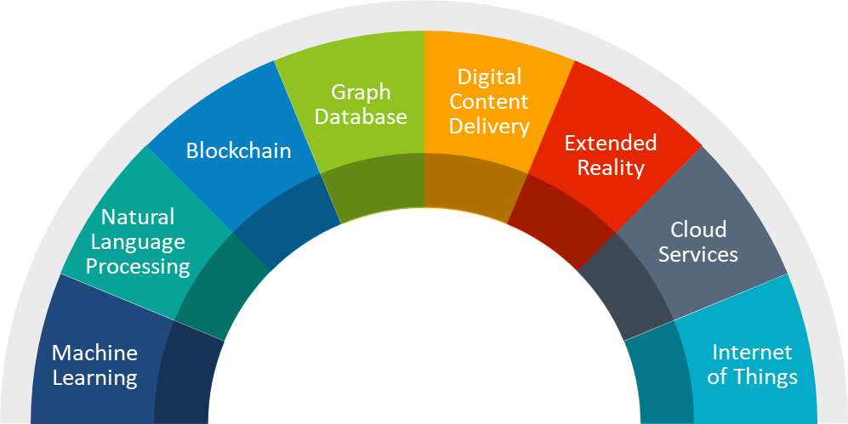

Technology is advancing every day. We believe oversight should, too.
www.gaoinnovations.gov

Slide 8
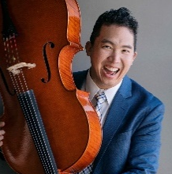
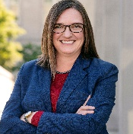
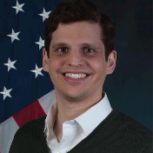

Mission-aligned innovation strategy
DATA GOVERNANCE
DATA SCIENCE
DATA LITERACY
CHIEF DATA SCIENTIST
DIRECTOR | INNOVATION LAB
Focus on (oversight) problems, not technologies
Create space to fail quickly
Connect possibilities with sustainability
Avoid recreating wheels
ADVANCED ANALYTICS
AUDIT-ADJACENT SOLUTIONS
EMERGING TECHNOLOGIES

Slide 9
1
2
3
What problems did you solve?
What will you
do for me?
What did you do with resources provided?
Measure and communicate what matters
4
5
6
Who cares about your work?
Who is doing
the work?
How did
you fail?

