Slide 1
Learning from the UK Government’s response to the COVID-19 pandemic
OFFICIAL

Slide 2
Background
Published over 30 reports on various aspects of the government’s response to the pandemic – we have used a variety of mechanisms to enhance accountability and transparency
This presentation brings together our initial thoughts on learning from this body of work
The pandemic has provided new learning on what has worked well and what hasn’t but has also laid bare existing fault lines within society, public services and government itself

Slide 3
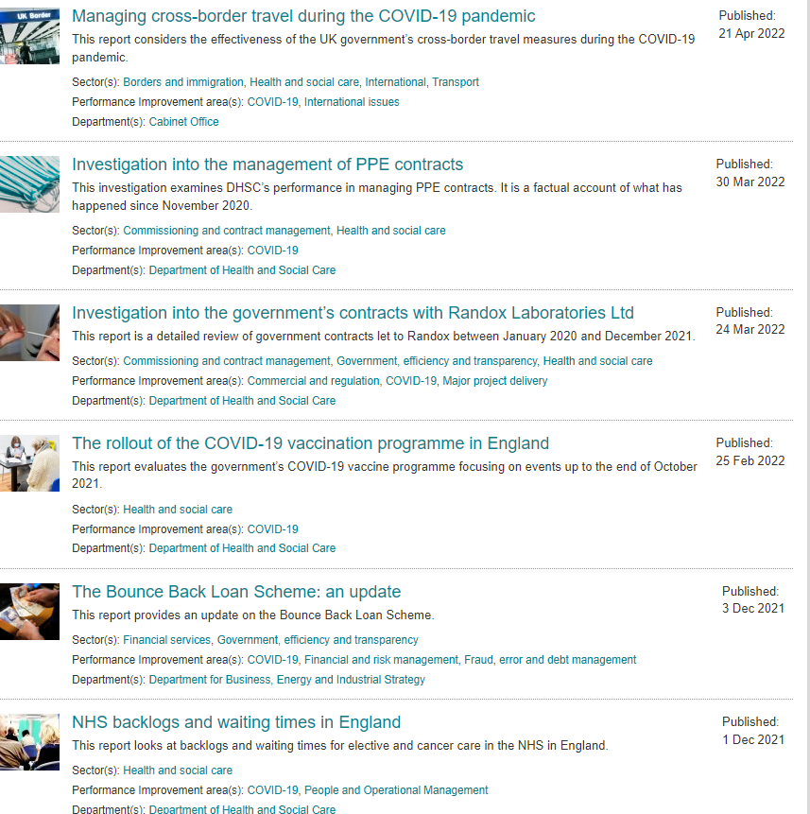
Our publications
We have published over 30 reports on COVID-19 on a range of topics

Slide 4
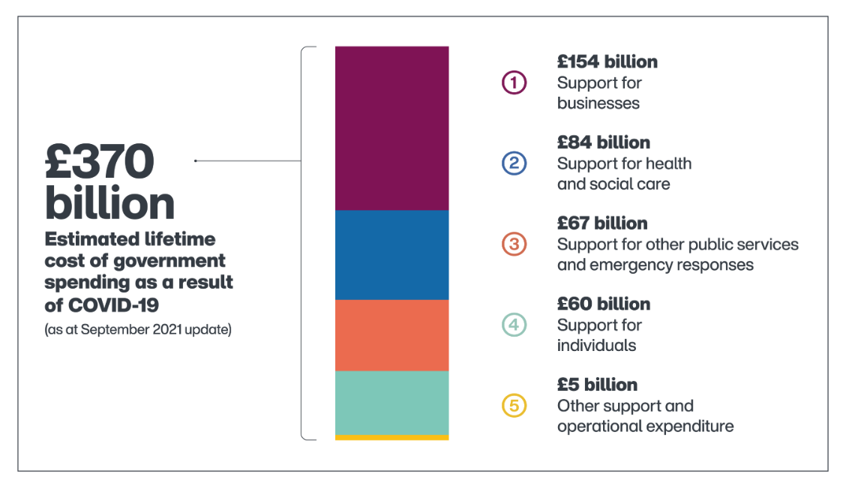
Covid tracker
COVID-19 cost tracker - National Audit Office (NAO)

Slide 5
Emerging themes from our COVID-19 reports
Risk management
Identifying the wide-ranging consequences of major emergencies and developing playbooks for the most significant impacts.
Being clear about risk appetite and risk tolerance as the basis for choosing which trade-offs should be made in emergencies.
Transparency and public trust
Being clear and transparent about what government is trying to achieve, so that it can assesses whether it is making a difference.
Meeting transparency requirements and providing clear documentation to support decision-making, with transparency being used as a control when other measures, such as competition, are not in place.
Producing clear and timely communications.
Data and evidence
Improving the accuracy, completeness and interoperability of key datasets and sharing them promptly across delivery chains.
Monitoring how programmes are operating, forecasting changes in demand as far as possible, and tackling issues arising from rapid implementation or changes in demand.
Gathering information from end-users and front-line staff more systematically to test the effectiveness of programmes and undertake corrective action when required.
Coordination and delivery models
Ensuring that there is effective coordination and communication between government departments, central and local government, and private and public sector bodies.
Clarifying responsibilities for decision- making, implementation and governance, especially where delivery chains are complex and involve multiple actors.
Integrating health and social care and placing social care on an equal footing with the NHS.
Balancing the relative merits of central, universal offers of support against targeted local support.
Supporting and protecting people
Understanding to what extent the pandemic and government's response have widened inequalities, and taking action where they have.
Providing appropriate support to front-line and other key workers to cope with the physical, mental and emotional demands of responding to the pandemic.
Workforce and capacity
Placing the NHS and local government on a sustainable footing, to improve their ability to respond to future emergencies.
Ensuring that existing systems can respond effectively and flexibly to emergencies, including provision for spare or additional capacity and redeploying staff where needed.
Considering which COVID-19-related spending commitments are likely to be retained for the long term, and what these additional spending commitments mean for long-term financial sustainability.

Slide 6
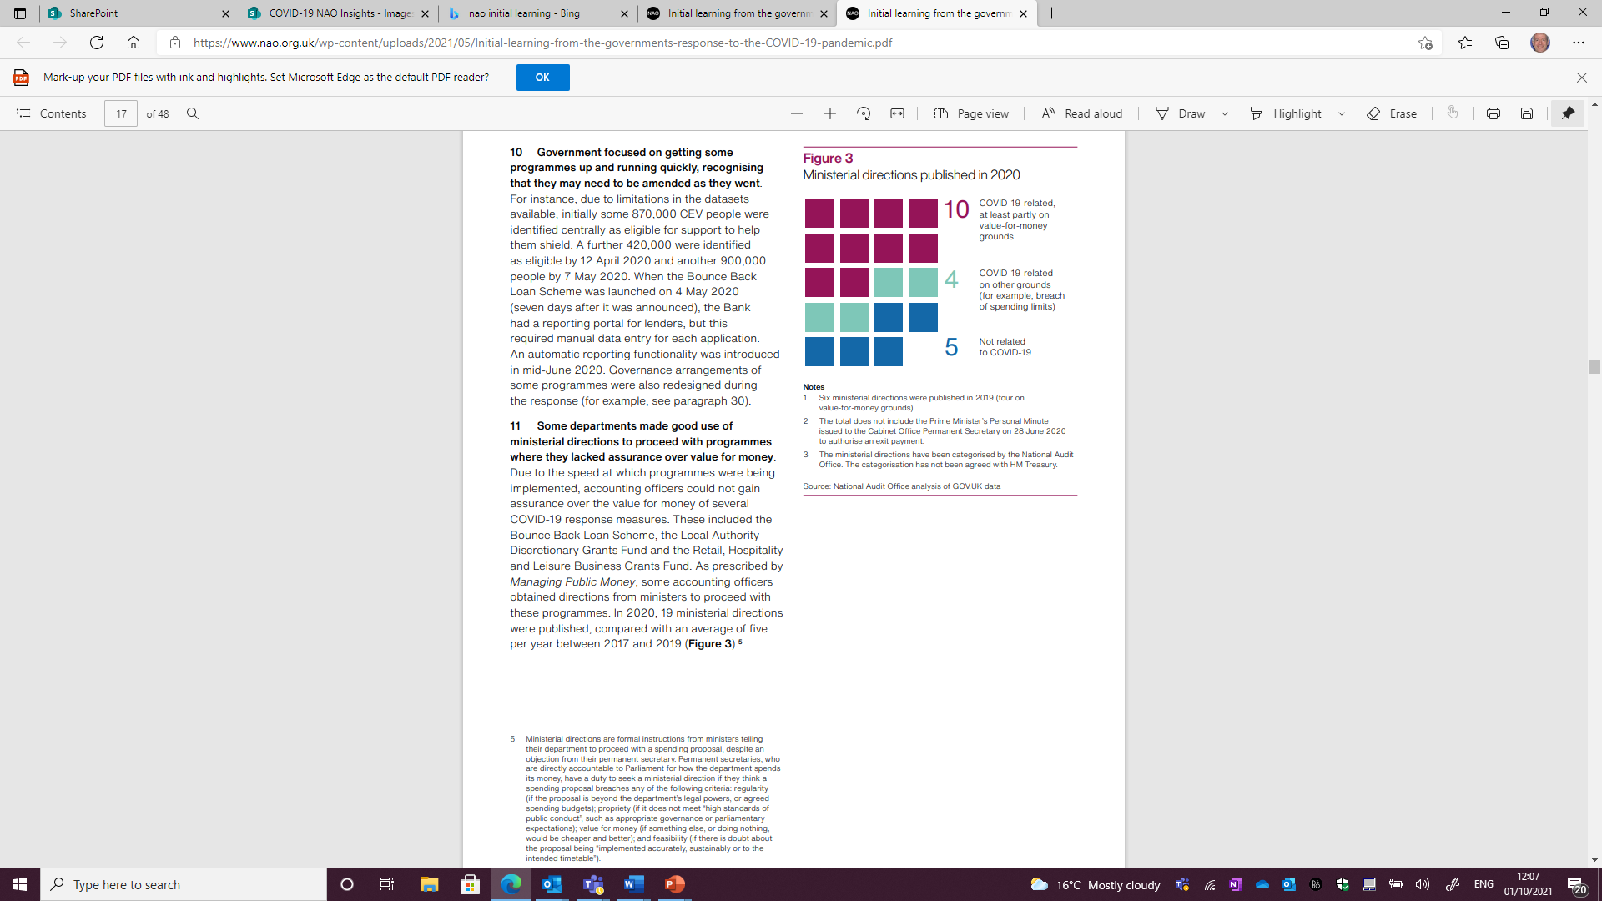
Theme 1: Risk management
Learning
Supporting findings from our work
Government lacked a playbook for many aspects of its response
Once the scale of the COVID-19 outbreak in the UK became apparent, the government made a number of rapid, large-scale spending decisions
To enable speed of action, government relaxed controls and streamlined spending approvals, leading to an increased risk of fraud and error
Government accepted other trade-offs from acting quickly, such as paying higher prices for goods than it would have paid before the pandemic
Government focused on getting some programmes up and running quickly, recognising that they may need to be amended as they went.
Some departments made good use of ministerial directions to proceed with programmes where they lacked assurance over value for money. Due to the speed at which programmes were being implemented, accounting officers could not gain assurance over the value for money of several COVID-19 response measures.
Identifying the wide-ranging consequences of major emergencies and developing playbooks for the most significant impacts.
Being clear about risk appetite and risk tolerance as the basis for choosing which trade-offs should be made in emergencies.
19 ministerial directions were issued in 2020
Six directions were issued in 2019 (four on VFM grounds).
Source: catalogue of ministerial directions on GOV.UK
OFFICIAL
Notes:
Government lacked a playbook for many aspects of its response. There were no detailed plans for: economic support schemes that that HMT and HMRC could easily adapt; identifying and supporting a large population advised to shield; managing mass disruption to schooling on the scale caused by COVID-19; and compensating local authorities for very sharp falls in income.
Once the scale of the COVID-19 outbreak in the UK became apparent, the government made a number of rapid, large-scale spending decisions. Food parcel scheme for clinically extremely vulnerable (CEV) people was up and running within days of being announced. In a matter of weeks personal protective equipment (PPE) and ventilator procurement were set up, and employment support and business loan schemes were designed and implemented.
To enable speed of action, government relaxed controls and streamlined spending approvals, leading to an increased risk of fraud and error. HMRC relaxed many controls to make payments quickly, but retained the control that grants could only be paid to known taxpayers, which reduced the risk of certain types of fraud significantly. Even so, HMRC estimates that between 5% and 10% of payments from the Coronavirus Job Retention Scheme (between £2bn and £3.9bn) were due to fraud and error (up to 20 Sept 2020). Fraud and error is likely to increase significantly as a result of easements made by DWP to the process of applying for benefits and using some inexperienced staff to process new claims. The Government Counter Fraud Function has assessed a high risk of fraud in the procurement of PPE.
DHSC experienced increasing global competition to buy ventilators and made purchases primarily on the offer’s credibility, not price. It also paid higher prices for PPE because of the global surge in demand for these goods and export restrictions in some countries.
Government focused on getting some programmes up and running quickly, recognising that they may need to be amended as they went. Due to limitations in the datasets available, initially some 0.87m CEV people were identified centrally as eligible for support to help them shield. A further 0.42m were identified as eligible by 12 April 2020 and another 0.9m people by 7 May 2020.

Slide 7
Theme 2: Transparency and public trust
Learning
Supporting findings from our work
Detailed objectives help to ensure that the success of programmes can be measured. Transparency, including a clear audit trail to support key decisions, is a vital control to ensure accountability when government is having to act at pace with fewer controls or emergency procedures in place
We found that many of the contracts awarded during the pandemic had not been published on time (see box)
Effective communication and public engagement is crucial to ensuring that key COVID-19 response programmes succeed
Communications from government were not always timely, clear and consistent
Being clear and transparent about what government is trying to achieve, so that it can assess whether it is making a difference.
Meeting transparency requirements and providing clear documentation to support decision-making, with transparency being used as a control when other measures, such as competition, are not in place.
Producing clear and timely communications.
Contract awards during the pandemic
Of the 1,644 contracts awarded across government up to the end of July 2020 with a contract value above £25,000:
25% were published within the 90-day target; and
55% had not had their details published by 10 November 2020.
Source: NAO, Investigation into government procurement during the COVID-19 pandemic
OFFICIAL
Notes:
Detailed objectives help to ensure that the success of programmes can be measured. HMRC agreed clear principles for the employment support schemes, including that the claim process should be simple and the grant calculation straightforward. On the other hand, while the Bounce Back Loans Scheme achieved its initial objective of quickly supporting small businesses, a lack of more detailed scheme-specific objectives will make it difficult to measure its ultimate success. DHSC had clear objectives for shielding (reduce mortality and illness), but, due to methodological challenges, could not measure these.
Transparency, including a clear audit trail to support key decisions, is a vital control to ensure accountability when government is having to act at pace with fewer controls or emergency procedures in place (e.g. for emergency purchasing). On the ventilator programmes, we found sufficient record of the programmes’ rationale, the key spending decisions taken and the information Departments had to base those on. In the procurement of PPE and other goods and services procured using emergency direct awards during the pandemic, there was not always a clear audit trail to support key decisions.
We found that many of the contracts awarded during the pandemic had not been published on time (see box).
Effective communication and public engagement is crucial to ensuring that key COVID-19 response programmes succeed. We found examples of effective, clear and consistent communications – e.g. HMRC developed a range of communication and engagement plans for its employment support schemes. Despite government advertising and communications relating to NHS Test and Trace (NHST&T), reported levels of non-compliance with self-isolation requirements were high. DHSC has acknowledged variation in the public’s perception of COVID-19 vaccines, with some groups more hesitant than others.
Communications from government were not always timely, clear and consistent. NHS and social care representatives criticised government guidance on PPE (changed 30 times up to 31 July 2020) and how it was communicated. The timeliness and volume of DfE’s guidance issued caused difficulties for schools. DfE calculated that, between 16 March and 1 May 2020, it published 148 new guidance documents and updates to existing material.

Slide 8
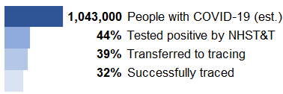
Theme 3: Data and evidence
Learning
Supporting findings from our work
Timely sharing and exchange of data is vital for providing front-line services and managing the response at the national level
However, timely sharing of data has not always occurred, and legacy IT issues remain challenging
Limitations in the accuracy and completeness of the data used and collected by government have affected several pandemic response schemes
Government has been able to take remedial action to address some issues arising from rapid implementation, and improve performance
Data limitations affected the government’s ability to assess the effectiveness and value for money of some measures, which made it harder to adapt its response and manage the risks of rapid implementation:
  Government’s ability to forecast changes in demand, and to update programmes based on updated demand, has been variable.
  Gathering feedback from end users (including frontline staff) is essential to monitoring the effectiveness of interventions and improve existing processes.
Improving the accuracy, completeness and interoperability of key datasets and sharing them promptly across delivery chains.
Monitoring how programmes are operating, forecasting changes in demand as far as possible, and tackling issues arising from rapid implementation or changes in demand.
Gathering information from end-users and front-line staff more systematically to test the effectiveness of programmes and undertake corrective action when required.
Detailed data for NHS Test and Trace supported tracking of performance
Performance from 28 May
to 4 November 2020
Source: NAO analysis of ONS, NHST&T and GOV.UK COVID dashboard data
OFFICIAL
Notes:
Timely sharing and exchange of data is vital for providing front-line services and managing the response at the national level. While DHSC and CO ran programmes to increase ventilators separately, they worked towards the same targets and exchanged progress data daily. MHCLG’s monthly data collection provided a good evidence base to underpin its support to local government.
However, timely sharing of data has not always occurred, and legacy IT issues remain challenging. NHST&T publishes data every week (see box), but local authorities did not initially have access to all NHST&T data they needed to deliver their local pandemic response. By 22 March, when shielding was announced, 0.87m people had been identified centrally as CEV. It took 3 weeks to identify and communicate with a further 0.42m CEV people - due to challenge of extracting usable data from different NHS and GP IT systems.
Limitations in the accuracy and completeness of the data used and collected by government have affected several pandemic response schemes. 0.375m CEV people who should shield could not be reached because of missing or inaccurate telephone numbers; and DfE did not know whether its contractor made a profit from running the free school meals voucher scheme.
Government has been able to take remedial action to address some issues arising from rapid implementation, and improve performance. On the free school meal voucher scheme, DfE and the contractor acted quickly to solve initial problems experienced by schools and families. NHSE&I has continually reviewed its deployment plans to respond to the latest information.
Data limitations affected the government’s ability to assess the effectiveness and value for money of some measures, which made it harder to adapt its response and manage the risks of rapid implementation: MHCLG didn’t know how many people local authorities had supported during shielding or what they had done to support 0.8m CEV contacts passed to them for follow-up support when the national contact centre could not reach them; HMRC has no data to monitor the take-up rate of the Self-Employment Income Support Scheme (SEISS) by different ethnic groups.
Government’s ability to forecast changes in demand, and to update programmes based on updated demand, has been variable. During March 2020, NHSE&I revised down its estimate of the peak number of ventilator beds that could be needed. NHST&T did not predict the scale of increased demand for COVID-19 testing in Sept 2020, when schools and universities reopened, and could not satisfy the demand for tests until mid-Sept 2020.
Gathering feedback from end users (including frontline staff) is essential to monitoring the effectiveness of interventions and improve existing processes. While NHS provider organisations told us they were always able to get the PPE that they needed in time, this was not the experience reported by many frontline workers, particularly BAME staff. Using ONS surveys, MHCLG found that 82% of CEVs who asked for food parcels said it helped them to shield at home.

Slide 9
Theme 4: Coordination and delivery models
Learning
Supporting findings from our work
The pandemic response involved examples of effective cross-government and public-private sector collaboration.
Effective governance, lines of accountability, and resourcing responsibilities are important for an effective rapid response in an emergency situation
Government has modified the governance arrangements of key pandemic response programmes
Issues predating the pandemic made responding to the crisis more difficult in some areas.
Pandemic response measures have employed a combination of universal offers and targeted delivery models.
Universal offers of support can be developed at speed but may not always be as cost-effective as targeted offers.
Ensuring that there is effective coordination and communication between government departments, central and local government, and private and public sector bodies.
Clarifying responsibilities for decision- making, implementation and governance, especially where delivery chains are complex and involve multiple actors.
Integrating health and social care and placing social care on an equal footing with the NHS.
Balancing the relative merits of central, universal offers of support against targeted local support.
OFFICIAL
Notes:
The pandemic response involved examples of effective cross-government and public-private sector collaboration. Policy and operational staff at HMRC and HMT worked closely to develop the employment support schemes, with HMT leading on policy design and HMRC leading on administrative design, implementation and administration. MHCLG’s engagement with local authorities on supporting clinical extremely vulnerable people to shield was initially directive rather than consultative, but improved as it moved to a collaborative approach. The purchase, manufacturing and deployment of vaccines involves extensive cross-government and public-private collaboration.
Effective governance, lines of accountability, and resourcing responsibilities are important for an effective rapid response in an emergency situation. DWP's clear prioritisation of paying benefits, and suspending other activity, enabled it to process an unprecedented number of claims during the first lockdown. This was supported by clear governance within the department. On the other hand, on PPE we found that several organisations had responsibility for approving, maintaining and distributing PPE from the pandemic influenza stockpile.
Government has modified the governance arrangements of key pandemic response programmes. In Sept 2020, a faster process for approving vaccines expenditure was introduced by government and the governance for vaccines activities was revised. DHSC appointed a single senior responsible officer to oversee deployment to create a unified programme to reduce duplication, streamline responsibilities, facilitate cross-departmental working, and increase transparency and accountability.
Issues predating the pandemic made responding to the crisis more difficult in some areas. The relationship between adult social care and the NHS has been problematic for decades. We have reported on successive efforts to integrate the two sectors: there have been 12 government white papers, green papers and consultations, and five independent reviews on integration over the past 20 years. E.g., national bodies initially provided more PPE support to hospitals than to social care.
Pandemic response measures have employed a combination of universal offers and targeted delivery models. The Everyone In campaign was rolled out across England to provide accommodation for all rough sleepers. For the winter of 2020, the campaign was supplemented with a targeted programme focused on the areas with large numbers of rough sleepers.
Universal offers of support can be developed at speed but may not always be as cost-effective as targeted offers. A government review of the shielding programme concluded that, due to the speed and context in which the programme was developed, it was largely offered universally, resulting in poor targeting and inefficient use of funds. The review noted that, should shielding be needed again, adopting a local support model could improve flexibility and, potentially, be more cost-effective.

Slide 10
Theme 5: Supporting and protecting people
Learning
Supporting findings from our work
The pandemic has disproportionately impacted specific groups of people
Employment support programmes helped many people, but some people were not eligible
Some Departments are undertaking further work to better understand take up of support schemes by different groups
The pandemic placed great stress on some health and social care workers already under pressure before the COVID-19 outbreak
Understanding to what extent the pandemic and government's response have widened inequalities, and taking action where they have.
Providing appropriate support to front-line and other key workers to cope with the physical, mental and emotional demands of responding to the pandemic.
People supported and ineligible for employment support schemes up to 20 Sept 2020
Source: NAO, Implementing employment support schemes in response to the COVID-19 pandemic
OFFICIAL
Notes:
The pandemic has disproportionately impacted specific groups of people. The virus is disproportionately deadly for certain groups, particularly the elderly, men, some ethnic groups, and those with some pre-existing medical conditions; and disrupted schooling is likely to have longer-term adverse effects on children from disadvantaged backgrounds in particular. The Education Endowment Foundation has projected that school closures in the 2019/20 academic year might widen the attainment gap between disadvantaged children and their peers by between 11% and 75%, with a median estimate of 36%, likely reversing progress made to narrow the gap since 2011. Representative groups told us that remote learning had been especially difficult for children with special educational needs and disabilities.
Employment support programmes helped many people, but some people were not eligible. The schemes have been largely successful in protecting jobs through the first lockdown period, with at least 12.2m people benefitting from support. However, a combination of policy decisions and constraints in the tax system meant that as many as 2.9m people were not eligible for the schemes (see box). E.g., SEISS claims from around 0.2m people who became self-employed after the 2018-19 tax return deadline of 31 Jan 2020 were not allowed because HMRC validated applications by using self-assessment records up to the tax return deadline. More frequent filing of tax return data is not currently supported by HMRC’s systems and is due to be in place from April 2023.
Some Departments are undertaking further work to better understand take up of support schemes by different groups. HMRC has carried out equality impact assessments for its employment support schemes and is commissioning further research to better understand take‑up and customer experience by different groups.
The pandemic placed great stress on some health and social care workers already under pressure before the COVID-19 outbreak. In May 2020, some 45% of doctors (3,936 out of 8,685) responding to a survey by the British Medical Association reported suffering from depression, anxiety, stress, burnout, emotional distress or other mental health conditions relating to or made worse by their work. Some registered managers in social care reported the mental health of workers was under massive strain, with individuals particularly concerned about getting ill and unknowingly passing the virus on; and some care workers, doctors and nurses considered that they were not adequately protected during the height of the pandemic’s first wave and many social care providers highlighted being extremely close to running out of personal protective equipment. This created uncertainty, anxiety and stress. Given the stress that staff were experiencing before the pandemic, and the additional pressures caused by COVID-19, it is likely that the after-effects of responding to the pandemic will be substantial and, for some people, long-lasting.

Slide 11
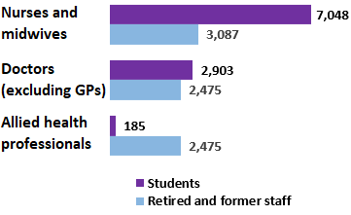
Theme 6: Workforce and capacity
Learning
Supporting findings from our work
The NHS and local government now face two main challenges: to maintain readiness to respond to emergencies, such as COVID-19, and to put other essential services onto a sustainable footing
Local authorities’ finances have been scarred and will not bounce back quickly once the pandemic ends. Existing workforce issues added to the challenges in responding to the pandemic. Government took action to increase the workforce available and was able to redeploy staff in key areas
Our good practice guide Improving operational delivery in government notes that government’s operational management capability has changed little over the past 10 years
By the end of July 2021, the government had committed an estimated £370 billion to its response to the pandemic
Placing the NHS and local government on a sustainable footing, to improve their ability to respond to future emergencies.
Ensuring that existing systems can respond effectively and flexibly to emergencies, including provision for spare or additional capacity and redeploying staff where needed.
Considering which COVID-19-related spending commitments are likely to be retained for the long term, and what these additional spending commitments mean for long-term financial sustainability.
Additional staff deployed
to support the NHS in England
as at 30 April 2020
Source: NAO, Readying the NHS and adult social care in England for COVID-19
OFFICIAL
Notes:
The NHS and local government now face two main challenges: to maintain readiness to respond to emergencies, such as COVID-19, and to put other essential services onto a sustainable footing. Since 2010-11, both the NHS and local government have been under financial pressure.
Local authorities’ finances have been scarred and will not bounce back quickly once the pandemic ends. As of early Dec 2020, 3/4 of local authorities have a reported funding gap in 2020-21 between their forecast pressures and estimated government support, and 94% of chief finance officers from single tier and county councils we surveyed expected to make cuts in service budgets in 2021-22.
Existing workforce issues added to the challenges in responding to the pandemic. Previous NAO reports had highlighted staffing shortages in both the health and social care sectors. For instance, between Oct and Dec 2019, NHS trusts reported vacancy rates of 11% for nursing and 7% for medical staff.
Government took action to increase the workforce available and was able to redeploy staff in key areas. By the end of Apr 2020, an extra 18,200 NHS staff were deployed in clinical and support roles, including 7,000 nursing and midwifery students and 8,000 returning retired and former staff. NHS staff were redeployed, with effects on other areas of the health service. A cross-government team involving 450 staff was set up to support the procurement of PPE. DWP redeployed around 10,000 staff at different points during its initial response, moving them from policy, back-office roles and other benefits and services into new claim handling roles, to maximise its jobcentre and service centre capacity.
Our good practice guide Improving operational delivery in government notes that government’s operational management capability has changed little over the past 10 years. Government has often operated in a firefighting mode, reacting in an unplanned way to problems as they arise and surviving from day to day. Our evidence suggests that a fundamental shift in capability, capacity and resilience may be needed to cope better with future emergency responses.
By the end of July 2021, the government had committed an estimated £370 billion to its response to the pandemic. Represents a highly significant, unplanned increase in public spending. While a portion of this spending relates to short-term measures, some commitments and liabilities are likely to remain for the medium and long term, although there are significant uncertainties about their amount and timeframe. These commitments may impact the longer-term sustainability of public finances.

Slide 12
Concluding remarks
The challenges posed by the pandemic have highlighted:
The importance for government of adopting a systematic approach to preparing for high-impact events, evaluating its performance frequently, and acting quickly on learning points while adhering to required standards of transparency and accountability even in emergencies. This goes beyond meeting legal (or audit) requirements. It involves adhering to the standards that government has set for itself to maintain and strengthen public trust.
If government can build resilience into systems and delivery chains, and develop consistently robust horizon scanning, risk management and operational management capabilities across government, this will help it to cope better with future emergency responses while also improving business-as-usual activities.
The pandemic has also laid bare existing fault lines:
For example, the relationship between adult social care and the NHS, workforce shortages, the challenges posed by legacy data and IT systems, and the financial pressure felt by parts of the system all require long-term solutions.

