Slide 1

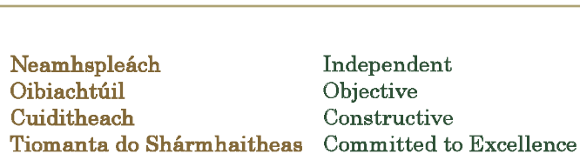

Slide 2
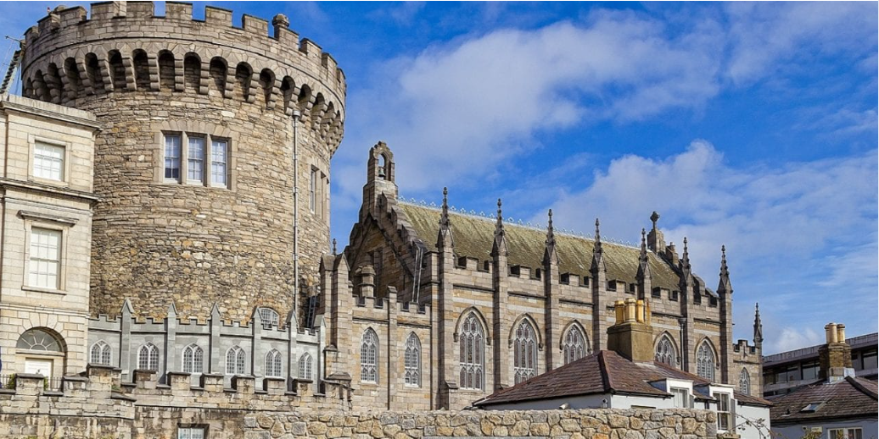

Slide 3
mBaile Átha Cliath
Dublin
28 – 29 March 2023

