Slide 1

News from the WGEPPP and next Forum on methods in Bern
INTOSAI Performance Audit Subcommittee
London 8-9 June 2022 – Emmanuel Sangra

Slide 2
Change of chairmanship…
The French SAI has chaired the WGEPPP for many years. Since March 2022, the Swiss Federal Audit Office (SFAO) leads the Group.
The group has held numerous meetings with its members and has produced the “Guidelines on the Evaluation of Public Policies” which has been classified by INCOSAI as Intosai GOV 9400.
What will change?

Slide 3
First, some reflections…
PAS and WGEPPP are complementary.
The performance audit principles ISSAI 300 and the standards ISSAI 3000 are excellent and very useful for SAI,
as well when conducting evaluations.
Time is over to discuss on the merits and differences between performance audit and evaluation…
We all produce reports and generally recommendations…
By complex topics we need to use adequate methods and processes, especially when SAI want to measure effects of policies and programs.

Slide 4
Some intentions…
Focus on the exchange of good practices and on the promotion of international cooperations. Not on setting new standards or guidelines…
Demonstrate the usefulness of the group to a large number of SAI
Internal : opening our meeting not only to some official representatives but also to managers of audits or evaluations of SAI even if they are not members of the WGEPPP
Internal : finding other countries that are willing to take on some of the group's tasks

Slide 6
Target audience
Regular members of the WGEPPP group
Experienced colleagues from all SAIs willing to present or to discuss a performance audit or an evaluation that used innovative methods

Slide 7
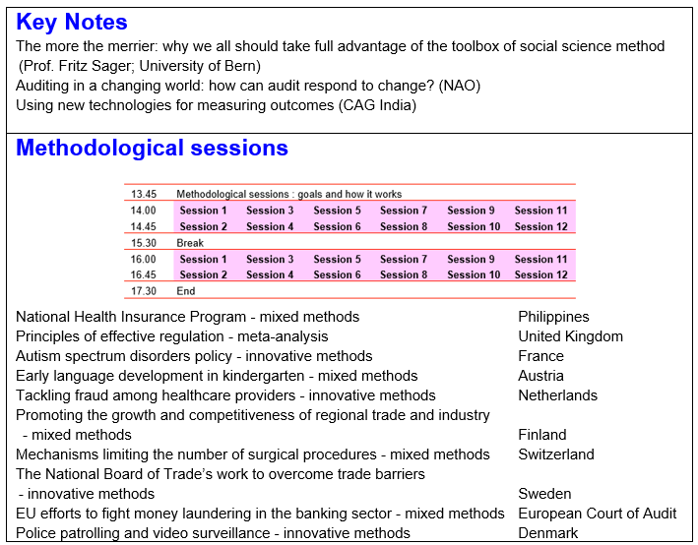
Format of the Forum – Day 1

Slide 8
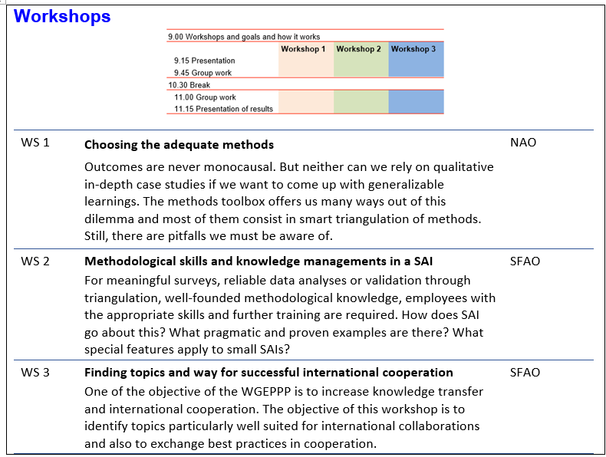
Format of the Forum – Day 2

Slide 9
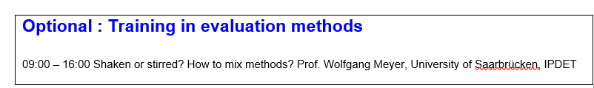
Format of the Forum – Day 3 (optional)
26-28 September 2022 in Bern… only if face-to-face is possible!
For more information and inscription (number of participants is limited!), see:
https://www.intosaicommunity.net/wgeppp/

Slide 10

Thank you for your attention
Questions?
Reactions?

