Slide 1
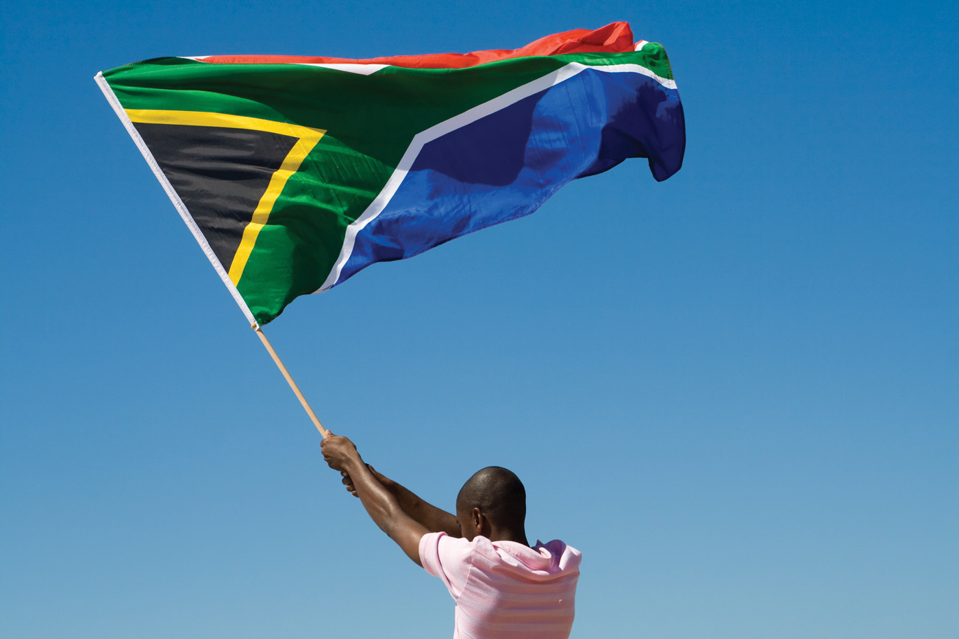


Presentation to PAS
Impact on the lived reality of ordinary South Africans
June 2022

Slide 2

Reputation promise
^{REPUTATION PROMISE}
The Auditor-General of South Africa has a constitutional mandate and, as the supreme audit institution (SAI) of South Africa, exists to strengthen our country’s democracy by
enabling oversight, accountability and
governance in the public sector through
auditing, thereby building public confidence.
To be recognised by all our stakeholders as a relevant supreme audit institution (SAI) that enhances public sector accountability.
^{MISSION}
^{VISION}

Slide 3
Extract of SAI South Africa’s strategy 2022-2025
Intosai defines the role of the public sector auditor as an important factor in making a difference in the lives of citizens.
In this way, South Africans through elected representatives are able to hold the executive and accounting authorities, officials and public entities accountable. This provides the rationale for our work in empowering citizens ‘to hold the custodians of public resources accountable’ in terms of Intosai-P 12, The value and benefits of supreme audit institutions – making a difference to the lives of citizens.
The impact on the lived reality of ordinary South Africans is significant. Behind the numbers, findings and audit outcomes are real people who are sometimes without the basic services promised to them by their elected representatives, and who are ultimately prevented from participating in the country’s economy or from realising their potential.

Slide 4
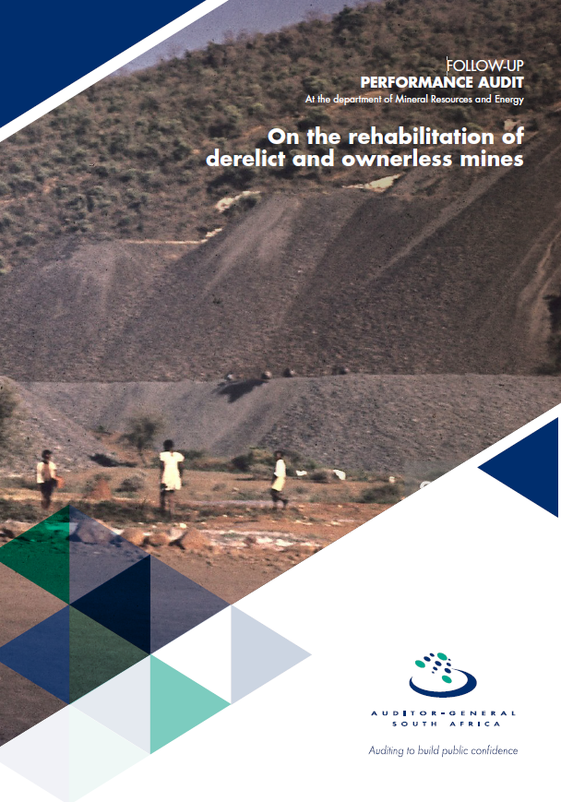
Implementation of SAI SA strategy
To give affect to the strategy, additional work was conducted during the performance audit focusing on the lived experience of citizens living in areas close to mining activities.
A chapter, Citizens’ Lived Experience of derelict and ownerless mines, was included in the report to highlight the impact on the citizens.
The full report can be downloaded from the AGSA website: Performance Audit Reporting (agsa.co.za)

Slide 5
Performance audit on the rehabilitation of derelict and ownerless mines
Press Release when the report was tabled in Parliament:
The Department of Mineral Resources and Energy needs to speed up its management of rehabilitating South Africa’s abandoned mines, as they “pose serious health, safety and environmental hazards for nearby communities,” Auditor-General (AG) Tsakani Maluleke warned on Wednesday, 30 March 2002.
The report showed the negative impact on environment and on local communities’ health and safety:
  Contamination of agricultural soil, groundwater and surface water with acid, salts and metals
  Air pollution by dust
  Uncontrolled combustion from burning mine tailings or dumps
  Surface deformation – open shafts and unstable slopes
  Illegal mining activities
Environmental
Health
Social

Slide 6
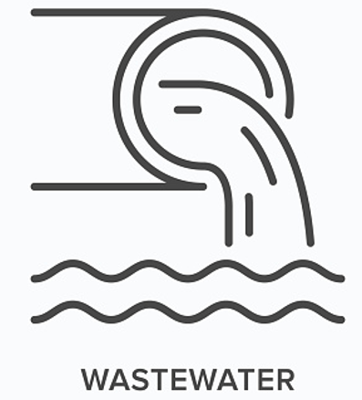
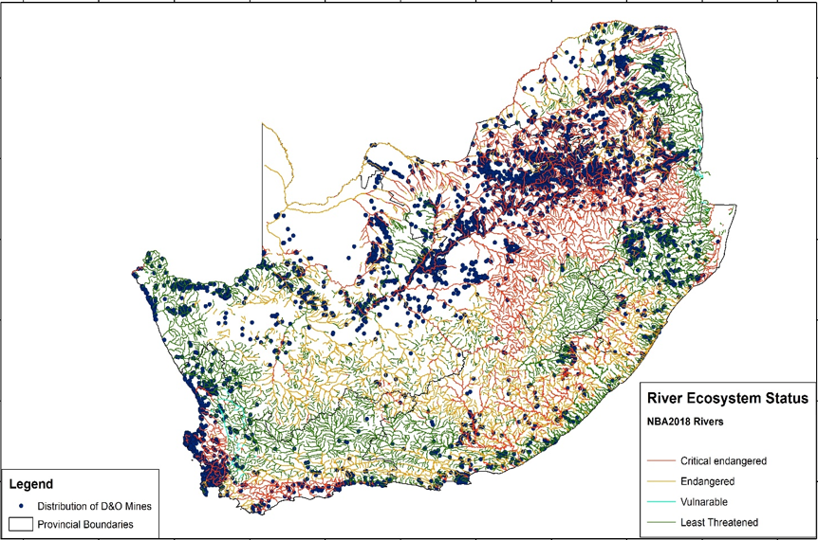
Impact of D&O mines (cont.)
Contamination of agricultural soil, groundwater and surface water with acid, salts and metals
South Africa is a water-scarce region that depends on rivers and groundwater for food production and economic activity
Many abandoned coal and hard rock (i.e. gold and copper) mines emit acid mine drainage (AMD)
People who live close to these sites risk exposure to toxic contaminants through the air that they breathe, the food that they eat and the water that they drink.

Slide 7

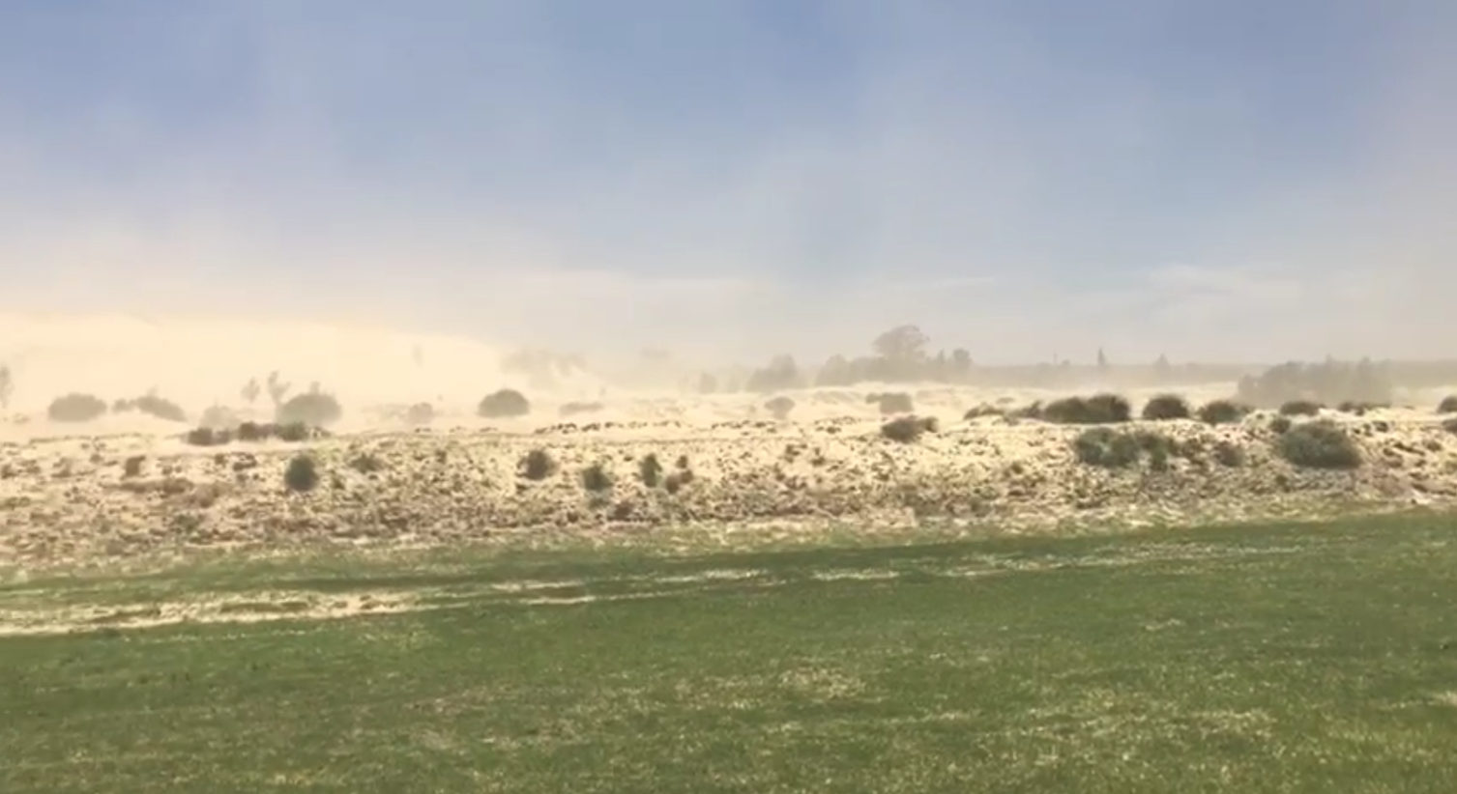
Impact of D&O mines (cont.)
Air pollution by dust
Asbestos mine spoil dumps
  Unmonitored D&O asbestos-polluted environments release asbestos fibres into atmosphere, reaching critical levels and becoming a hazard if inhaled; preventing vegetation from growing
  Could cause asbestosis and cancer
Gold mine tailing dumps
  Highly radioactive dust (from abandoned mine waste) filled with uranium and cyanide transported during windy season – Gauteng, with highest population density
  Pollutes land, endangering ecosystems
  Causes respiratory diseases (TB and asthma) and heart and lung diseases in humans and livestock in communities living in close proximity
  Biological effects of ionising radiation on human body include genetic (genes and chromosomes get altered) and non-genetic disorders (body damage, i.e. birth defects, burns, some types of leukaemia, miscarriages, tumours)

Slide 8
Commitment by the Accounting Officer to address the findings in the report
The department committed to:
  fast-track the finalisation of the Mine Closure Strategy,
  conduct a liability study to quantify the government’s liability for all D&O mines. This would inform the re-alignment of the long, medium and short term implementation plan to manage and rehabilitate D&O mines and mine openings, and
  revise the stakeholder engagement framework to include solutions for unsuccessful engagements with communities during project execution.

Slide 9
AUDITING TO
BUILD PUBLIC CONFIDENCE
THANK YOU
Auditor General of South Africa
@AuditorGen_SA
Auditor-General of South Africa
www.agsa.co.za

