Slide 1


The IFPP standard-setting process
The strategic development plan
Review of the IFPP (Component 1)
PSC Secretariat, London
8 June 2022

Slide 2
Key INTOSAI bodies involved in standard setting

Slide 3
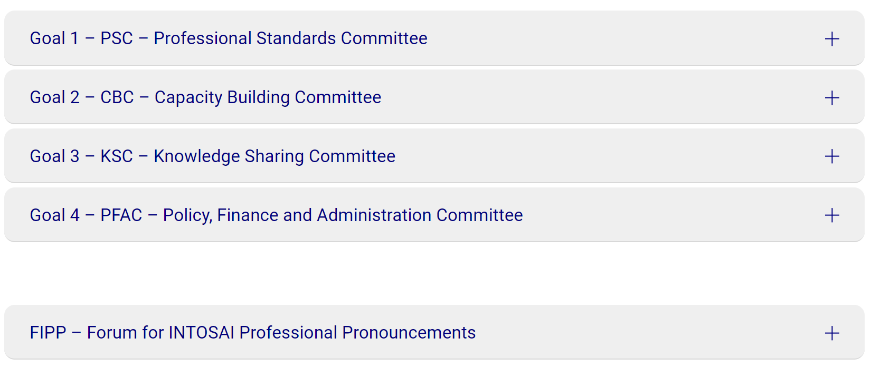
INTOSAI Goal Committees

Slide 4
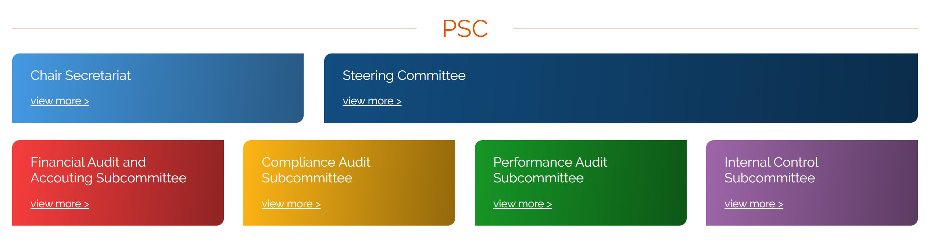
PSC – Professional Standards Committee
Leads the efforts to provide relevant and clear professional standards and guidance to the SAIs.
Manages the development of the Strategic Development Plan for standard setting (SDP)
Accountable to the PSC Steering Committee

Slide 5
FIPP – Forum for INTOSAI Professional Pronouncements
Expert body ensuring quality control for developing and maintaining pronouncements
Key role in IFPP due process
Input to the SDP in the form of proposals
10 - 16 members nominated ad personam (diversity preferred)
Members selected by PSC, CBC and KSC in consultation with FIPP chair

Slide 6
SDP – Strategic Development Plan
Tool to develop and maintain a clear, consistent and relevant standards framework.
Also covers conceptual issues (eg. creation of IFPP, Component 1…)
Second SDP being implemented (review of IFPP, development of pronouncements, competency pronouncements)
Decision taken by PSC SC, with consent of CBC and KSC (FIPP input)

Slide 7
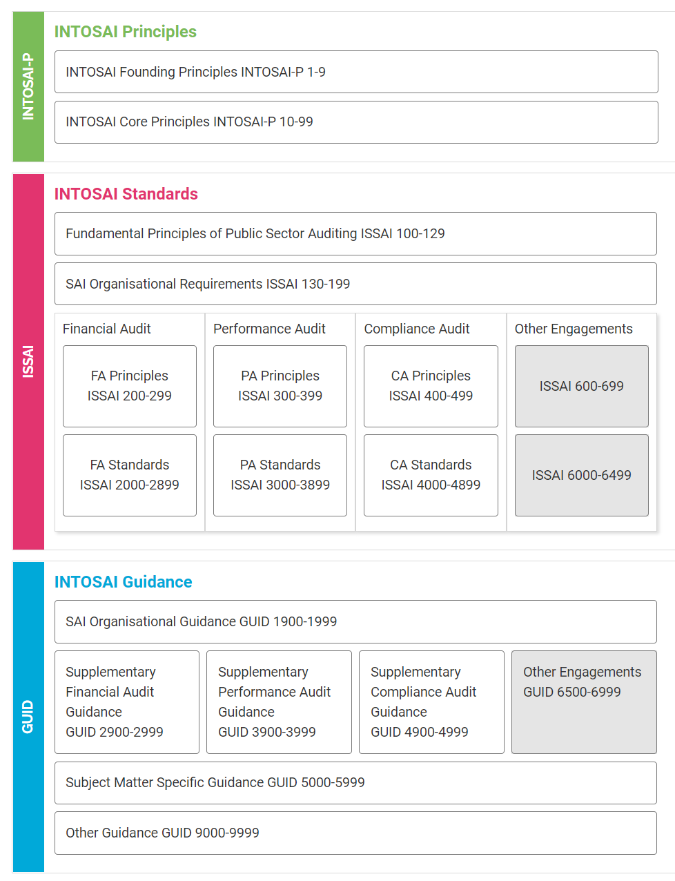
IFPP – INTOSAI Framework of Professional Pronouncements
a family of three sets of documents
Principles (INTOSAI-Ps)
Standards (ISSAIs)
Guidance (GUIDs)

Slide 8
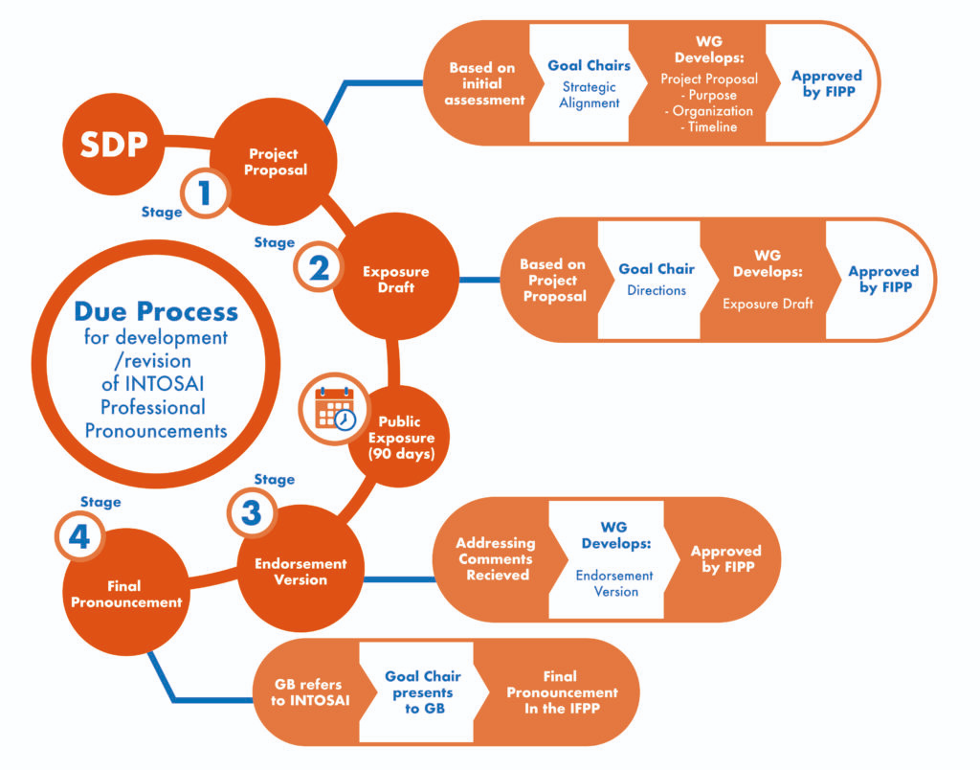
IFPP due process

Slide 9
IFPP news – major new pronouncements

Slide 10
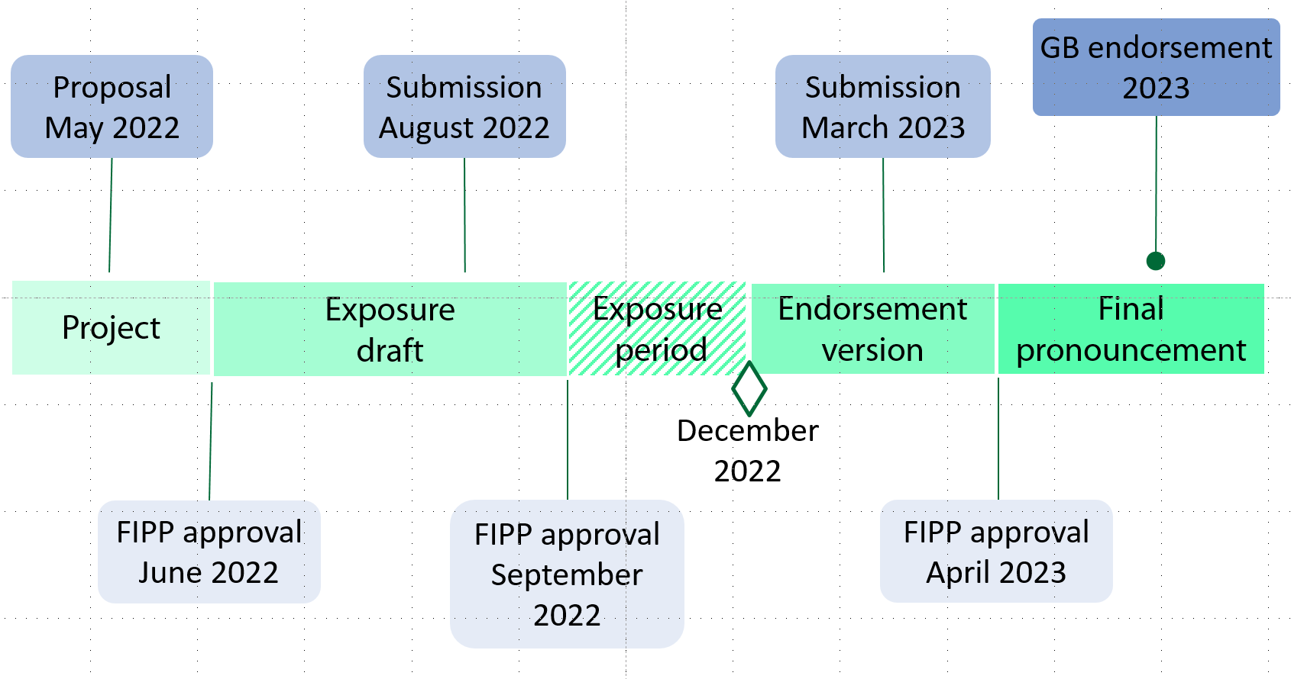
Review of ISSAI 140
Notes:
Scope of this project:
Identify and suggest the architecture for this suite of quality management pronouncements
Draft the ISSAI 140 as the top level standard
Identify conforming amendments to other INTOSAI pronouncements

Slide 11
Component 1 – review of the IFPP

Slide 12
Component 1 – review of the IFPP
The overall goal is to
slim down the core framework to the essential
by making it simple, principles-based and future-proof...
…while losing no content

Slide 13
Component 1 – review of the IFPP
Key steps of the process
Preliminary analysis
Workshops with the ISLOs (5 topics)
Global survey
Discussion with SAIs working in complex situations
Workshops with INTOSAI bodies on selected issues stemming from the survey (3 topics)
Next step
Report to the PSC SC and Governing Board – input to the next SDP

Slide 14
Component 1 - global survey - results
 | responses | %
Total responses | 125
INTOSAI | 117 | 60 %
EUROSAI | 42 | 82 %
ASOSAI | 27 | 57 %
AFROSAI | 29 | 54 %
ARABOSAI | 10 | 45 %
OLACEFS | 19 | 39 %
PASAI | 10 | 37 %
CAROSAI | 5 | 22 %
non-INTOSAI responses | 8

Slide 15
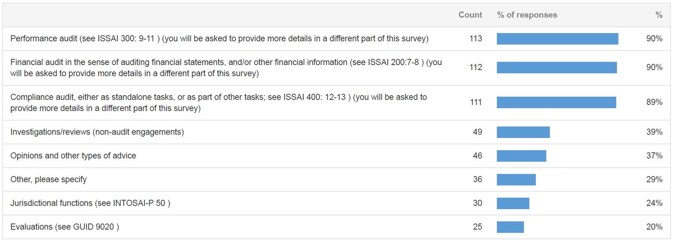
Survey results - the work SAIs do

Slide 16
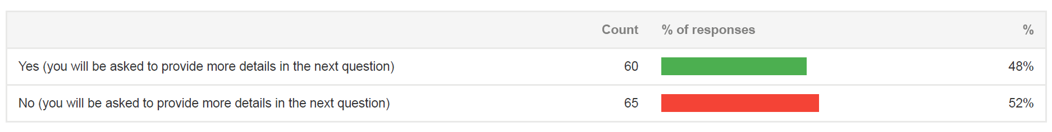
Survey results – desire to cover more engagement types

Slide 17
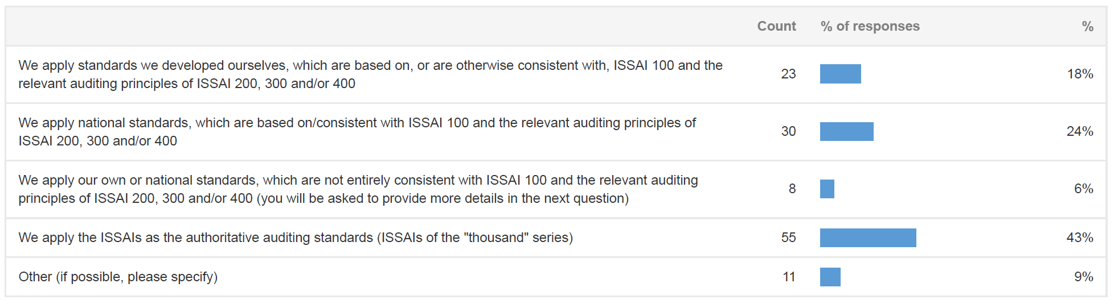
Global survey - What standards SAIs apply

Slide 18
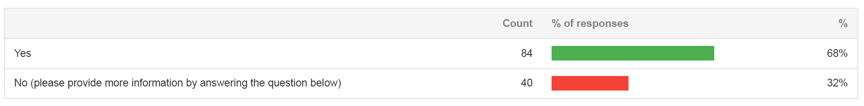
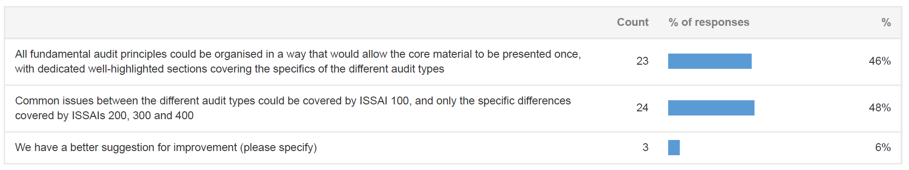
Global survey – desire to keep ISSAI 100 separate of other ISSAI principles

Slide 19
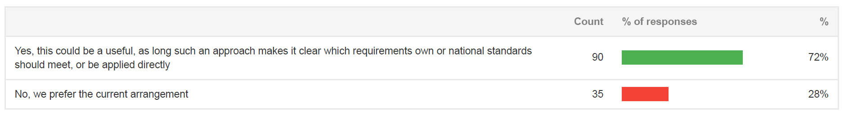
Global survey – desire to present audit type material (principles and standards) in one place?

Slide 20
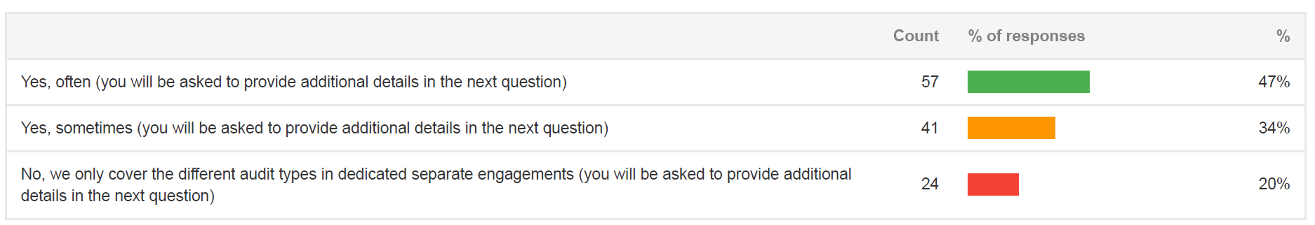
Global survey – combined audits a standard process

Slide 21
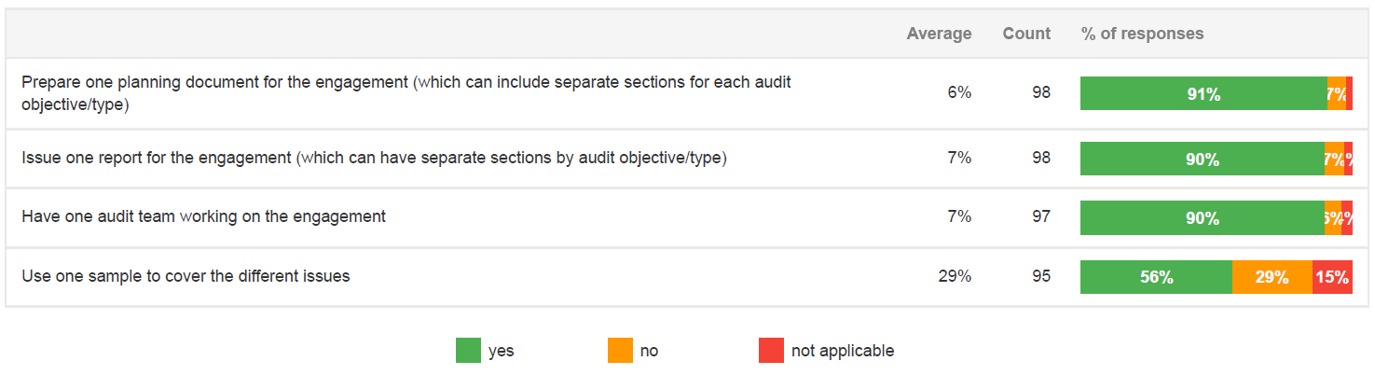
Global survey – SAI practice when combining audits

Slide 22
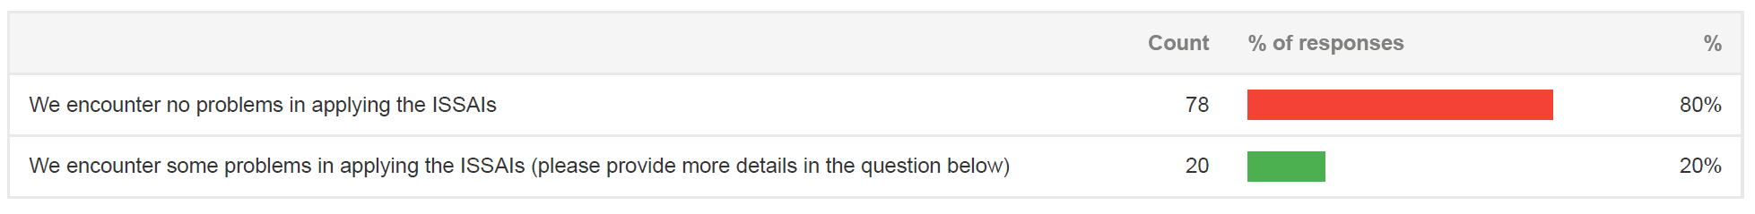
Global survey – clarity in applying ISSAIs when undertaking combined audits

Slide 23
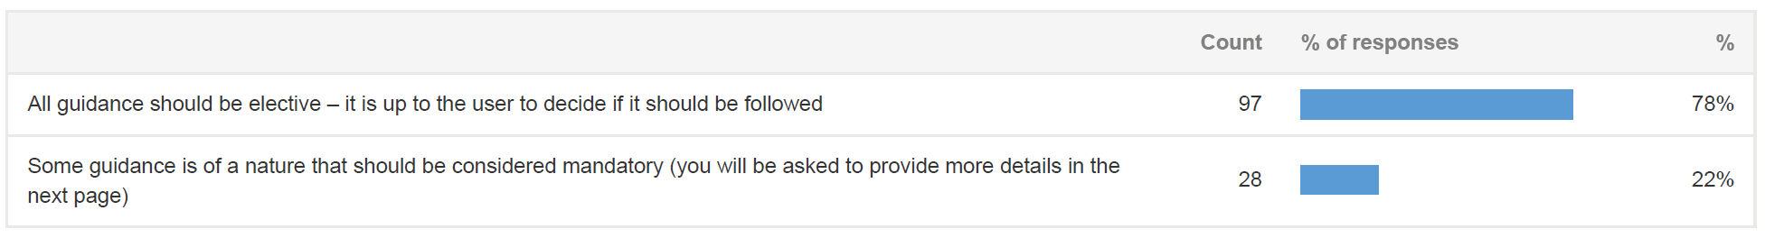
Global survey – should guidance be elective or mandatory?

Slide 24
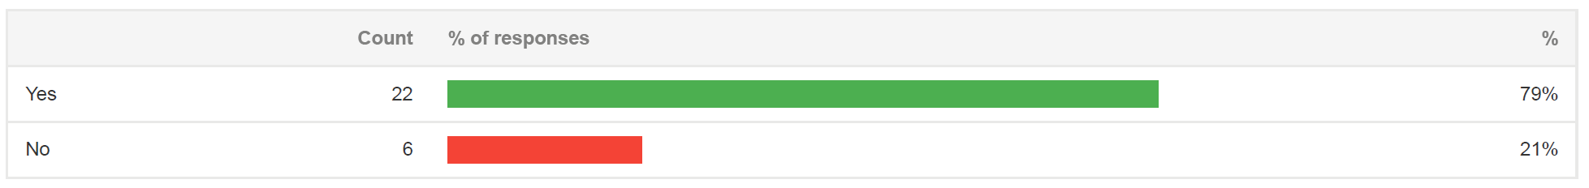
Global survey – should mandatory guidance be renamed?

Slide 25
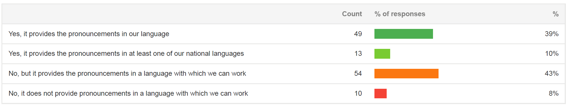
Global survey – is IFPP available in your language?

Slide 26
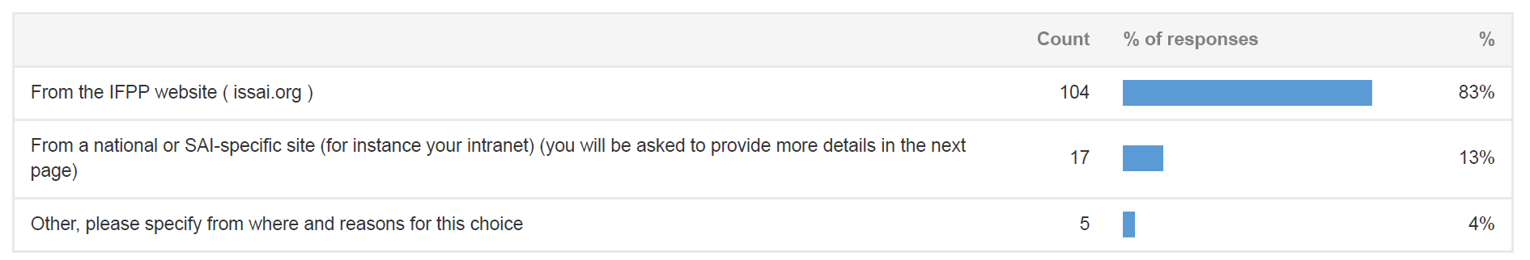
Global survey - How SAIs access IFPP…

Slide 27
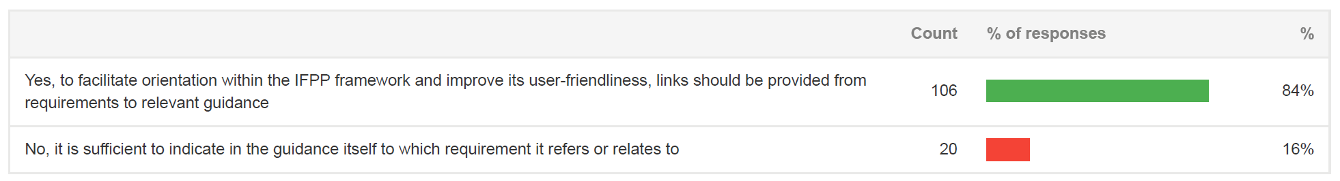
Global survey - facilitating navigation across IFPP

Slide 28
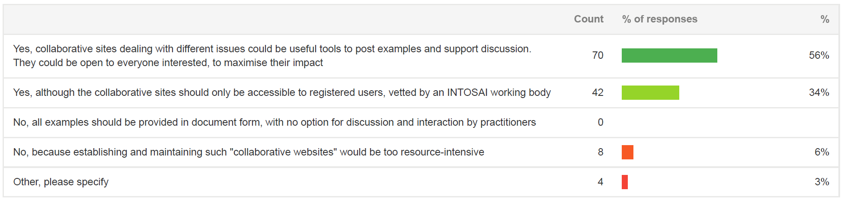
Global survey – presenting material in a flexible way (collaborative sites)

Slide 29
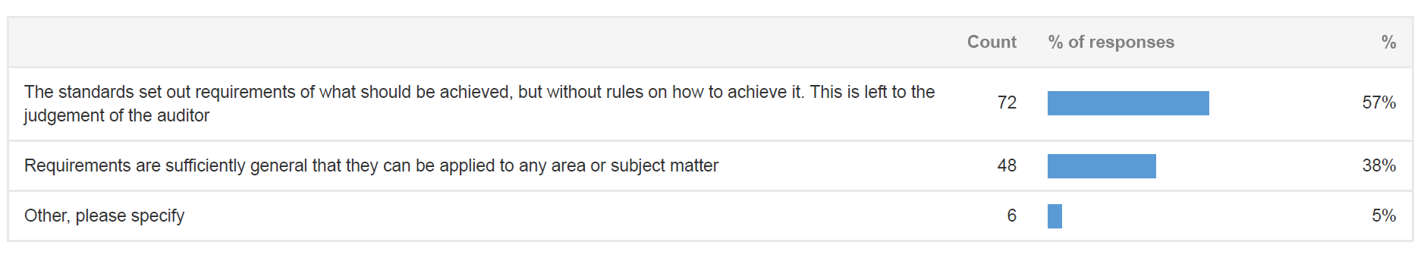
Global survey - the meaning of principles-based standards

Slide 30
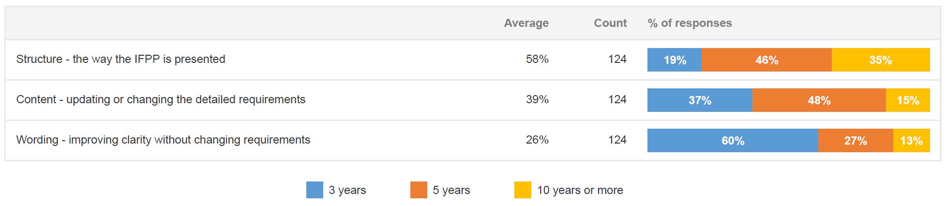
Global survey - optimal frequency for reviewing and changing the IFPP

Slide 31
The next SDP 2023+

Slide 32
Timeline for developing the next SDP (2023+)
June 2022
PSC SC approves SDP process
August/September – November 2022
Working bodies/ INTOSAI community provide input to SDP process
February/March 2023
Goal chairs and FIPP reach agreement on draft SDP
October 2023
PSC SC approves SDP
November 2023
Governing board approves SDP

Slide 33
Aspiration
INTOSAI should aim to be a recognised leader in producing clear relevant standards through agile processes, and making them effective and accessible in a flexible way through the use of modern technologies

Slide 34

Thank you for listening!

