Slide 1


The 13th annual meeting of the Performance Audit Subcommittee

Slide 2

PAS meeting planning committee
Corrie Pretorius, South Africa
Kevish Lachman, South Africa
Andy Fisher, UK
Ammar Sakini, Qatar
Cathleen Berrick, USA
Giorgi Kapanadze, Georgia
Bidzina Makashvili, Georgia
Deirdre Quaid, Ireland

Slide 3
1B - Presentation of the agenda
Notes:
:

Slide 4
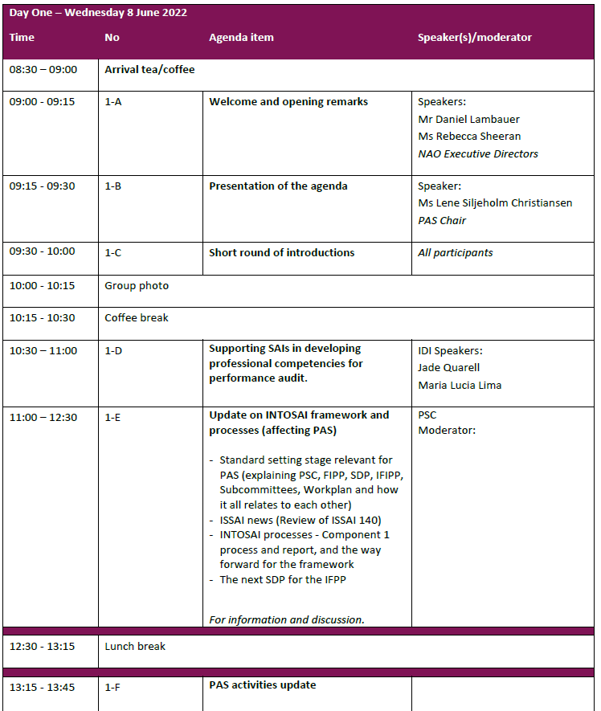

Slide 5

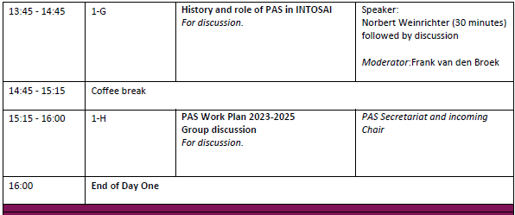

Slide 6
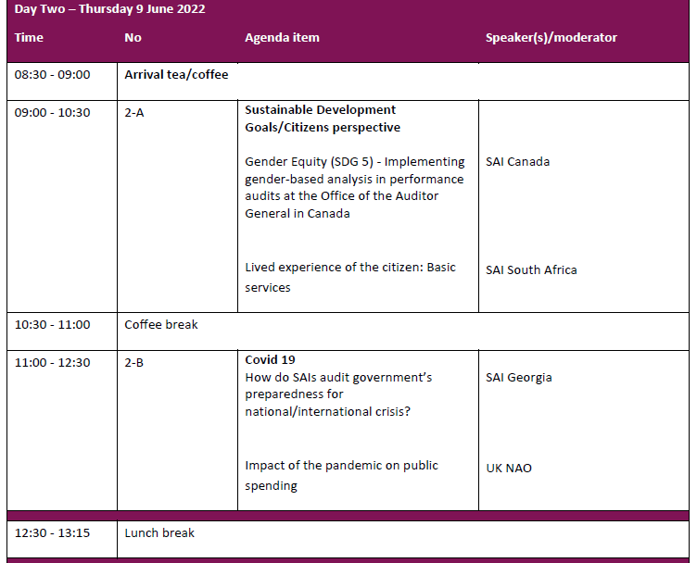

Slide 7
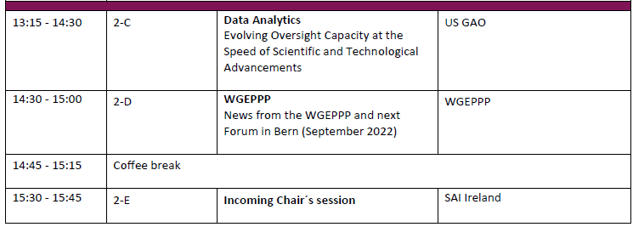
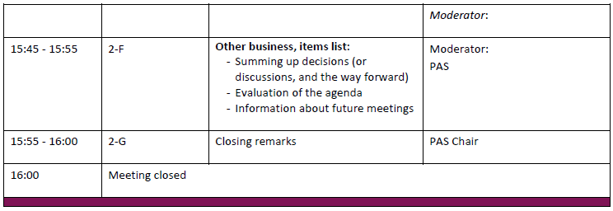

Slide 8
1C – Introductions

Slide 9
1F – PAS Activities update

Slide 10

PAS main activites 2021-2022
Online meeting in May 2021
PAS blog and PAS website
Consultation group on standard related issues
INTOSAI processes and projects involving PAS
  Projects
  Hearings
  Component 1
Membership policy

Slide 11

1. PAS Online meeting in 2021
Online meeting 25-26 May
Approval of PAS Work Plan 2020-2022
Update on INTOSAI processes and PAS activities
Technical update and discussion
PAS priorities

Slide 12

2. PAS website and blog
https://www.intosaipas.org
https://www.intosaipas.org/pas-blog/
Guidelines for the PAS blog

Slide 13

3. Consultation group on standard related issues
Corrie Pretorius, South Africa
Kevish Lachman, South Africa
Lars Florin, Sweden
Ingemar Delveborn, Sweden
Frank van den Broek, Netherlands
Norbert Weinrichter, Austria
Jan Roar Beckstrøm, Norway
Deirdre Quaid (observer), Ireland

Slide 14

4. INTOSAI processes and projects involving PAS
Project 2.6 GUID 5160 Guidance on using the work of internal auditors (SDP for 2017-2019)
Project 2.3 GUID Guidance on carrying out combined audits in accordance with mandate of SAI (SDP for 2017-2019)
IDI Performance Audit ISSAI Implementation Handbook

Slide 15
4. INTOSAI processes and projects involving PAS cont.
Component 1 (SDP for 2020-2022)
  Desk review
  Online discussions to further explore specific issues
  Survey to identify the needs of the INTOSAI community
  Workshop in May main issues:
    Setting the bar at the adequate level for requirements
    Improving user experience when accessing and applying the standards
    Providing relevant and up-to-date guidance
  Final report for INCOSAI 2022

Slide 16
4. INTOSAI processes and projects involving PAS cont.
PSC Terms of Reference
Revision of ISSAI 140
Hearings:
GUID 5340 Audit of Public Private Partnership
GUID 5320 Audit of Privatisation
GUID 5280 Public Procurement Audit deadline 13.06.
SDP for the IFPP 2023-2026

Slide 17

SDP for the IFPP 2023-2026
Information gathering
1. What part (if any) of the current material under your responsibility needs updating? Why?
"The 3000 series will undergo mandatory review as scheduled at the time of adoption (INCOSAI 2016). No major updates are anticipated, however, the documents may be subject to minor adjustments and some editorial changes, where needed".
2. What additional material would be useful? Why?
"The PAS has currently no plans to create additional material, however, needs may be identified as part of the upcoming review of the 3000 series."
3. Which of the current material is surplus to requirements, and could be removed?
"No existing material is regarded as surplus to requirements, and could be removed without undergoing appropriate review processes in PAS. A review process will however identify overlaps and any needs for adjustment."

Slide 18
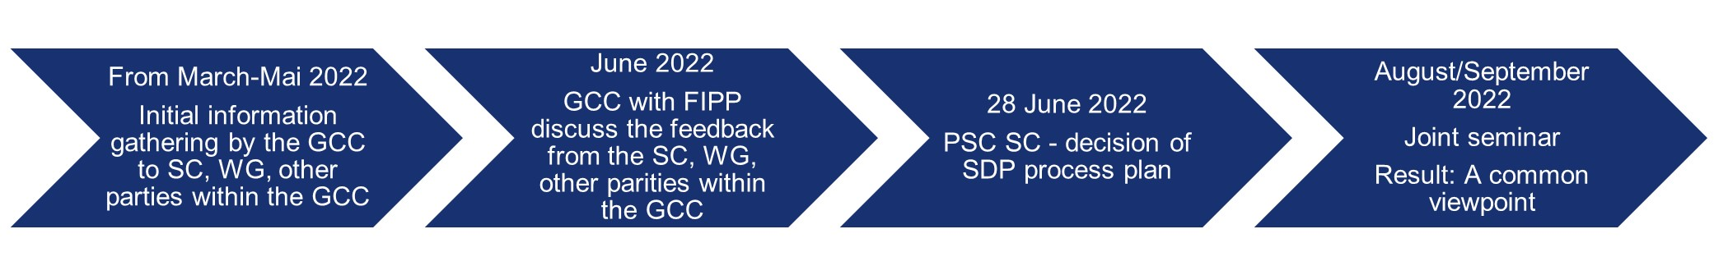
The initial internal information-gathering phase of the SDP 2023-2026

Slide 19
5. Membership policy
Appointment of new members (PAS ToR)
“Originally, members of PAS were appointed by the INTOSAI regional working groups (one SAI from each region) and supplemented by other SAIs with special interest and expertise in performance audit. Currently, members may be appointed on request to the Chair. The Chair presupposes that members commit to taking an active role in the work of the subcommittee, and are willing to contribute to tasks in line with the PAS work plan. Since the PAS has many members, regional distribution will influence the Chair`s assessment of new membership applications.”
“Please note that as of March 2020, the PAS Chair will not appoint any new members to the PAS. Due to a large number of existing – both active and less active – members, the committee has reached its maximum capacity.”

Slide 20
5. Membership policy cont.
The PAS Chair will recommend that PAS open up for membership on request to the chair according to criterias favoring representation from the different regions and interest and expertise in PA.
The formulation of criterias should be formulated in the next PAS ToR.

Slide 21

1H – Future PAS Activities – The next work plan

Slide 22

Input PAS work plan 2023-2025
Group exercise
Group 1 | Group 2 | Group 3 | Group 4
UK | Netherlands | Brazil | Afrosai-E
Austria | Hungary | Saudi Arabia | Ireland
Canada | ECA | Denmark | Romania
IDI | Sweden | Georgia | Australia
France | India | South Africa | Qatar
Norway | USA | Germany | Switzerland
Thailand | WGEPP | Azerbaijan

Slide 23
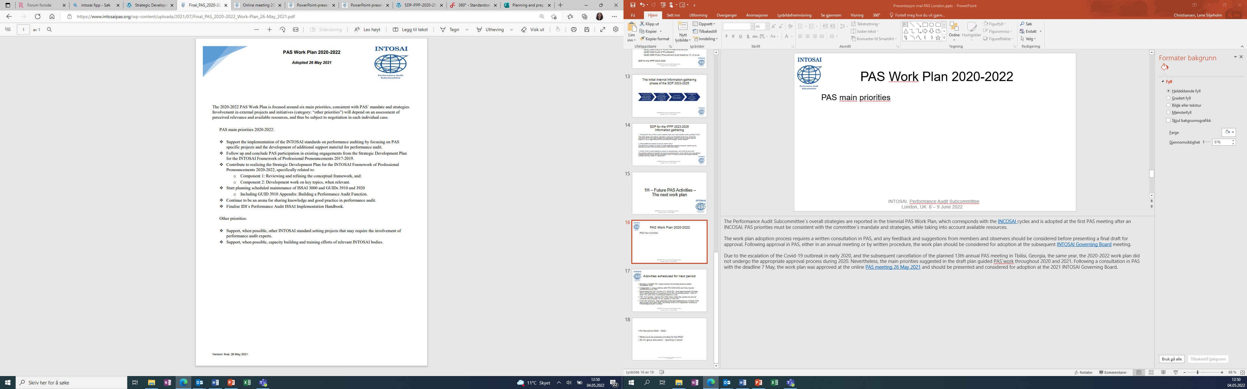

PAS Work Plan 2020-2022

Slide 24

Activities scheduled for the next period
Revision of ISSAI 140 - Approvement Governing Board possibly November 2023
Component 1 - may continue after INCOSAI 2022 and may require contribution from PAS (Possible also Component 2)
Developing the SDP for the IFPP 2023-26 - Final approvement October 2023, endorsement in November 23 by the Governing Board - Kick off med PSC and Sub Committees March to June.
PSC ToR update - before INCOSAI 2022 - After the update we should consider the necessity for an update of PAS ToR
From WP 2020-22: Start planning scheduled maintenance of ISSAI 3000 and GUIDs 3910 and 3920. Including GUID 3910 Appendix: Building a Performance Audit Function.

Slide 25

PAS Work Plan 2023-2025
What could be possible priorities for the PAS?
• group discussion and reporting in plenary

Slide 26
2F Other business
Evaluation of the agenda
Information of future meetings

Slide 27
Thank you!

