Slide 1
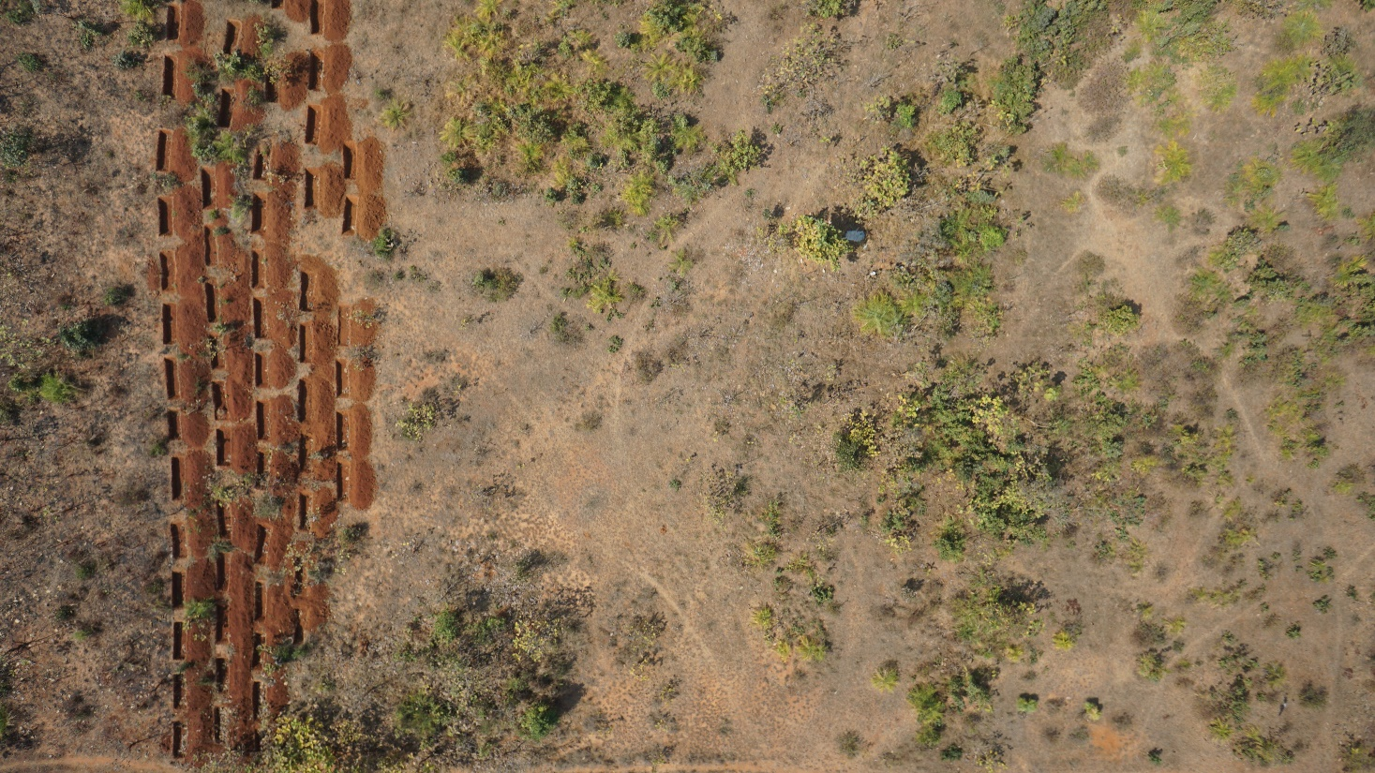
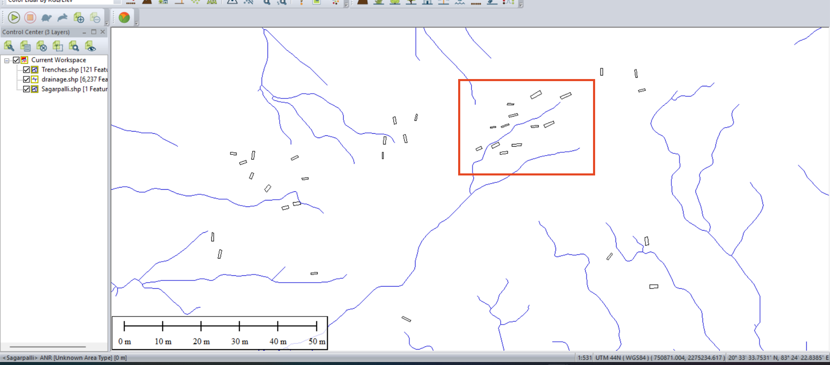
Photograph captured by drone (UAV)
ANR is a naturally induced plantation activity; there is no watering provision to these plantation sites. Instead, soil trenches are created to trap running rainwater and to recharge the ground water level.
The trenches dug parallel to contours will have low water retention capacity.
We observed that 50% of trenches were dug parallelly.
Overlapping of drainage pathways and trench locations

