Slide 1
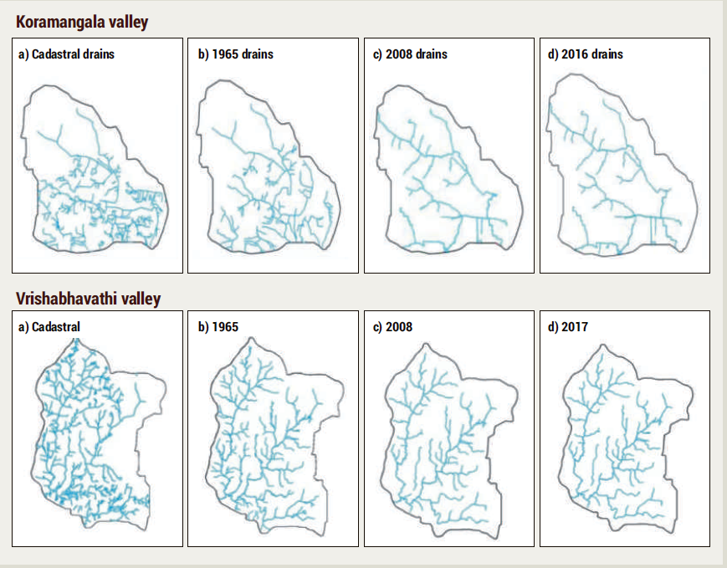
The total length of drains (primary and secondary) as per cadastral maps was 113.24 km and 226.29 km in Koramangala and Vrishabhavathi valleys respectively, which was reduced to 62.84 km and 111.72 km by 2016/2017.

