Slide 1
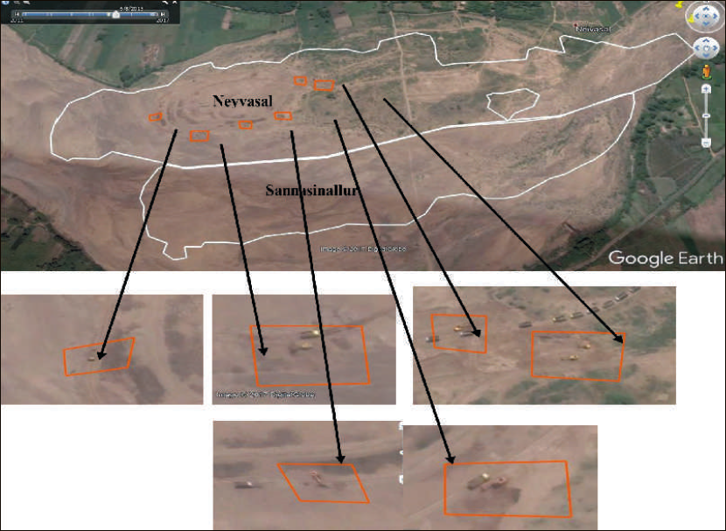
Vehicular movement and the presence of equipment was analyzed using Google Earth map
The picture alongside shows operation of seven excavators against two permitted in Neyvasal quarry on a particular date.
Moreover, mining was being carried out beyond the permitted area.

