Slide 1
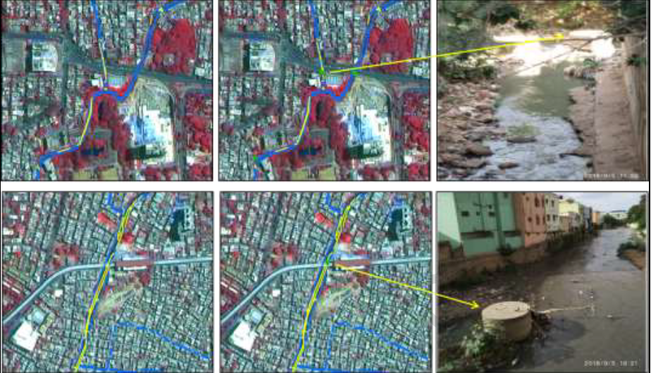
Overlap of Sewer Line (Yellow colour) and Drain (Blue Colour)
About 28.09 km stretch and 342 points showed overlapping/line of intersection between drains and sewer lines which are possible zones for intermixing of sewage and drain water.

