Slide 1
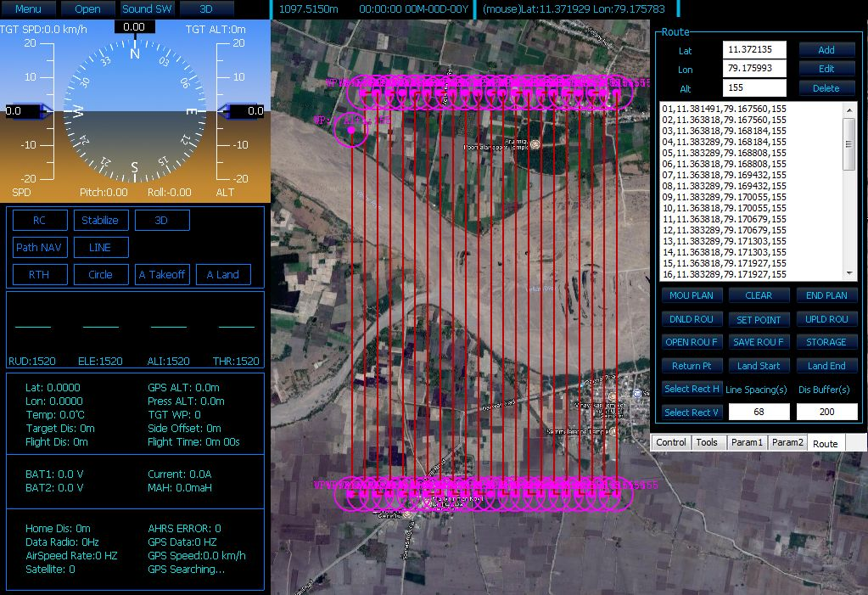
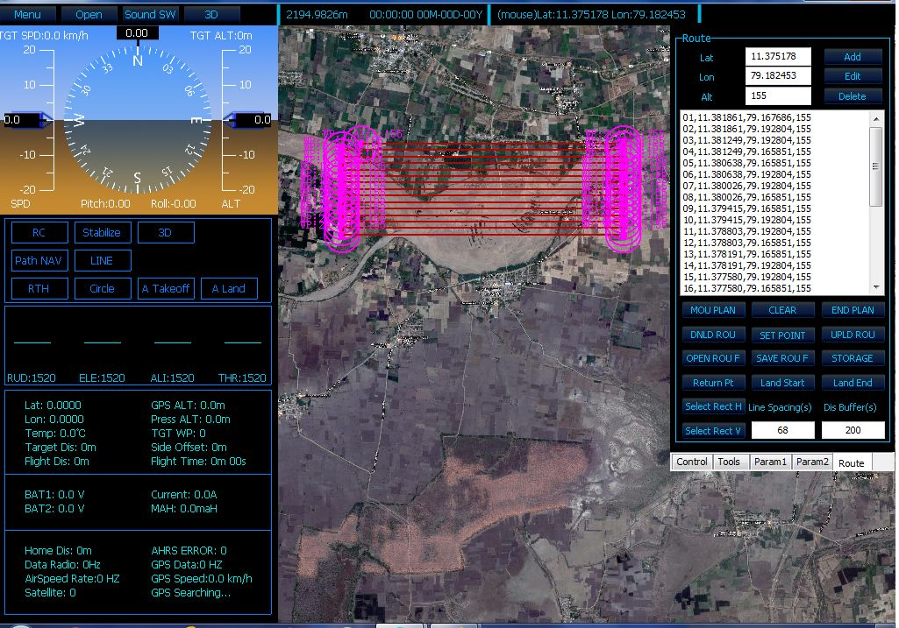
Fixed wing UAV (DH-FX Mapper) was used for nadir photo acquisition.
  It took 6625 photographs
Quad copter was used to acquire oblique images for better 3D reconstruction.
  Total 2332 photos were taken at 40º angle

