Slide 1
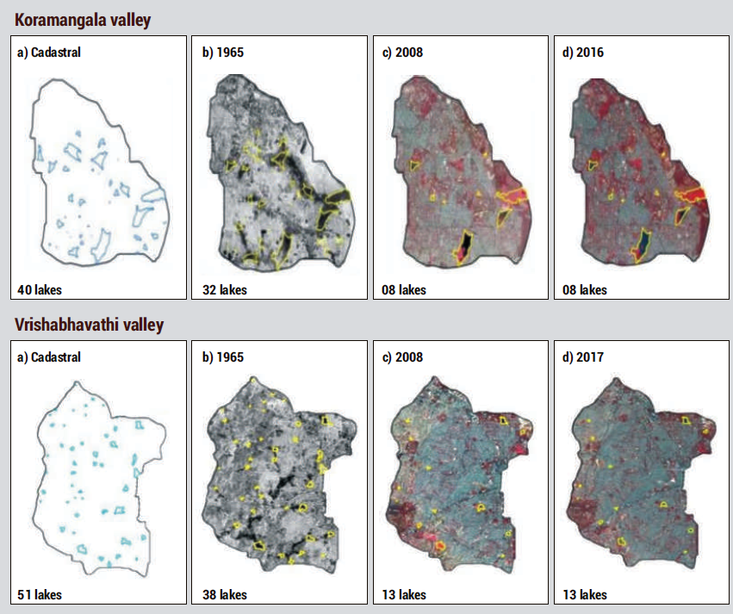
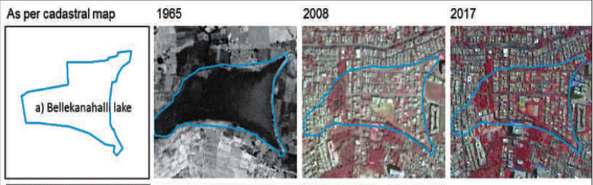
Time series map showing changes in lakes
Area of wetland system reduced from about 215.46 ha (2.24 %) of geographical area of the valley to 62.05 ha (0.65%) during 2017 indicating the gradual erosion of wetland systems due to land use changes.
Large-scale encroachment of lakes

