Slide 1
ANAO: Using technology to assist in analysis of unstructured data
Michelle Page
Senior Executive Director
March 2023

Slide 2
What is eDiscovery?
Forensic investigative software that originated as a tool to assist law enforcement investigators to process and navigate through emails and electronic documents
Useful to consider Nuix in two discrete stages:
  ‘case creation’—involving a powerful data ingest process; and
  ‘review and investigation’—searching and analysing the contents of your audit evidence

Slide 3
Who uses eDiscovery?
Investigative journalists – Panama Papers – April 2016
  Nuix was used by journalists from 107 media organisations in 80 countries to analyse leaked legal documents detailing the operations of the Panamanian law firm, Mossack Fonseca.
Large corporations – Waymo vs Uber
  Nuix used to produce legal evidence that a Waymo employee took valuable intellectual property about its self-driving car program before resigning and taking up a position at Uber.

Slide 4
Who uses eDiscovery?
A range of our auditees, including:
  Department of Defence
  Department of Foreign Affairs and Trade
  Department of Home Affairs
  Department of Infrastructure and Regional Development
  Department of Human Services
  Department of Social Services
  Department of Employment

Slide 5
History of eDiscovery in ANAO audits
Nuix first procured in 2010 for the audit of the Green Loans Program (tabled 29 September 2010)
Poor entity record keeping and reliance on emails in lieu of formal documentation the key driver
Nuix was rarely used again for the following five years

Slide 6
How many audits have used eDiscovery?

Slide 7

Why use eDiscovery for performance auditing?
  Audit quality
  ASAE 3500: ‘sufficient appropriate evidence’
  Audit efficiency
  Find evidence faster
  ANAO and PASG priority
  Build Nuix capability

Slide 8
When to consider using eDiscovery
Nuix is very effective in allowing the auditor to filter through large volumes of evidence in a very short period of time, with a high degree of accuracy.
  The quality of your search results depend only on the evidence available, and your search parameters.
Best to consider Nuix early in the audit – as part of the AWP, or early in fieldwork.
  Gaining the data from the entity, and then ingesting the data into ANAO Nuix servers can be a very time consuming process.
  The earlier you start, the more time you will have to utilise Nuix.

Slide 9
What do teams use eDiscovery for?
Options for different levels of Nuix usage: limited through to substantial. For example:
  Optical character recognition (OCR) documents that are not already text recognised
  Consolidating all documents collected from different systems/shared drives into one location
  Large bulk extraction of emails

Slide 10
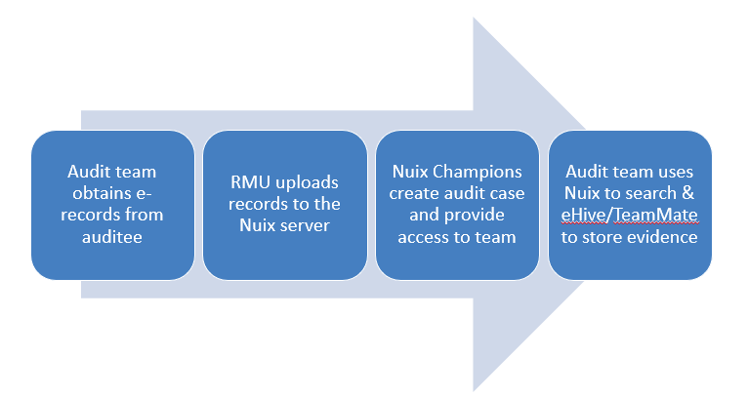
eDiscovery workflow

Slide 11
Advantages/disadvantages of eDiscovery
Advantages | Disadvantages
Mitigates information overload | Sensitivities around email collection
Document types: not limited | Case creation time (it can take a few days) and processing time
Increased ability to find relevant info | Storage constraints
Sophisticated search/browse/filter/ document relationships | Need to delete case and data after tabling
Transparency

Slide 12
Exploratory: Case study 1
Auditee did not keep register of complaints and had very few on file
Audit team performed key word searches in Nuix, for example:
  “complain*”
  “not happy”
  “not good enough”
  “my concern*”
  “incident”
  ("not” OR "*n't") W/5 (“follow*” W/5 "rule*”)
Identified various examples of complaints
Included a finding in the Report Preparation Paper that the auditee should improve their complaints management

Slide 13
Investigative: Case study 2
Stakeholders were telling us that consultation wasn’t adequate
However record-keeping was poor and we needed stronger evidence
The projects were also complex and difficult for an outsider to understand
We reviewed email traffic between key staff members in Nuix
Found examples of staff members raising concerns about the adequacy of consultation
Led to findings in the draft audit report that the entity’s consultation needed improvement

Slide 14

Structured analysis: Case study 3
Human Biosecurity for International Air Travellers during COVID-19
Sample of health screening forms for incoming travellers, completed by Department of Agriculture.
Did they comply with procedures?
Required to scan and email to Department of Health, retaining scan on file.
Some airports were not retaining copies on file.

Slide 15

Structured analysis: Case study 3
Human Biosecurity for International Air Travellers during COVID-19
Collected Health mailboxes and processed into Nuix.
Used Nuix to filter out unnecessary files.
Downloaded, sampled and tested for compliance
Concluded that the entities largely adhered to procedures

Slide 16
Other use-cases for eDiscovery
Legal Services Team – searchable legal advice repository
Last 10 years of ANAO performance audits – useful for teams wanting to quickly identify topics mentioned in previous audits

Slide 17
Questions?

