Slide 1
Ensuring quality through independent quality review
29 March 2023
Wilfred Aquilina
INTOSAI
Performance Audit Subcommittee
14th annual meeting
Dublin

Slide 2
Quality management at the ECA IQR checks and follow-up Wrap up Discussion

Slide 3
Quality management at the ECA

Slide 4
Purpose
iStock
Comply with professional standards and applicable regulatory requirements
Issue high quality reports
More details in AWARE – the ECA’s audit methodology and guidance platform

Slide 5
Responsibilities
iStock
Supervision and review
Independent quality review
Quality assurance reviews
More details in AWARE – the ECA’s audit methodology and guidance platform

Slide 6
Independent quality review
iStock
Independent documented checks on presentation, and an objective assessment of audit evidence, including the way significant judgements were made and conclusions reached
Adds to the assurance provided on the quality of the document
More details in AWARE – the ECA’s audit methodology and guidance platform

Slide 7
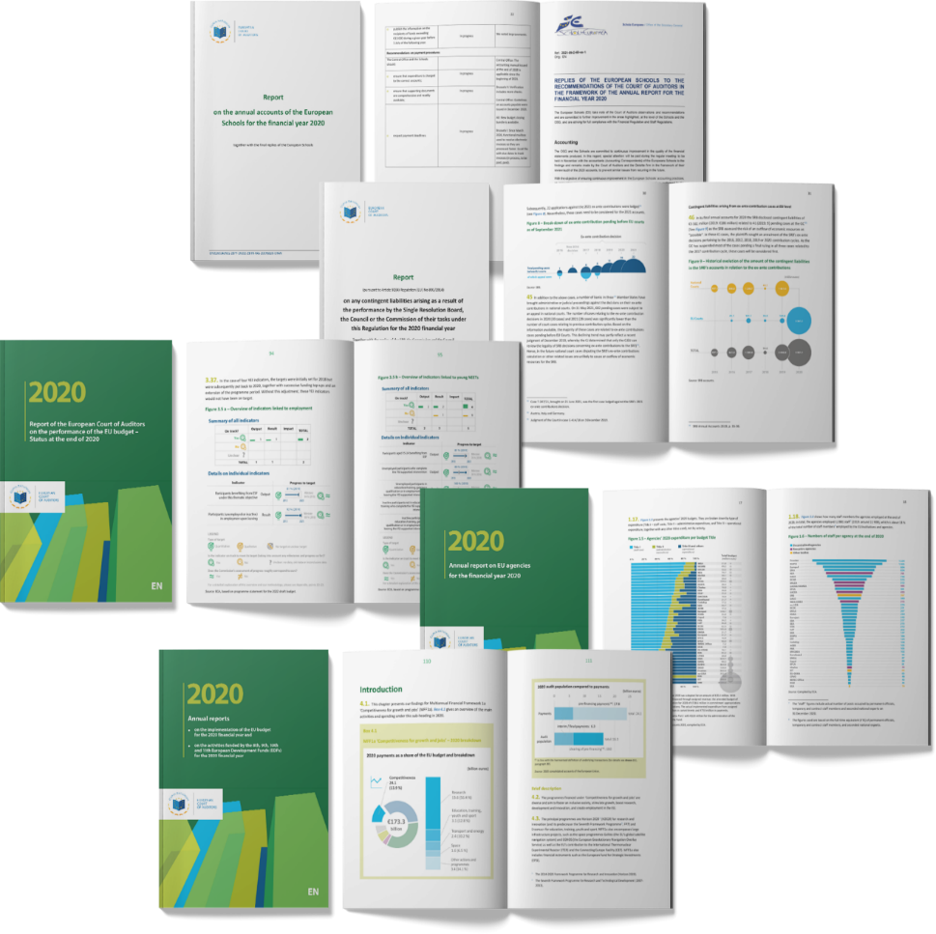
IQR checks and follow-up

Slide 8
Particular attention to…
iStock
The main audit questions and sub-questions are well-defined and clear
The reader can understand what the audit is expected to achieve
There is sufficient detail on why the audit was carried out at the time, and what value it is expected to add
The audit scope is clearly defined and any limitations are explained
The report provides a complete description of the approach used for the audit, and the work carried out to gather the evidence
The report is based on a clear and logical structure, and with good signposting through headings and subheadings

Slide 9
Particular attention to…
iStock
The observations are structured around the main audit questions
Each set of observations provides enough information to allow the reader to understand the applied standard (criteria), work done, findings and impact
The reported observations are objective and balanced, giving due importance to both positive and negative findings
The observations are based on clear, coherent and convincing progression of reasoning, they lead the reader from the questions to the analysis and findings and to the conclusions
Titles and headings are succinct and reflect fairly the text they cover
The consistency of main messages in the report, and with previous ECA reports

Slide 10
Particular attention to…
iStock
Checks on key elements of the audit report’s underlying evidence
See AWARE – the ECA’s audit methodology and guidance platform

Slide 11
Particular attention to…
iStock
Conclusions provide clear answers to the audit questions
Conclusions flow logically from the observations reported, and the evidence presented
Recommendations stem from the audit results, and are specific, useful, feasible, timely and cost-effective
The auditee replies are acceptable and the ECA text remains valid text in the light of these replies
The executive summary is clear and complete

Slide 12
Particular attention to…
iStock
The report’s overall length, avoidance of any unnecessary or repetitive detail
The background information in the introduction
The inclusion of examples
Proper use of references, links, footnotes and annexes
The reported data is correct and precise
Visuals and images complement the text, and are attractive and useful
Brief and clear explanations of the main terms are added to the glossary
Limited use of abbreviations and avoidance of jargon

Slide 13
Wrap up and discussion

Slide 14
iStock
Relevant
Adding value
Timely
Unique
Standards
Approach
Rigour
Accuracy
Interpretation
Focus
Depth
Tone
Balance
Consistency
Structure
Flow
Logic
Style
Concise
Readable
Clear
Finetuning
Feedback
Review
Communication
Reputation
Awareness
Impact

Slide 15
Your SAI’s experience and good practice
iStock

Slide 16
Contact details
Wilfred Aquilina
Senior Administrator – Audit Quality
wilfred.aquilina@eca.europa.eu
Want to know more about our work:
Visit our website: eca.europa.eu
Follow us on Twitter @EUAuditors
Check our page on LinkedIn and Facebook
Watch our videos on YouTube: EUAuditorsECA
Contact us at: ECA-info@eca.europa.eu

