Slide 1
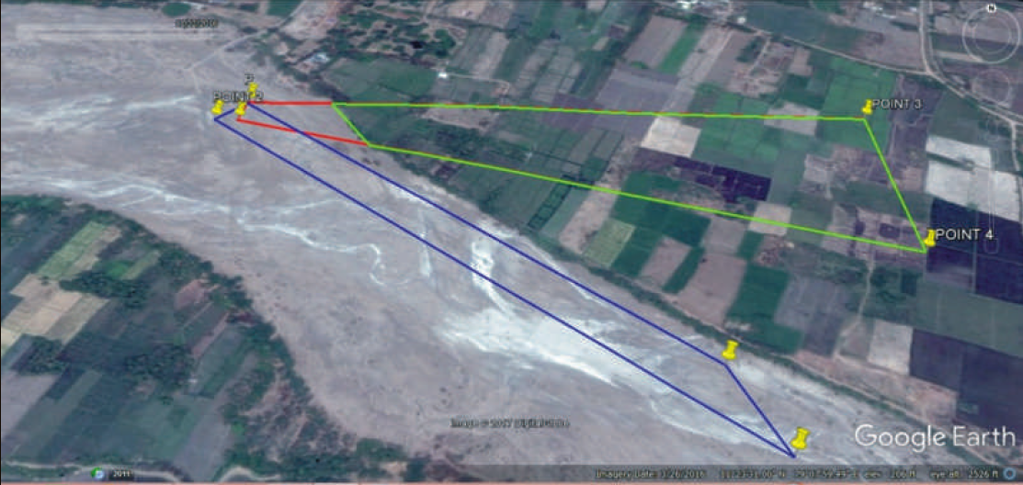
Blue Polygon – area of quarrying as per geo-coordinates in Mining plan.
Green & Red Polygon – area of quarrying as per geo-coordinates in Environmental Clearance.

