Slide 1

Performance Audit Subcommittee Meeting
Dublin, Ireland, March 28-29, 2023
www.idi.no
Maria Lucia Lima
IDI Senior Manager

Slide 2

How can SAIs add value through performance audits?

Slide 3

Through sustainable performance audit practices

Slide 4
What will it take?
Effective leadership
Competent auditors
Professional audit practices
Relevant audit practices

Slide 5

What are the IDI initiatives linked to these elements?

Slide 6



Effective leadership
Leadership engagement – all initiatives

Slide 7
Competent auditors
Competency framework
Professional Education for SAI Auditors (PESA)
Continuous Professional Development (CPD)

Slide 8


Slide 9

Performance Audit Exams 2022
 | Total exams | Passed (number) | Passed (percentage)
Performance audit exams | 163 | 90 | 55%
Auditors from 36 SAIs certified

Slide 10
Scaling up PESA
Review based on lessons learned
Exams available twice a year
No limits of participants from each SAI
Discussion of strategic partnerships
Recognition for PESA at the country level
CPD opportunities for PESA graduates
Checking demand for PESA in Spanish, French and Arabic

Slide 11

Centre for
SAI Audit Professionals

Slide 12
Professional audit practices
Adoption of standards
Assessing needs
Alignment of audit methodology
Performance audit strategic audit plan and annual audit plan
Pilot audits
Stakeholder engagement
Follow-up systems
System of audit quality management
Measurement of audit impact

Slide 13
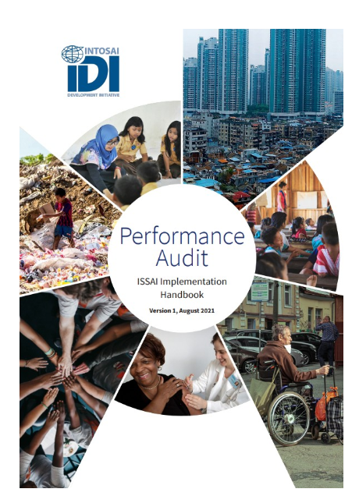
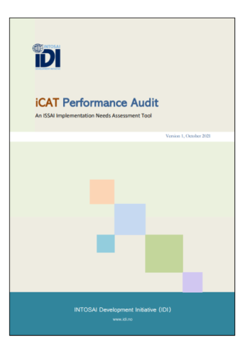
Professional audit practices

Slide 14

Professional audit practices
Impact driven audits
Robust follow-up systems
Strong stakeholder coalitions

Slide 15
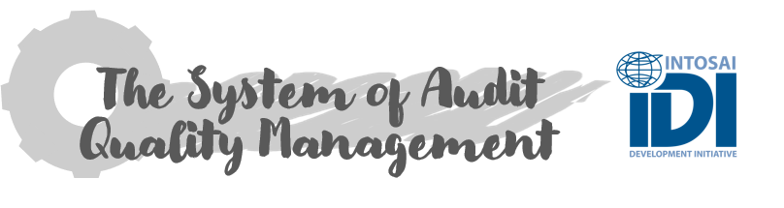
Professional audit practices
Pilot for SAIs

Slide 16
Professional audit practices
IDI/ADB initiative - Strengthening Performance Audit Capacity in Asia and the Pacific
Bangladesh
Bhutan
Mongolia
Nepal
Papua New Guinea
Philippines

Slide 17
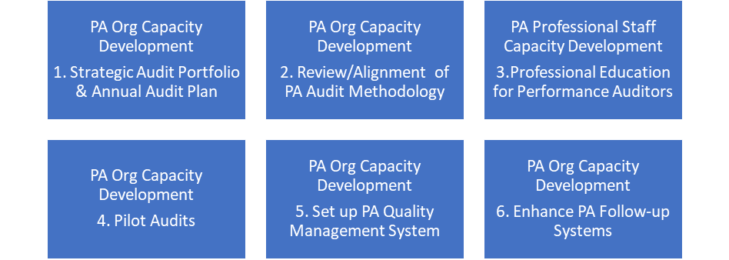
IDI/ADB initiative
Overview – phases 1 and 2
Phase 1 – ISSAI Implementation Needs Assessment (IINA)
Phase 2

Slide 18
Relevant audit practices
Innovating audit practices
Scanning trends
Auditing emerging areas
  Technology
  Inclusion
  Climate change
  Sustainable Development Goals (SDGs)

Slide 19


Slide 20



Slide 21


Slide 22


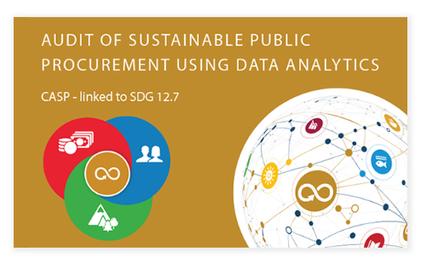
Audits linked to SDG 3.d, 5.2 and 12.7

Slide 23


Slide 24


