Slide 1
ISSAI 140 revision
Independent
Objective
Committed to Excellence
Constructive
Andy Harkness
FAAS representative on project team

Slide 2
Agenda
Why revise ISSAI 140?
ISQC1 vs ISQM1
ISSAI 140 revision project
Revised ISSAI 140
Timeline

Slide 3
Why revise extant ISSAI 140?
ISSAI 140 based on key principles in the International Standard on Quality Control (ISQC 1), adapted as necessary to apply to SAIs
structured around elements of quality control system:
        key principle quoted from ISQC 1
        key principle adapted for SAIs (for elements 1,2,3 and 6 only)
        application guidance for SAIs
ISQC1 replaced by
International Standard on Quality Management 1, Quality management for Firms that Perform Audits or Reviews of Financial Statements or Other Assurance or Related Services Engagements
ISA 220 revised
ISA 220 (Revised), Quality Management for an Audit of Financial Statements
International Standard on Quality Management 2, Engagement Quality Reviews
effective as of December 15, 2022 (revised ISA 220 effective for audits of financial statements for periods beginning on or after December 15, 2022)

Slide 4
ISQC1 –v- ISQM1
ISQC 1
ISQM 1
quality control standard
set of requirements to comply with
holistic system of quality management operating in continuous and iterative manner
quality objectives
risks to achievement of these quality objectives
respond appropriately to the risks
some mandatory objectives and responses
more flexibility to identify risks specific to the firm’s circumstances and to set up responses in a proportionate way to their circumstances
requirement to evaluate the system and conclude on its effectiveness in achieving quality objectives on an annual basis

Slide 5
ISQC1 vs ISQM1- six vs eight components
Risk assessment process
Governance and leadership
Relevant ethical requirements
Acceptance and continuance of client relationships and specific engagements
Engagement performance
Resources
Information and communication
Monitoring and remediation process

Slide 6
Revision of ISSAI 140 – working group
26 participants
17 SAIs
4 stakeholders
Performance Audit Subcommittee
Financial Audit and Accounting Subcommittee
Compliance Audit Subcommittee
Internal Control Standards Subcommittee
Quality review arrangements
core drafting team of five
rest of the team acting as quality reviewers

Slide 7
Aim and scope of the project
Revise ISSAI 140 into a principle based standard:
adapting the content of the IAASB quality management standards ISQM1 and ISQM2 for SAIs
fit into the INTOSAI framework
applicable to different SAI organisational models
clear, useful and accessible for SAIs that seek compliance with the ISSAIs
consistent with similar level standards in terms of presentation
consistent with ISSAI 100 in terms of content.
Scope :
draft the ISSAI 140 as the top level standard
identify conforming amendments to ISSAI 100, ISSAI 2000 and other INTOSAI pronouncements

Slide 8
Revised ISSAI 140 vs ISQMs - how we did it
Set out in the Explanatory Memorandum to the Exposure Draft :
we have taken over the key high level requirements from ISQM1
adapted them to the SAI context
analysed the remaining ISQM1 requirements
included these in the application material
This approach, while allowing a certain level of flexibility to the SAIs, will effectively result in SAIs applying most of what is actually required by ISQM1
We have not taken over the detailed requirements of ISQM2 as they concern EQRs, which are one of key responses that a SAI should consider putting in place. These should be taken over in further guidance to be developed.

Slide 9
Revised ISSAI 140 – Exposure Draft
Introduction
Scope
        all work carried out (judicial activities included)
Underlying principles
        SQM commensurate with SAIs mandate and circumstances
        Provides assurance on achievement of strategic objectives and compliance with standards and legal/regulatory requirements
        SQM operates in continual and iterative manner, responsive to changes in nature and circumstances
        Eight components
        Risk based approach to designing, implementing and operating SQM
Definitions
Organisational requirements

Slide 10
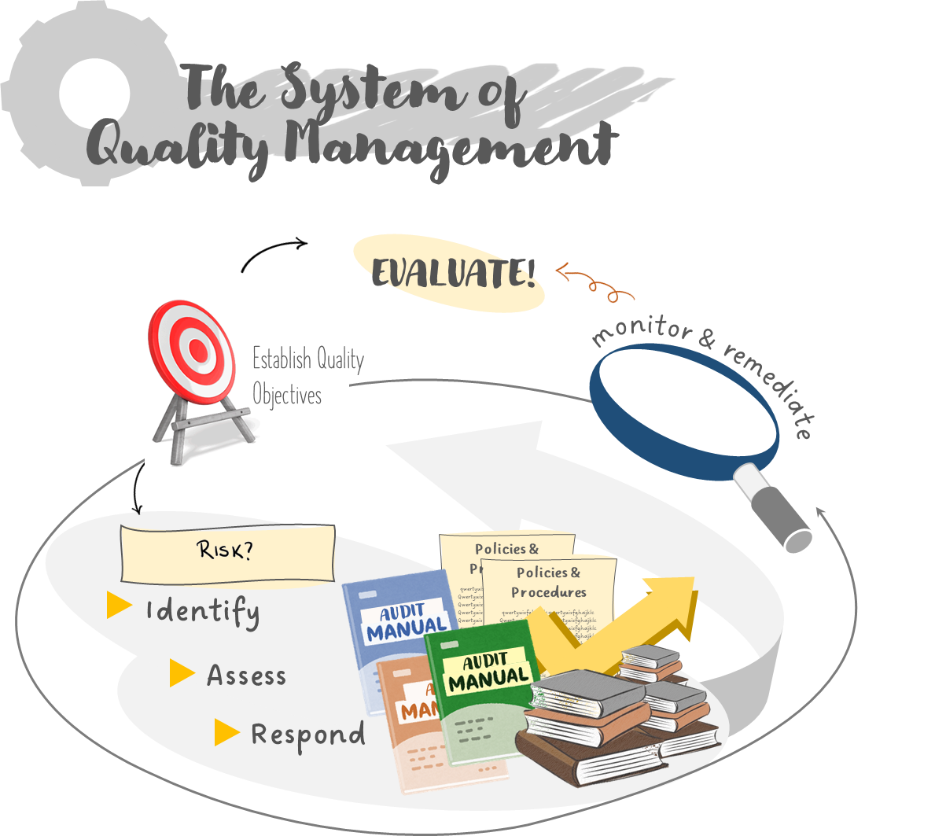
Revised ISSAI 140 – Set around processes

Slide 11
Revised ISSAI 140 – Set around processes
Organisational requirements :
  Establishing the system of quality management
  Establishing quality objectives
  Identifying and assessing quality risks
  Designing and implementing responses
  Monitoring the system of quality management and remedying identified deficiencies
  Evaluating and concluding on the effectiveness of the system of quality management
  Documenting the system of quality management.

Slide 12
Timeline of the project - following the due process (as of April 2023)
INTOSAI Gov Board endorsement November 2023
Proposal May 2022
Submission November 2022
Submission August 2023
Project
Exposure
draft
Exposure
period
Endorsement version
Final pronouncement
June 2023
FIPP approval
June 2022
FIPP and PSC approval September 2023
FIPP approval March 2023

Slide 13
The INTOSAI Framework of Professional Pronouncements https://www.issai.org/
Due Process for INTOSAI Framework of Professional Pronouncements https://www.intosaifipp.org/wp-content/uploads/2021/01/Due-process-IFPP1.pdf
Forum for INTOSAI Professional Pronouncements (FIPP) https://www.intosaifipp.org/about-fipp/
Want to know more about INTOSAI standards
and standard setting process?

Slide 14
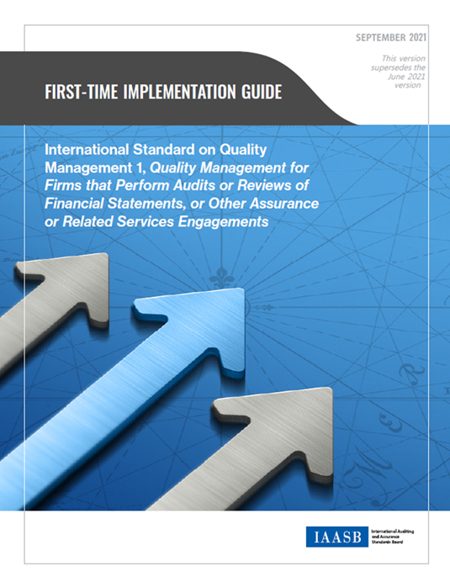
Other useful guides from IAASB
Basis of conclusions for ISQM1 and ISQM2
Fact sheets
First time implementation guides

