Slide 1
Data Science Applied
The Innovation Lab & Performance Audit
Sverre Lunde
Deputy Auditor General, OAGN
PAS Meeting, Dublin
March 28-29th, 2023

Slide 2
The OAGN innovation lab

Slide 3
The innovation lab - What they do
Curate /wrangle data – all audit types
On-demand data analytics
Make small tailor made webapps - particularly financial audit
Make custom search apps
Promote data science and use of machine learning
Experiment and take in use new (cloud) technologies and methods

Slide 4
Who they are
2 political scientists
1 economist
1 sociologist
1 social psychologist
1 physicist
( started as a project with only 3)
… we are not an IT thing , we are one data science thing

Slide 5
Why was the Innovation Lab established?
Desire for more speed on technological development/innovation in OAGN
The usual – do things faster, possibly stop doing some things
Private audit - full speed ahead with the automation of the audit
Some international colleagues (UK, Netherlands) had got a head start - we wanted to keep up

Slide 6
"We automate boring stuff,
so you can have more time for fun stuff“
(perhaps most relevant for financial auditors)

Slide 7
The OAGN Data Science Project
2017.02 Project Initiative
2017.03 Inspirational Visit NAO - UK
2017.05 Data Center Project established
2018.10 Staff increase
2019.01 OAGN Innovation Lab established
2022.04 Further staff increase

Slide 8
Success factors

Slide 9
Ideas on how to start:
Start small
Identify a concrete and practical problem
Find three competent persons and give them full freedom
The message: «Just fix something»
Limit the amount of planning, meetings, involvement, adm. memos, follow-up and reporting

Slide 10
Then…
The three might not fix the assignment
However, they might fix something else and at least as important
Take risk (you waste an incredible amount of time on meaningless tasks anyway)
Work almost as a small tech startup (results and product is everything; process less important)
A small NB: With freedom comes responsibility (something tangible and useful should have been produced within a few months)

Slide 11
Back in 2017…
We could have spent the two first months planning
We didn’t – we started making our first product
Called the «back catalogue analyser»
Ready after a month
«Wow… We actually do something…»

Slide 12
Some general comments
Knowledge of both audit and technology is important
" Entrepreneurial spirit " is probably yet more important
Lots of nice technology is open source and (almost) free – use it
Make something , and sell what you have

Slide 13
A few principles
If someone else at the office can do it, the lab shouldn’t
Prioritization is based on cost/benefit
Everything the lab does should involve something novel, untried, innovative

Slide 14
A rather major risk…
Becoming victims of our own success
When you make something useful, you have to keep it running, updated
You may end up just updating old successes, no time for experimentation

Slide 15
Examples of things we have made/done

Slide 16
Using machine learning in PA
Two examples from performance audit:
- classification of criminal cases – ICT crime
- satellite data and food security

Slide 17

ML-example 1: ICT-crime
  Of all reported crime cases
    how many cases are related to ICT-crime?
    what types of ICT-crime do we have?
  A classical (binary) classification problem
    300 000+ criminal cases → train a ML-algorithm
    Used Support Vector Machine as ML-algorithm
«Office of the Auditor General’s
examination of police efforts related to ICT crime»

Slide 18
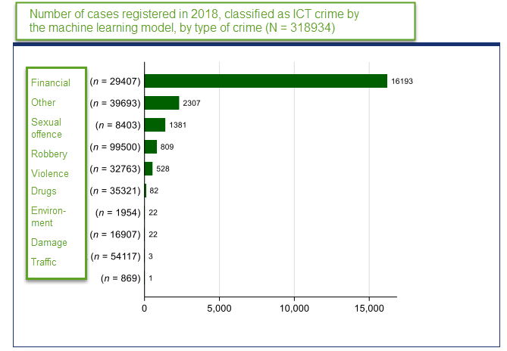
Some of the results

Slide 19
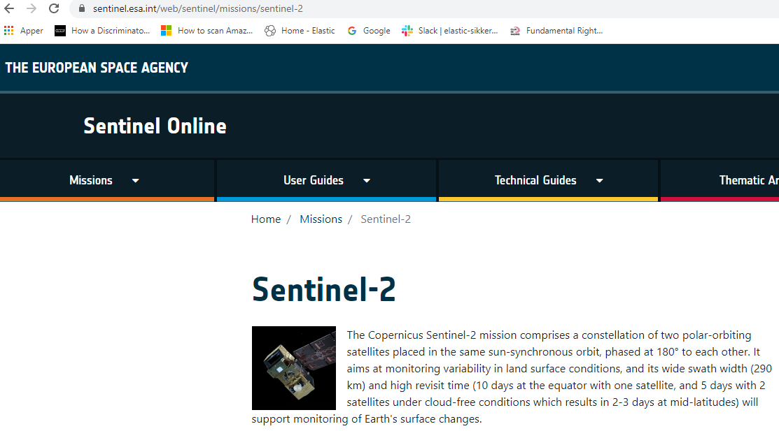
ML-example 2: ML and food security
Question:
  Is agricultural land actually used for producing food?
We used ML on satellite images to study this.
Trained a deep learning model to recognise different types of crops
Didn’t really work out that well because of bad data…
But a valuable proof-of-concept

Slide 20
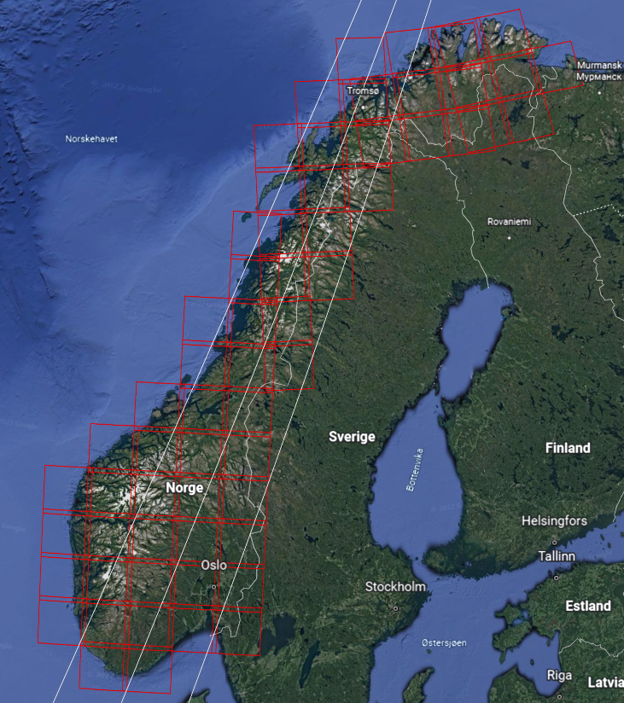
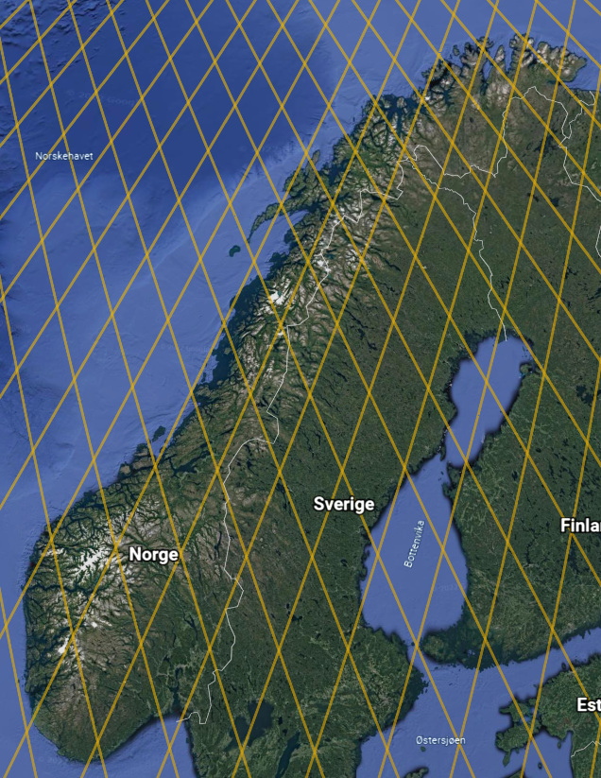
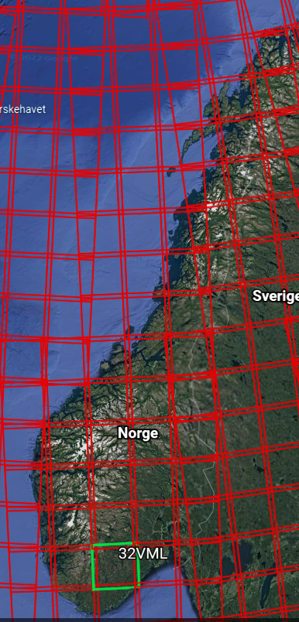
Sentinel 2 tiles and relative orbits
Most relevant tiles and orbits for our analysis
More orbits
More tiles

Slide 21
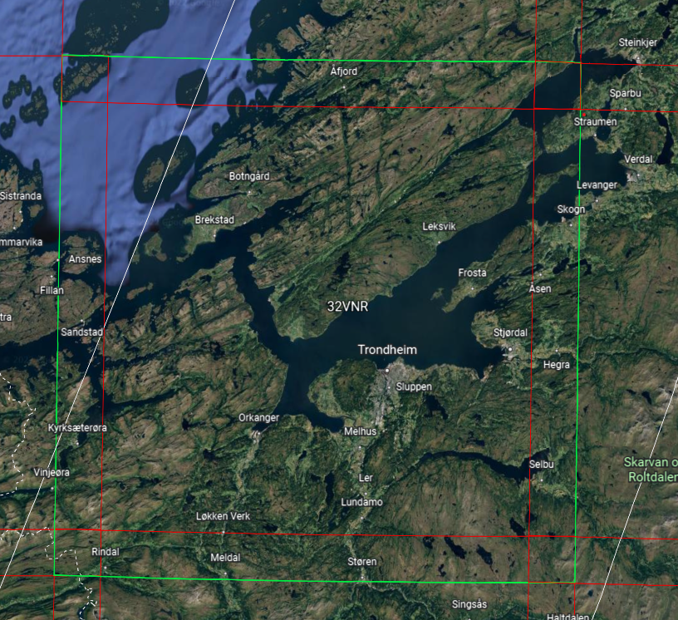
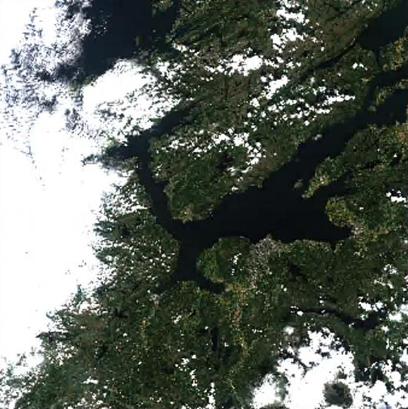
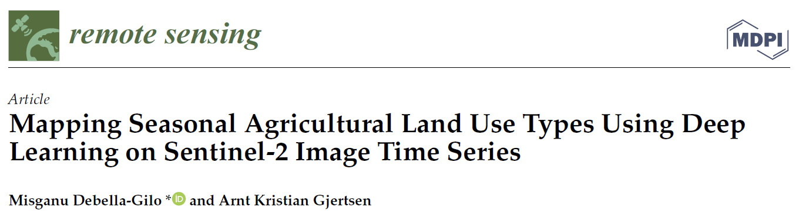
Example: The problem of clouds – tile number T32VNR
Google earth view ☺
Actual data ☹
(Algorithm used was convolutional neural network (CNN) –
A type of deep learning algorithm)

Slide 22
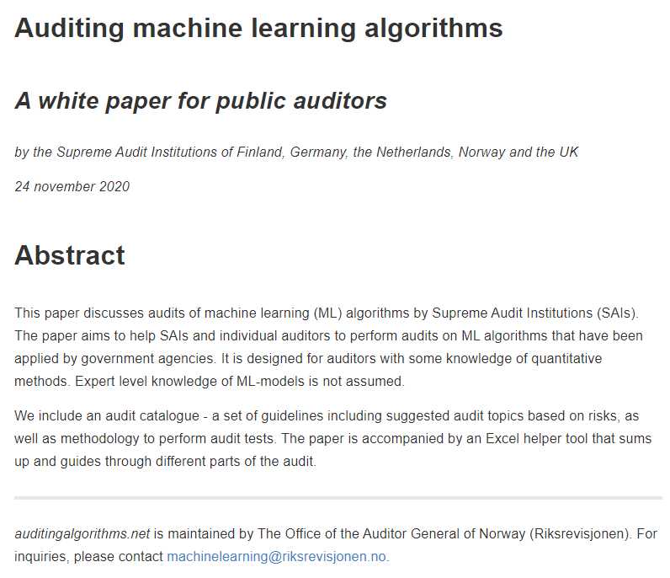
Auditing algorithms
Doing a performance audit on the use of artificial intelligence in government
Also:
Together with good SAI colleagues we wrote
www.auditingalgorithms.net

Slide 23
PDF - Where Information Goes to Die
  What if you want do ( fast ) full text search in 100,000 PDF documents ?

Slide 24
Example : 50,000 PDFs – what to do
50,000 PDF documents from the Norwegian hospital boards
25 healthcare companies , 12-14 board meetings a year , last 7 years
All documents published online (25 different web pages )
How to make this searchable in full text

Slide 25




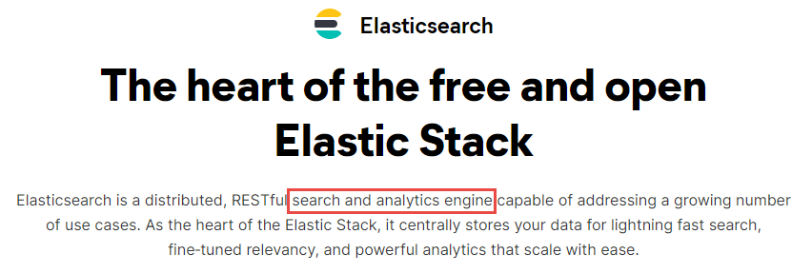
V i built a pipeline where …
Board documents
  Picked up automatic from web ( webscraped once a week )
  Ingested into a type of database, incl . PDF → JSON ( Elasticsearch )
  Made searchable in a webapp (built with R & Shiny)
If we have a need (and data), we can now make a new custom search app in one week

Slide 26
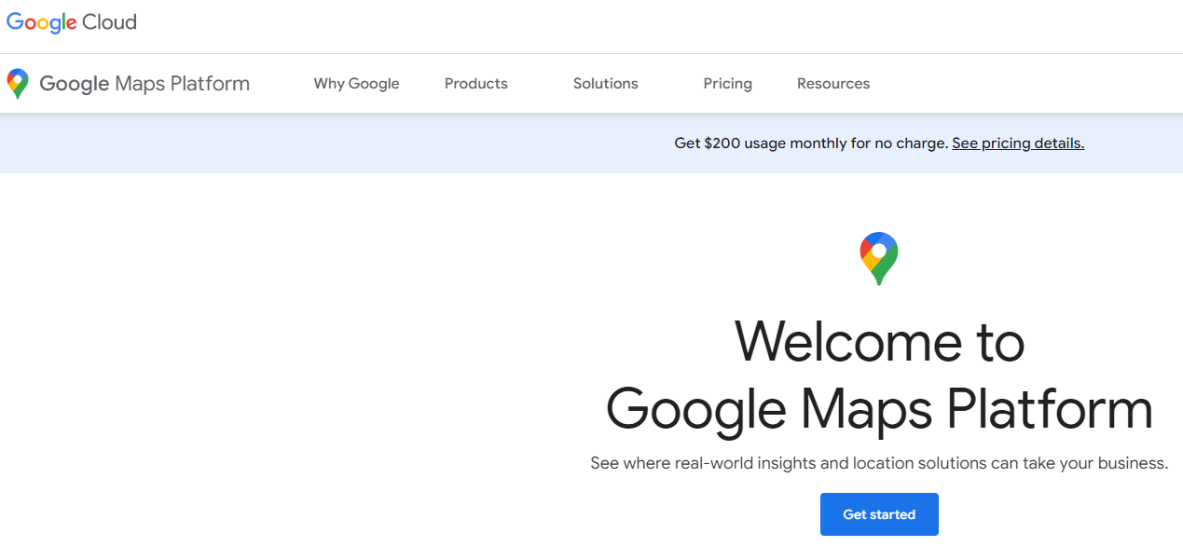
Example: Use of travel data from Google Maps
- work in progress
Question: Is road maintenance being done when needed?
Combined:
Data on travel time for cars from Google (Maps api)
Weather data from the MET api
GPS-data on the location of snowploughs
Data stored on AWS - Analysed using R/R studio

Slide 27
Webapp for DEA-analysis
DEA = Data Envelopment Analysis
Analysis of productivity based on input-output
  For example: How many cases do different courts handle, compared to the number of judges and admin. staff?
  Efficiency is the «gap» between a court’s productivity and the court which is «best in class».
This webapp is available for anyone, in the form of an R-package (we can send it to you)

Slide 28
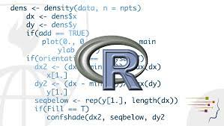
R-packages for easier access to open data
Made a few R-packages for easy collection of (examples)
enterprise data from the register of legal entities
data from The Central Bank of Norway
Wrapped in an webapp so you don’t need to know how to code

Slide 29
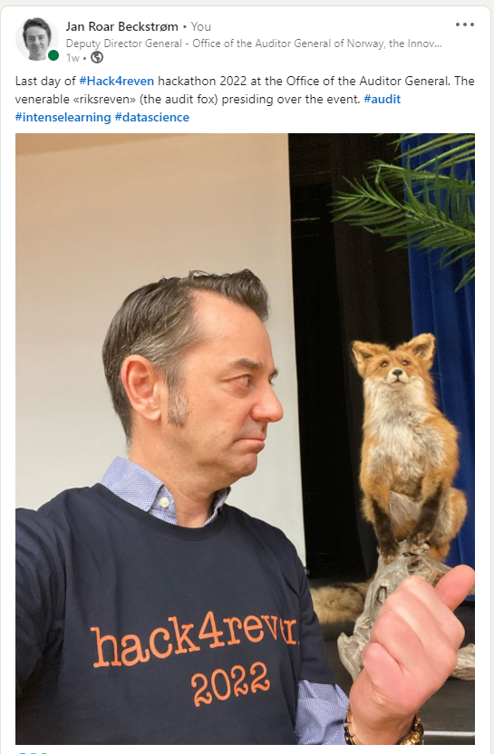
And of course: Hackathon 2022

