Slide 1


Performance Audit Subcommittee (PAS)
Annual Meeting
28 – 29 March 2023
Dublin Castle, Ireland
Niels-Erik Brokopp, INTOSAI Professional Standards Committee secretariat and Liaison Officer

Slide 2
Agenda
A competent framework
Component 1 – main outcomes
Moving forward with the SDP
The initiatives
Other news from the PSC

Slide 3

Agenda
A competent framework
Component 1 – main outcomes
Moving forward with the SDP
The initiatives
Other news from the PSC

Slide 4
Framework of Professional Pronouncements
Ensure the quality of the audits conducted.
Strengthen the credibility of the audit reports for users / stakeholders.
Enhance transparency of the audit process.
Specify the auditor’s responsibility in relation to the other parties involved.
Define the different types of audit engagements and their related concepts
Provides a common language for public sector auditing.
What is the purpose of an auditing standards framework?

Slide 5
Agenda
A competent framework
Component 1 – main outcomes
Moving forward with the SDP
The initiatives
Other news from the PSC

Slide 6
Clarity
To be clear requires clarity and consistency in:
Drafting style (short, active sentences)
Concepts and their meaning
Structure and presentation of material
A framework that is easily understood, unambiguous and not open to misinterpretation
The review of the IFPP found:
Drafting style often overly elaborate and inconsistent.
A lack of clarity in concepts and consistency in their application.
Inconsistent and sometimes illogical structure and presentation of material

Slide 7
Relevance
To the relevant the framework needs to:
Cover key tasks most SAIs do.
Reflect on how SAIs do their work.
Be up-to-date and timely in providing content.
A framework that covers key organisational issues and tasks that many or most SAIs are required to do
The review of the IFPP found:
Much material concerning audit work is covered.
An increasing amount of non-audit work SAIs do not covered (even indirectly).
Material separated by audit type, whilst most audit work integrates different audit objectives.
Lengthy and complex development process makes it difficult to keep the framework up-to-date.

Slide 8
Robustness
To be robust the framework needs to:
Underpinned by technically sound material
Clear terms in what must be achieved
Clarity what it means to apply or comply with the framework
A framework that is technically strong and leads to reliable results
The review of the IFPP found:
Material technically robust, but can be difficult to identify or access.
No clarity about how to calibrate the principles, requirements and other content for optimal output.
Confusion about what it means to claim compliance with the framework.

Slide 9
Non-compliance with ISSAIs
(% of 129 SAIs)
Source:
IDI Global Stocktaking Report 2020

Slide 10
Accessibility
To be accessible the framework needs to:
Use up-to-date methods in presenting content
Be consistent in form and extent
Be searchable
A framework that is available to all users in ways that suit their needs
The review of the IFPP found:
Material available in national or working language of most users, but translation problems.
Material presented in static, not easily searchable documents, little cross-referencing.
Advantages of modern presentation methods not used.

Slide 11
Strengths on which to build
Strong material based on a strong and inclusive standard setting process.
Appreciation of ISSAI 100.
A framework widely known and used across the community.
Potential and desire to make the framework clearer, more relevant, more robust and more accessible to benefit users.

Slide 12
Agenda
A competent framework
Component 1 – main outcomes
Moving forward with the SDP
The initiatives
Other news from the PSC

Slide 13

Stages of the SDP

Slide 14
Agenda
A competent framework
Component 1 – main outcomes
Moving forward with the SDP
The initiatives
Other news from the PSC

Slide 15
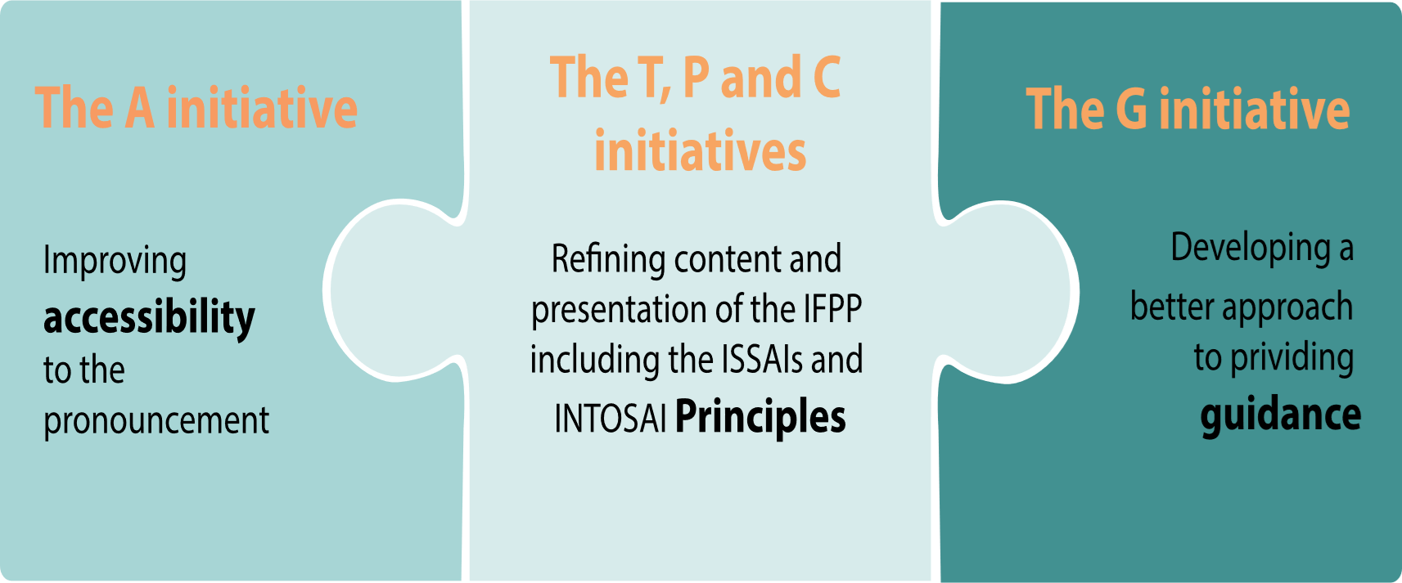
Stages of the SDP

Slide 16
Agenda
A competent framework
Component 1 – main outcomes
Moving forward with the SDP
The initiatives
Other news from the PSC

Slide 17
New PSC chair and secretariat
Introducing the new PSC chair and secretariat
PSC Chair: Ms Iliana IVANOVA (ECA)
PSC Vice-chair Mr Bruno DANTAS (TCU)
PSC secretariat
Niels-Erik, Alan, Radek, Heika (ECA)
Paula, Raisa, Hellen, Alice, Cíntia (TCU)

Slide 18
PSC steering committee meetings 2023
22nd meeting of the PSC-SC
Spring meeting: 28 June 2023) – online only
23rd meeting of the PSC-SC
Autumn meeting: 27 & 28 September in Luxembourg and online

