Slide 1
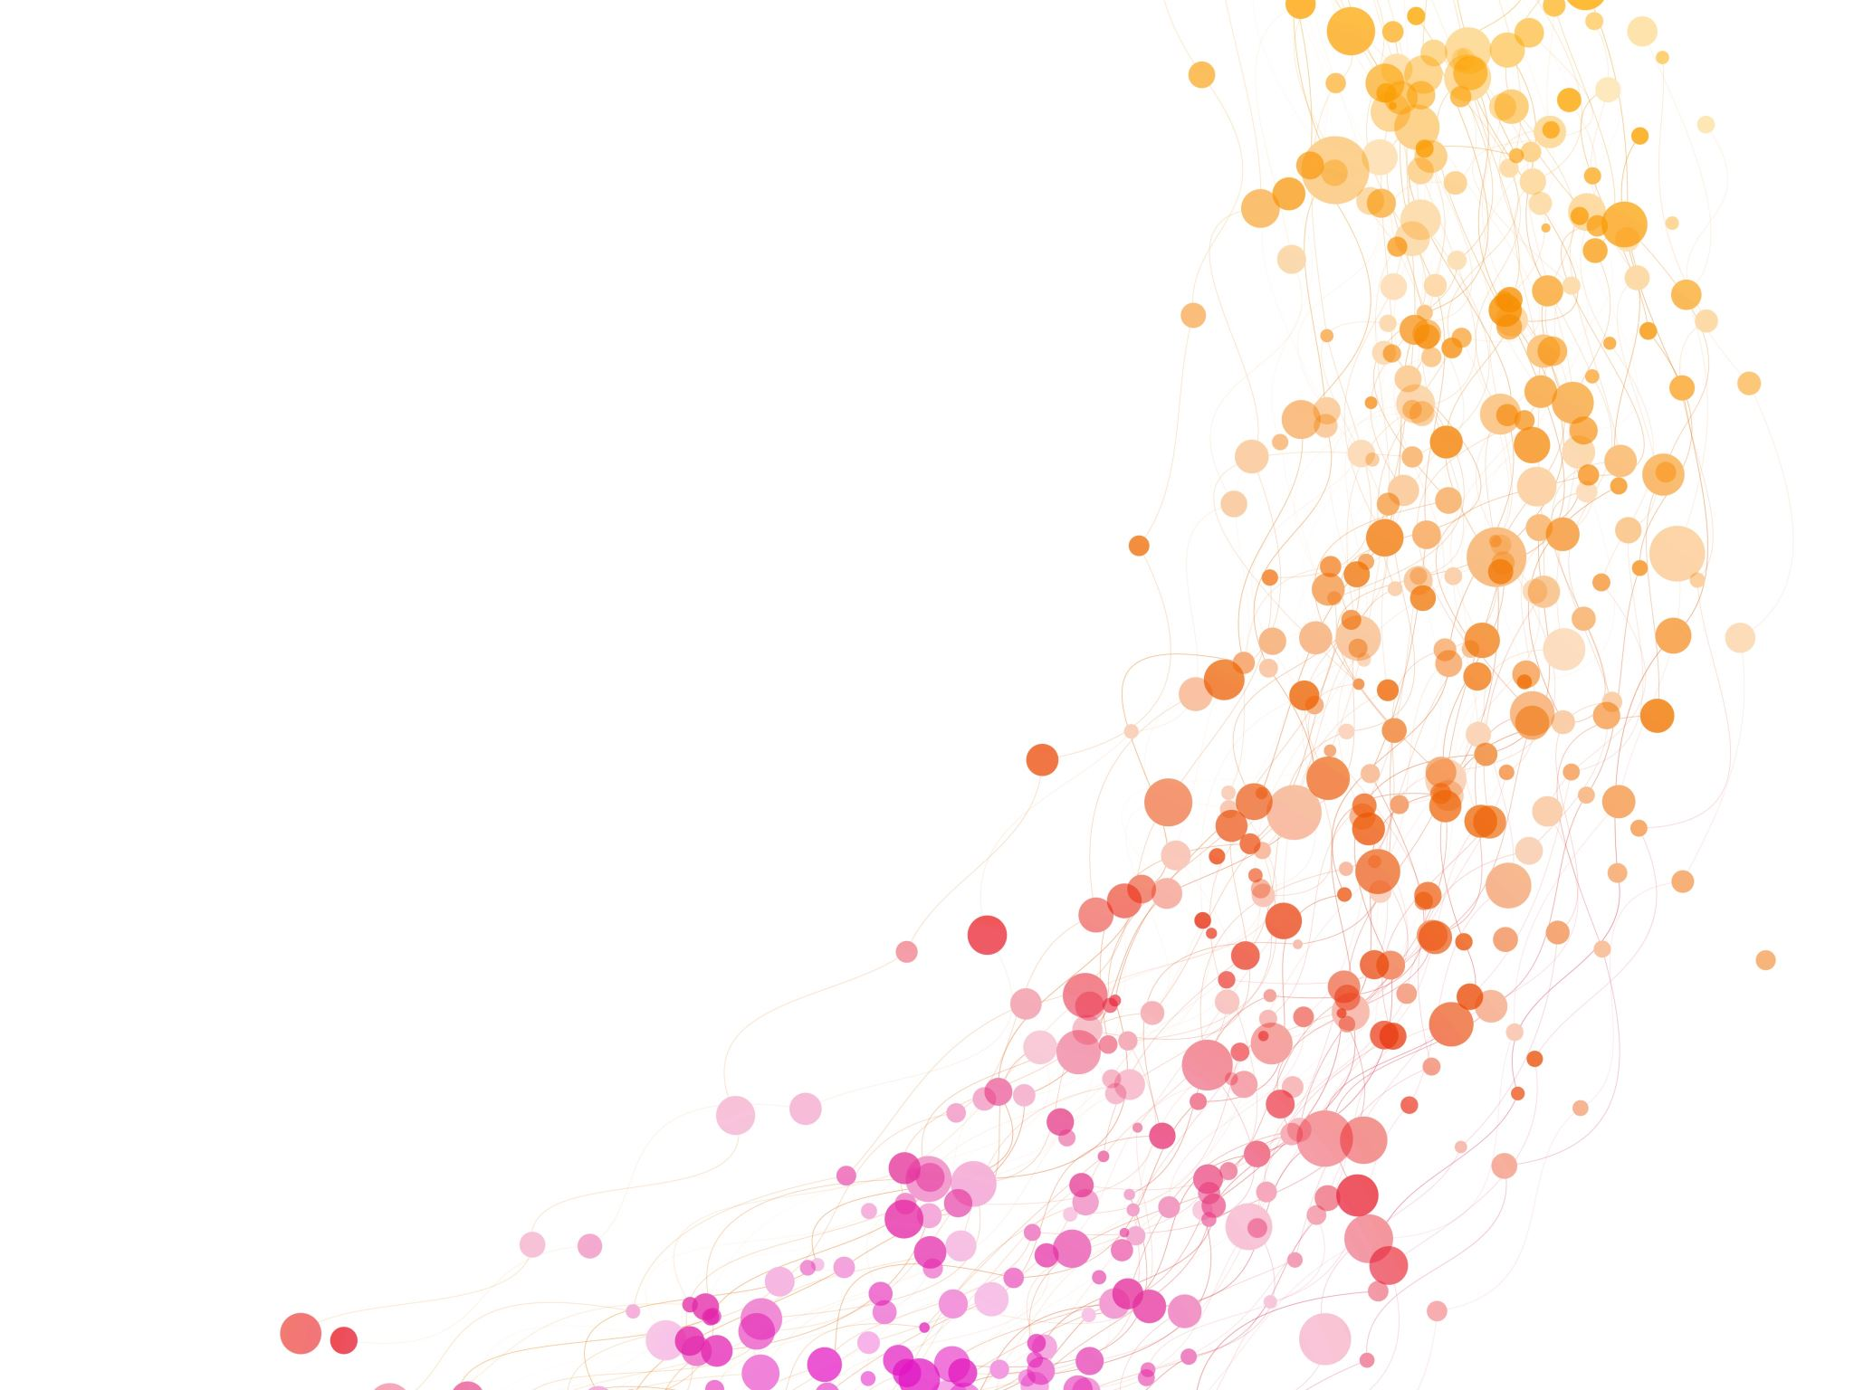
Leveraging Scientific and Technological tools for conducting performance Audits
PRESENTATION BY SAI INDIA

Slide 2
Introduction
INDIA
Seventh largest country in the world
Second most populous country
Largest democracy
Fifth largest economy
Mandated by the Constitution of India, SAI India promotes accountability, transparency and good governance and provides independent and credible assurance that public funds are being collected and used effectively and efficiently.
SAI India carries out Performance Audits, which include those in the areas of:
Welfare Schemes
Forest & Environment
Disaster Management
Receipt Audit

Slide 3
Performance Audit standards & challenges
ISSAI 3000
Audit Criteria
Audit Risk
Materiality
Audit Evidence
Availability
Reliability
Incomplete coverage of audit universe
Lack of in-depth analysis
Quantification of observations
Inaccessibility to sample space

Slide 4
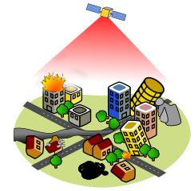
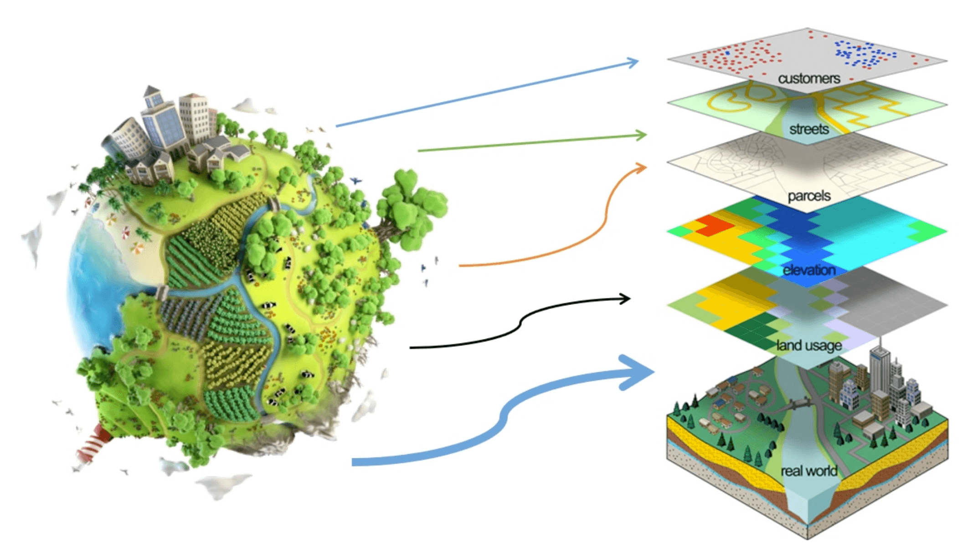
Using scientific & technological tools
Remote Sensing
Process of obtaining information from a distance which can be used to assess certain features of the Earth
Surveying & data collection - satellite, airplane & UAVs
Spatial & Temporal resolution
Allows retrieval of data in regions `which are difficult to access
GIS
Computer-based tool for mapping, analyzing and presenting all geographically referenced data
Temporal, location and terrain analysis
Helpful in risk analysis and audit design
Data Analytics
Collection -> Analytics -> Field Validation
Models/Reports highlight specific risk areas (outliers or anomalies) – basis for framing audit guidelines
Helps in analyzing 100% of electronic transactions rather than just a sample - assurance
ISSAI 3000 (63 – 65) – Augmenting professional competence & engaging external expertise

Slide 5
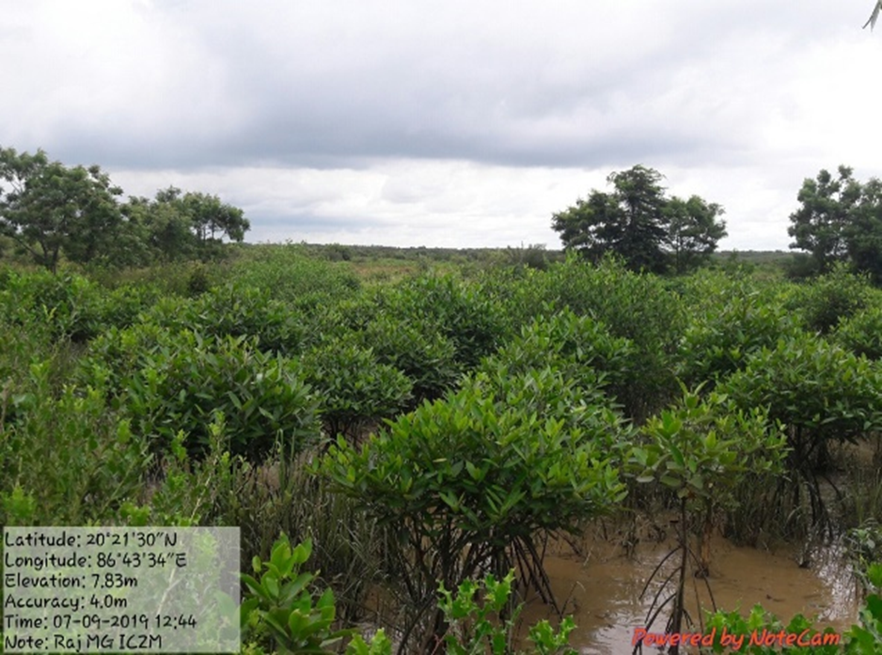
Use of UAV Technology in Assessment of Plantations in Forest Department
1
Objective: To provide reasonable assurance that the systems for monitoring and evaluation of plantations were sufficient, effective and efficient.
Challenges faced:
Vast area under consideration
Inaccessibility to the entire plantation site due to heavy vegetation, threat of wildlife, terrain etc
Plantation journals were not properly maintained

Slide 6
Leveraging scientific tools
The GPS coordinates of the site was plotted on Google Earth and the site was analysed with Historical Imagery tool available in GE to check for changes in the site. Areas of no/minimal change in plantation cover were identified as potential risk areas.
Count of trees (species wise)
Tree height & canopy density
100% coverage of sampled space
Drainage pattern

Slide 7
Impact of audit
State government brought out circulars regarding use of local species for plantation which have a better survivability rate.
Plantation Cost norms have been revised.
Creation of landbank for degraded patches is in progress.
Forest Department has started using UAVs/drones for efficient monitoring and evaluation of plantations.

Slide 8
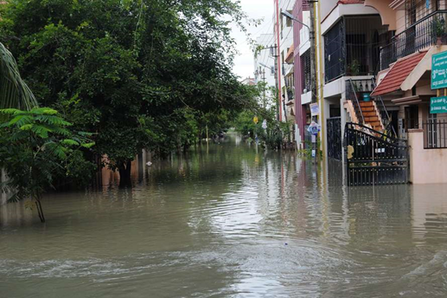
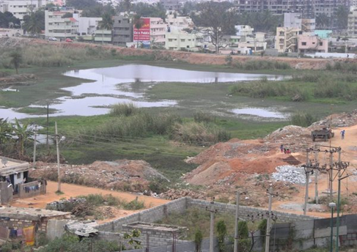
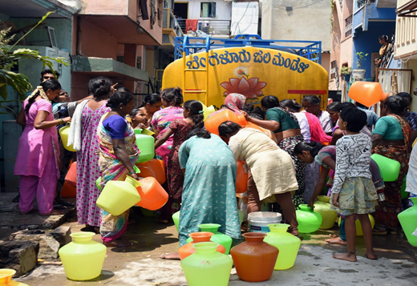
Use of GIS and remote sensing in storm water management
2
Bengaluru – City of Lakes & Silicon Valley of India
Ideally, about 73 per cent of Bengaluru’s water demand can be met out of rain water if rejuvenation of lakes and re-establishing inter-connectivity, treatment of sewage generated in households, rainwater harvesting, etc., was effectively managed.

Slide 9
Leveraging scientific tools
Challenges faced:
Spatio -temporal changes of water bodies
Spatio-temporal changes of drains
The City Corporation did not possess database of SWD infrastructure in the city.
Difficulty in tracing storm- water drains in unplanned localities and invisible dirty stretches, to ensure their connectivity and physical status.
Creation of temporal thematic layers
Intersection of drains and sewer lines

Slide 10
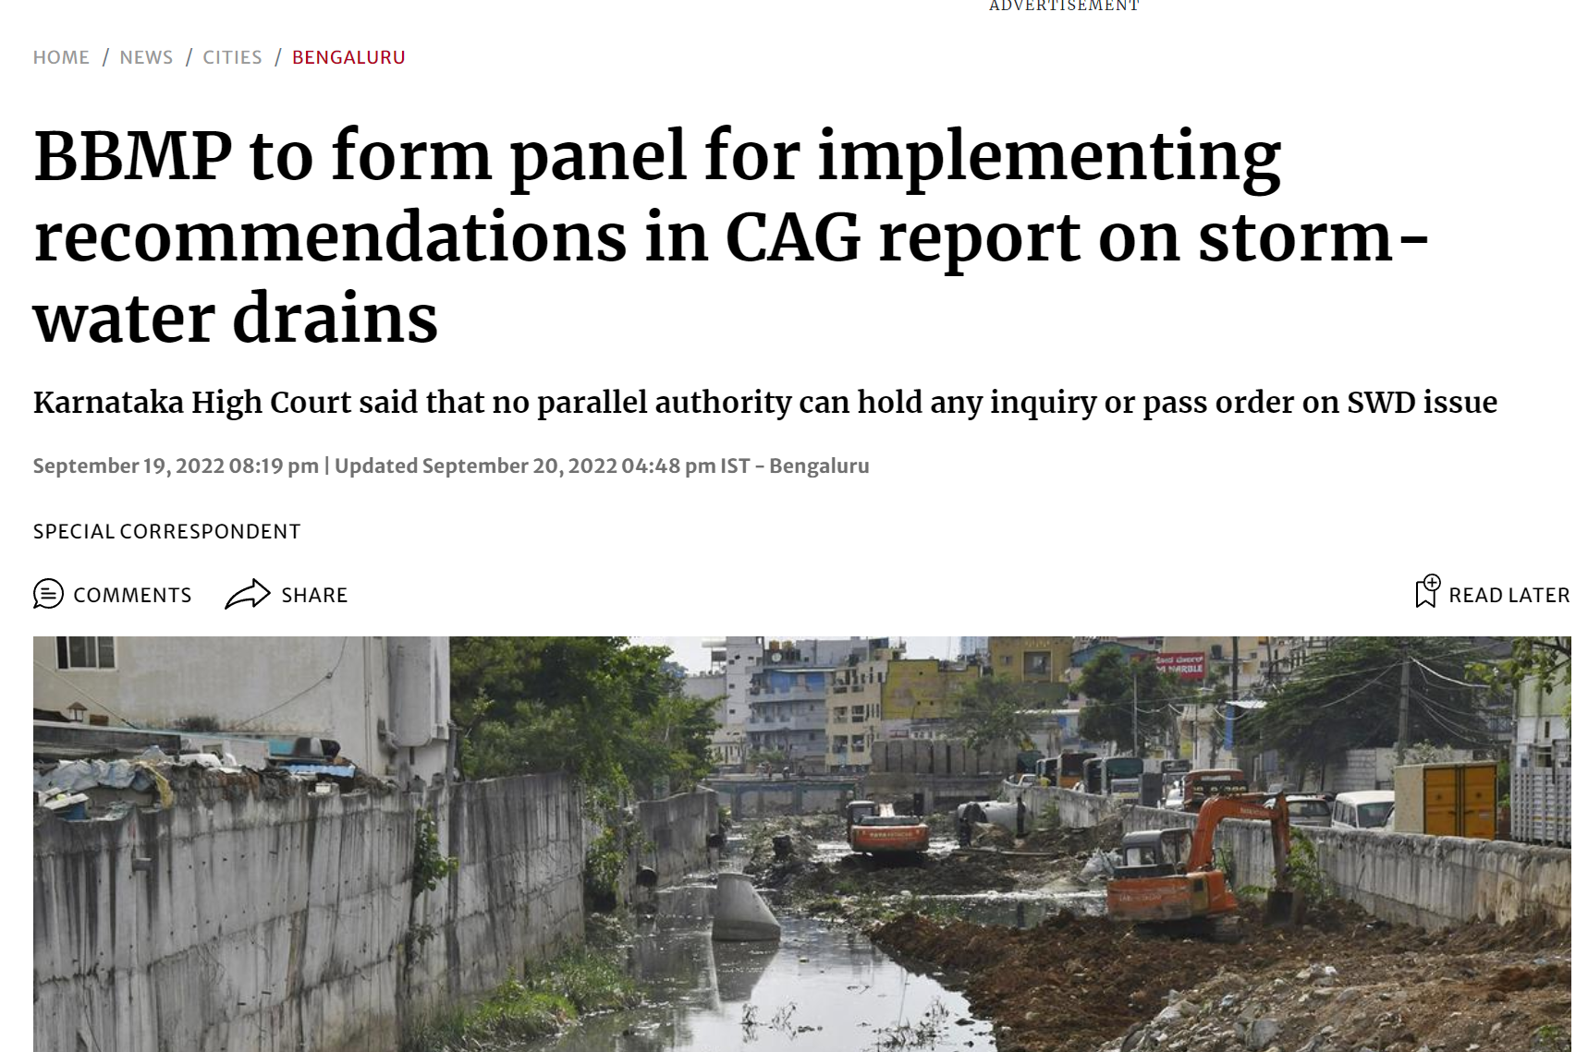
Impact of audit
The audited entity immediately initiated the following actions:
Reconciliation of databases between Bangalore Development Authority and the City's municipal corporation.
Entrusting the maintenance of storm- water drains on annual contract.

Slide 11
Use of uav in Mineral Wealth Management
3
Objective: To ascertain whether the controls of system of mineral administration were adequate and effective to facilitate revenue maximisation and sustainable mineral exploration.
Challenges faced:
Verification of compliance to the Mining Plan and the conditions in the Environmental clearance
Quantification (volume and value) of the extent of illegal mining activities carried out.
Traditional methodology of joint physical verification was insufficient to prove weaknesses in control mechanisms leading to illegal mining and determine impact.

Slide 12
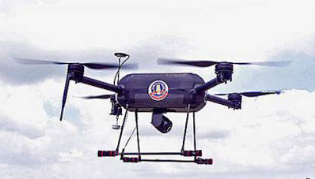
Leveraging scientific tools
Mining co-ordinates, as defined in the approved Mining Plan and those approved in the Environmental Clearance were mapped in Google Earth and respective polygons were compared.
Similarly, the Historical Timeline feature was utilized to analyze presence and movement of equipment beyond the permitted hours.
Excess Sand Mining
Fixed Wing
Quad Copter

Slide 13
Impact of audit
State government accepted the following observations:
Independent analysis of audit through UAV revealed illegal removal of limestone and granite that resulted in non-collection of royalty and cost of minerals of around $ 0.96 million.
Excess removal of granite and rough stone to the tune of around $ 70.75 million over and above the mining plan.
Executive has created a mining tenement registry (master database of geo-tagged mining)
State Government has started monitoring illegal mining activity both in leased and non-leased areas.

Slide 14
Data-led audit of GST
India has a unified indirect taxation system (GST) for taxing domestic consumption of goods & services. GST was rolled out in 2017.
C&AG has access to pan-India taxpayer data at GSTN and to back-end systems of the Tax Department.
Risk assessment based on analysis of pan India data and the results are forwarded to field offices
Data-led audit has led to
Transition from generic risk assessment at unit level to more comprehensive subject-matter risk assessment in areas such as registrations, return scrutiny/assessment etc
Online audit of fully digitized aspects of GST administration through remote access
Uniformity in auditing approach.

Slide 15
Network analysis to detect relationship among Entities (Creating network relation using R programme)
Utilizing Data analytics tools in PA
Methods adopted:
Network Analysis was done on EPCG database using R- Program.
The igraph library was used for mapping the relationship on the IEC Code using four fields i.e. APP_TELE_211, APP_EMAIL_211, EXPO_PAN_211 and EXP_ACNO_211

Slide 16
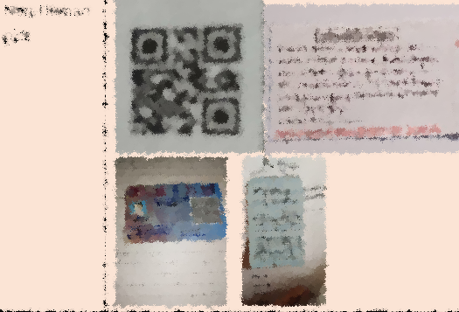
Image Analytics
GoI program for promotion of digital literacy.
Data of sampled training centers taken up for image analysis.
Various python libraries such as opencv-python, pillow, face-recognition, dlib etc. were used for image analytics to detect
Duplicate images
Non-human images
Matching/same face in different images

Slide 17
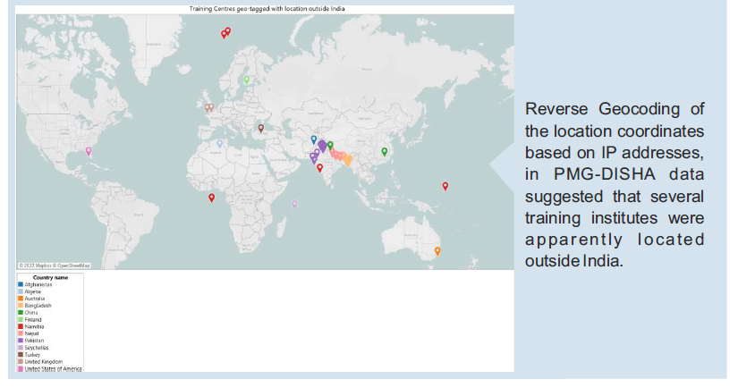
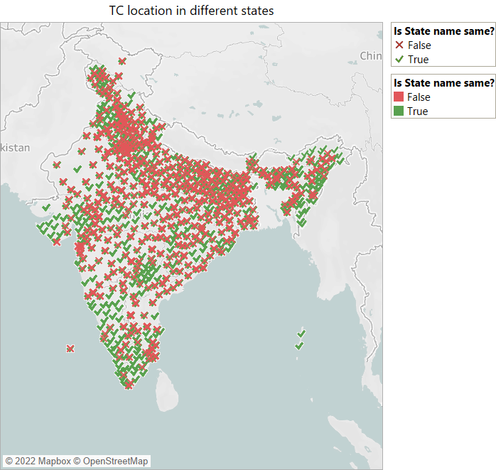
Reverse geocoding

Slide 18
Significance of remote and data-led audit
Overcomes challenges faced in traditional methodologies and approach.
Improves efficiency of audit (required manpower, cost and time).
Provides better audit assurance.
Facilitates in giving specific and implementable recommendations.
Helps us to lead by example, in encouraging adoption of technology by the auditee, in control mechanisms and impact assessments.

Slide 19
Thank you

