Slide 1
Real time audit on flood relief and Government’s readiness to manage disasters
PAS 2023

Slide 2
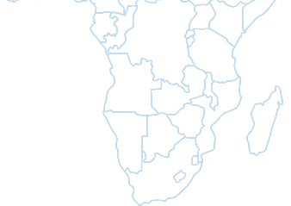
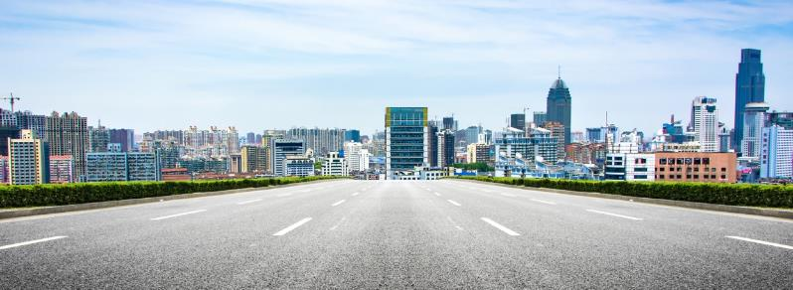
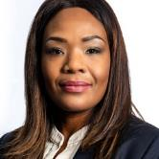
MISSION AND VISION
VISION
To be recognised by all our stakeholders as a relevant supreme audit institution that enhances public sector accountability
MISSION
The Auditor-General of South Africa has a constitutional mandate and, as the supreme audit institution of South Africa, exists to strengthen our country’s democracy by enabling oversight, accountability and governance in the public sector through auditing, thereby building public confidence

Slide 3
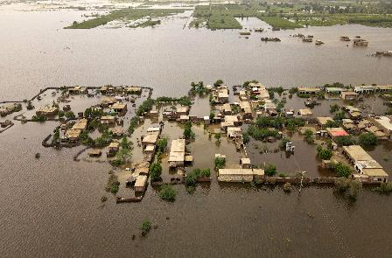
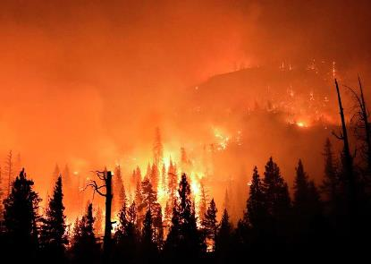
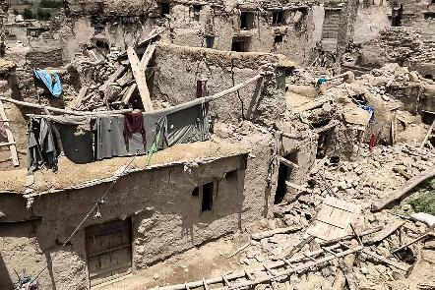
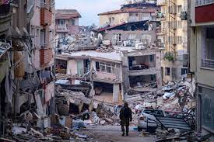
Disasters around the world
Disasters have become an unavoidable part of everyday life. In 2022, the world witnessed disasters, such as:
Record-breaking flooding in Pakistan between June and October, washing away thousands of homes and taking the lives of more than 1 700 people
Mass wildfires in California between January and October, damaging more than 100 structures and destroying 772.
Earthquake in Afghanistan killed around 1 000 people
More recently in 2023, an earthquake struck Turkey and Syria, in February, killing more than 46 000 people and leaving at least a million people homeless.
Performance Auditing business unit

Slide 4
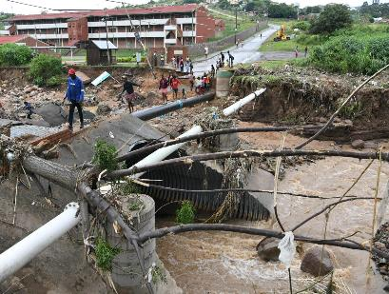
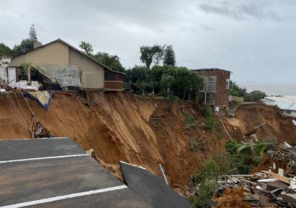
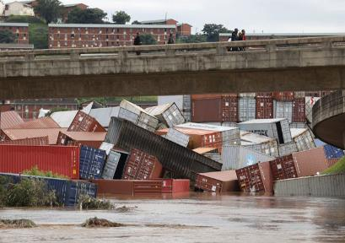
Disasters in South Africa
South Africa is also subject to natural disasters:
In April 2022, extreme weather conditions caused unprecedented downpours across the country.
This had a devastating impact, especially on the poorest of the poor.
  At least 435 people died across KwaZulu-Natal
  several thousand homes were damaged and destroyed.
  These disasters occurring in South Africa impact significantly the living conditions and livelihoods of the most vulnerable people who are poverty-stricken and/or living in informal settlements. It further has a negative impact on the economy and the social environment of citizens
  The floods caused more than R17 billion (+/- $1billion) in infrastructure damage and a national state of disaster was declared by government.
Performance Auditing business unit

Slide 5
SAI South Africa’s (AGSA) response
Interventions announced by the President followed a phased approach, focusing on
  immediate humanitarian relief,
  stabilisation and recovery (incl. rehousing people who have lost homes and restoring services), and
  reconstruction and rehabilitation.
The President further requested AGSA to perform a real-time audit on the flood relief funds
  to contribute towards preventing financial loss, the misuse of funds, non- or poor delivery as well as to detect and report on any findings and risks identified – ultimately ensuring that value for money was derived from government spending.
In response, the AGSA launched a real-time audit, a multi-disciplinary team was established to ensure that the audit could focus impact fully on the reality of the citizens experiences during this trying time.
  our first special report on flood relief funds, focused on what we have found and what needs to be done, on the immediate and short-term initiatives that government has implemented.
  impactful CSO engagement with the communities and AGSA
Performance Auditing business unit

Slide 6

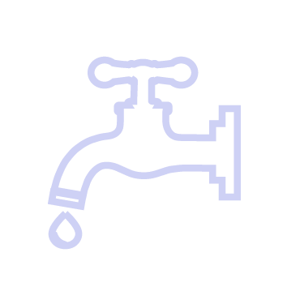


AGSA response (Scoping)
In conducting the real-time audit of the funds that government has made available to provide much needed relief to communities in flood-ravaged areas, we audited the processes as they unfolded and communicated risks and findings identified without delay so that prompt action could be taken to implement corrective actions
Provision of mobile classrooms and kitchens to severely damaged schools in KZN
Provision of temporary residential units for KZN residents who lost their homes in the flood
Water tankering services in eThekwini Metro were damaged to water infrastructure affected water supply
Repairs to government properties
Social relief efforts in KwaZulu-Natal and Eastern Cape
Performance Auditing business unit

Slide 7
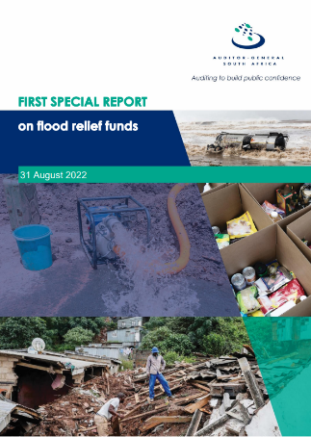
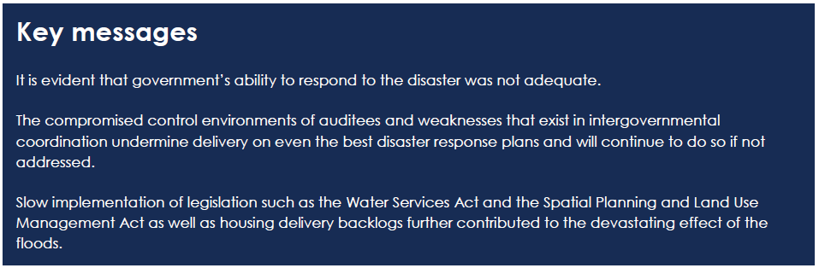
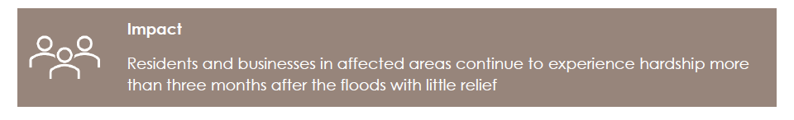
AGSA response (As per tabled Special Report 1)
What we found:
Performance Auditing business unit

Slide 8

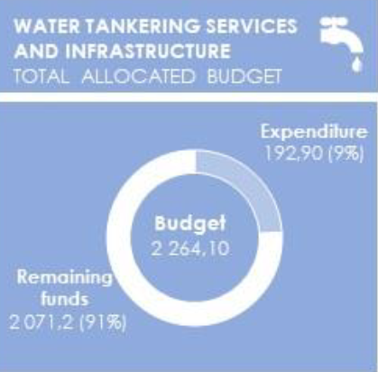
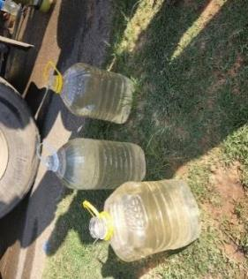
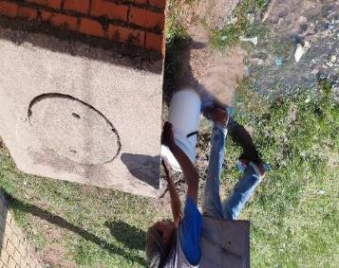
Findings on emergency provision of water
At a Metro, we identified that the water provided was insufficient to meet the demands of citizens as per the legislative requirements. Some areas had gone up to 45 days without a water tanker visiting the area, while in another instance water which was discoloured (brown) was provided to communities.
An overflowing manhole used as a source of water
Dirty water provided by a water tanker
Performance Auditing business unit

Slide 9
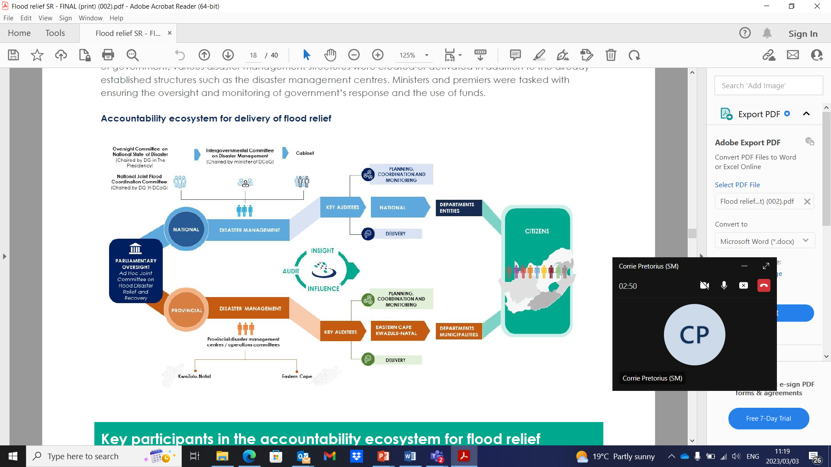
STRATEGY 2030: making a difference in the lives of our people
- a culture of accountability will improve service delivery
Accountability ecosystem for delivery of flood relief
Performance Auditing business unit

Slide 10
Envisaged audit on government’s preparedness for disaster
Prevent or reduce risk of disaster
Mitigate severity or consequences of disaster
Emergency preparedness
Response (rapid and effective)
Post-disaster recovery and rehabilitation
Efforts, including development aimed at creating a situation where-
(a) normality in conditions caused by aa disaster is restored;
(b) the effects of a disaster are mitigated; or
(c) circumstances are created that will reduce the risk of a similar disaster
Measures aimed at stopping a disaster from occurring or preventing an occurrence from becoming a disaster
Focus of audit: disaster preparedness and mitigation are largely a developmental activity, which, through sustained initiatives, minimizes the likelihood of a disastrous occurrence by reducing either
the intensity of external threats (hazards) or
the vulnerability of those at risk.
Measures taken during or immediately after a disaster in order to bring relief to people and communities affected by the disaster
Measures aimed at reducing the impact or effects of a disaster
Disaster
A state of readiness which enables organs of state and other institutions involved in disaster management, the private sector, communities and individuals to mobilise, organise, and provide relief measures to deal with an impending or current disaster or the effects of a disaster

Slide 11
Points for discussion
What can a SAI do to ensure that Government is ready to deal with disasters in an economic, efficient and effective manner?
How should the audit be structured?
What international best practice can be shared in this regard?
How can citizens and civil society organisations (CSO) be engaged during this type of audit?
How can active citizenry contribute to increased readiness to deal with disasters?
Performance Auditing business unit

