Slide 1


Data Visualization:
Storytelling in the Oversight Community
March 2023

Slide 2




OUTLINE
Why does data visualization matter?
1
2
Gathering data and identifying visual opportunities
3
Turning information into knowledge
4
Sharing wisdom

Slide 3



PART 1
Why does data visualization matter?

Slide 4





WHY DOES DATA VISUALIZATION MATTER?
What is it?
The practice of translating information into a visual, such as a map or data graphic, to make information easier for the human brain to understand.

Slide 5
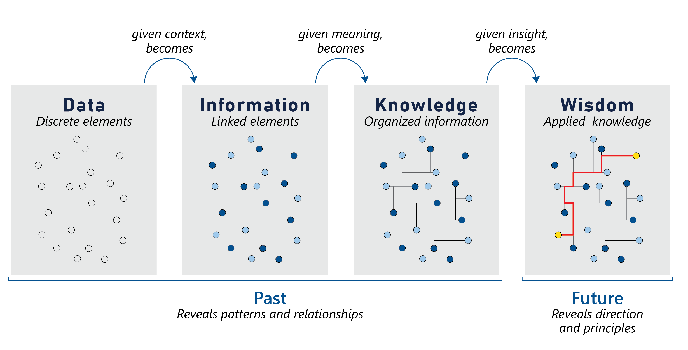
WHY DOES DATA VISUALIZATION MATTER?
Data visualization process

Slide 6
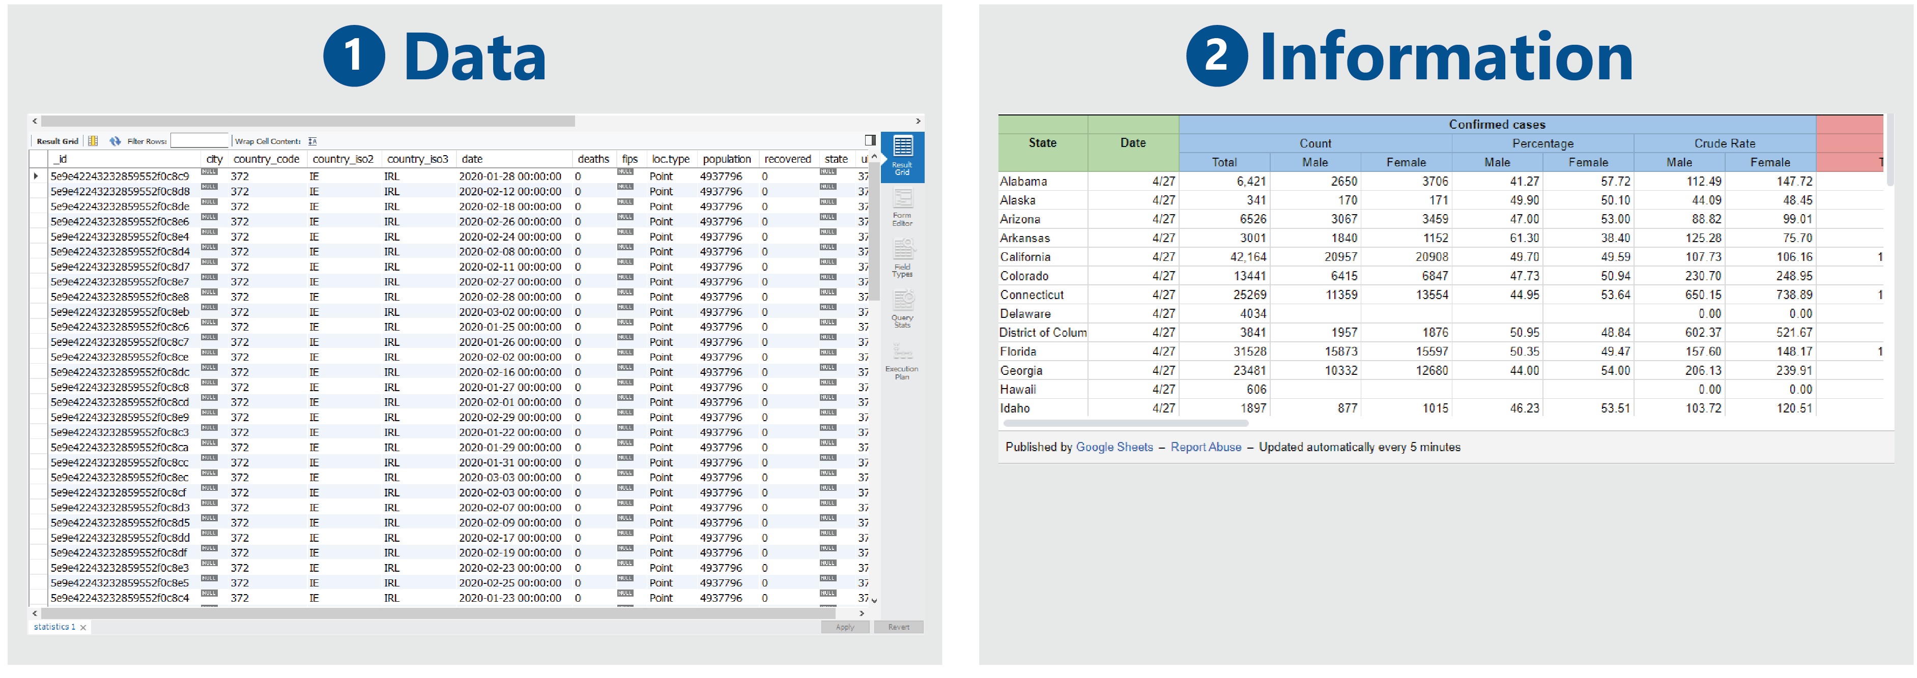
WHY DOES DATA VISUALIZATION MATTER?
Case study: Seeing the spread of COVID-19

Slide 7
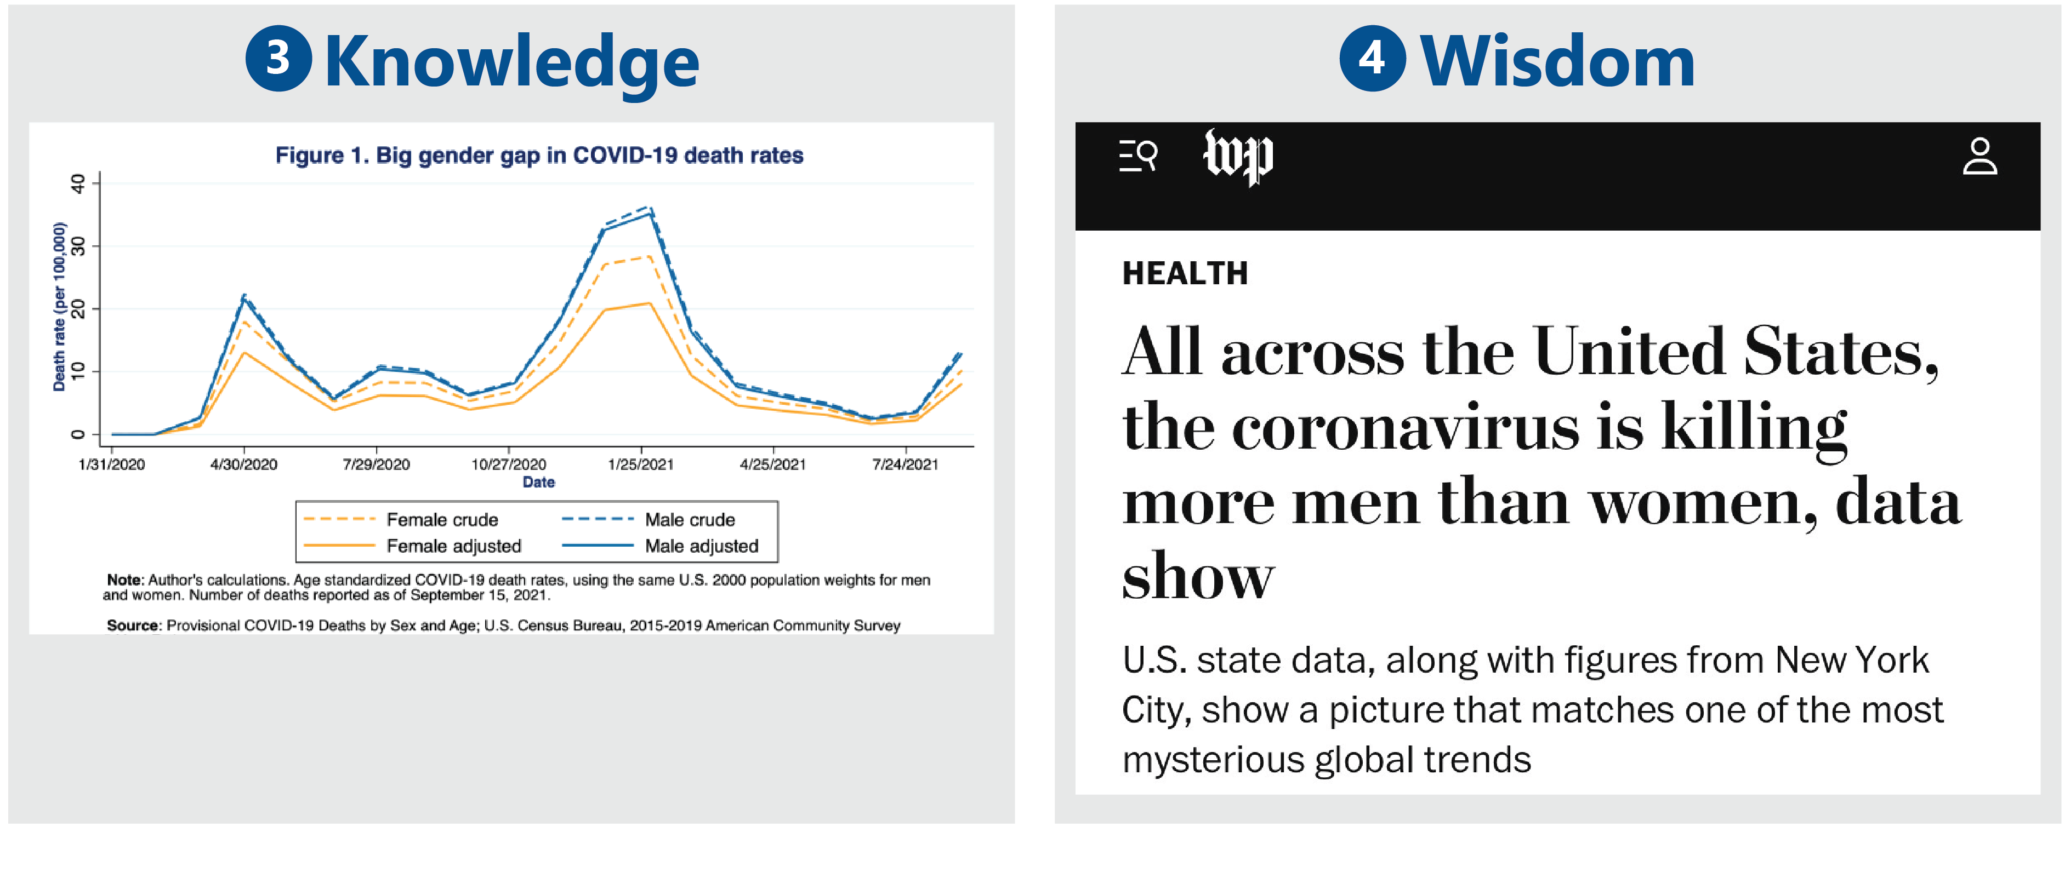
WHY DOES DATA VISUALIZATION MATTER?
Case study: Seeing the spread of COVID-19

Slide 8

PART 2
GATHERING DATA AND IDENTIFYING VISUAL OPPORTUNITIES

Slide 9
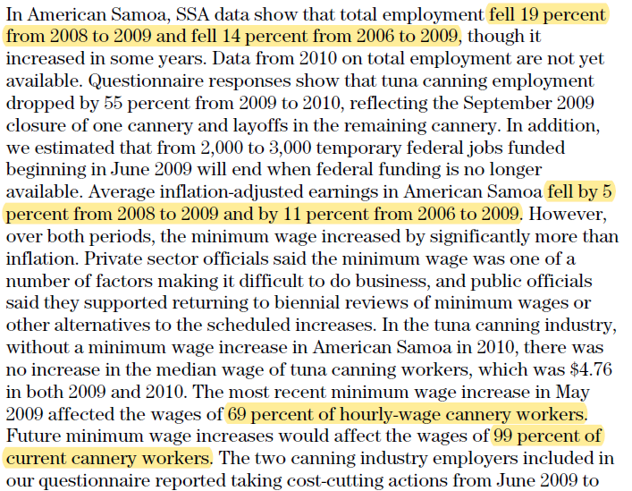
IDENTIFYING VISUAL OPPORTUNITIES
Information is causing confusion
Datasets are too large
and unwieldy
Writers are struggling
Reviewers have critical questions

Slide 10
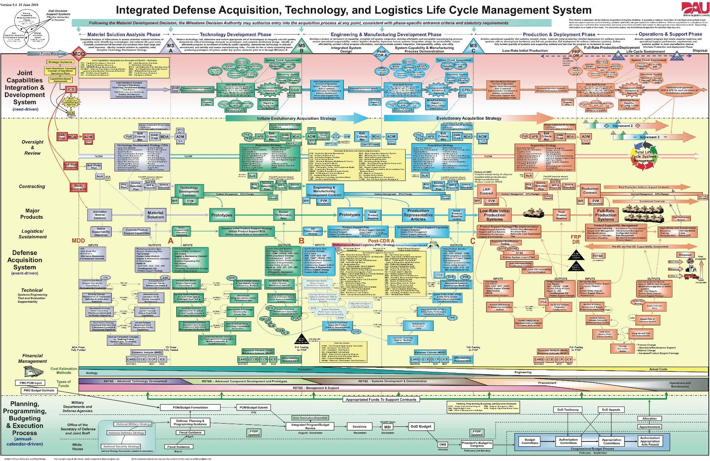
IDENTIFYING VISUAL OPPORTUNITIES
Information shows non-linear relationships
Numerical information
Geographic information
Spatial information
Organizational or relationship information

Slide 11
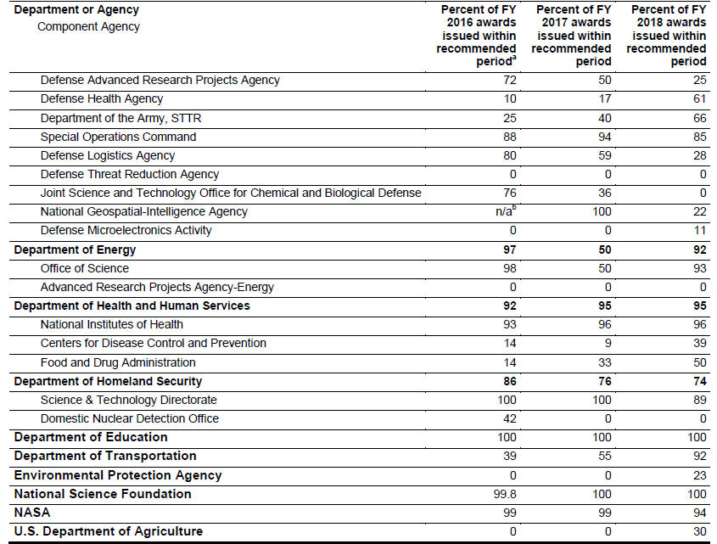
IDENTIFYING VISUAL OPPORTUNITIES
Information shows patterns or trends
Upward or downward movement
Year-over-year data
Key metrics

Slide 12

PART 3
TURNING INFORMATION
INTO KNOWLEDGE

Slide 13
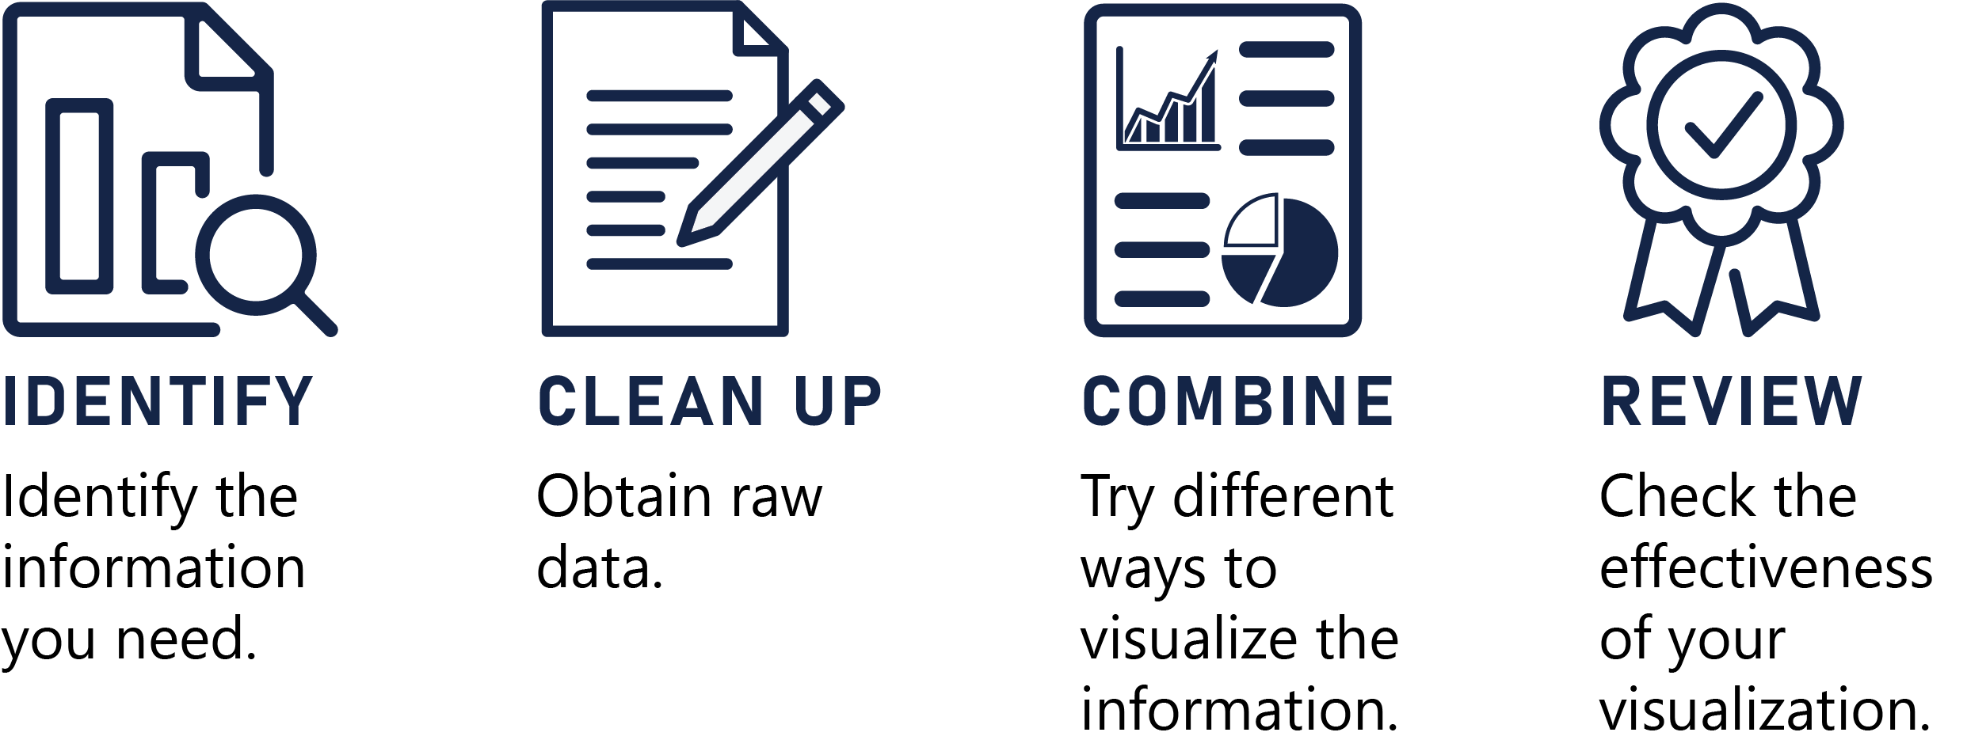
TURNING INFORMATION INTO KNOWLEDGE
Information validation and transformation

Slide 14
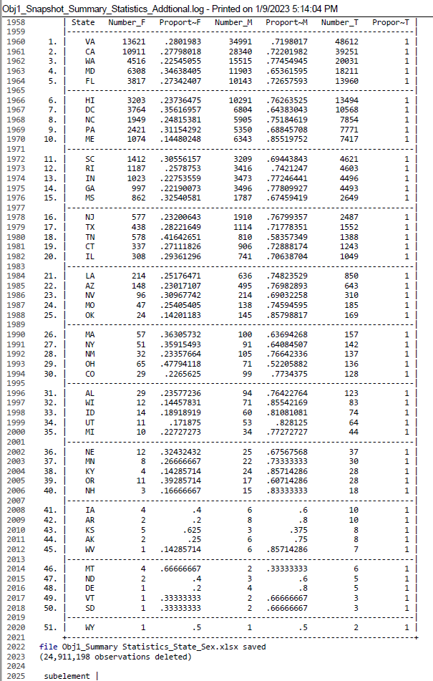
TURNING INFORMATION INTO KNOWLEDGE
Case study: Identify

Slide 15
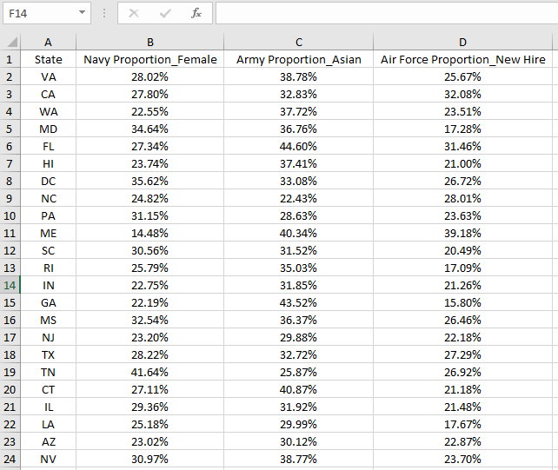
TURNING INFORMATION INTO KNOWLEDGE
Case study: Clean up

Slide 16
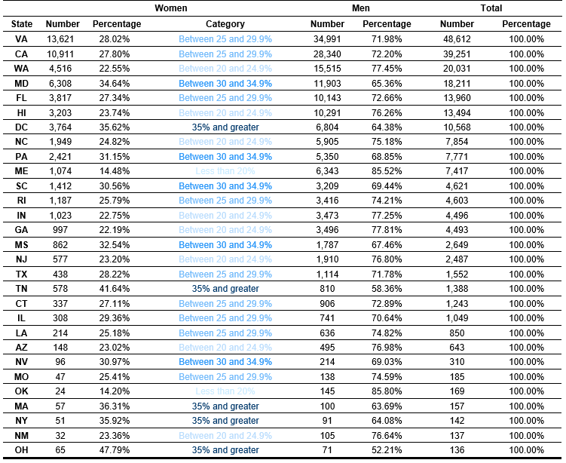
TURNING INFORMATION INTO KNOWLEDGE
Case study: Combine

Slide 17
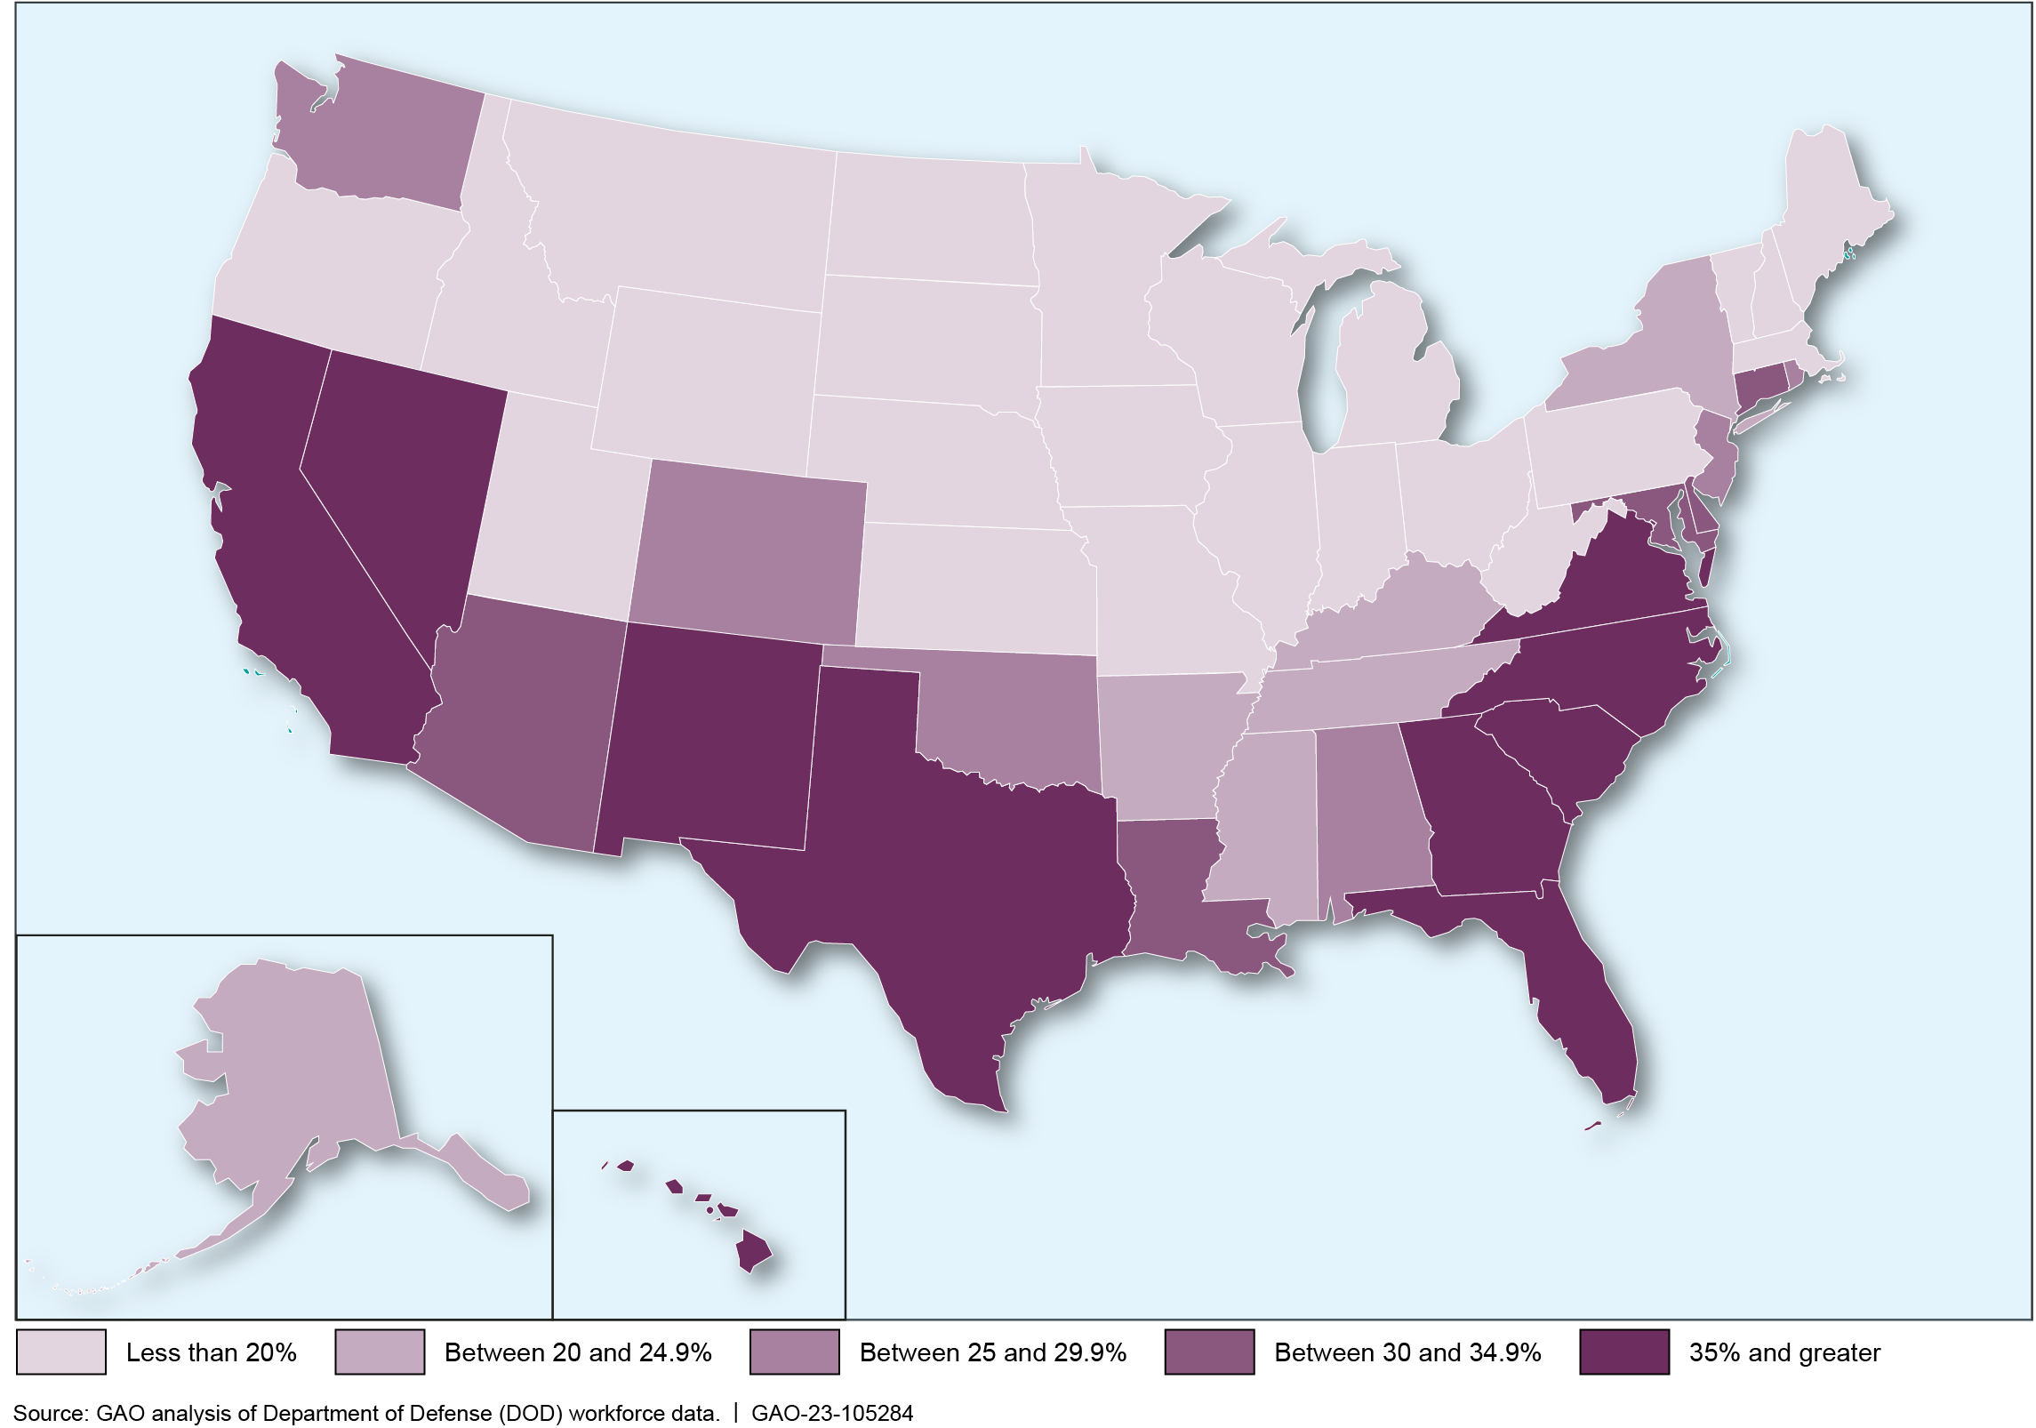
TURNING INFORMATION INTO KNOWLEDGE
Case study: Review

Slide 18
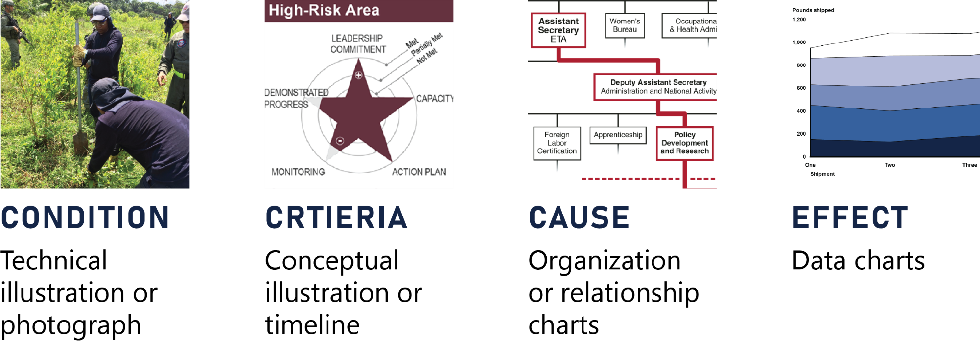
TURNING INFORMATION INTO KNOWLEDGE
What did you “find” in the data?

Slide 19
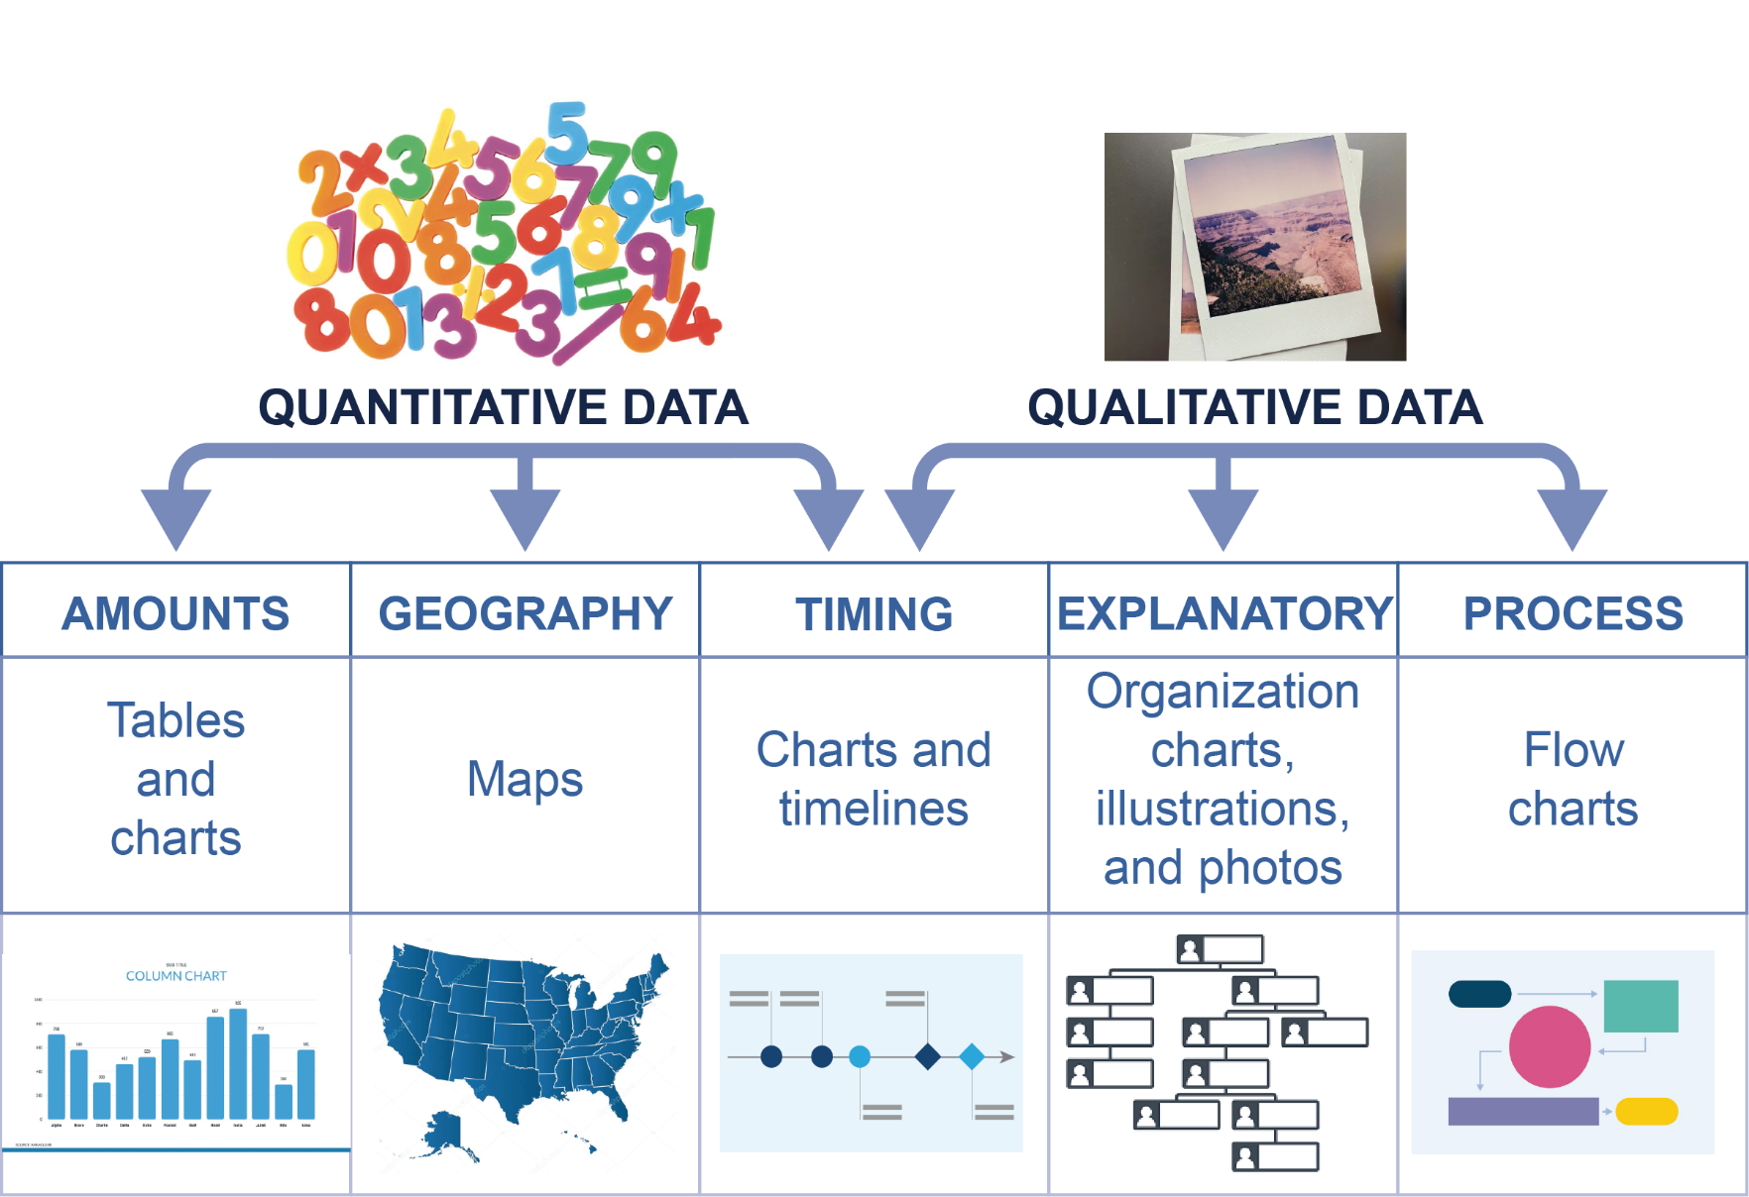
TURNING INFORMATION INTO KNOWLEDGE
Common visual types

Slide 20
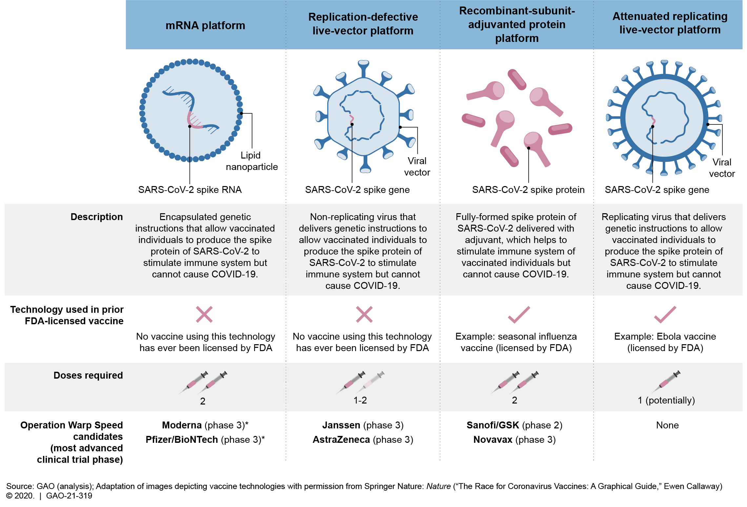
AMOUNTS: TABLES

Slide 21
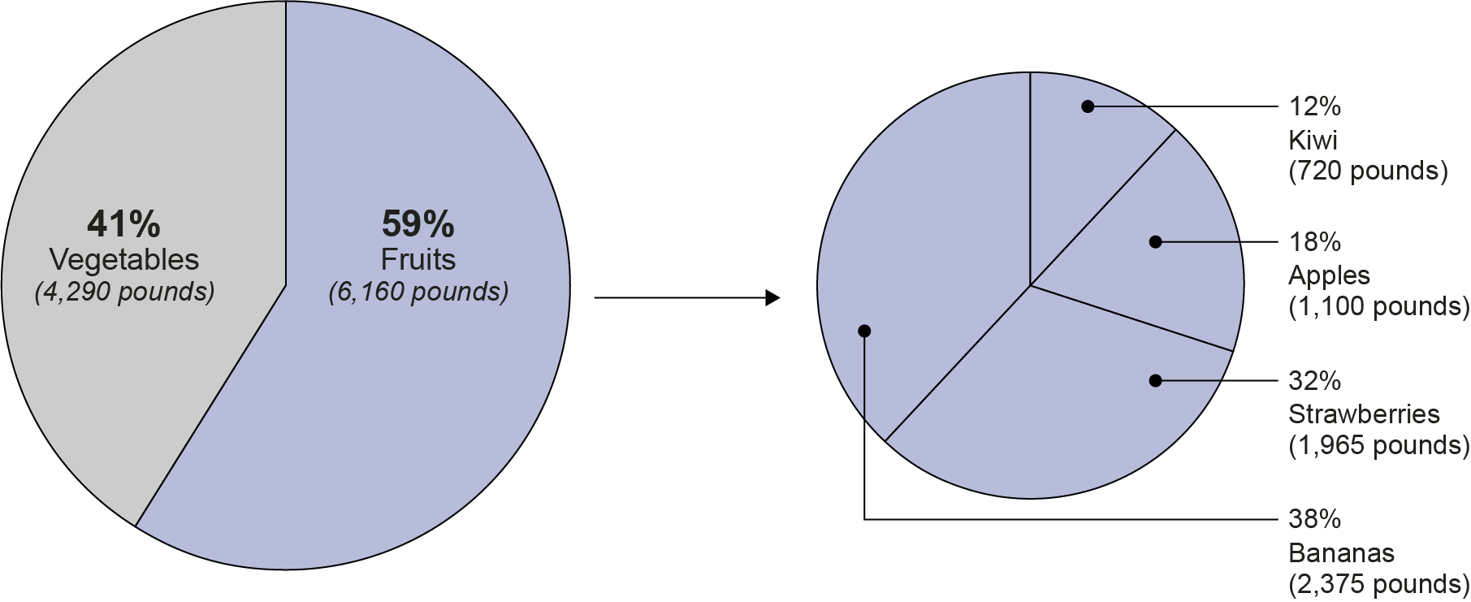
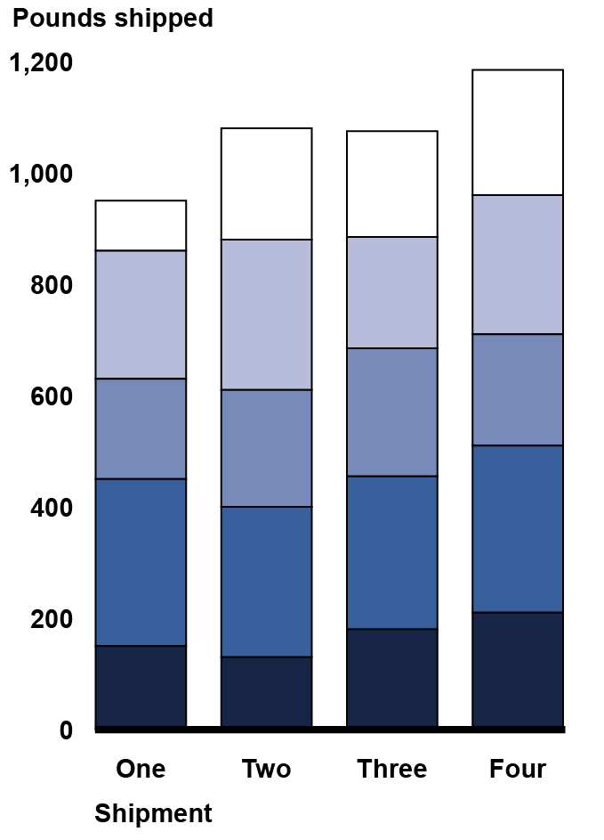
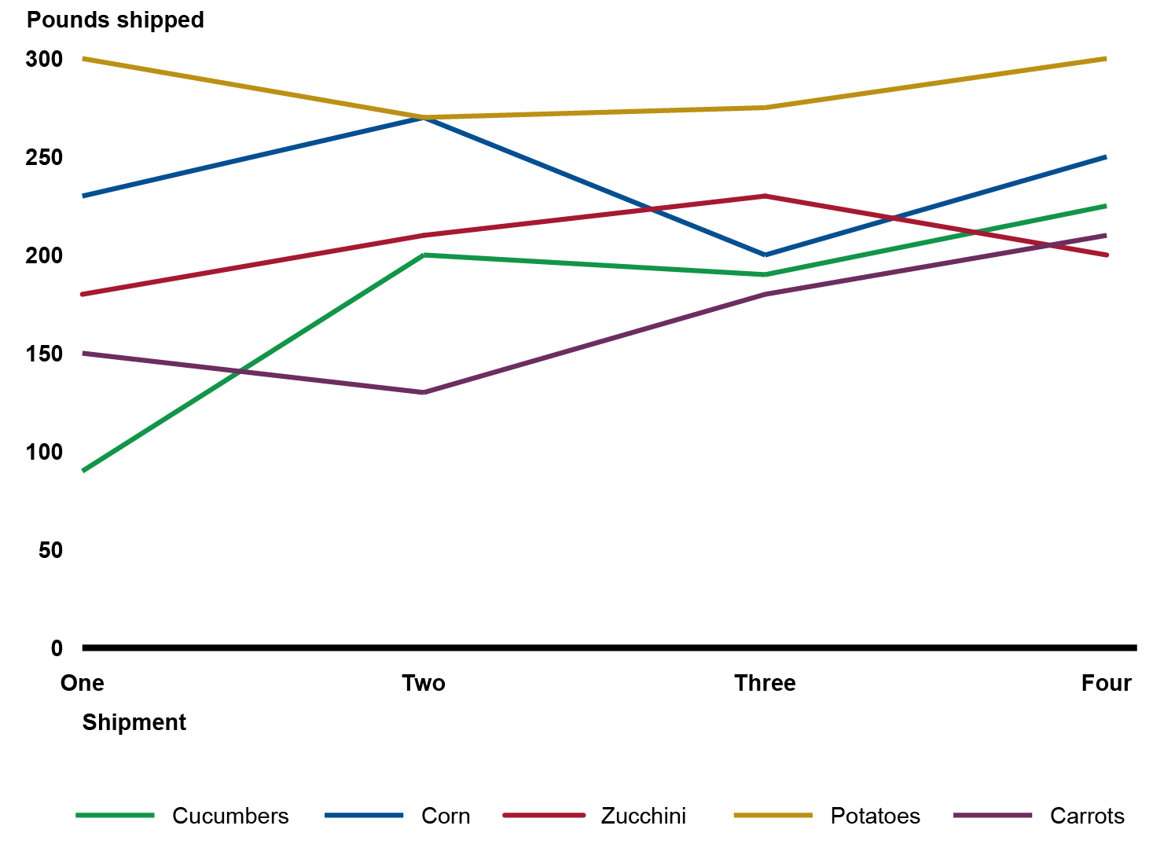
AMOUNTS: DATA CHARTS

Slide 22
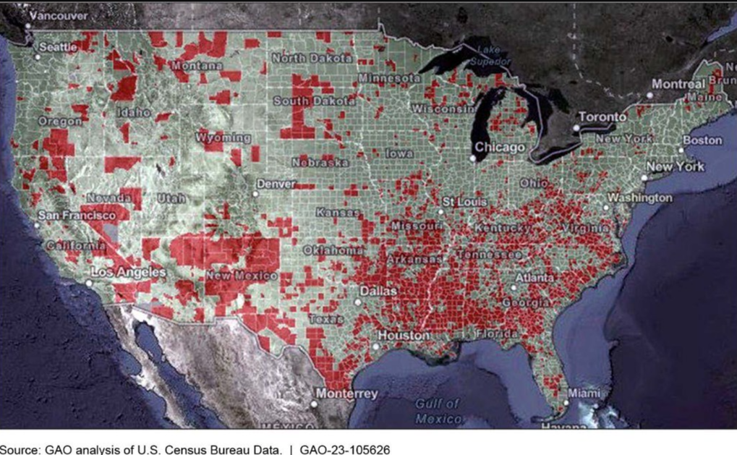
GEOGRAPHY: SCALE AND CONTEXT

Slide 23
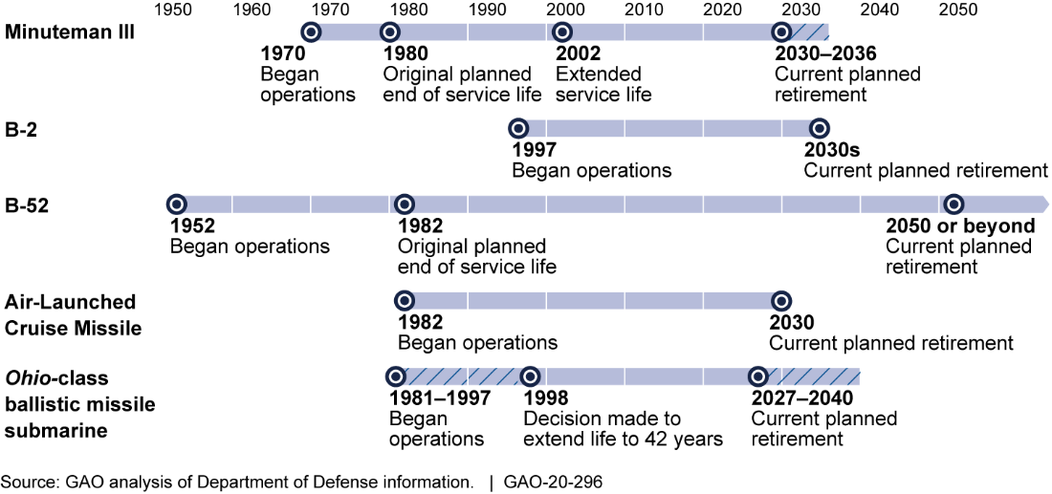
TIMING: TIMELINE

Slide 24
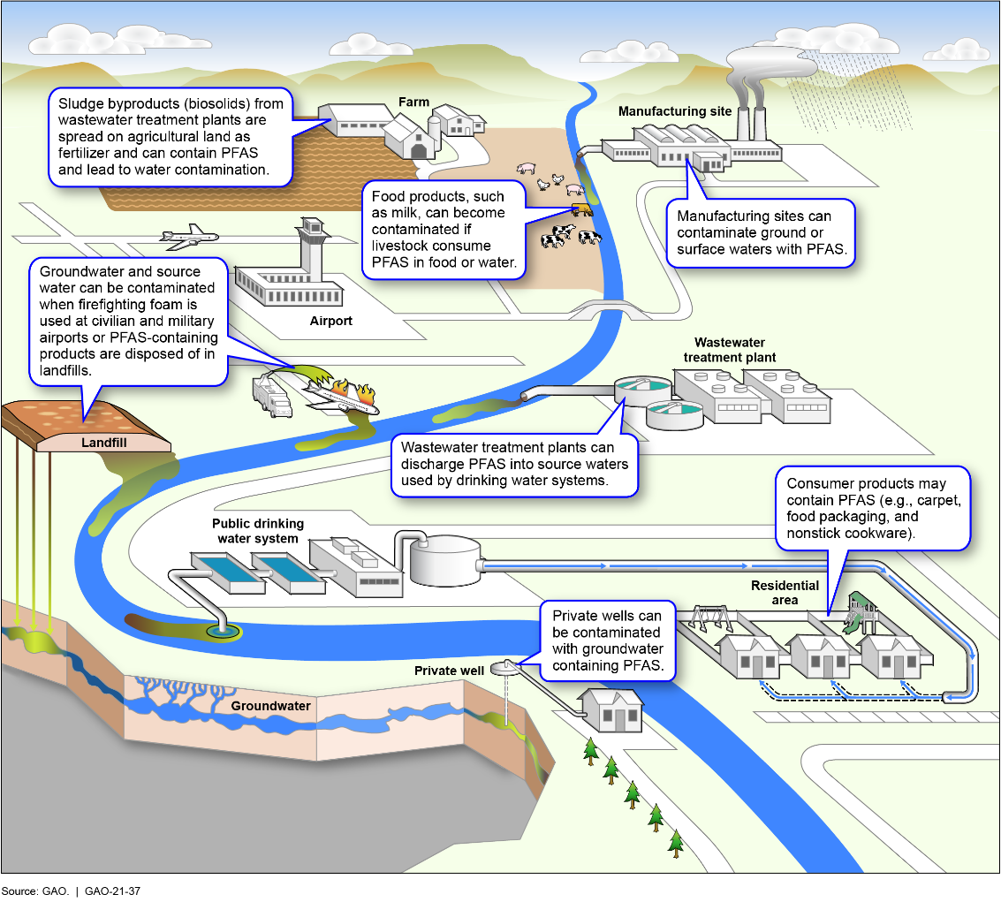
EXPLANATORY: ILLUSTRATION

Slide 25
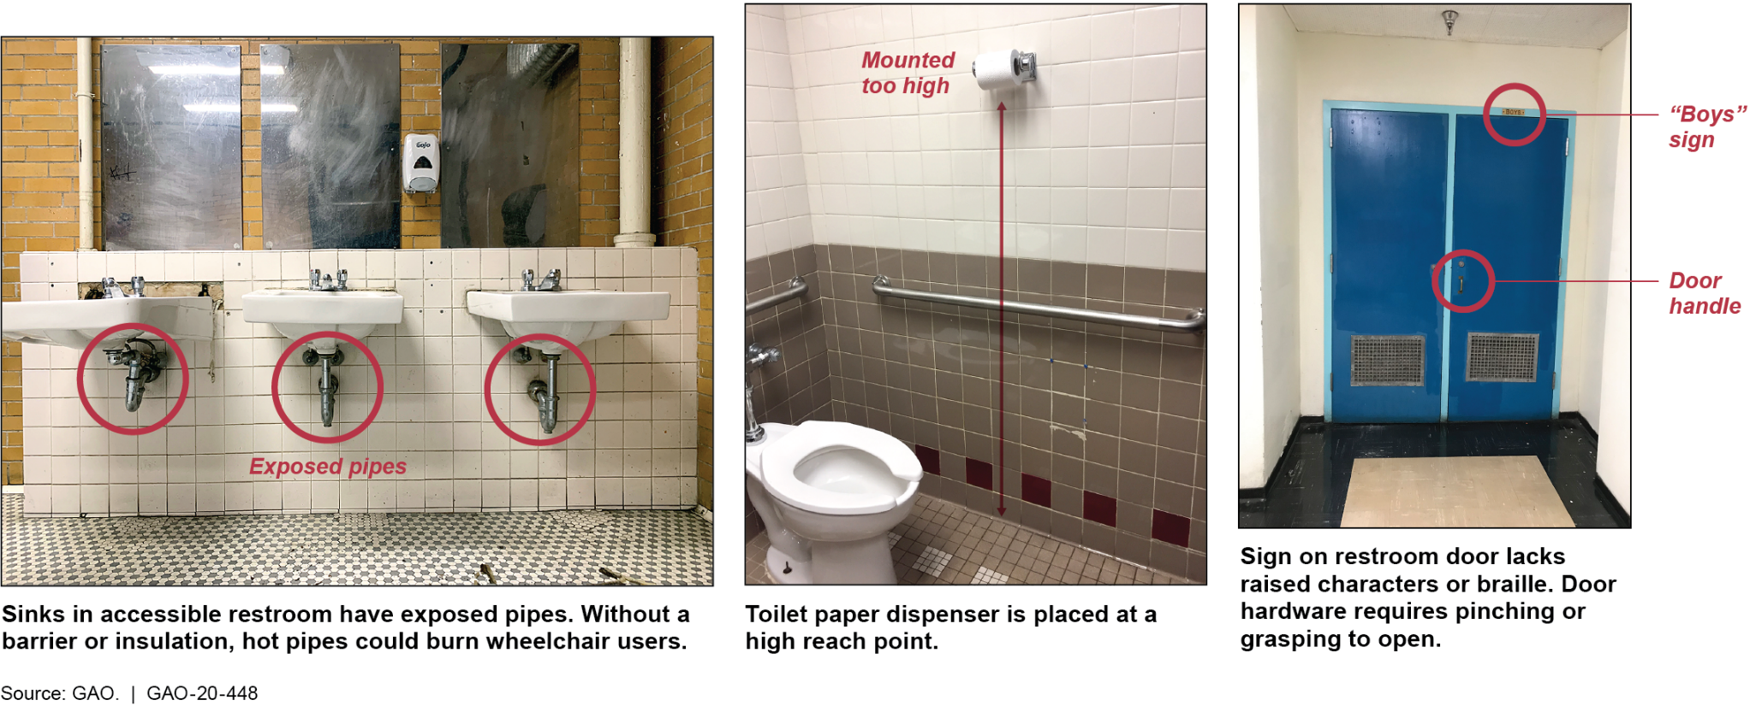
EXPLANATORY: PHOTOGRAPH

Slide 26
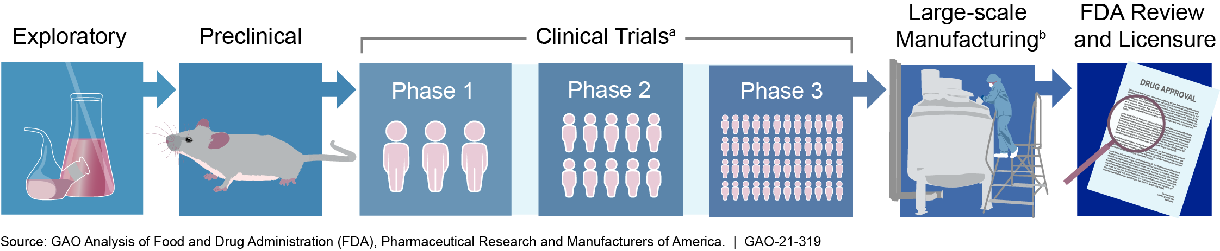
PROCESS: FLOWCHART

Slide 27
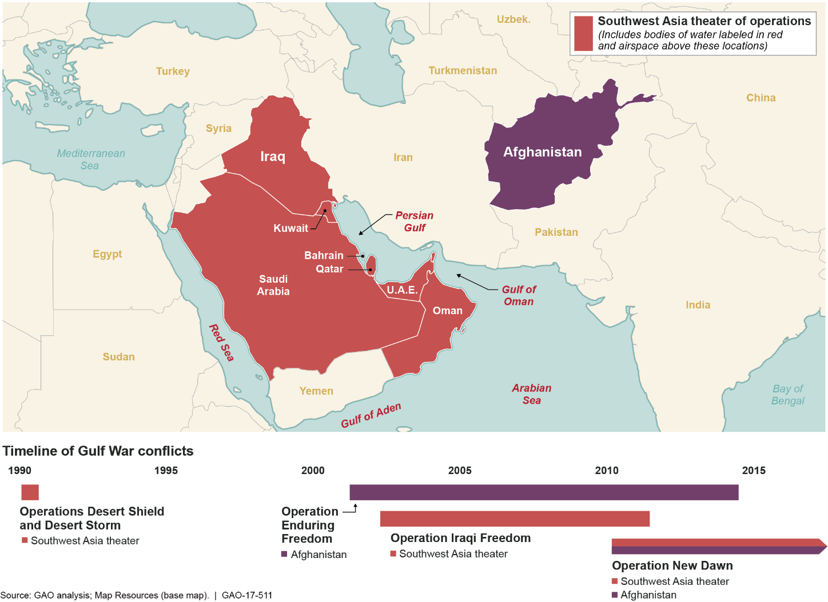
COMBINING TYPES

Slide 28
TURNING INFORMATION INTO KNOWLEDGE
Advanced visual types
Interactive graphics
Videos and animation
Visual-heavy special publications
Visual-heavy short products

Slide 29
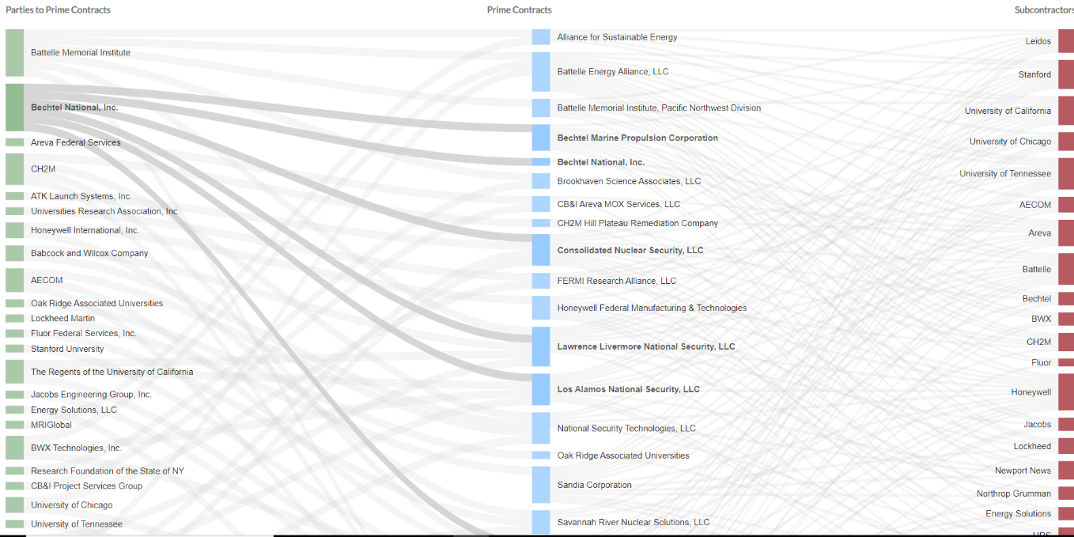
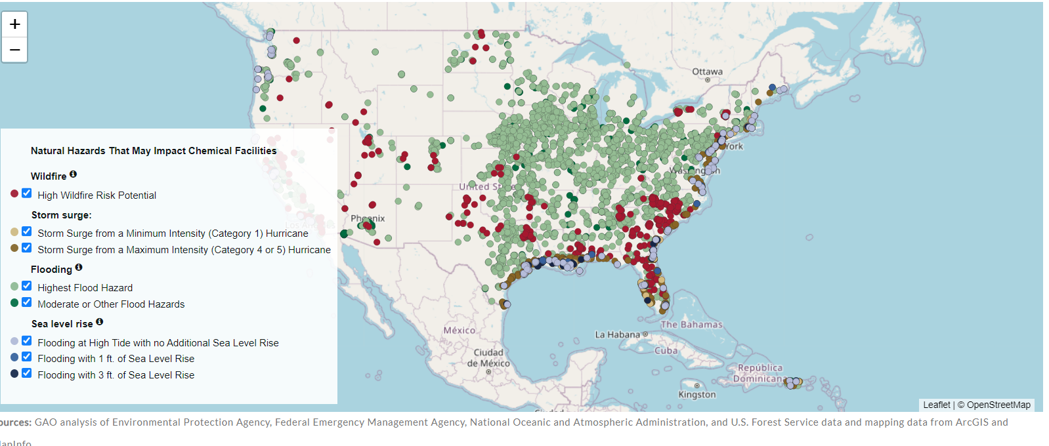
TURNING INFORMATION INTO KNOWLEDGE
Interactive graphics
Typically HTML-based
Actively engages the reader
Encourages exploration and consideration
Reveals layers or hierarchy of content
Visualizing Relationships in Department of Energy Contracting
Chemical Facilities and Climate Change

Slide 30
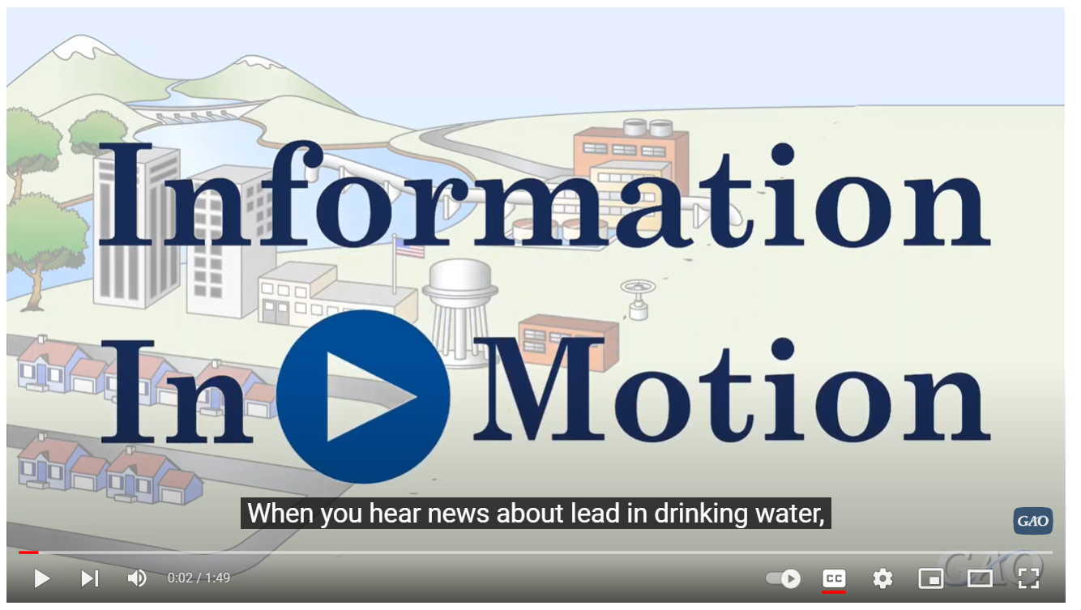
TURNING INFORMATION INTO KNOWLEDGE
Videos and animation
Immersive experience that engages multiple senses
Can control time (slow-motion, real-time, or time-lapse)
Opportunity to utilize multiple approaches or weave a story
Can make the abstract concrete
Lead in drinking water

Slide 31
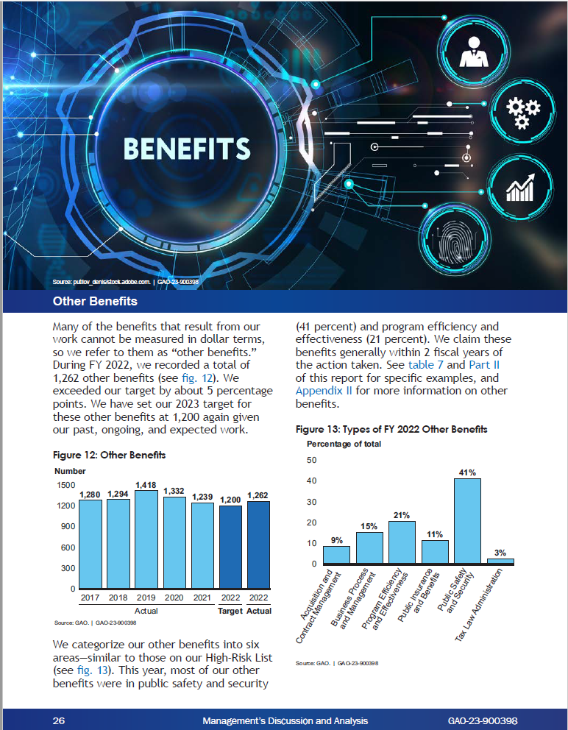
TURNING INFORMATION INTO KNOWLEDGE
Visual-heavy special publications
Unique approach to summarizing an issue or product
Re-enforces key ideas and messages

Slide 32
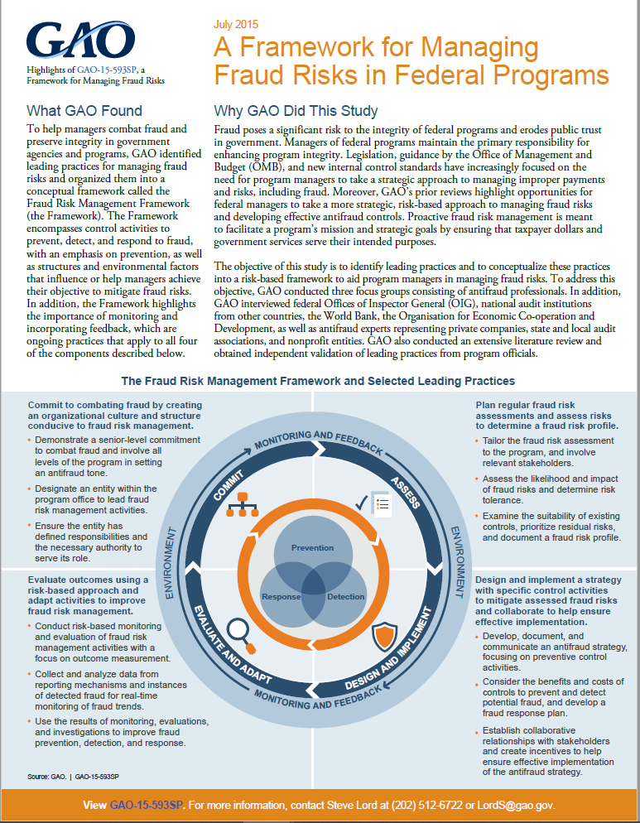
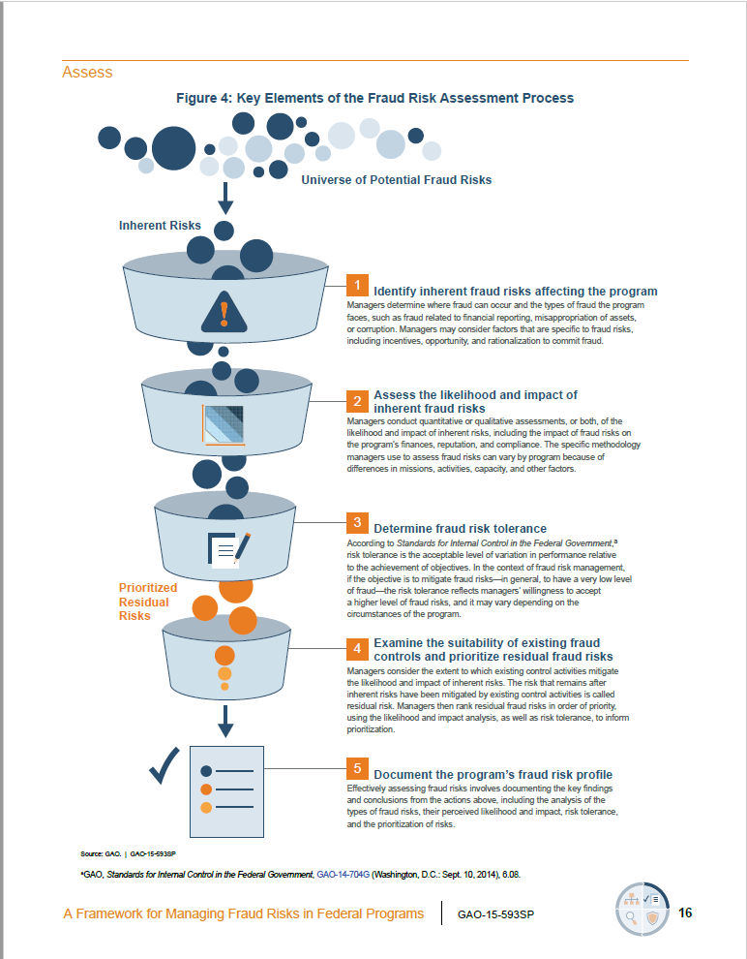
TURNING INFORMATION INTO KNOWLEDGE
Visual-heavy special publications

Slide 33
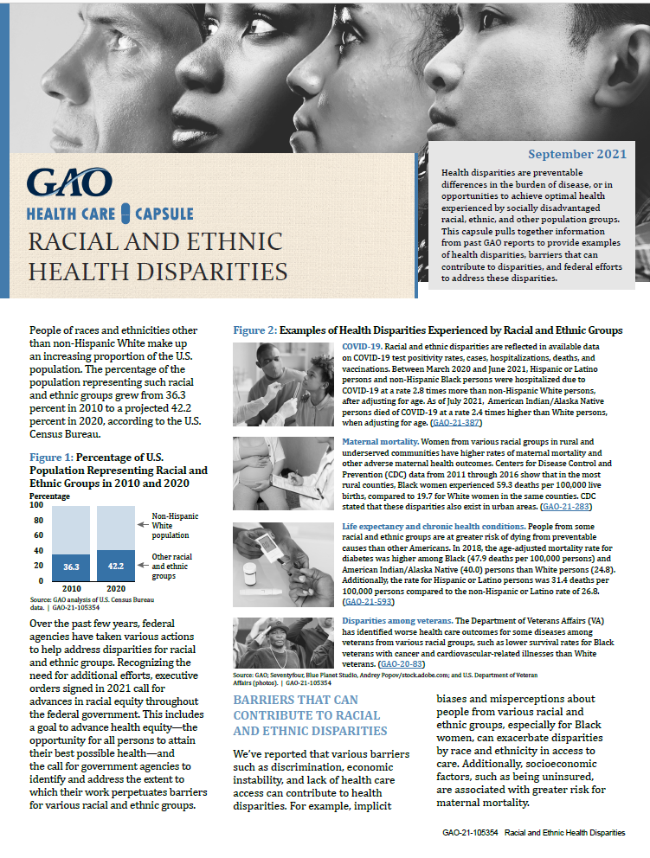
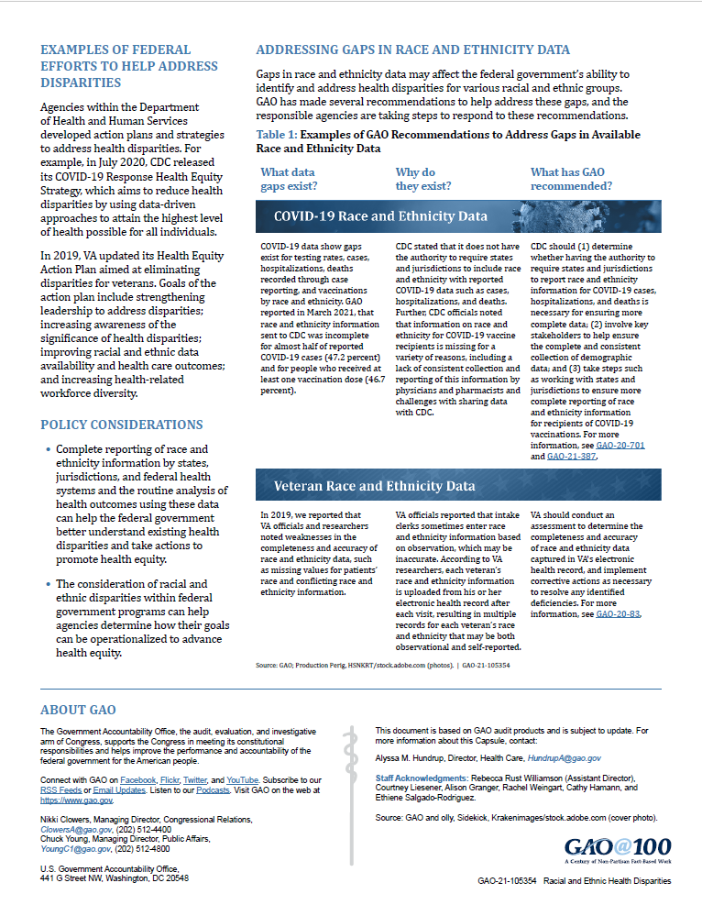
TURNING INFORMATION INTO KNOWLEDGE
Visual-heavy short products
Communicates broader messages by integrating a timely body of work into a concise, graphics-heavy product
Addresses topics of interest and brings attention to published findings and analyses

Slide 34
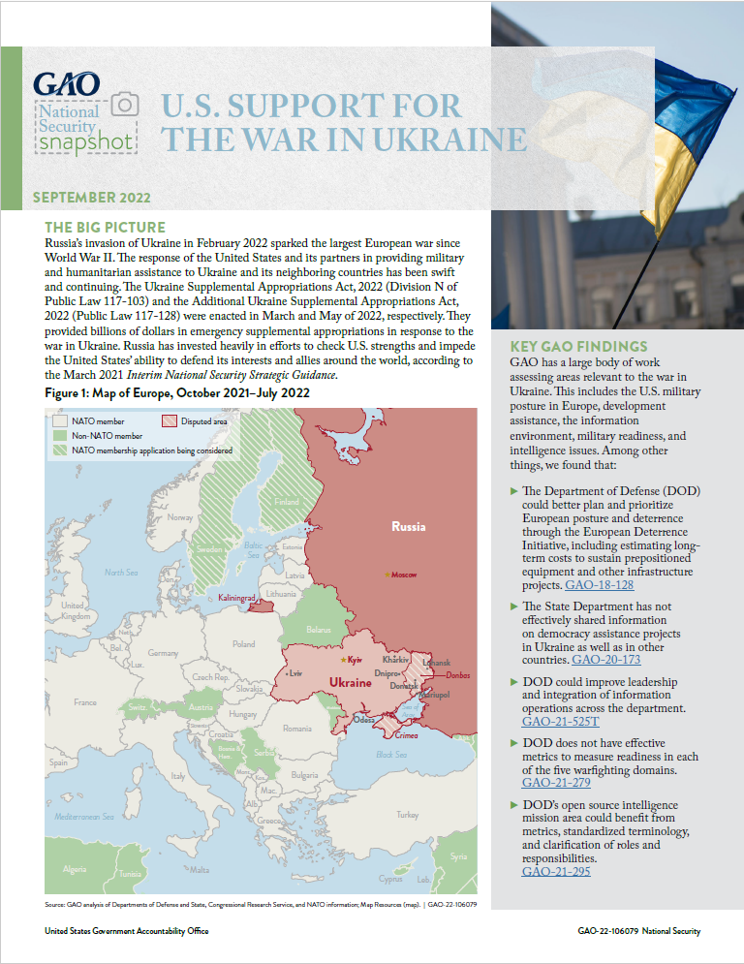
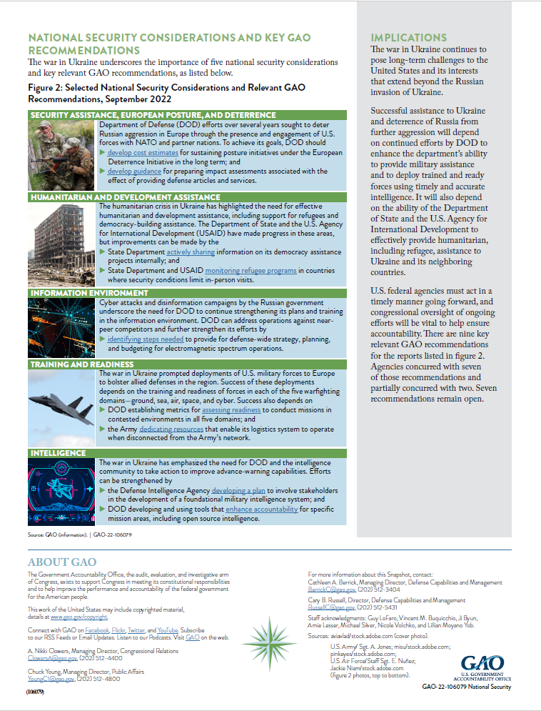
TURNING INFORMATION INTO KNOWLEDGE
Visual-heavy short products

Slide 35
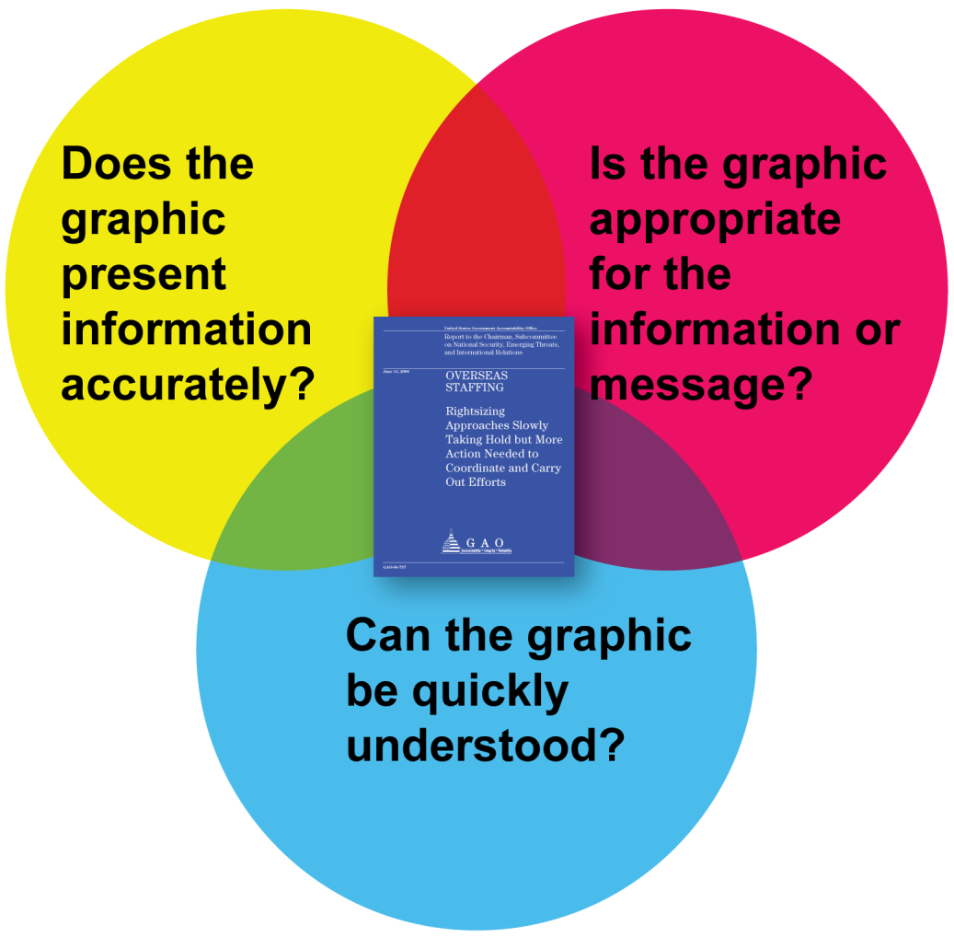
IDENTIFYING VISUAL OPPORTUNITIES
GAO’s key tenets: Accuracy
The visualization should accurately represent the data and its message.

Slide 36
IDENTIFYING VISUAL OPPORTUNITIES
GAO’s key tenets: Clarity
Your visualization should be easy to understand.
In general, GAO graphics
adhere to a strict agency-wide style guide, which specifies font,
type size, and colors;
are as simple as possible;
have white space to provide visual relief for readers;
are accessible for individuals with disabilities; and
must stand alone.

Slide 37
IDENTIFYING VISUAL OPPORTUNITIES
Tools
Adobe Creative Suite
Leaflet

Slide 38

PART 4
SHARING WISDOM

Slide 39
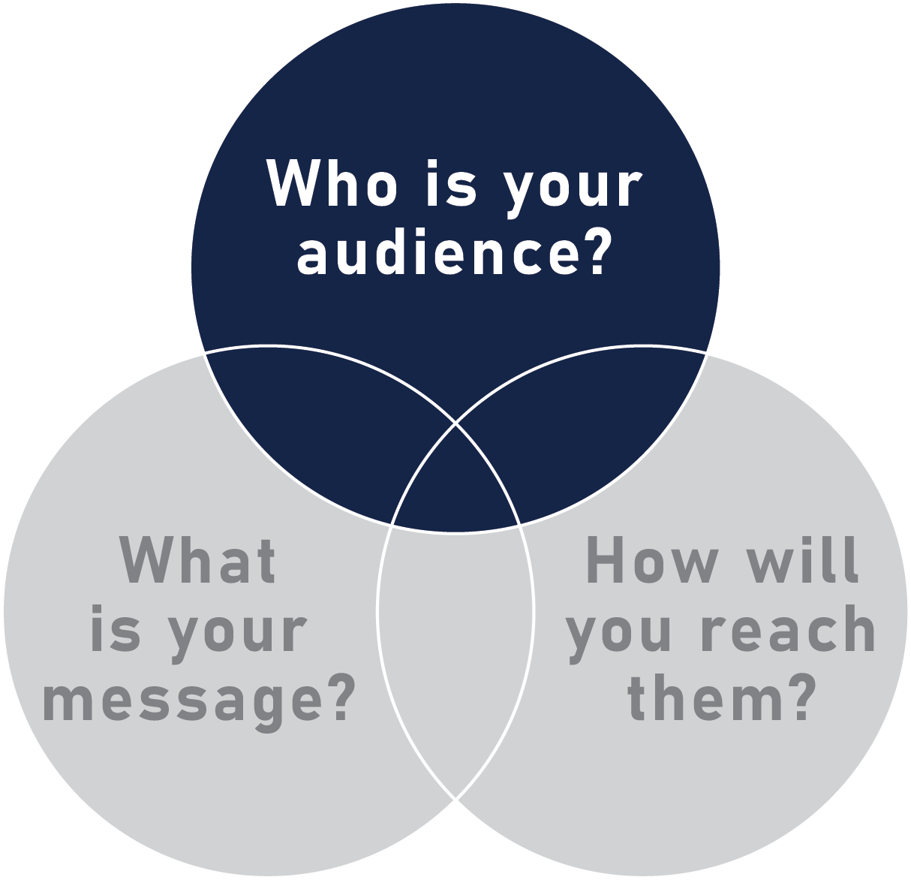
SHARING WISDOM
Know your audience
What are their needs?
What kinds of questions do they care about?

Slide 40
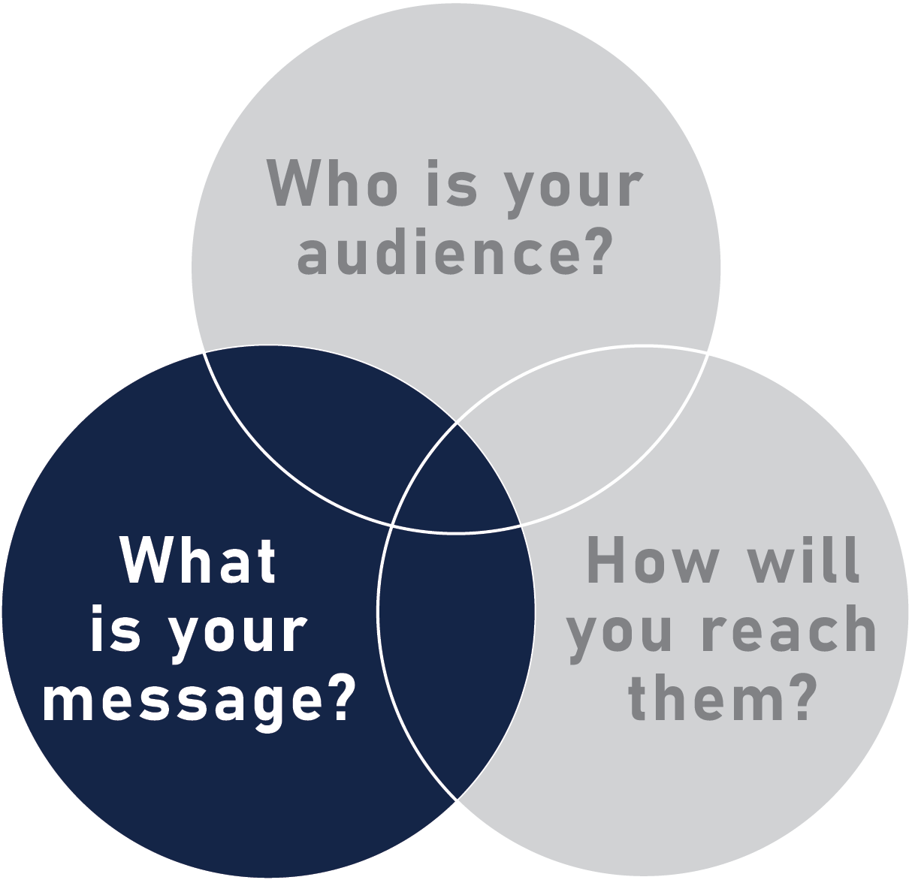
SHARING WISDOM
Know your message
Highlight key points
Avoid technical jargon
Keep it simple

Slide 41
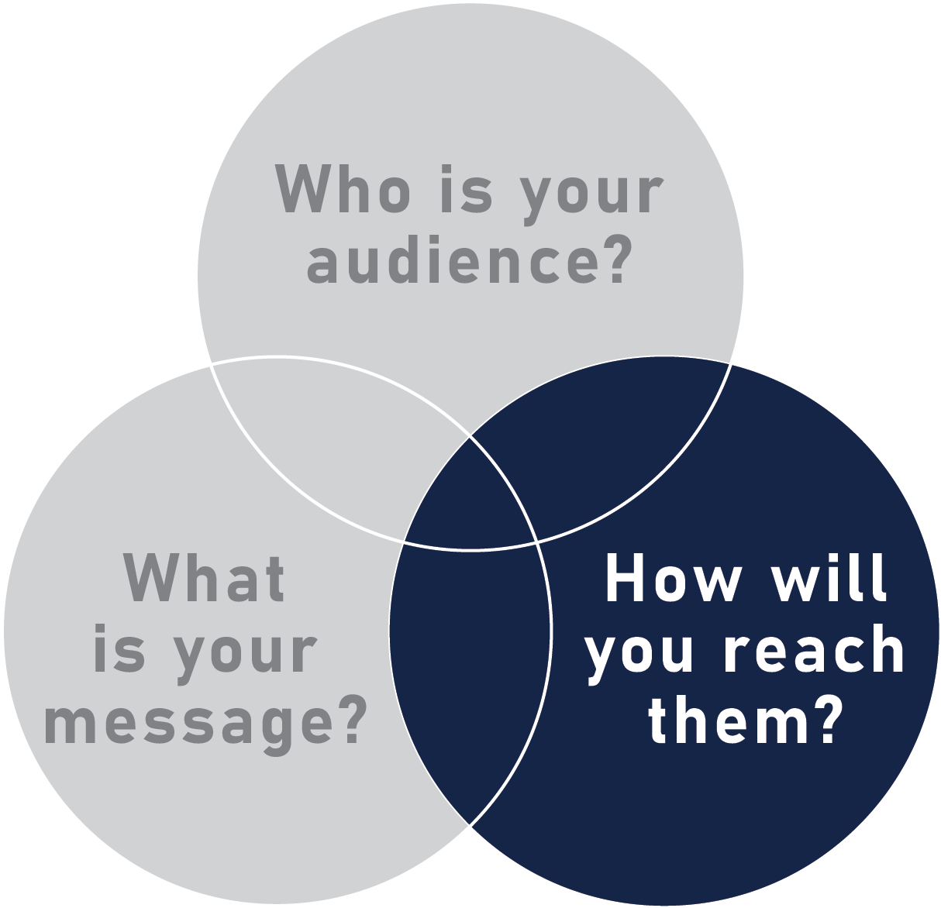
SHARING WISDOM
Create calls to action
What action do you want your audience to take with this information?
Do you have a recommendation for legislators?

Slide 42
IN CLOSING
Key takeaways
Choose an effective visual
Set the context
Know your audience
Keep it simple

Slide 43
IN CLOSING
Questions?

