Slide 1

Supporting SAIs in building
Presentation for INTOSAI Performance Audit Subcommittee Meeting,
5-6 March 2024, Tbilisi

Slide 2
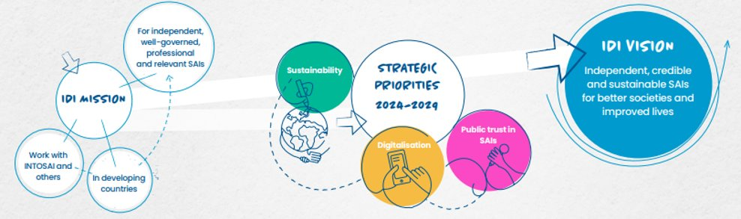
IDI Strategic Plan 2024-2029

Slide 3


Professional & Relevant SAIs Value Delivery
1.Competent SAI Audit Professionals
2.Effective SAI Leaders
3.Sustainable SAI Audit Practices
4. Raised SAI Audit Profiles

Slide 4



Slide 5


Future SAI Audit
Bring together audit professionals from SAIs and stakeholders to explore, experiment and innovate solutions for the future SAI audits and auditors.
- Sustainability reporting & oversight
- Strategic foresight in performance auditing
https://idi.no/elibrary/professional-sais/1861-pi-ps-sustainability-reporting-v2

Slide 6
Professional Audit Practice Resources
Offer a library of up-to-date tools and guidance on core audit practices.
  PA iCAT
  PA ISSAI Implementation Handbook
Coming up ( 2024)
- Diagnostic tool for Sust. Audit Practices
- Playbooks for planning for impact, robust follow up mechanism and strong stakeholder coalitions

Slide 7
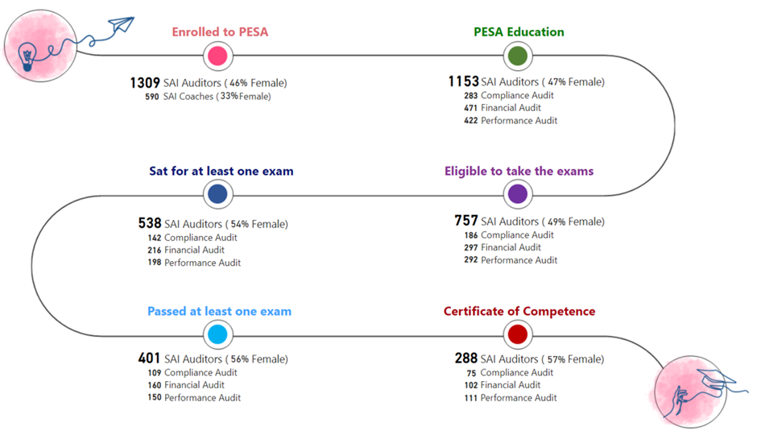

Slide 8

Scale Up Strategy
Laddering
PESA Spanish, Arabic, French
PESA outside INTOSAI Community

Slide 9
Continuing Professional Development
Foster alumni networks of certified pools and create opportunities for structured continuing professional growth.
PESA CIRCLE

Slide 10
System of Audit Quality Management (SoAQM)
Audit Quality Management Specialists Certificate
Shared Services Arrangements
Pilot Setting up System of Audit Quality Management (12 SAIs):
Albania, Azerbaijan, Bosnia and Herzegovina, Cyprus

Slide 11
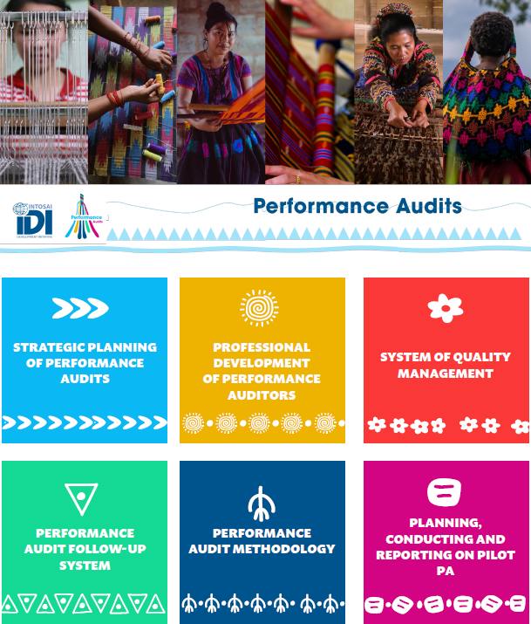

SAIs have a sustainable performance audit practice, which consistently delivers relevant and high-quality (ISSAI compliant) performance audits (PA) which make a positive difference (impact)
RAISE Performance Audit Profile

Slide 12


ISAM update
ISAM Pilots
Leave no one behind audit framework
SAI SDG Auditor
Supporting SAIs in auditing
2030 Agenda for
Sustainable Development

Slide 13



Performance Audits in trending areas

