Slide 1
Certification of Performance Auditors
Tbilisi, PAS 6.03.2024

Slide 2
Little background
SAO started building PA around 2010
Started with small group of people 3-4
Capacity development mainly by learning by doing/pilots
Supplemented by designated trainings by experts
Little specialized training within the PA

Slide 3
Why is it important
Standardized knowledge base
Safe heaven for the unqualified/dabblers
Equal opportunity to different employees
Facilitates more analytical ambition in PA

Slide 4
Current practice
Training center – “Pubic Audit Institute” - where we contribute as trainers
Ad-Hoc trainings
Materials from International cooperation (GIZ, SNAO)
GAO Center of Excellence

Slide 5
Professional development – ISSAI 150
Standard for Professional Competence refers to professional development pathways for :
Entry level competencies
Continuous Professional Development

Slide 6
Pesa – Stats:
PESA-P (2020-21)
PESA (2023-24)
Registered: 16 auditors, 7 coaches
15 auditors registered for the exams in May
Registered: 19 auditors, 7 coaches
Took exam: 13 auditors, passed 11.

Slide 7
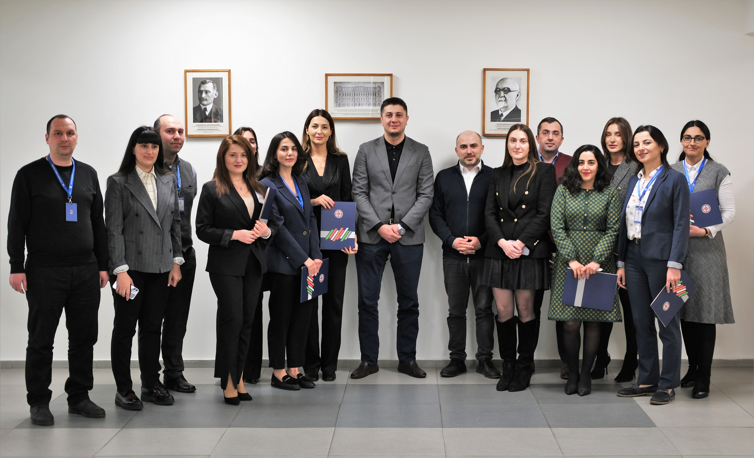
PICTURE HERE

Slide 8
For the next steps:
CIPFA ?
Specialized trainings
Broadening scope of the PA
Working with our GAO colleagues to have more consistent PDP

