Slide 1


  Civil society engagement in performance audit – CITIZENEYE – a tool for engaging stakeholders and citizens for greater impact

Slide 2
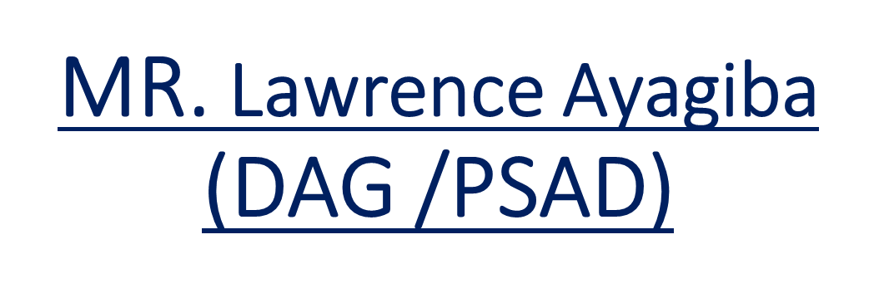
PRESENTATION BY

Slide 3
GAS & CSO
Areas of cooperation in audit work
As a means of selecting audits of interest to the public
Assist in the dissemination of audit findings
Engage with the media to get publicity for audit reports
Engage with Parliament/PAC to sit and take PA reports
Ensure implementation of audit recommendations

Slide 4
Areas of cooperation Cont.
Follow –up
Provide advocacy through their activities for the work of GAS.
Legal backing for GAS to implement Constitutional provisions.
Article 187(7)b (i) (ii) (iii). The supreme court ruling on Occupy Ghana v. Attorney General

Slide 5
Benefits
Disseminated about 100 audit reports to the Assemblies in 2016 and 2019. 60 reports in 2023
Seen improvement especially in procurement of infrastructure projects from Follow-up
Seen improvement in Internal controls and compliance with procedure.
There has been an increase in implementation of audit recommendations from 60% to 85%. (Although other factors could account for this e.g. Audit committees )
Media interest/public discussions and engagement has been heightened.

Slide 6
Benefits Cont.
The use of the Disallowance and Surcharge has been applied effectiveness since the ruling of the supreme court on 14 June 2017.
In the six month in 2017, GH¢43million cedis ($9.3million @4.52/$) was recovered.
Recoveries for 2018 and 2019 GH¢ 77,591,657.56 cedis ($13.7 @5.65/$)

Slide 7
Other Benefits
Development of the Citizen eye.
Enhances citizen participation in the work of the AG.
Bring issues otherwise hidden to the public to the notice of the AG.
Allows citizens to express areas of interest for audit work especially Performance Audits
Enhance the trust of the citizen in the work of the SAI
Justifies our existence and budget allocation to the SAI

Slide 8
Benefits from use of Citizens Eye
Received 688 complaints from citizens across the country (May 2019 to Dec. 2020 )
Completed reviews and dealt with 38.6%.
Saving made in man/hrs tracking audit issues.
Other saving in monetary terms yet to be determined

Slide 9
Benefits Cont.
Budgetary support to the SAI Ghana eg USAID, Kfw, GIZ and the European Union Commission.
Capacity building
Development of Manuals
Logistics (Printers, Laptops etc)

Slide 10
Common challenges
Not necessarily neutral. Perceived to be aligned to Political parties
Political motives can not be ruled out
Academic backgrounds- Varied and has both positive and negatives

Slide 11
Mitigating the Challenges
They have no influence on audit topics and areas to audit
They do not determine when audit reports should be submitted
Do not influence GAS budget.
The development of the guide on selection of issues to follow has been helpful

Slide 12


Slide 13
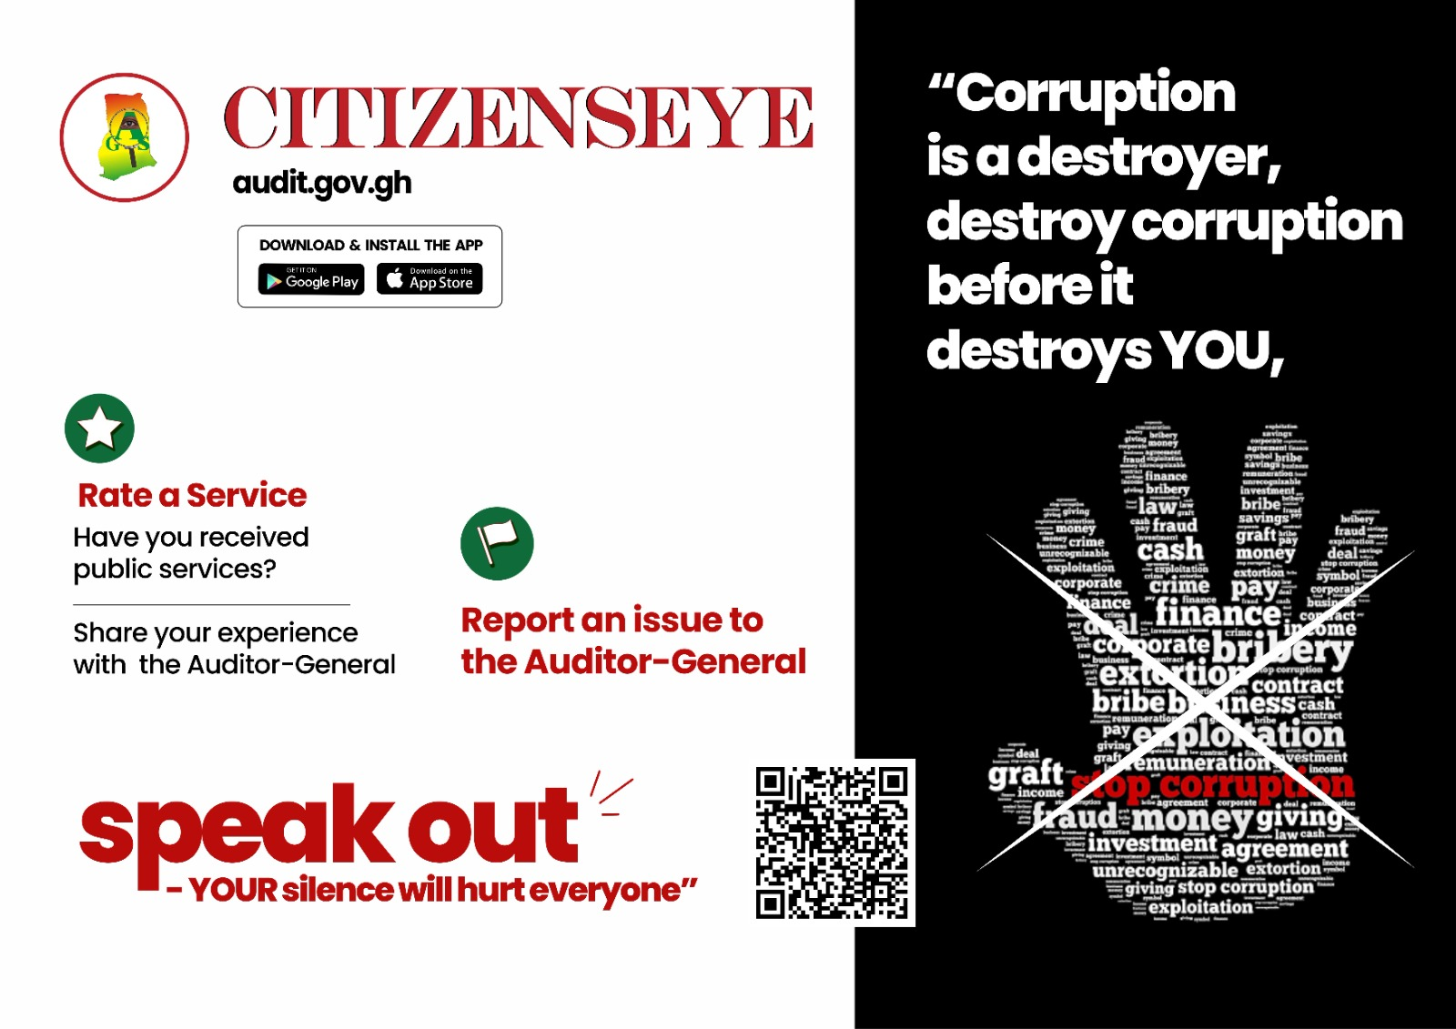

Slide 14
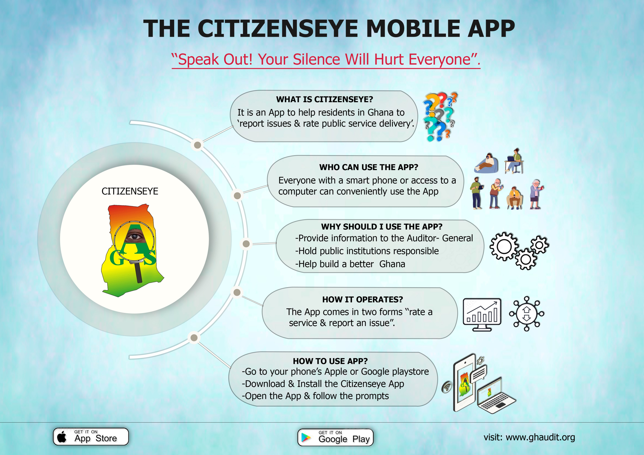

Slide 15
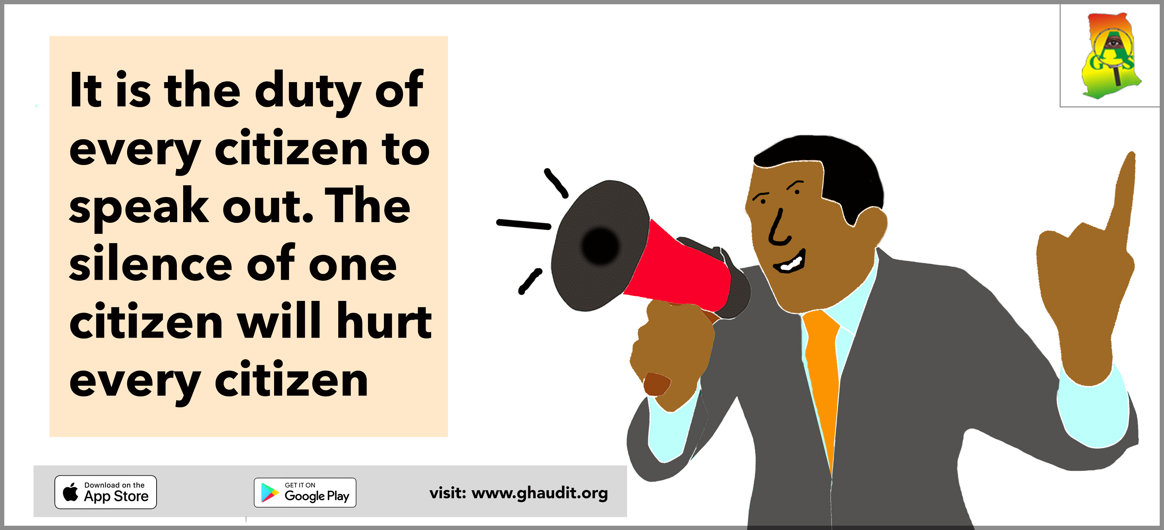

Slide 16
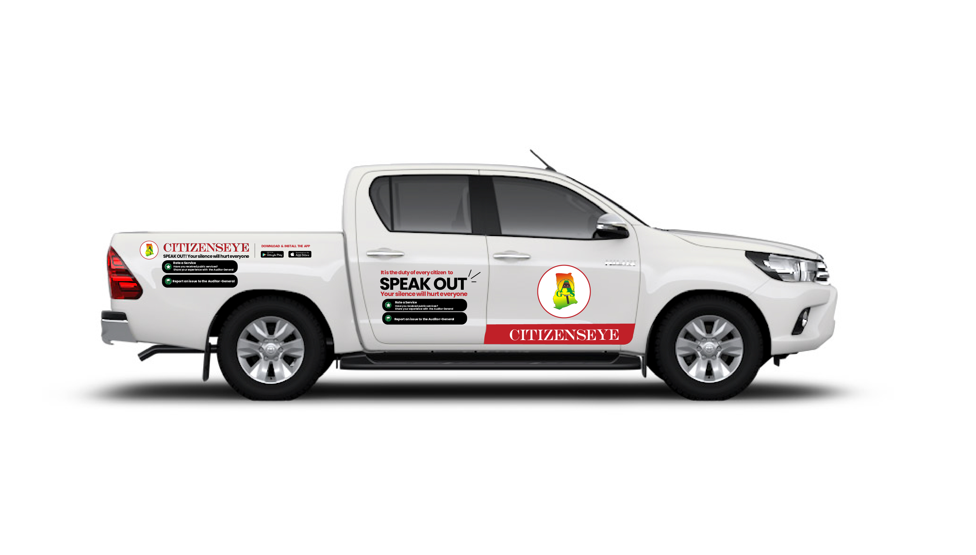

Slide 17


