Slide 1
Involving civil society:
three new actions in 2022-2023
the French financial jurisdictions
Jean-Christophe POTTON, Senior Auditor, French Court des comptes Paris
6 March 2024

Slide 2
A BETTER and quicker information to citizens
Traditional mission of the Court des comptes, added in the text of the French constitution in 2008 (article 47-2 stipulates that with its public reports, the Cour des comptes contributes to the information of the citizens)
An internal reform of financial jurisdictions “JF 2025” includes measures to better inform and better associate civil society
All the reports of the Court and regional chambers are now available on their website (except confidential data protected by law).
It initiates “flash audit” for some topics

Slide 3
The citizen’s consultation platform
The platform, launched in march 2022, involves directly the citizens in the planning of the works of the Court. During the sessions, citizens may deposit on the platform not only their opinion on the work of the Court, but also their audit proposals.
2022: 9 000 participants and 330 audit proposals. The analysis of the consultation resulted in 6 major topics selected for a control: inclusive school; detection of personnal tax fraud; public support for hunters federations; equality between women and men; medical interim and permanence of care; the use by State of private consultancy firms.
2023: 19 000 participants and 620 audit proposals. Decision of including in our 2024 program 10 of these audits for the Cour des comptes and 15 for the regional chambers.
see more https://participationcitoyenne.ccomptes.fr/
,

Slide 4
The REPORTING Platform
A protected reporting area on the website opened on sept 2022: the Court is now listening to citizens, associations or “whistle-blowers” who report potential irregularities in the management of public bodies or in handling public money.
This platform, administered by the General Prosecutor's office at the Cour des comptes, allows to refine programming, launch flash audits and, in the event of precise and well-documented alerts, to allow to initiate public action before the new Cour des comptes’ Litigation chamber or the judicial judge.
In the first year, it received 1120 alerts (vs. 100 in 2021 before the creation of the platform). Half of them were investigated in a Court chamber or a Regional chamber.
The main issues are abusive use of public funds (21%), serious management fault (15%), situation of conflict of interests (13%) and irregularities in HR management (11%).
See more: https://signalement.ccomptes.fr/

Slide 5
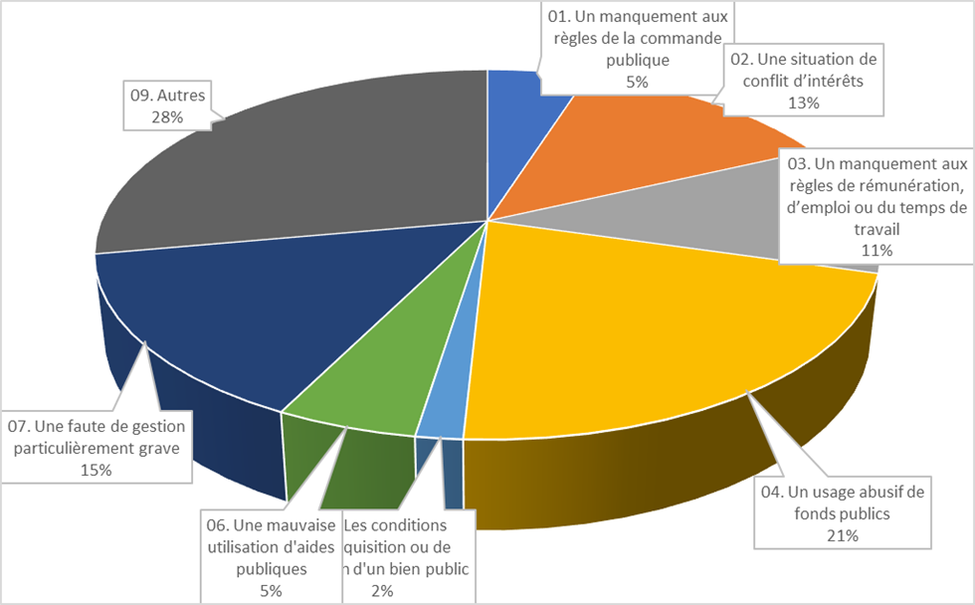
CHIFFRES CLÉS DE LA PLATEFORME DE SIGNALEMENT
1120 signalements du 6 septembre 2022 au 31 août 2023

Slide 6
MERCI DE VOTRE ATTENTION
THANK YOU FOR YOUR ATTENTION see more: https://www.ccomptes.fr/en

