Slide 1

Due Process
for INTOSAI’s framework of professional pronouncements
Procedures for developing, revising and withdrawing the International Standards of Supreme Audit Institutions (ISSAIs) and other pronouncements

Slide 2

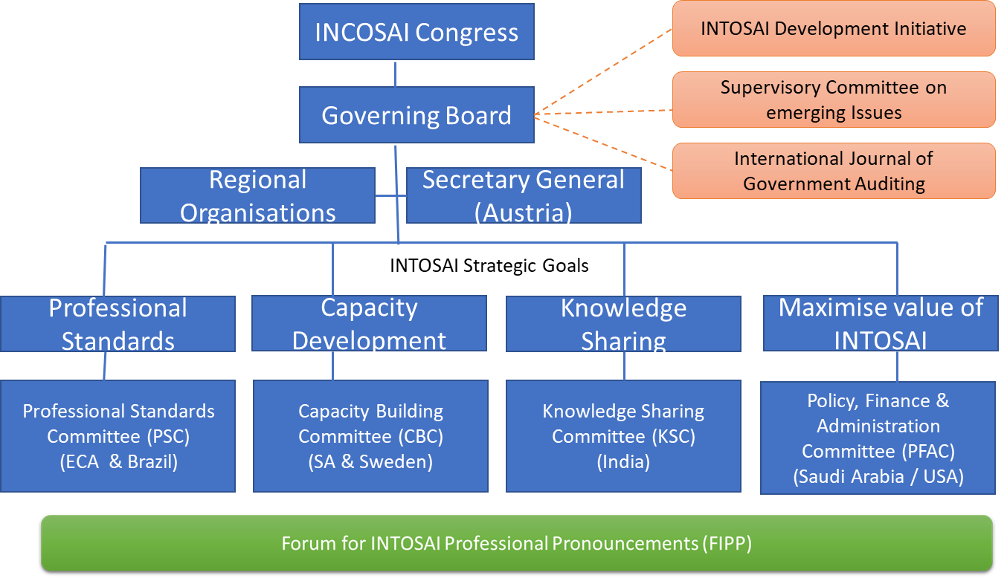
INTOSAI Organisation chart

Slide 3
Governance of FIPP
The INTOSAI Statutes and the due process for INTOSAI’s Framework of Professional Pronouncements (IFPP) define and safeguard FIPP’s decision-making competencies.
Membership is personal - members are appointed based on their expertise through a process of selection.
All members are appointed to serve the common interest of INTOSAI - they do not represent their SAIs or any other INTOSAI bodies.
All members contribute equally (approx. 300 working hours annually per member) – one member is appointed as liaison for each SDP project
FIPP’s role and membership

Slide 4
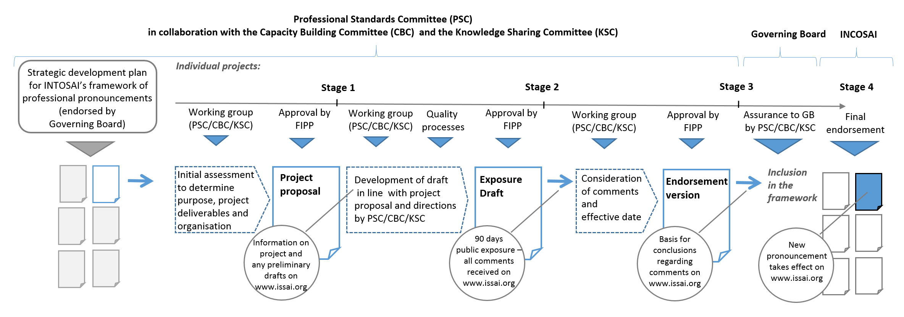
“Due Process” for INTOSAI’s framework of professional pronouncements
In reality there is also a “Stage 0”
The process contains in total four main stages

Slide 5
START
FIPP
Proposes how the planning process will be organised and the content of the plan
STAGE 0
PSC-SC
incl. Goal Chairs
“Due Process” for INTOSAI’s framework of professional pronouncements
Approves FIPP proposal
Any INTOSAI member/other interested parties may provide suggestions
INTOSAI community & external stakeholders
Receives suggestions for the SDP
PSC
Including public consultation at least every three years
Proposes priorities for the SDP
Analyses suggestions for develop, revise or withdraw pronouncements
FIPP
The Strategic Development Plan (SDP)
Finalises and approves the proposed SDP
Consults with all affected parties
PSC-SC
incl. Goal Chairs
Ascertains that all relevant needs are addressed (vis-à-vis the SDP)
FIPP may propose amendments / updates to an existing SDP
GB
Endorses the SDP

Slide 6
STAGE 1
Makes initial assessment
“Due Process” for INTOSAI’s framework of professional pronouncements
WG
Makes project proposal
Allocates resources, considers timelines and SP alignments
PSC-SC (incl. CBC & KSC Chairs) provide direction and guidance
Responsible Goal Chair
Sends project proposal to FIPP for approval
FIPP
Approves project proposal

Slide 7

FIPP
approval
FIPP approves in Stage 1:
Issues identified in the initial assessment
The scope of applicability
The absence of overlaps and inconsistencies
The organisation and timelines
The working title and proposed numbering
“Due Process” for INTOSAI’s framework of professional pronouncements

Slide 8
Approved project proposal
STAGE 2
Applies quality process to developing draft
GC provide direction and guidance
“Due Process” for INTOSAI’s framework of professional pronouncements
WG
Sends the draft pronouncement to FIPP
FIPP
Approves exposure draft
Posts exposure draft on ISSAI website
Stakeholders are notified and can make comments
WG
Collects comments on exposure draft
Exposure draft & comments to "Stage 3"

Slide 9

FIPP
approval
FIPP approves in Stage 2:
The exposure draft fulfils the purposes of the project
And is in line with the approved project proposal
Rigorous and relevant quality processes were performed
Overlaps and inconsistencies have been addressed
The submission for public exposure
“Due Process” for INTOSAI’s framework of professional pronouncements

Slide 10
Exposure draft & comments from "stage 2"
STAGE 3
“Due Process” for INTOSAI’s framework of professional pronouncements
Collects comments and posts them on ISSAI webpage
WG
Analyses comments & finalises endorsement version
FIPP consults with the WG if changes of the exposure draft require a re-exposure of the pronouncement
FIPP
Examines WG’s consideration of comments and approves endorsement version
Posts translated version on ISSAI website
WG
Approved endorsement version to "Stage 4"

Slide 11
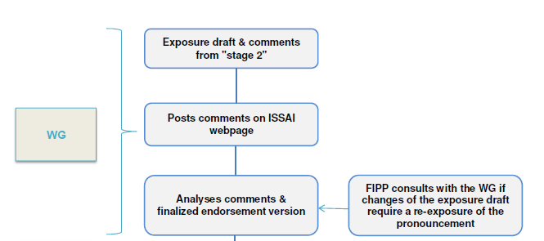
FIPP
consultation
At Stage 3 FIPP will:
In close relation with the WG, see if the changes of the exposure draft require a re-exposure of the pronouncement
“Due Process” for INTOSAI’s framework of professional pronouncements

Slide 12

FIPP
approval
FIPP approves in Stage 3:
The comments received have been properly been taken into account
The comments are properly reflected in the endorsement version
The forwarding of the document to the INTOSAI GB
“Due Process” for INTOSAI’s framework of professional pronouncements

Slide 13
Approved endorsement version from "Stage 3"
STAGE 4
WG
Sends approved endorsement version to GC responsible for the committee
“Due Process” for INTOSAI’s framework of professional pronouncements
Responsible Goal Chairs
Gives assurance to GB that "Due Process" has been followed
GB
Sends to INCOSAI for final endorsement
WG
Publishes publication on ISSAI website
Endorsement by INCOSAI
WG
Prepares executive summary and review frequency and submits to the INTOSAI General Secretariat
END

Slide 14
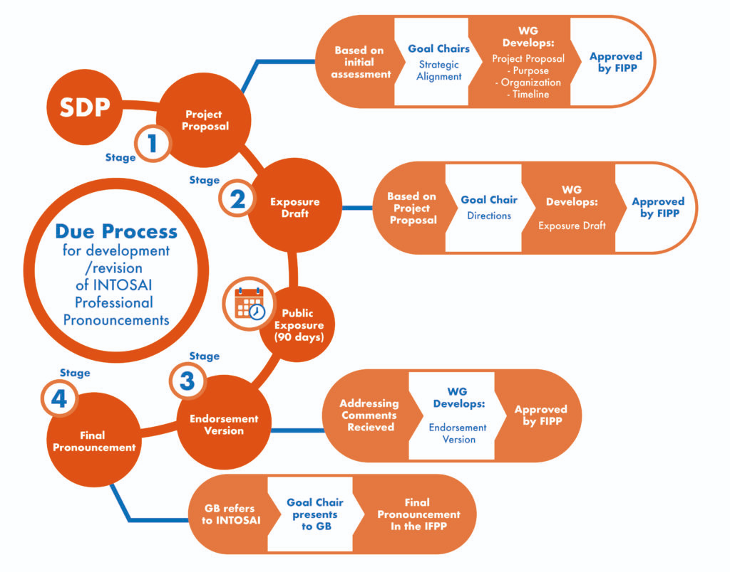
Due process simplified

