Slide 1
Performance audit of environmental issues
15th INTOSAI Performance Audit Subcommittee meeting
5 - 6 March 2024
Wilfred Aquilina
European Court of Auditors

Slide 2
Introduction
The ECA’s experience and approach
Performance audit of environmental issues

Slide 3
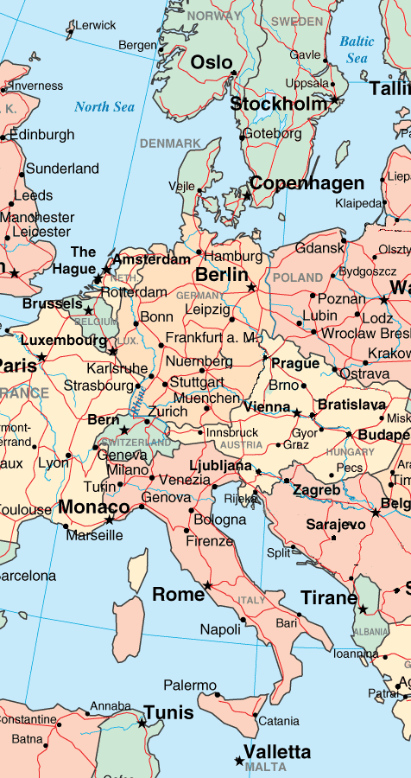
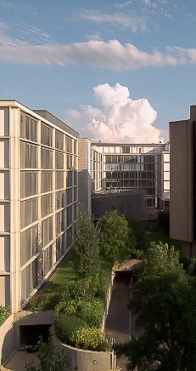
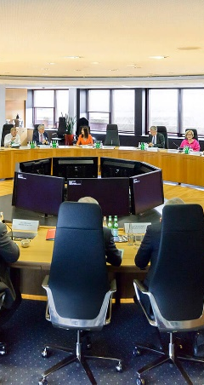
European Court of Auditors
The EU’s external auditor, based in Luxembourg
https://www.eca.europa.eu/en

Slide 4
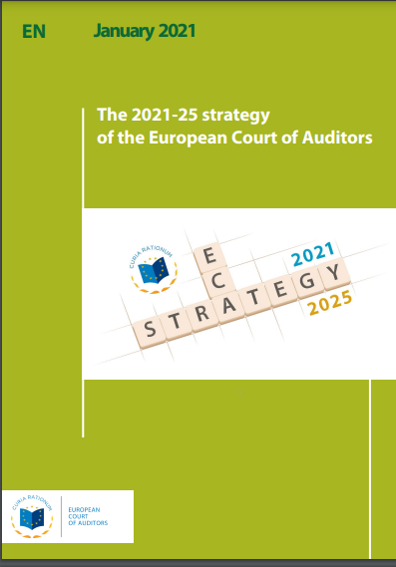
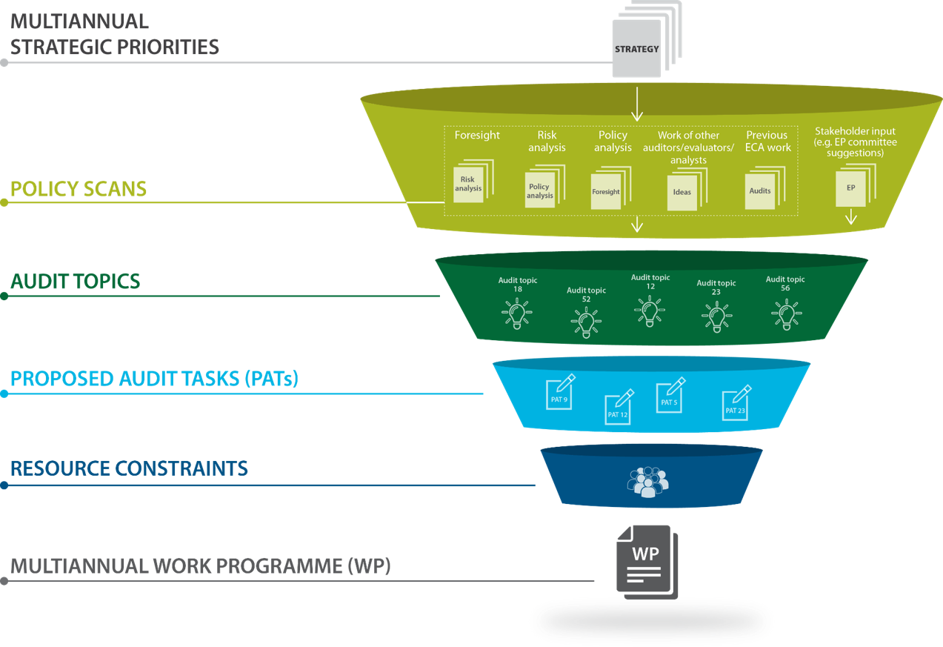

The ECA Strategy for 2021- 2025 https://www.eca.europa.eu/Lists/ECADocuments/STRATEGY2021-2025/STRATEGY2021-2025_EN.pdf
The programming process to implement strategy
https://www.eca.europa.eu/Lists/ECADocuments/WP2023/WP2023_EN.pdf

Slide 5
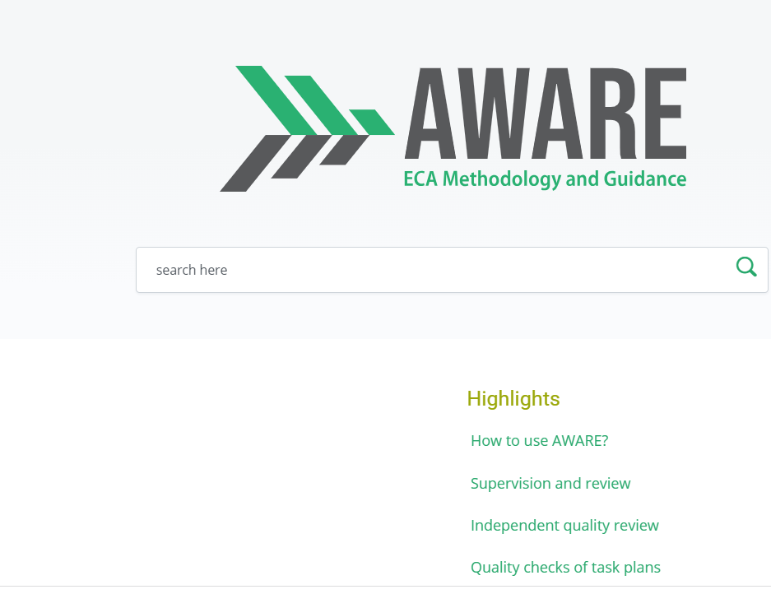
https://methodology.eca.europa.eu/aware/Pages/Home.aspx

Slide 6


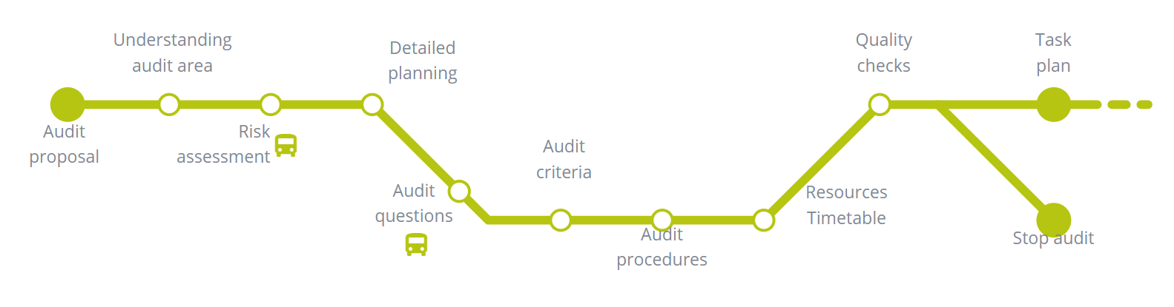
Planning
ISSAI 300/19,27-28
ISSAI 3000/29-31,49-51,101-103
GUID 3910/24-26
GUID 3920/35-37,42
ISSAI 140
ISSAI 300/32
ISSAI 3000/66-67
GUID 3920/60
ISSAI 300/37
ISSAI 3000/104
GUID 3920/56
ISSAI 300/37 ISSAI 3000/100
ISSAI 300/27
ISSAI 3000/45-48
GUID 3910/55-60
GUID 3920/38-43
ISSAI 300/36
ISSAI 3000/89-95
GUID 3920/8-15
ISSAI 100/46 ISSAI 300/37 ISSAI 3000/100 GUID 3920/21,28
ISSAI 300/28,30,37 ISSAI 3000/63-67 GUID 3920/56-62
ISSAI 300/12
ISSAI 300/25-26
ISSAI 3000/16,35-44
GUID 3910/35-36
GUID 3920/20,24,34
ISSAI 300/37-38
ISSAI 3000/101-103

Slide 7
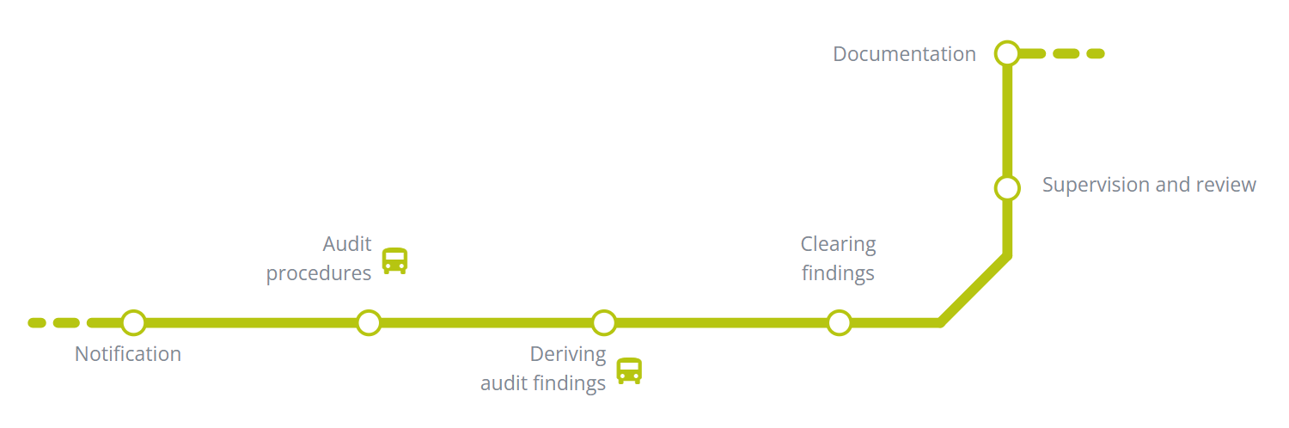
ISSAI 300/34 ISSAI 3000/86-88 GUID 3910/114-118 GUID 3920/100-101
Examination
ISSAI 300/37-38
ISSAI 3000/101-103
ISSAI 140
ISSAI 300/32
ISSAI 3000/66-67
GUID 3920/60
ISSAI 300/29
ISSAI 3000/55-62
GUID 3910
GUID 3920
ISSAI 300/29 ISSAI 3000/129-132
ISSAI 300/38
ISSAI 3000/112-115
GUID 3920/84-93

Slide 8

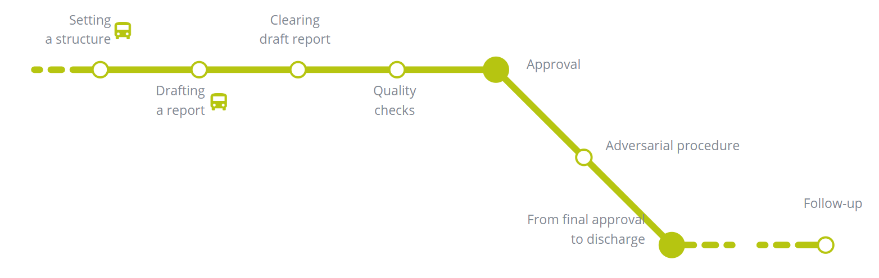
Reporting, publication and follow-up
ISSAI 300/39
ISSAI 3000/118
GUID 3920/115,121
ISSAI 300/29 ISSAI 3000/129-132
ISSAI 300/41 ISSAI 3000/133 GUID 3920/136-144
ISSAI 300/29
ISSAI 3000/129-132
ISSAI 300/42 ISSAI 3000/136-141 GUID 3920/145-155
ISSAI 140
ISSAI 300/32
ISSAI 3000/66-67
GUID 3920/60
ISSAI 300/39 ISSAI 3000/116-125
Publication
ISSAI 300/41
ISSAI 3000/133
GUID 3920/136-144

Slide 9
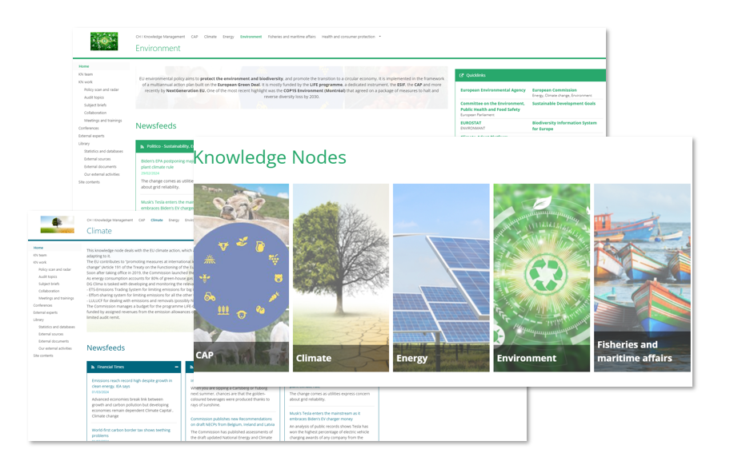
Knowledge nodes

Slide 10

INTOSAI Working Group on Environmental Auditing
Part of the INTOSAI Knowledge Sharing Committee (KSC)
Member of the INTOSAI WGEA Steering Committee
Assembly, meetings, development of tools, bulletins, newsletter, seminars, webinars, online courses…
ECA leading with the GAO a project on Green fiscal policy tools
E.g. participation in COP 28: https://www.youtube.com/watch?v=noQEAJPLWjY
https://wgea.org/
EUROSAI Working Group on Environmental Auditing
Member of EUROSAI WGEA Steering Committee
Annual meeting, spring session, newsletter, courses…
E.g. participation in COP 26: https://www.youtube.com/watch?v=aAVw1rKKRnQ

Slide 11
Transport and the environment
Urban development
Energy transition
Farming, fishing and aquaculture
Forests
EU framework and programmes
Reporting on climate targets
Performance audit of environmental issues

Slide 12
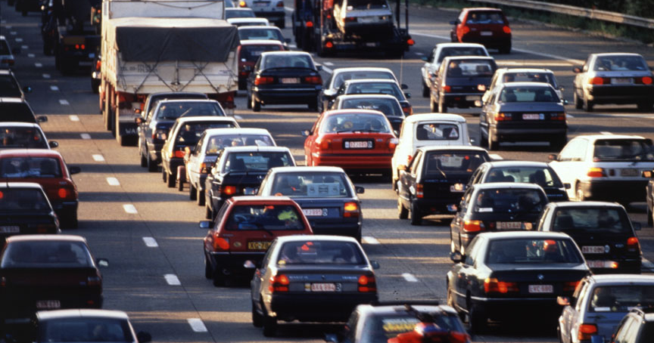
Transport and the environment
© European Union, 2020

Slide 13
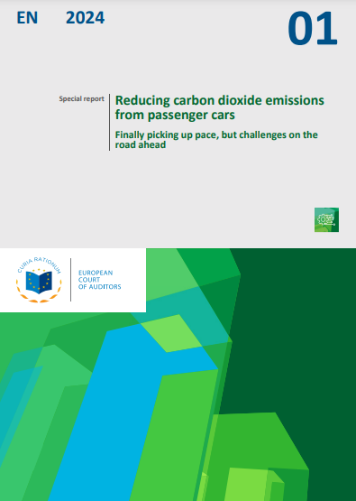
Reducing carbon dioxide emissions from passenger cars
Progress since the EU’s first Cars CO₂ Regulation (2010)
Key EU measure for reducing CO₂ emissions in new cars
Audit covered several issues affecting implementation
Insufficient assurance on accuracy of CO₂ emissions declared by manufacturers on certificates of conformity
Car CO₂ emissions data collected and verified by the European Commission
Difficulty to align with EU’s climate ambitions, and accelerate uptake of electric vehicles
Published in January 2024
https://www.eca.europa.eu/ECAPublications/SR-2024-01/SR-2024-01_EN.pdf

Slide 14
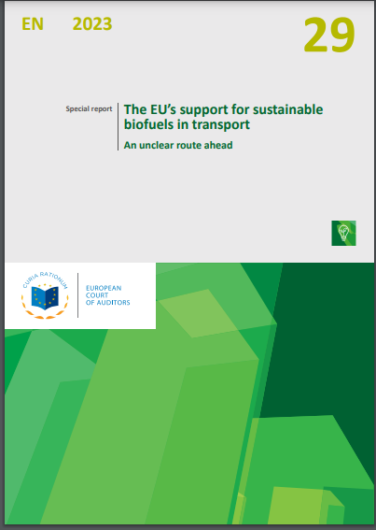
The EU’s support for sustainable biofuels in transport
Published in December 2023
An alternative to fossil fuels. Intended to help reduce greenhouse gas emissions in the transport sector
Covered all member states, and a sample of 22 biofuel projects (located in 4 member states)
Lack of a long-term perspective in EU biofuels policy
Affected investment, sustainability, availability and costs. Limited deployment of biofuels, despite also EU support for research
2020 targets had not been reached by most member states
EU system for the certification of biofuels covered by the ECA in a 2016 report
https://www.eca.europa.eu/ECAPublications/SR-2023-29/SR-2023-29_EN.pdf

Slide 15
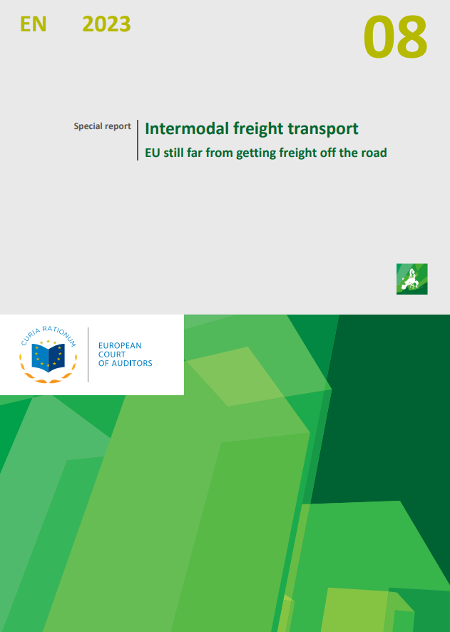
Intermodal freight transport
Published in March 2023
Transport of goods in a single loading unit (such as container) using a combination of modes of transport: road, rail, waterways or air.
Reduce environmental impact
Assessed whether the EU's regulatory and financial support for intermodal freight transport since 2014 was effective
Targets at EU level for increased use of rail and inland waterways were unrealistic and member states’ targets not aligned
Regulatory and infrastructural barriers
https://www.eca.europa.eu/Lists/ECADocuments/SR-2023-08/SR-2023-08_EN.pdf

Slide 16
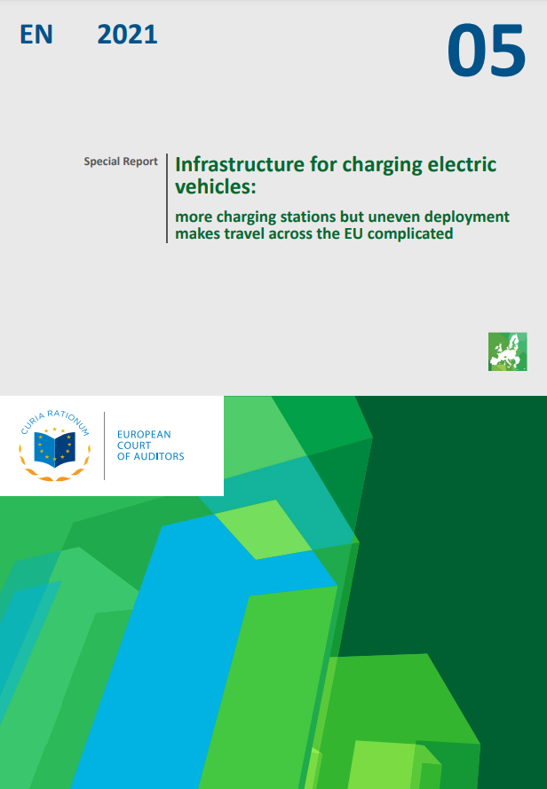
Infrastructure for charging electric vehicles
Published in April 2021
Assessed the effectiveness of Commission’s support for deployment of an EU-wide publicly accessible infrastructure for charging electric vehicles
Success in promoting a common EU plug standard, improving access to different charging networks…
However: major obstacles to travel across the EU in electric vehicles, availability of charging stations varies between countries
Commission unable to ensure EU funding went where it was most needed, still a long way off Green Deal target of 1 million charging points by 2025
EU lacked an overall strategic roadmap for electro-mobility
https://www.eca.europa.eu/Lists/ECADocuments/SR21_05/SR_Electrical_charging_infrastructure_EN.pdf

Slide 17
Sustainable urban mobility
Audit published in March 2020
https://www.eca.europa.eu/Lists/ECADocuments/SR20_06/SR_Sustainable_Urban_Mobility_EN.pdf
Urban Mobility Package and funding for clean urban transport
Weaknesses in implementation and no clear trend
Air pollution
Audit published in September 2018
https://www.eca.europa.eu/Lists/ECADocuments/SR18_23/SR_AIR_QUALITY_EN.pdf
Excessive air pollutants such as dust particles, nitrogen dioxide and ozone
Found weak legislation and poor policy implementation

Slide 18
Sea water pollution from vessels
Ongoing audit, publication in 2024-2025
Whether EU actions tackling sea water pollution originating from vessels are well designed and implemented
Looking at the coherence of the framework in place at EU and member state level
The policies, measures, services and systems used by the Commission and member states to tackle this type of pollution
The use of EU funds in implemented projects

Slide 19
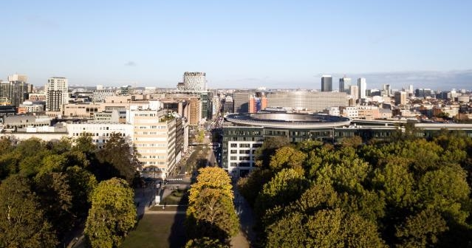
Urban development and the environment
© European Union, 2020

Slide 20
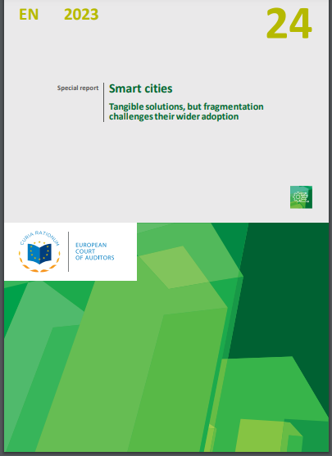
Smart cities
Published in October 2023
¾ of EU citizens live in urban areas - a major source of pollution. Using technological innovation, cities and towns can improve how they are managed and contribute to achieving environmental, digital and economic benefits.
Focus on the Lighthouse programme (assessed all 18 projects) and whether lessons learned applied to Horizon Europe Mission on Climate-Neutral and Smart Cities
15 cities selected, and replies from 40 cities on audited projects
Positive results but coordination with Mission not fully exploited
https://www.eca.europa.eu/ECAPublications/SR-2023-24/SR-2023-24_EN.pdf

Slide 21
Energy efficiency in buildings
Audit published in April 2020
https://www.eca.europa.eu/Lists/ECADocuments/SR20_11/SR_Energy_efficiency_in_buildings_EN.pdf
Whether EU co-funded energy efficiency investments in buildings had cost-effectively helped the EU toward its 2020 energy saving target
Programmes were not driven by a cost-effectiveness rationale
Projects delivering higher energy savings / benefits at lower cost not prioritised
Improvement to planning, selection and monitoring of investments needed

Slide 22
Urban pollution
Ongoing audit, publication in 2024-2025
Assessing actions, under the EU framework, of the European Commission and the member states to tackle air and noise pollution in urban areas
Protection of citizens and the environment
Looking at the implementation of the EU framework (e.g. Commission’s use of its powers, member states’ actions, compliance,…)
Auditing the use of EU funds in completed projects

Slide 23
Municipal waste management
Launched audit, publication in 2025
Whether the European Commission and the member states took effective action towards achieving the EU’s objectives related to municipal waste
Covering three levels: EU, member states, and final beneficiaries
Various tools and instruments and how they were designed and applied by the Commission and member states
The effective use of EU funds in co-financed projects

Slide 24
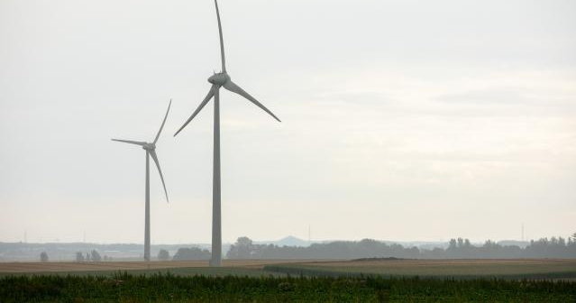
Energy transition
© European Union, 2020

Slide 25
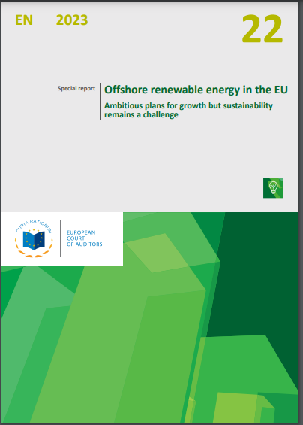
Offshore renewable energy
Published in September 2023
Ambitious deployment targets for 2030 and 2050
Examined promotion of sustainable development of offshore renewable energy at both European Commission and member state level
Actions have supported this type of energy, but targets difficult to achieve
Problem to ensure social and environmental sustainability
Numerous environmental aspects yet to be recognised during the development of offshore renewables
Given the scale of the planned offshore renewable energy rollout in coming years, environmental footprint on marine life could be significant
https://www.eca.europa.eu/ECAPublications/SR-2023-22/SR-2023-22_EN.pdf

Slide 26
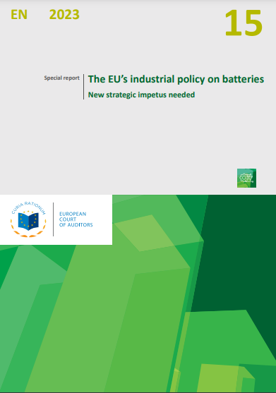
The EU’s industrial policy on batteries
Published in June 2023
In 2018 the Commission designated batteries as a strategic imperative for clean energy transition
Launched an action plan aimed at making Europe a global leader in sustainable battery production and use
We assessed the relevance of that plan, its implementation, and the results achieved to date
Commission effective at promoting EU industrial policy
But issues with monitoring, coordination and targeting
Access to raw materials remains a major strategic challenge, from outside the EU
We made recommendations towards a renewed strategic impetus in support of the EU’s battery value chain
https://www.eca.europa.eu/ECAPublications/SR-2023-15/SR-2023-15_EN.pdf

Slide 27
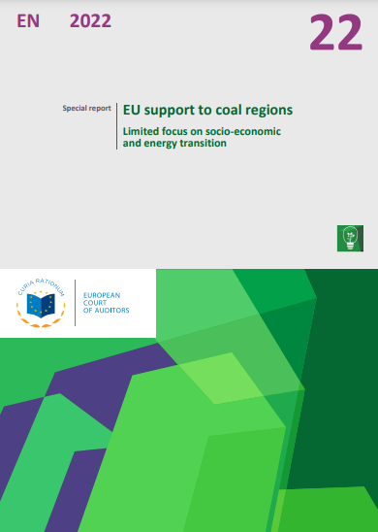
EU support to coal regions
Published in November 2022
Phasing-out coal is essential for achieving the EU climate objectives
EU established the €19.3 billion Just Transition Fund to support the transition to climate neutrality
Support had limited focus and impact energy transition
Despite overall progress, coal remains a significant source of greenhouse gas emissions in some member states
https://www.eca.europa.eu/Lists/ECADocuments/SR22_22/SR_coal_regions_EN.pdf

Slide 28
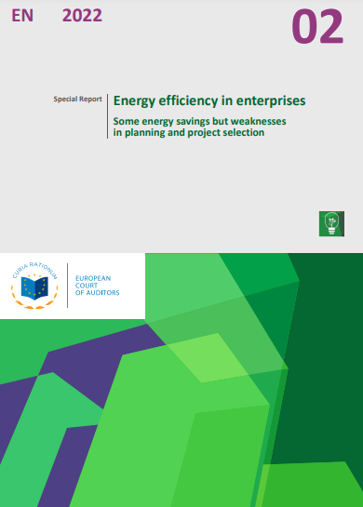
Energy efficiency in enterprises
Published in January 2022
Energy efficiency essential to achieve EU carbon neutrality by 2050
Potential for energy savings of enterprises or financing needs were not assessed by the Commission
Programmes did not specify how the funds contribute to energy efficiency priorities
Limited use of financial indicators in project selection
Good investments made in energy efficiency
Estimated contribution was only 0.3 % of effort to 2030
https://www.eca.europa.eu/Lists/ECADocuments/SR22_02/SR_Energy-effic-enterpr_EN.pdf

Slide 29
EU greenhouse gas emissions
Audit published in November 2019
https://www.eca.europa.eu/Lists/ECADocuments/SR19_18/SR_Greenhouse_gas_emissions_EN.pdf
Recommendations to improve the Commission’s review process of greenhouse gas emission data for the land use, land-use change and forestry sector and the framework for future emission reductions.
Wind and solar power for electricity generation
Audit published in June 2019
https://www.eca.europa.eu/Lists/ECADocuments/SR19_08/SR_PHOTOVOLTAIC_EN.pdf
Recommendations to the Commission to help Member States support further deployment, including resolving grid insufficiencies

Slide 30
Modernising EU electricity grids and meters for clean energy transition
Planned audit, publication in 2025
The European Green Deal: 55 % reduction in greenhouse gas emissions by 2030, and achieving climate neutrality by 2050
To assess whether the EU is contributing effectively to the deployment of smart grids and meters
Electricity sector undergoing significant transformation: more decentralised and using a variety of renewable energy generators
Shift towards bidirectional electricity flows
Clean energy transition is a key enabler for reaching the EU’s 2030 and 2050 climate and energy targets

Slide 31
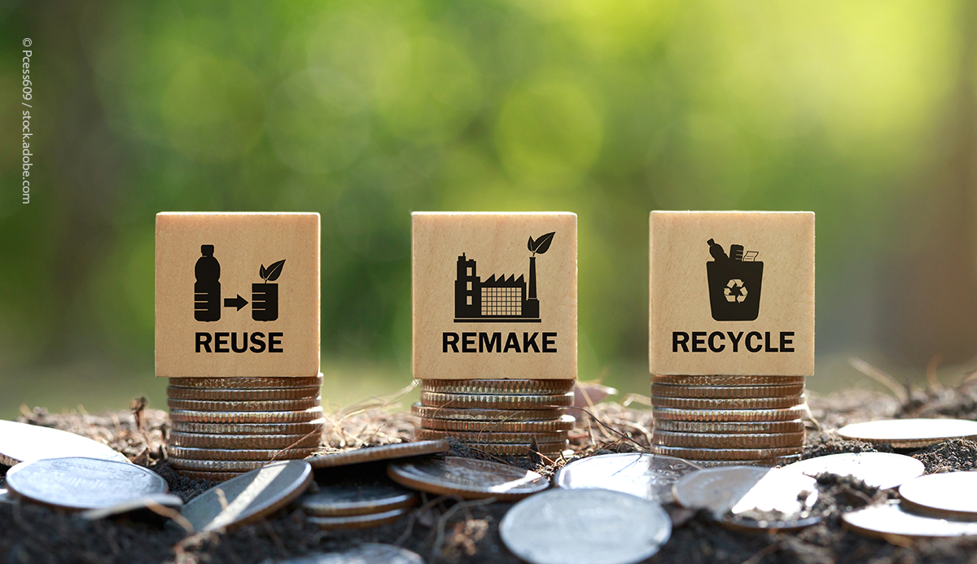

Economy and environment

Slide 32
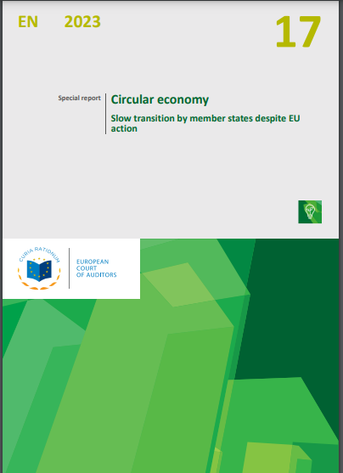
Circular economy
Published in July 2023
A circular economy preserves the value of products, materials and resources and minimises waste
A product’s design determines around 80 % of its environmental impact
Limited evidence that the Commission’s two Circular Economy Action had been effective in influencing circular economy activities in the EU
The pace of progress remains slow - EU’s ambition of doubling its share of material recycled and fed back into the economy by 2030 looks very challenging
The Commission’s framework for monitoring did not fully capture all the key aspects and lacked certain specific indicators
https://www.eca.europa.eu/ECAPublications/SR-2023-17/SR-2023-17_EN.pdf

Slide 33
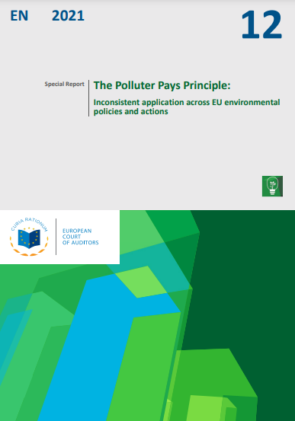
Making the polluter pay
Published in July 2021
Polluter Pays Principle (PPP): polluters are incentivised to avoid environmental damage and are held responsible for the pollution that they cause.
PPP was reflected and applied to varying degrees in the different EU environmental policies
However, its coverage and application was incomplete
The EU budget is sometimes used to fund clean-up actions that should, under the PPP, have been borne by polluters
Recommended to strengthen integration of PPP into environmental legislation, reinforce environmental liability regime at EU level, and better protect EU funds from being used to finance projects that should be funded by the polluter
https://www.eca.europa.eu/Lists/ECADocuments/SR21_12/SR_polluter_pays_principle_EN.pdf

Slide 34
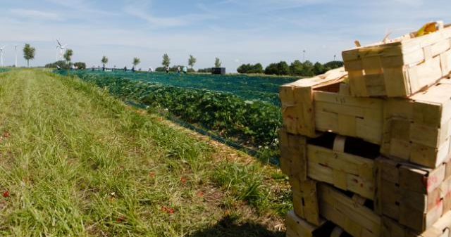
Farming, fishing and aquaculture
© European Union, 2017

Slide 35
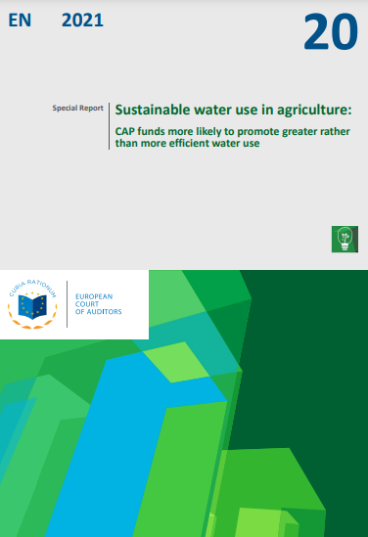
Sustainable water use in agriculture
Published in September 2021
¼ of all water abstracted in the EU is used for agriculture, mainly for irrigation
Many regions affected by water scarcity and climate change
Target by 2027 for good status of all water bodies (Water Framework Directive) - significant delays in reaching this target
Agricultural policies not consistently aligned with EU water policy
Member States need to better justify exemptions to Directive
Commission should link CAP payments to environmental standards on sustainable water use
https://www.eca.europa.eu/Lists/ECADocuments/SR21_20/SR_CAP-and-water_EN.pdf

Slide 36
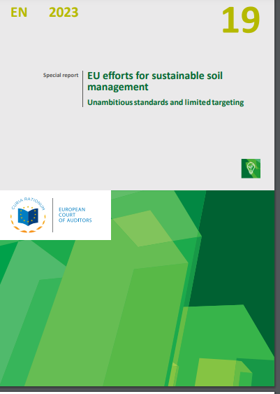
Sustainable soil management
Published in July 2023
In EU, 60-70 % of soils are unhealthy, in part due to soil and manure management practices
The common agricultural policy and the Nitrates Directive provide measures to encourage improvements in soil and manure management
Assessed the Commission’s and member states’ actions and found insufficient use of the EU tools and conditions for direct payments to farmers
Recommended various actions for the Commission to take to ensure measures are better designed, implemented and monitored
https://www.eca.europa.eu/ECAPublications/SR-2023-19/SR-2023-19_EN.pdf

Slide 37
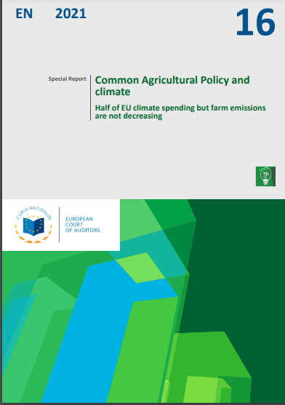
Climate change and agriculture
Published in June 2021
Cover 2014-2020 period when Commission attributed ¼ of CAP budget to mitigate climate change
Found that €100 billion of CAP funds attributed to climate action had little impact on reducing greenhouse gas emissions from agriculture
CAP mostly financed measures with a low potential to mitigate climate change
https://www.eca.europa.eu/Lists/ECADocuments/SR21_16/SR_CAP-and-Climate_EN.pdf

Slide 38
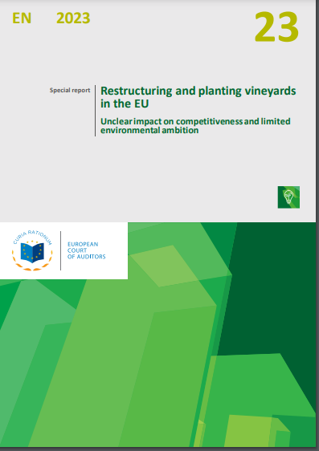
Vineyards
Published in September 2023
EU support for vineyard restructuring: improve competitiveness, sustainability and the environmental footprint
Flaws in the design and implementation of the policy and the scheme
Falls short of the common agricultural policy’s environmental objectives. Environmental protection was only partially taken on board
https://www.eca.europa.eu/ECAPublications/SR-2023-23/SR-2023-23_EN.pdf

Slide 39
Sustainable use of plant protection products
Published in February 2020 https://www.eca.europa.eu/Lists/ECADocuments/SR20_05/SR_Pesticides_EN.pdf
Pesticides used to protect crops
Limited progress in addressing risks
Applying integrated pest management is compulsory for farmers, but was not a requirement for receiving payments and enforcement was weak
Renewable energy for sustainable rural development
Published in March 2018 https://www.eca.europa.eu/Lists/ECADocuments/SR18_05/SR_Renewable_Energy_EN.pdf
A driver of sustainable development in rural areas
Found unrealised synergies between renewable energy policy and funds designated to facilitate sustainable development

Slide 40
Protection of wild pollinators
Published in July 2020 https://www.eca.europa.eu/Lists/ECADocuments/SR20_15/SR_Pollinators_EN.pdf
Declined in abundance and diversity. Commission launched the Pollinators Initiative
We found little effect on halting the decline. Initiative needed better management. Biodiversity and agricultural policies, and pesticides legislation did not offer adequate measures
Biodiversity on farmland
Published in June 2020 https://www.eca.europa.eu/Lists/ECADocuments/SR20_13/SR_Biodiversity_on_farmland_EN.pdf
Decline in number of animal species on farmland.
Difficulty to measure progress and tracking of biodiversity expenditure in the EU budget was unreliable; the impact of CAP direct payments is limited or unknown.

Slide 41
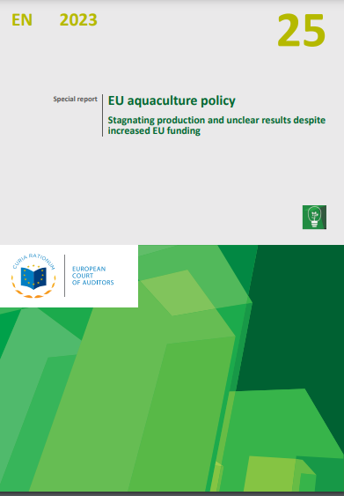
EU aquaculture policy
Published in November 2023
An important element of the EU blue economy, if carried out sustainably
EU’s strategic framework for aquaculture has improved in recent years
Some key national strategies for the environment do not take aquaculture into account properly
Obstacles to aquaculture growth
EU funds, despite large increase, were not fully taken up and weak selection criteria
Little growth and no reliable indicators to monitor
https://www.eca.europa.eu/ECAPublications/SR-2023-25/SR-2023-25_EN.pdf

Slide 42
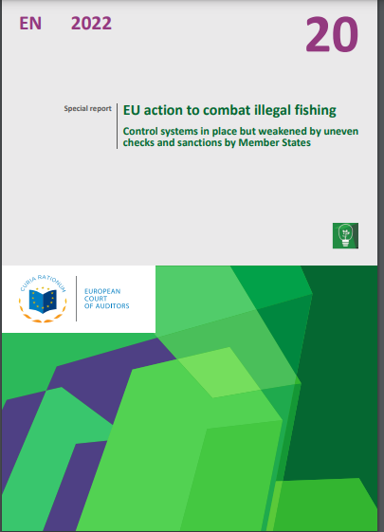
Illegal fishing
Published in September 2022
Illegal, unreported and unregulated fishing: one of greatest threats to marine ecosystems, undermining efforts to manage fisheries sustainably
Control systems in place were partially effective
Uneven application of checks and sanctions by member states
Target not met (SDG 14.4)
https://www.eca.europa.eu/Lists/ECADocuments/SR22_20/SR_Illegal_fishing_EN.pdf

Slide 43
Organic farming
Ongoing audit, publication in 2024
Assessing EU support for organic farming in terms of its contribution to the EU’s climate and environmental objectives
Use of sustainable farming practices (crops/animals), a fast-growing sector in EU agriculture with significant environmental benefits
Organic farming and production regulated at EU level since 1991. Regulation (EU) 848/2018 includes several environmental objectives
Audit examining the EU policy, framework and strategies used to support the development of organic farming; the measures of member states to develop organic farming; and the monitoring/evaluation of the EU policy

Slide 44

Forests
© European Union, 2024

Slide 45
Forest wildfires
Audit to start in 2024
To assess whether the EU effectively protected forests against wildfires by:
addressing prevention (including afforestation and reforestation)
Supporting the fight against such disasters, and
ensuring sustainable restoration of damaged forests
EU funding for biodiversity and climate change in EU forests
Audit published in October 2021
The Commission could have taken stronger action to contribute to the protection of EU forests
https://www.eca.europa.eu/Lists/ECADocuments/SR21_21/SR_Forestry_EN.pdf

Slide 46
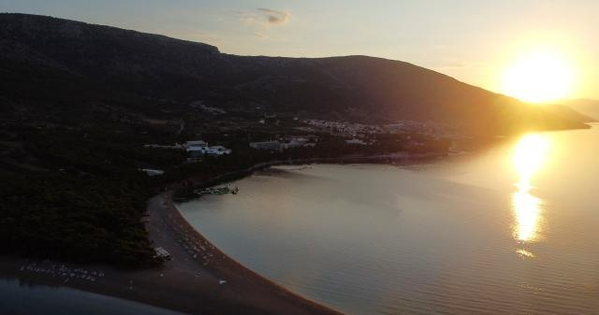
Marine environment
© European Union, 2020

Slide 47
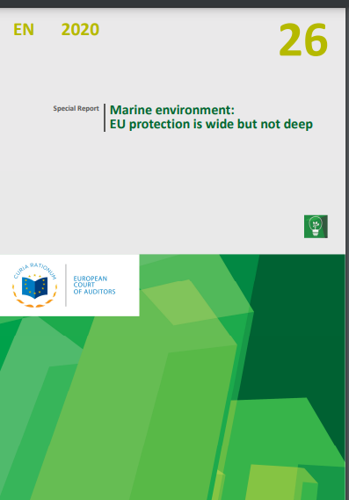
Marine environment
Marine biodiversity and habitat loss: how this challenge was addressed by EU policies and programmes
Framework in place to protect the marine environment but EU actions have not restored seas nor fishing to sustainable levels in all seas
EU protection rules not led to recovery of significant ecosystems and habitats. Marine Protected Areas provide limited protection
Provisions to coordinate fisheries policy with marine protection policy were little used in practice
Relatively few of available funds are used for conservation measures
Measurable improvement in fish stocks in Atlantic, but not in Mediterranean
https://www.eca.europa.eu/Lists/ECADocuments/SR20_26/SR_Marine_environment_EN.pdf
Published in November 2020

Slide 48
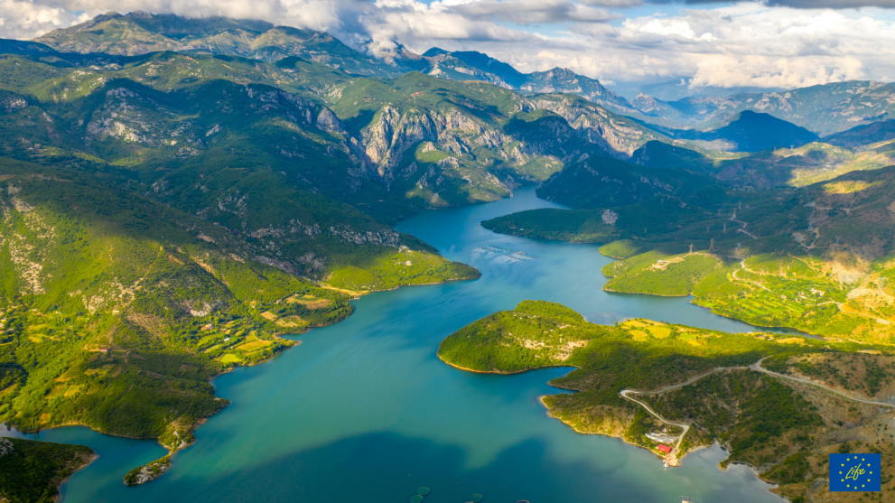
General: EU framework and programmes
© European Union, 2022

Slide 49
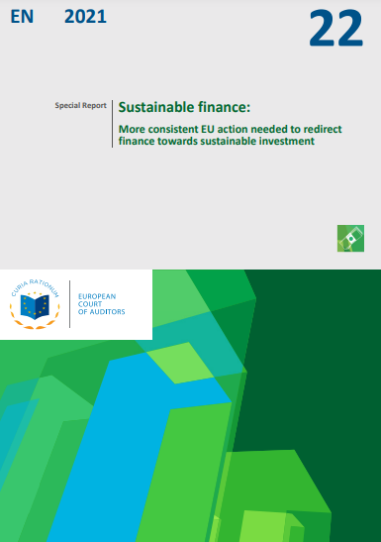
Financing sustainable investment
Published in September 2021
Transition to a net-zero emission economy will require significant private and public investment
Examined whether the Commission had taken the right action to redirect finance towards sustainable investments
More consistent EU action was needed, including measures to address the cost of unsustainable economic activities
Many actions were delayed
Need for consistent criteria to determine the sustainability of EU budget
https://www.eca.europa.eu/Lists/ECADocuments/SR21_22/SR_sustainable-finance_EN.pdf

Slide 50
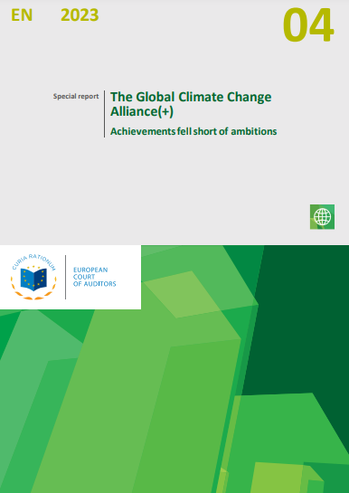
The Global Climate Change Alliance(+)
Published in February 2023
EU initiative to help the poor developing countries most vulnerable to climate change increase their capacity to adapt to the effects of climate change
Completed actions generally delivered their outputs but at a high cost
Initiative did not measure the improvements in the beneficiaries’ situation, nor did it focus sufficiently on the needs of those most affected
Sustainability was limited, and scaling-up of adaptation did not take place
https://www.eca.europa.eu/Lists/ECADocuments/SR23_04/SR_Climate_change_and_aid_EN.pdf

Slide 51
LIFE programme
Green transition (The Recovery and Resilience Facility)
Ongoing audit, publication in 2024
The EU’s temporary instrument designed to boost the recovery of the post-COVID-19 Europe, important instrument towards achieving the European Green Deal
RRF supports the green transition contributing to the EU’s 2030 climate targets and climate neutrality by 2050
Assessing the design and implementation of the measures included in national plans and contribution to EU objectives
Planned audit, publication in 2025
To assess whether the LIFE programme contributed to achieving the EU’s environmental policy objectives effectively
The EU’s LIFE programme 2021-2027 is dedicated entirely to environmental, climate and energy objectives

Slide 52
Floods
Published in November 2018 https://www.eca.europa.eu/Lists/ECADocuments/SR18_25/SR_FLOODS_EN.pdf
Floods Directives had positive effects overall but major challenges remained
Weaknesses in allocation of funds for implementation of flood prevention measures
Improvements of member states’ flood risk management plans were needed
Climate adaptation
Ongoing audit, publication in 2024
Assessing the EU framework (policies, strategies, plans and tools) on climate adaptation, and how it has been integrated and monitored
Effectiveness of EU funding of projects addressing the effects of climate change

Slide 53
Combating desertification in the EU
Published in December 2018 https://www.eca.europa.eu/Lists/ECADocuments/SR18_33/SR_DESERTIFICATION_EN.pdf
Risk of desertification in the EU was not being effectively and efficiently addressed
Steps had been taken to combat desertification but lacked coherence
No shared vision on how land degradation neutrality will be achieved by 2030
Instruments for climate action
Published in October 2018 https://www.eca.europa.eu/Lists/ECADocuments/SR18_24/SR_CCS_EN.pdf
Recommendations to strengthen design of future programmes

Slide 54
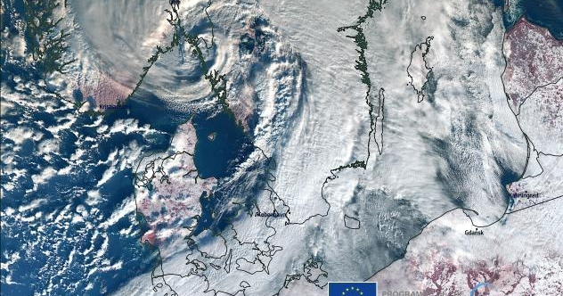
Reporting on climate targets
© European Union, 2024

Slide 55

EU climate and energy targets
Published in June 2023
EU achieved its 2020 climate and energy targets, but some member states did not contribute as expected to the targets
Commission did not assess whether targets were reached due to its policies rather than external factors (2009 financial crisis, COVID-19 pandemic)
EU’s 2020 and 2030 greenhouse gas emissions targets exclude emissions embodied in imported goods, from international aviation, shipping
Little data available on the cost and effects of action taken, or on the future investments needed to reach targets
https://www.eca.europa.eu/ECAPublications/SR-2023-18/SR-2023-18_EN.pdf

Slide 56
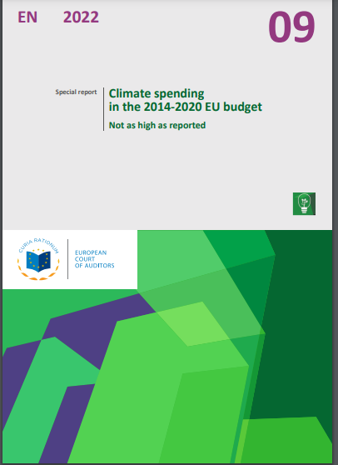
Climate spending in 2014-2020 EU budget
Published in May 2022
EU committed to spending at least 20 % of its 2014-2020 budget on climate action
The Commission announced that the EU met the target (€216 billion)
Reported spending was not always relevant to climate action and climate reporting was overstated overall. (at least €72 billion)
Recommendations aimed to enhance climate reporting: link the EU’s budgetary contribution to its climate and energy objectives, and obtain scientific evidence to support the reported contribution
https://www.eca.europa.eu/Lists/ECADocuments/SR22_09/SR_Climate-mainstreaming_EN.pdf

Slide 57
European Environmental Economic Accounts
Published in October 2019 https://www.eca.europa.eu/Lists/ECADocuments/SR19_16/SR_EEEA_EN.pdf
The Accounts are important source of data to monitor and evaluate environmental policies
A statistical framework with a comprehensive tables and accounts describing relationship between the environment and EU economy
Found that EEEA modules were not used to their full potential

Slide 58
Contact details
Wilfred Aquilina
Assistant to the Director, Audit Quality
wilfred.aquilina@eca.europa.eu
Want to know more about our work:
Visit our website: eca.europa.eu
Follow us on X @EUAuditors
Check our page on LinkedIn, Instagram and Facebook
Watch our videos on YouTube: EUAuditorsECA
Contact us at: https://www.eca.europa.eu/en/contact

