Slide 1

March 2024
INTOSAI PAS annual meeting
A Design Thinking Approach
to enhance innovative auditing for SDGs
INTOSAI
PRESENTATION
PAS
Presented by:
Dr. Matulee Yokee
Director of Performance Audit Office No. 3
State Audit Office of the kingdom of Thailand

Slide 2

O U T L I N E
BACKGROUND OF
THIS STUDY SURVEY
DESIGN THINKING
IN ACTION
LABORATORY CONTRIBUTIONS
TO AUDITING
02

Slide 3


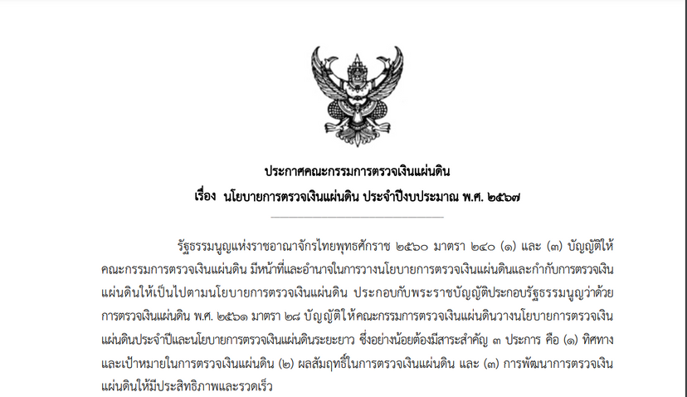
BACKGROUND
1.
State Audit Policy
State Audit Policy 2024
State Audit Policy 2023 - 2027
03

Slide 4

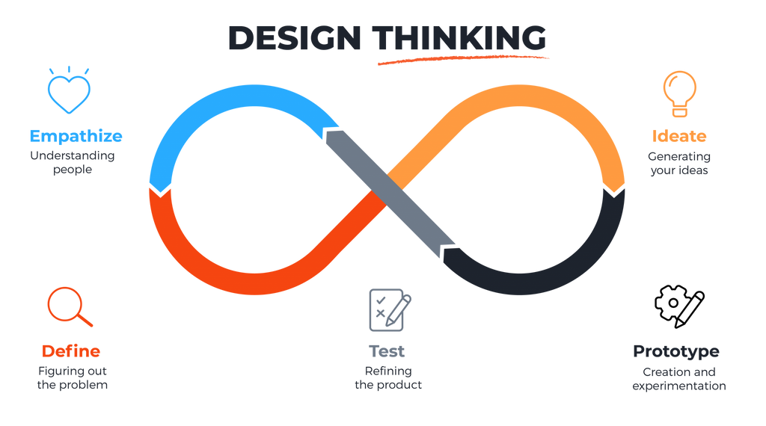
BACKGROUND
2.
The implementation of ISAM in performance audits and the application of a Design Thinking approach
04
https://www.maqe.com/insight/the-design-thinking-process-how-does-it-work/

Slide 5





BACKGROUND
3.
Laboratory SDGs audit
Why Laboratory and ISAM?
How the Laboratory Functions
Stakeholder-Centric SDG Audit:
The Core Message
05

Slide 6



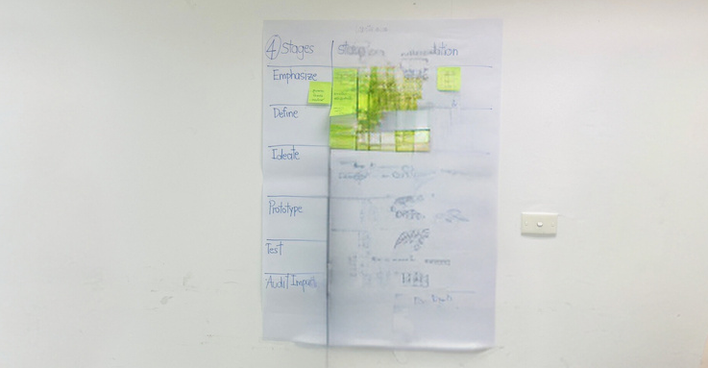




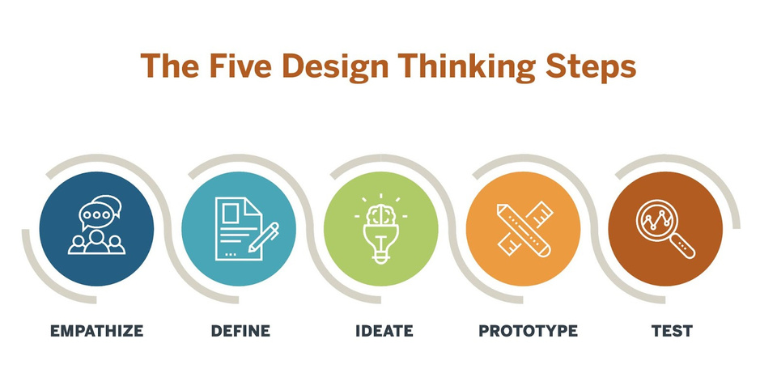
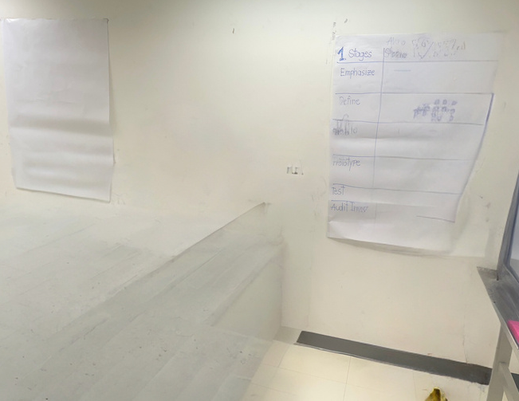
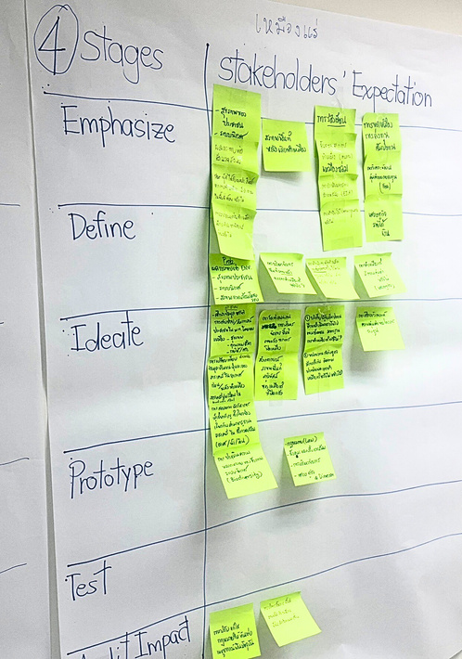





Design Thinking
in Action
1.
Lab Clink
Lab Clink: Stakeholder-Centric SDGs Audit Development
This phase encompasses five stages of Design Thinking, intertwined with stakeholder expectations
https://www.maqe.com/insight/the-design-thinking-process-how-does-it-work/
06

Slide 7

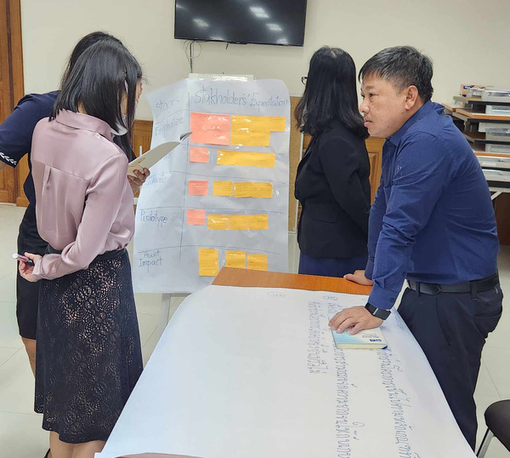
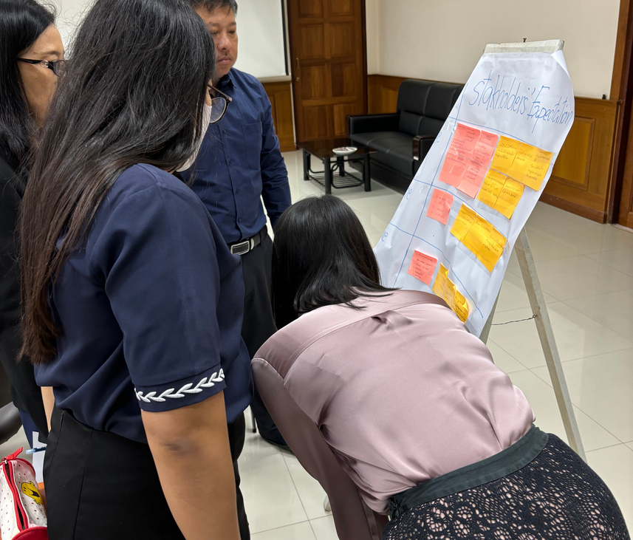

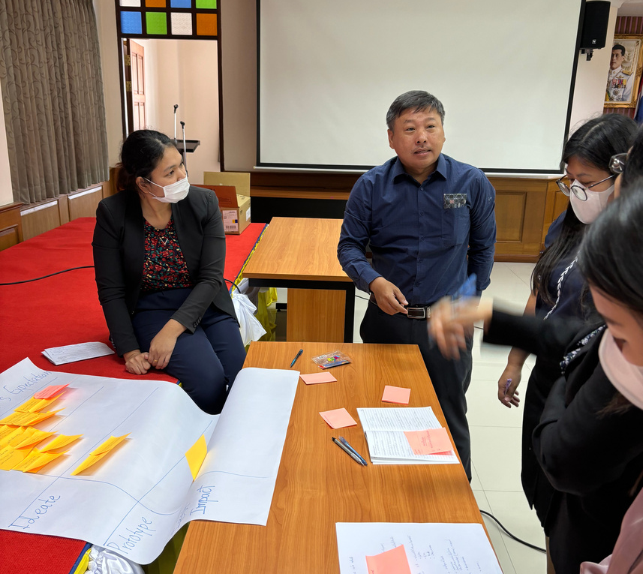
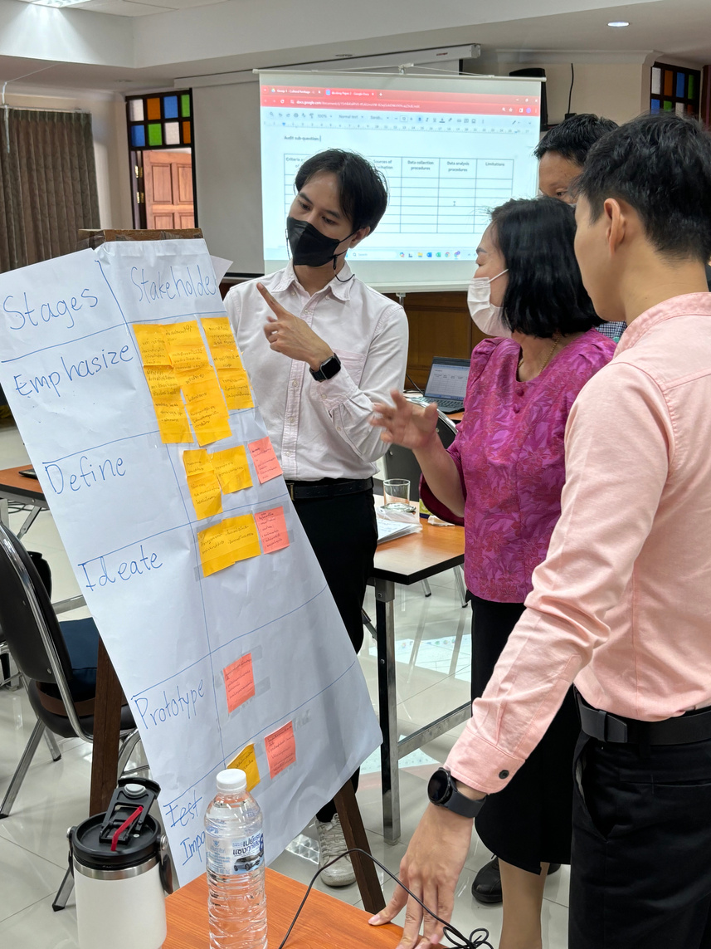
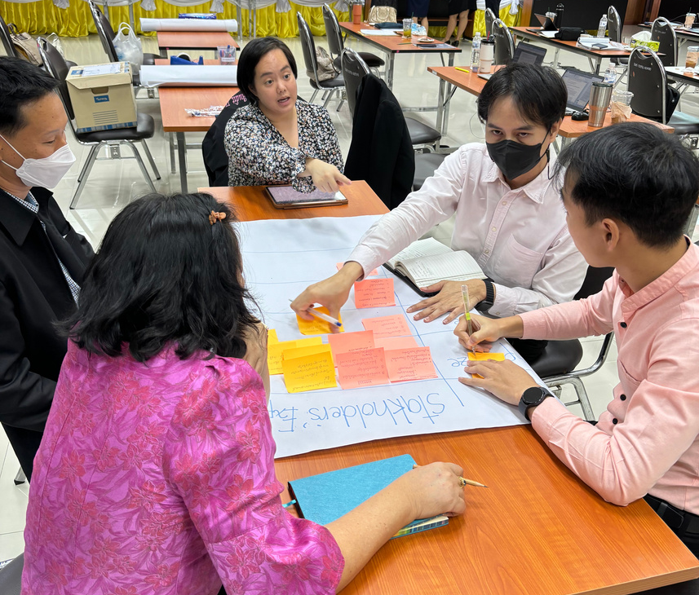




Design Thinking
07
in Action
2.
"Ten Minutes with Audit Questions Game."
  A platform for stakeholder feedback
  Emphasizes the importance of
stakeholder perspectives

Slide 8
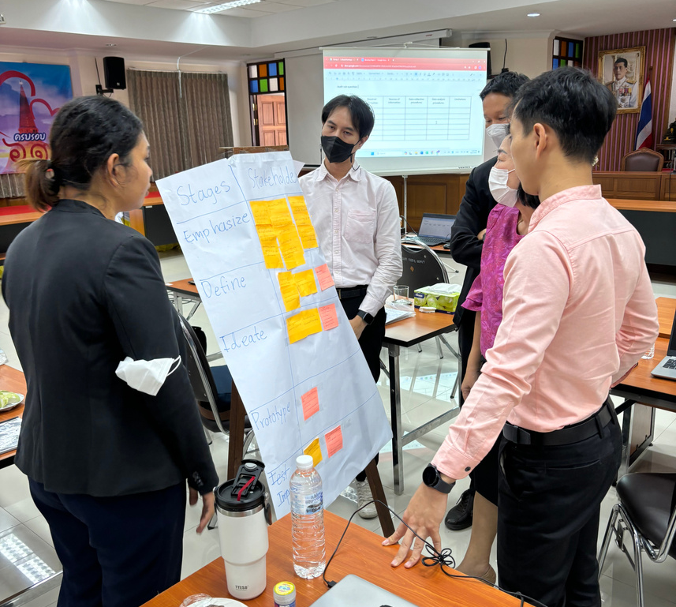
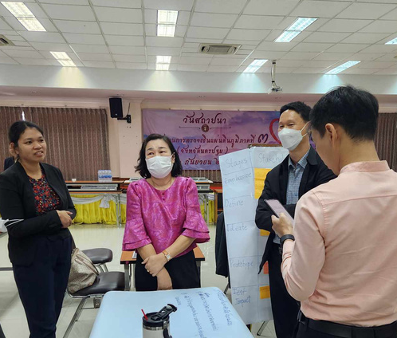
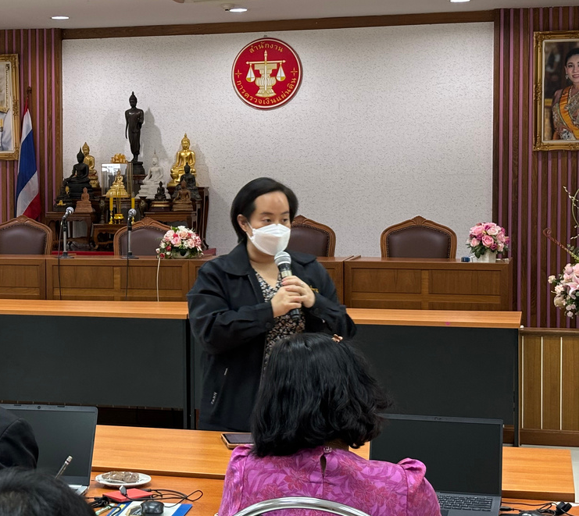
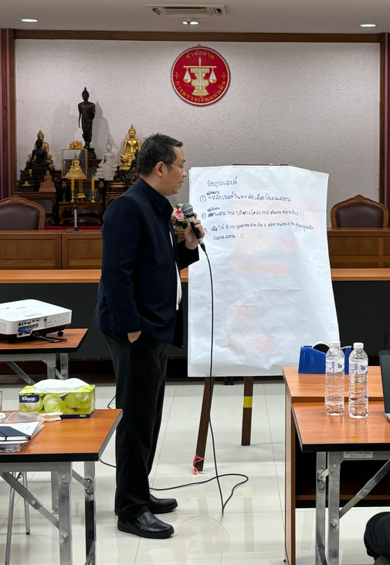
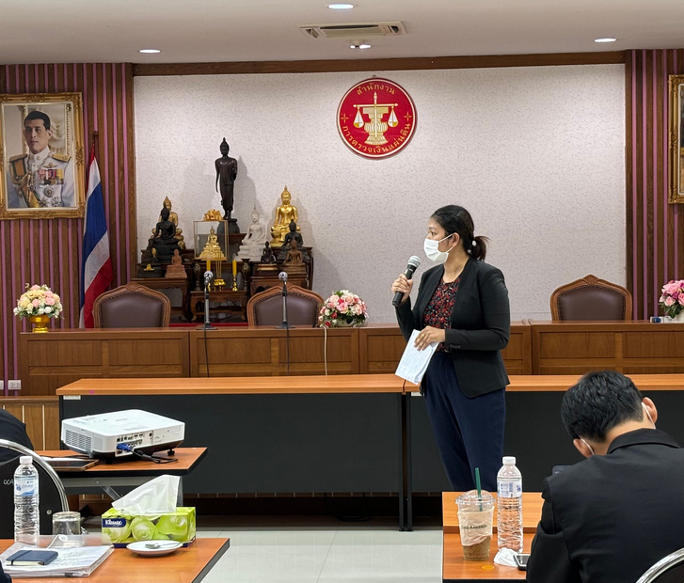
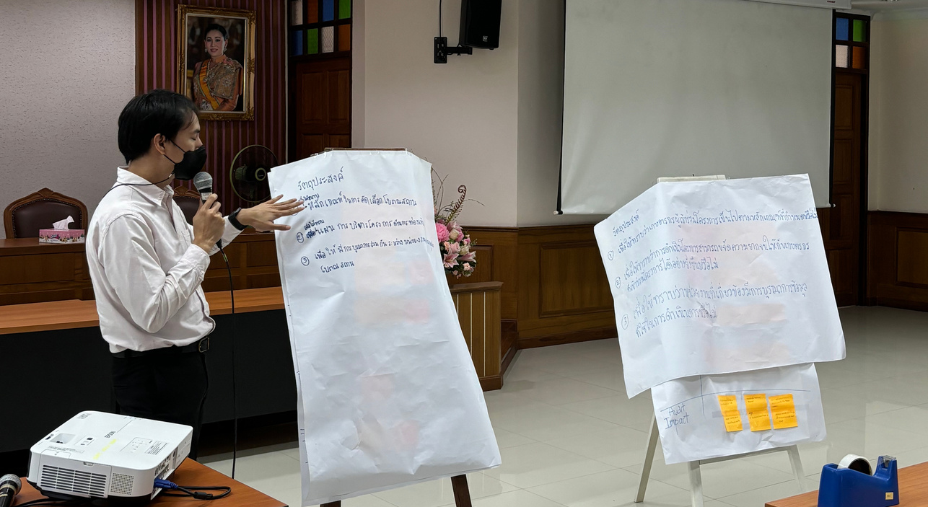
Design Thinking
08
in Action
3.
"AFM Completion Challenge Game"
  Another key component of the laboratory's approach
  Mock AFM:
- demonstrates how findings are systematically organized
- analyzed in the context of an audit

Slide 9

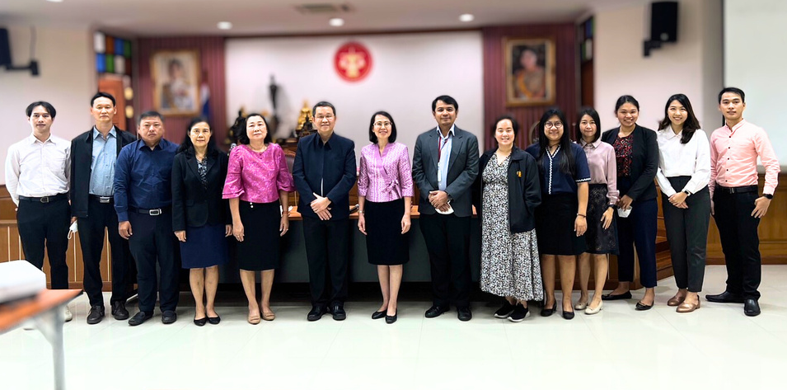
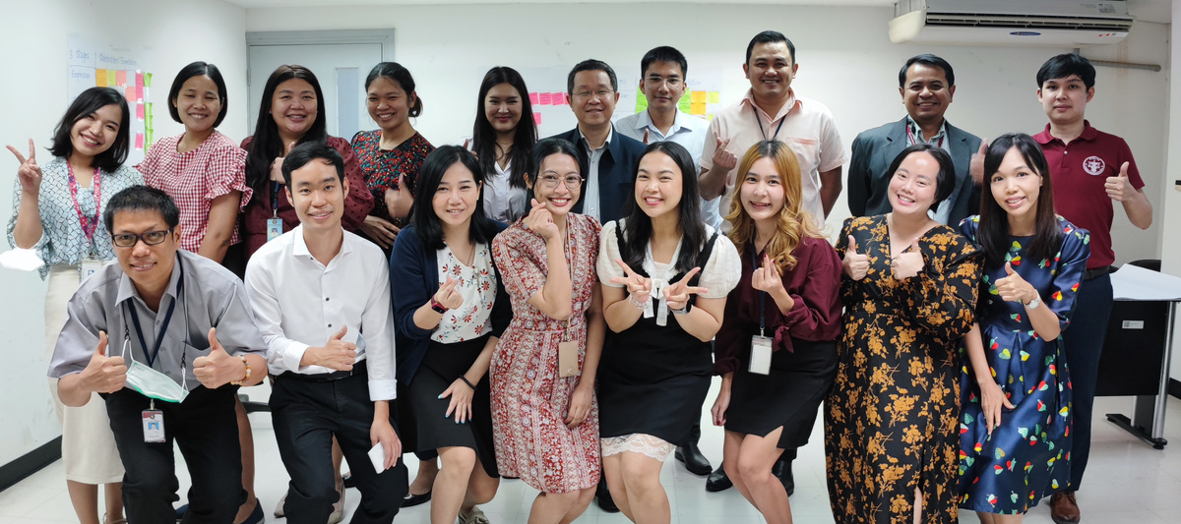
Laboratory Contributions
The Laboratory SDGs Audit by SAI Thailand makes significant contributions to the field of auditing, especially in the context of SDGs:
  Enhanced understanding of SDGs audit
  Capability to implement ISAM
  Development of critical skills
09

