Slide 1


Role of Artificial Intelligence in Performance Audit
Presented by:
SAI, India

Slide 2
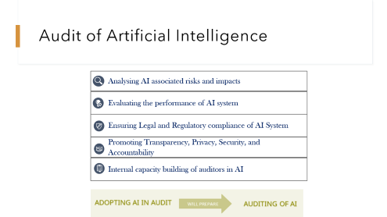
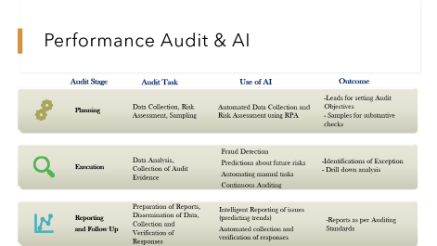
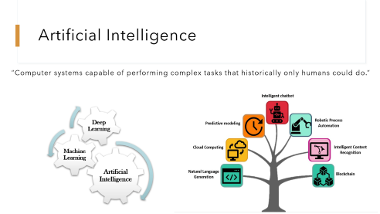
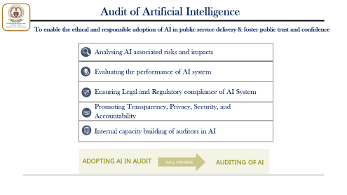

Overview
Artificial Intelligence
Performance Audit & AI
Next Steps

Slide 3
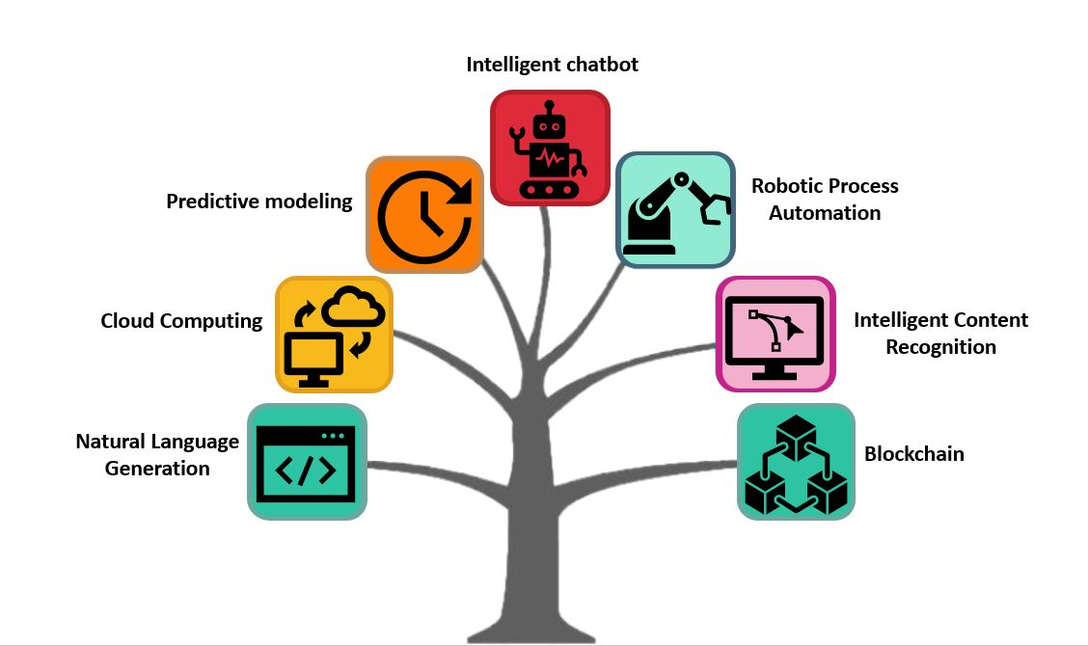
Artificial Intelligence
“Computer systems capable of performing complex tasks that historically only humans could do.”
Artificial Intelligence
Machine Learning
Deep Learning

Slide 4



Case for adoption of AI
Explosion of 3 Vs

Slide 5
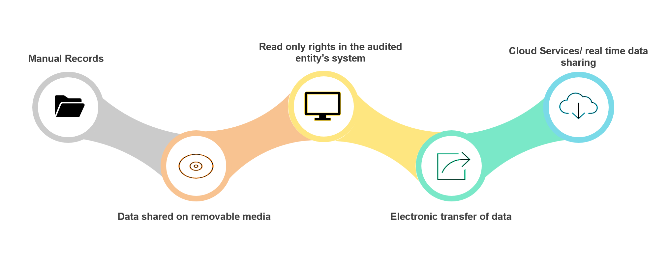
Case for Integration of AI in Audit Process
- Shift from the use of sampling to the analysis of entire populations and/ or even including analysis of unstructured data
- Use of AI techniques and rigorous analytical procedures increases the confidence of Auditors in expressing an Opinion

Slide 6
Performance Audit & AI
Audit Stage
Audit Task
Use of AI
Outcome
Planning
Automated Data Collection and Risk Assessment using RPA
Execution
Fraud Detection
Predictions about future risks
Automating manual tasks
Continuous Auditing
Reporting
and Follow Up
Intelligent Reporting of issues (predicting trends)
Automated collection and verification of responses
-Leads for setting Audit Objectives
- Samples for substantive checks
Data Collection, Risk Assessment, Sampling
Data Analysis,
Collection of Audit Evidence
-Identifications of Exception
- Drill down analysis
Preparation of Reports, Dissemination of Data, Collection and Verification of Responses
-Reports as per Auditing Standards

Slide 7


Case -1 : Use of AI to detect Non-existent Schools/ Ineligible Students claiming Scholarship Benefits
Objective
Problem Statements
To assess the genuineness of the students and the schools through which the scholarship is claimed
- The huge data size and geographical distribution of the schools across the country meant that it was not possible to physically verify all the existing schools.

Slide 8
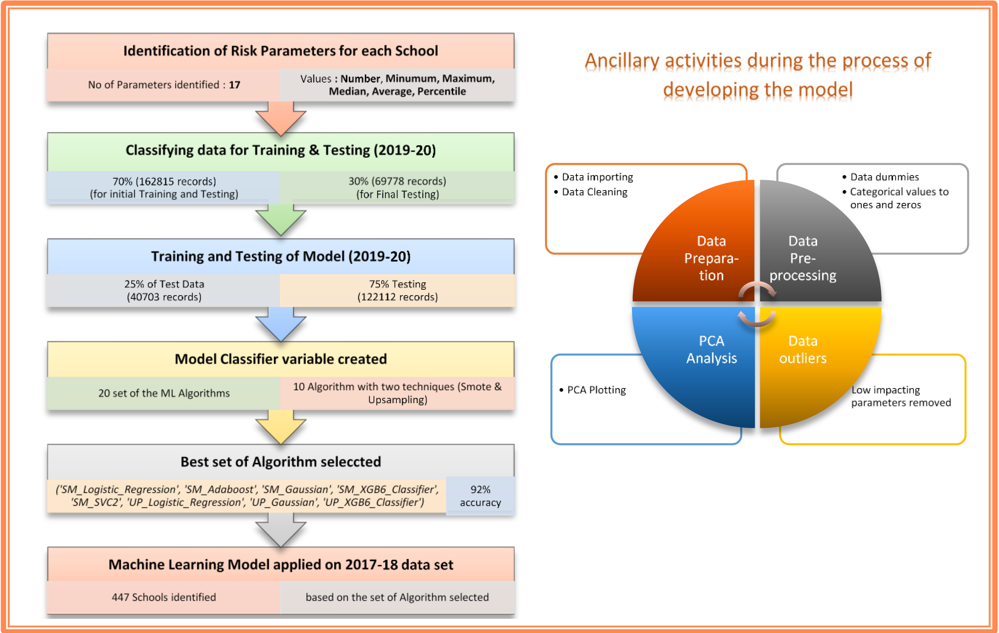
Case 1 - Use of AI to detect Non-existent Schools/ Ineligible Students claiming Scholarship Benefits
Outcome
The model achieved above 92% accuracy.
This helped in identifying 447 risky samples for field level verification

Slide 9

Case 2 - Detection of Collusion in Government Procurement
Objective
Problem Statement
To ensure that anti-competitive practices are not being followed in the government procurement being carried out through E-Procurement portal
- The challenge was to identify network of bidders who may bid in collusion, the data of which may grow exponentially by forming combinations of bidders

Slide 10
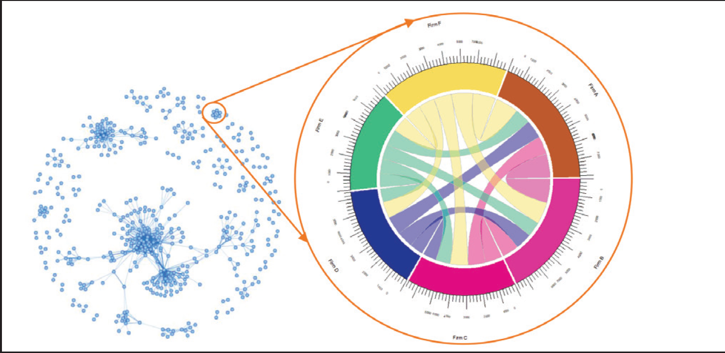
Case 2 - Detection of Collusion in Government Procurement
Solution
Outcome
The bid data was converted into graph with nodes and edges. Further, required weights were also allocated to these edges according to the number of tenders in which the bidders have participated together. Plotting this graph object we were able to detect connections between each of the bidders in the procurement system.
484 bidders were identified who were participating together for more than 500 tenders.

Slide 11

Case 3 - Use of AI in Identifying Circular Trading Transactions in Taxation
B
C
D
E
A
Objective
Problem Statement
To provide a reasonable assurance that the E-Waybill mechanism is effective in protecting revenue interest of Government
Circular trading normally is used to issue fake invoices in transactions among multiple parties without actual supply of goods.
Complexity of detecting multiple relations hidden in the data set.

Slide 12


Use of AI in Identifying Circular Trading Transactions in Taxation
Solution
Outcome
Using AI Algorithms, specific types of circular transactions with up to 8 iterations were identified. The model was trained and tested on the selected E-Way Bill data set (around 75,000 records) related to Taxation in India.
A total of 322 different circular path trading was noticed in the selected data set .

Slide 13


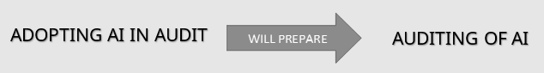
Audit of Artificial Intelligence
Analysing AI associated risks and impacts
Evaluating the performance of AI system
Ensuring Legal and Regulatory compliance of AI System
Promoting Transparency, Privacy, Security, and Accountability
Internal capacity building of auditors in AI

Slide 14
Development of LLM based Audit Application
Use of LLM in making an audit application which can be used by non-tech savvy auditors for generating queries for auditing any department/scheme.
LLM should be trained using audit reports, inspection reports, guidelines, ISSAI and any other documents which department uses in audit
As part of WGBD project SAI India is already working on such an application to assist effective auditing by field audit teams
The prompts will just be like ChatGPT wherein auditors can put in queries like what can be the audit questions for auditing transport department and the result will be extracted by various inspection reports using which model was trained .
These LLMs can be referred to as SLMs as predominantly the size and number of documents will be less

Slide 15

Thank You
გმადლობთ

