Slide 1




REPUBLIC of AZERBAIJAN
CHAMBER of ACCOUNTS
PROFESSIONALIZATION of PERFORMANCE AUDITORS
(SAI of Azerbaijan Practice)
Presentation by Mr. Sanan Aghakishiyev, SAI of Azerbaijan

Slide 2


AGENDA
Background on Performance Auditing
Activities in a PAS and PESA-P frameworks
Performance Audit practice
Audit of SDG implementation
as a part Performance Audits
Challenges

Slide 3



Background on Performance Auditing
Institutional Building Technical Assistance-2 Project,
Australian National Audit Office, World Bank, 2004-2005
- trainings
- study tours
- 2 pilot performance audits
Corporate and Public Sector Accountability Project, ECORYS Nederland and CIPFA (The Chartered Institute of Public Finance and Accountancy), World Bank, 2014-2015
- trainings
- study tours
- 2 pilot performance audits

Slide 4



Background on Performance Auditing
Twinning project on Strengthening the Institutional and Administrative Capacity of the Chamber of Accounts, Supreme Audit Office of Poland, Supreme Audit Office of Slovak Republic, European Union, 2017-2020
In 2018 Performance Audit had included to mandate of our SAI
In 2020 Performance Audit Division was established and in 2021 it transformed to Performance Audit Department
In 2021 Performance Audit Guideline prepared and it amended in 2023

Slide 5



Activities in a PAS and
PESA-P frameworks
Member of the PAS since 2020
Comments and proposals were issued to
7 draft documents of PAS
Participation in 14th annual INTOSAI Performance
Audit Sub-committee meeting and in
online meetings
2 PESA-P certificates

Slide 6
Performance Audit practice

Slide 7




Performance Audit practice (cont.).
Areas of PAs

Slide 8




Audit of SDG implementation as a part
of Performance Audits

Slide 9
Audit of SDG implementation as a part
of Performance Audits
 | Global SDG indicator framework | Calculated by State Statistical Committee
Number of SDG Indicators | 248 | 108
Number of SDG Indicators, evaluated in Performance Audits | 17 | 8

Slide 10

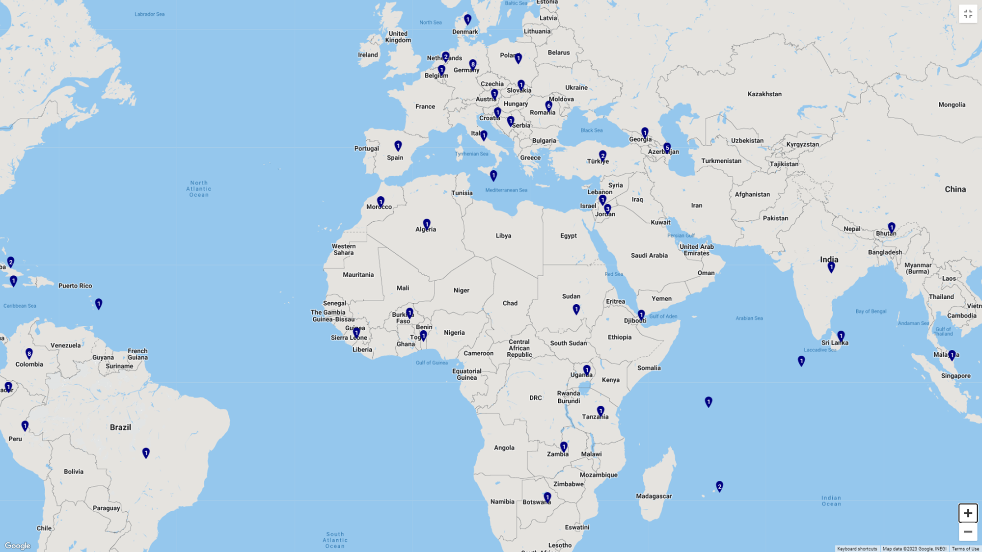

Audit of SDG implementation as a part
of Performance Audits
INTOSAI Atlas on SDGs (this tool provides us with an overview of the reports on the SDGs published by the INTOSAI member SAIs)

Slide 11


Challenges
Strategic planning
Performance budgeting
Cost-Benefit Analysis and Cost-Effectiveness Analysis
Understanding by audit entities and Effective communication of audit findings
Ensuring follow-up and implementation of recommendations
Professional capacities

Slide 12

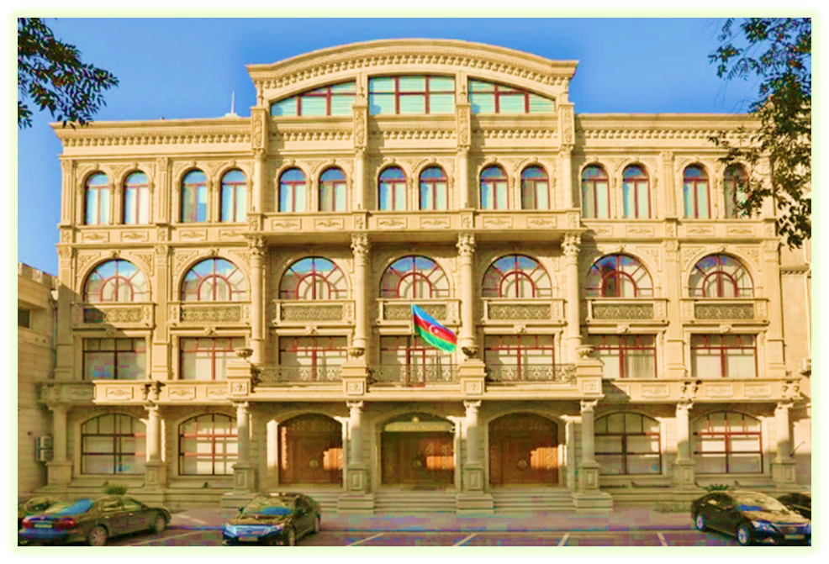
REPUBLIC of AZERBAIJAN
CHAMBER of ACCOUNTS
THANKS FOR YOUR ATTENTION!!!
Presented by Mr. Sanan Aghakishiyev, SAI of Azerbaijan

