Slide 1

Performance Audit ISSAI Implementation Handbook
Cathy Berrick
Managing Director
U.S. Government Accountability Office (GAO)

Slide 2

How does the Handbook
Facilitate the Application of the ISSAIs in Practice?
IDI, in partnership with the PAS, developed the Handbook in response to feedback from SAIs on the need for an auditor handbook for conducting ISSAI compliant audits.
Contains detailed explanations of the performance audit process with illustrative examples and templates.
Consolidates good practices from SAI community aligned with ISSAIs.
Is used as the basis for IDI’s Professional Education for SAI Auditors (PESA) training and certification of competence as an IDI Certified SAI Auditor.

Slide 3
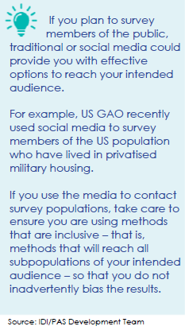
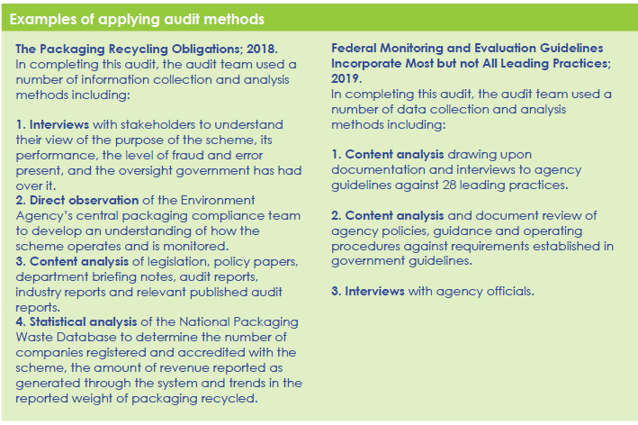
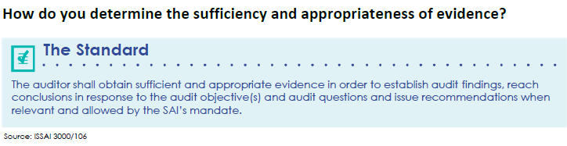
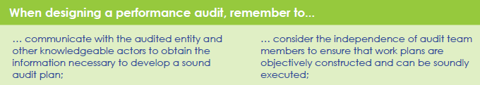
How is the Handbook Organized?
Written in plain language and presented from an auditor’s perspective.
Visual heavy, with many graphics, charts and templates.
Links to relevant guidance, auditing standards, and reference materials from SAIs around the world.
Definitions, tip sections, and call-out boxes to highlight important information and notes.
Examples throughout from actual SAI performance audits.

Slide 4
Key Principles of High-Quality Performance Audits
quality control;
independence and ethics;
professional judgement and scepticism;
audit team competence;
materiality;
audit documentation and audit supervision;
audit risk and assurance; and
communication with audited entities, external stakeholders, media and the public.
Eight Key Principles should be considered during every step of a performance audit.
Without these principles, SAIs and auditors will not be well-positioned to effectively execute performance audits and thus achieve improvements in economy, efficiency and effectiveness.

Slide 5
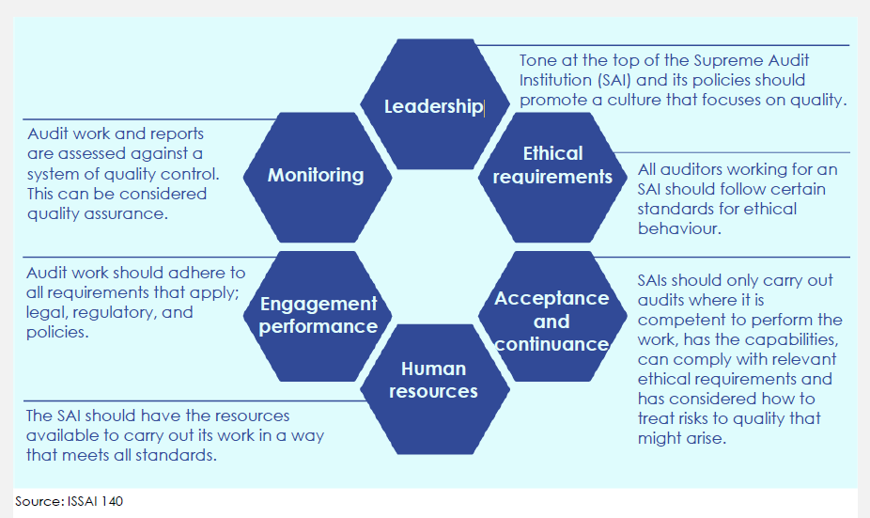
Key Principle of High-Quality Performance Audits: Quality Control

Slide 6
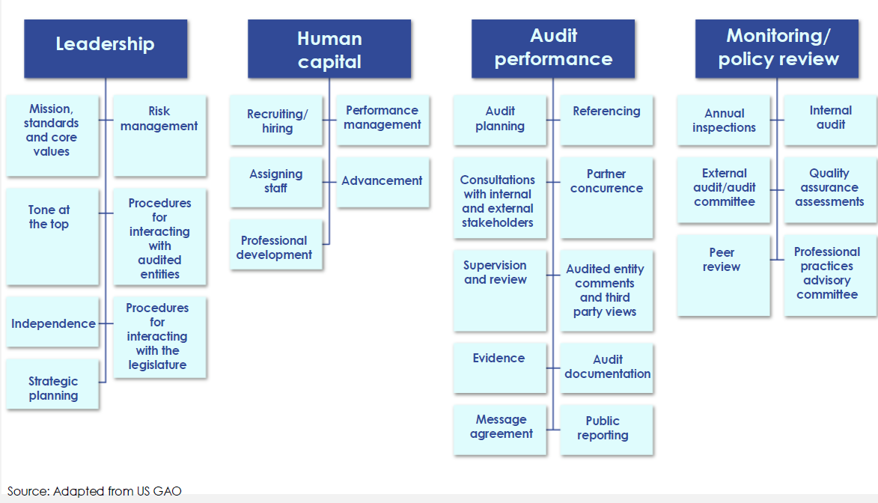
Quality Control – Example of SAI Quality Assurance Framework

Slide 7
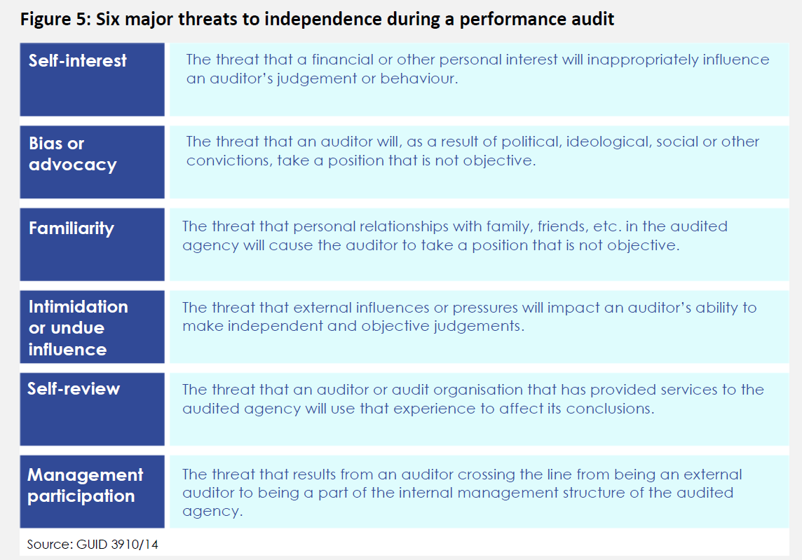
Key Principle of High-Quality Performance Audits: Independence and Ethics

Slide 8
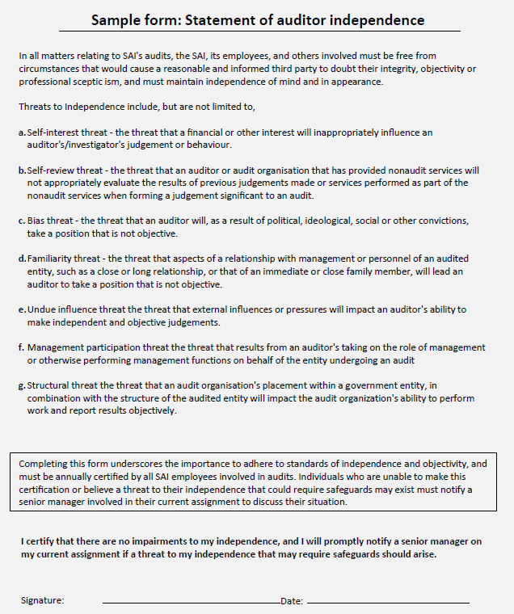
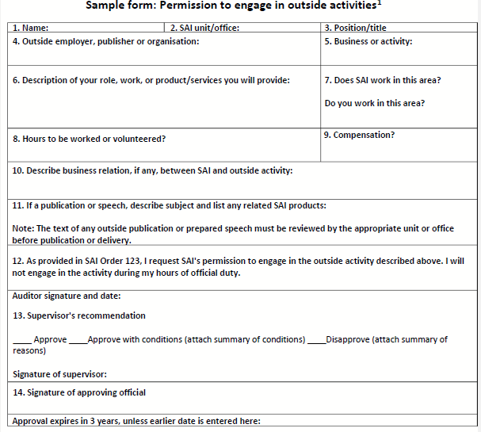
Independence and Ethics – Example of Forms to Document Auditor Independence

Slide 9
The Performance Audit Process

Slide 10
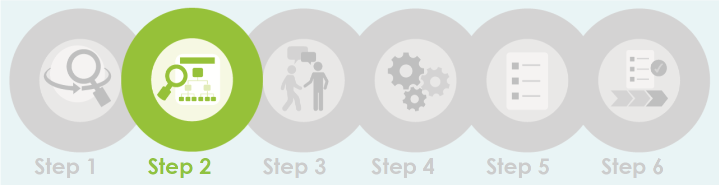
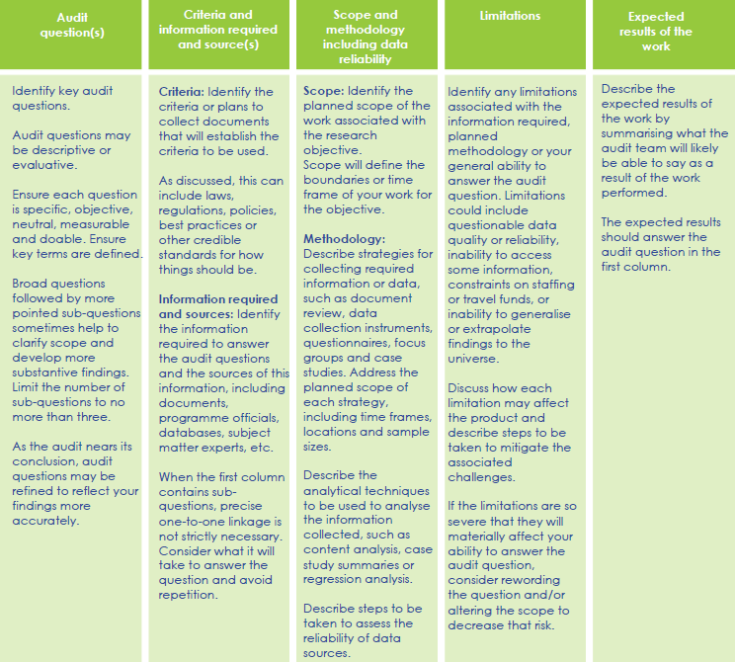
Example: Design Matrix Template
Designing the Audit
Good audit design is one of the most important aspects of effective performance audits and involves several sequential steps.
As they consider design, audit teams should use a design paper to document and link an audit’s scope, objectives, criteria, and methods and assure a logical chain of reasoning between the audit’s approach and likely results.

Slide 11

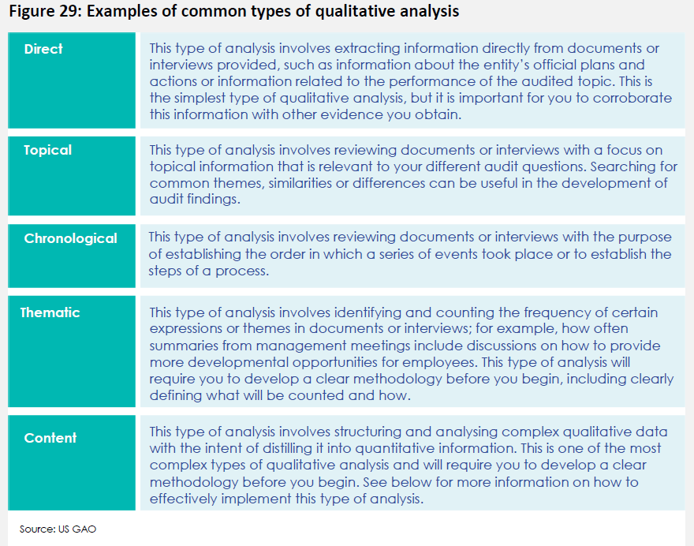
Conducting the Audit
Qualitative analysis
Document review
Case Studies
Surveys
Interviews
Focus groups
Content analysis

Slide 12
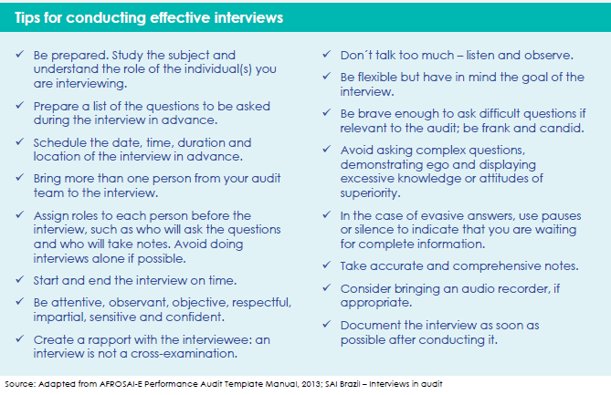
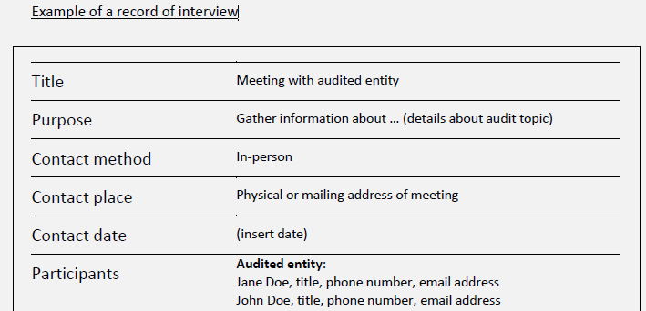
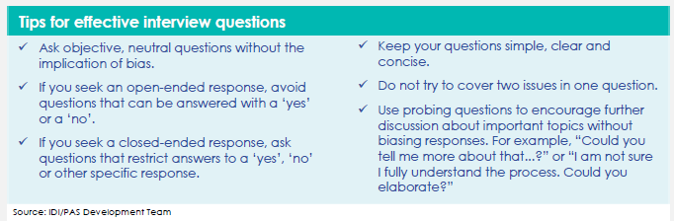
Conducting the Audit
Qualitative Analysis Example – Effective Interviewing

Slide 13
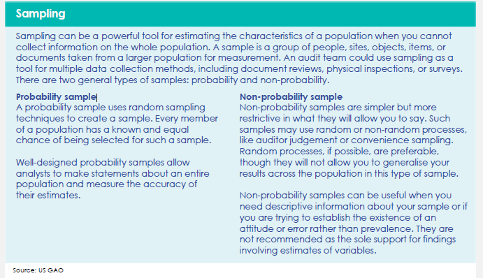
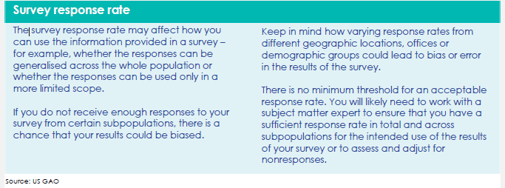
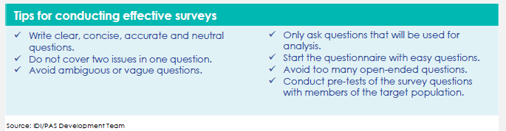
Conducting the Audit
Qualitative Analysis Example – Surveys
Identifying the survey population
Sampling (generalizable or non-generalizable)
Methods for administering survey
Analyzing and documenting results

Slide 14
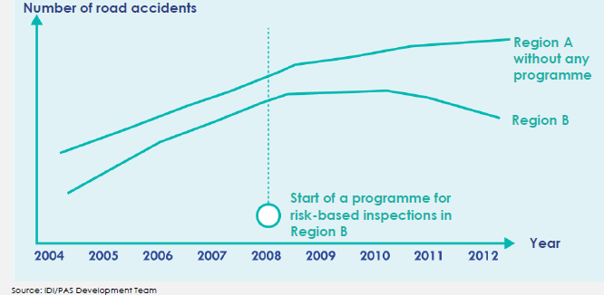
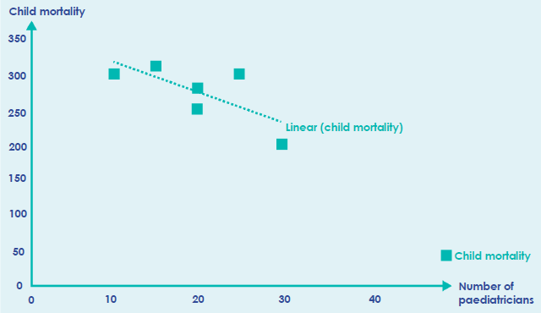
Conducting the Audit
Example of Trend Analysis
Quantitative Analysis
Statistical Analysis
Descriptive Statistics
Regression Analysis
Trend Analysis
Important Considerations
Data Reliability
Using graphics for communicating results
Example of Regression Analysis

Slide 15
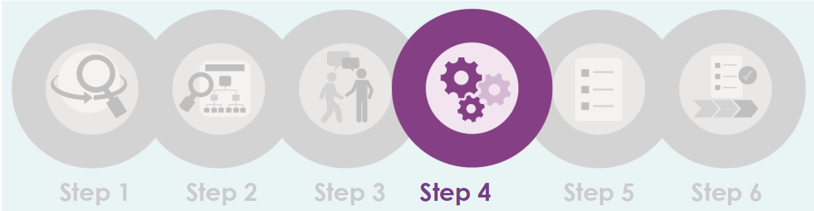
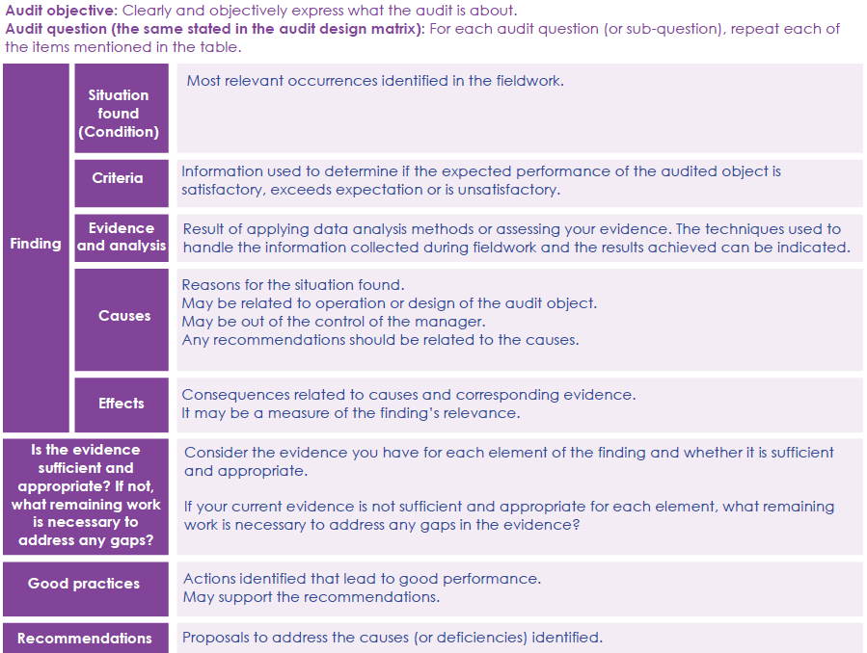
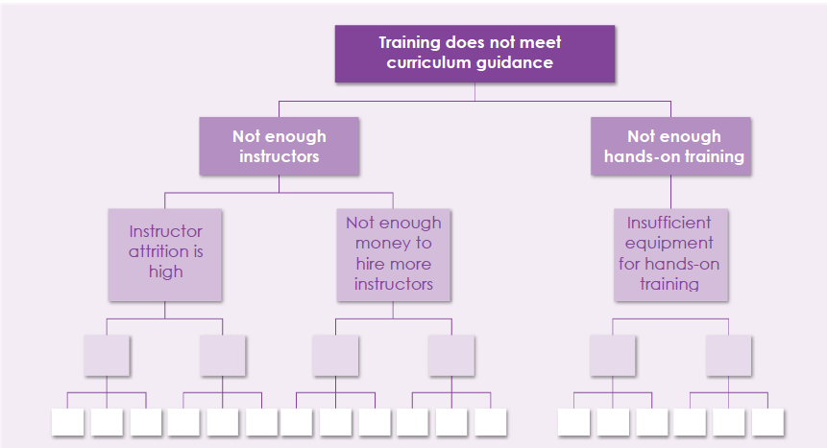
Developing Findings, Conclusions, and Recommendations
Example: Audit Findings Matrix
Assessment of evidence to identify audit findings and draft conclusions and recommendations, if applicable.
Example: Organization Chart for Evidence Assessment

Slide 16

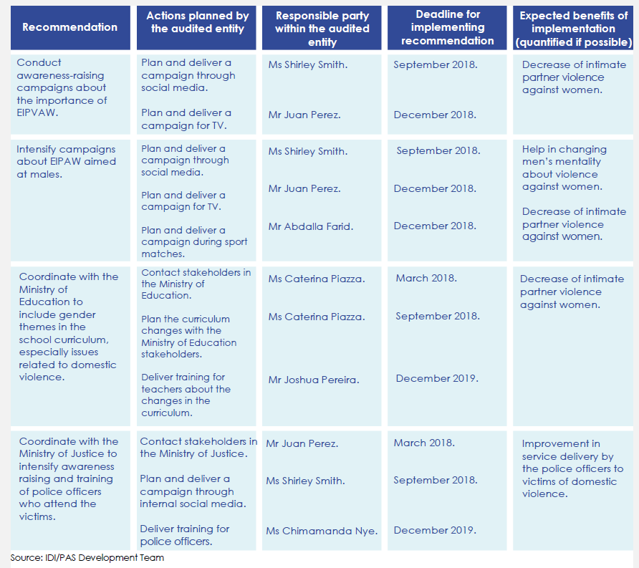
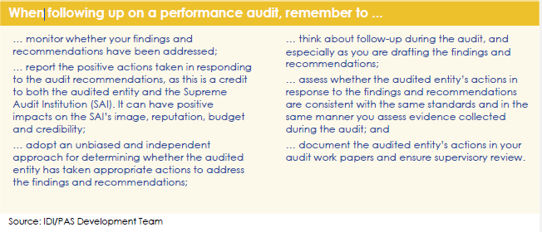
Following Up on Audit Results
Importance of Audit Follow Up and How to Follow Up

Slide 17
Nearly 50 pages of high-quality and useful examples of auditing tools and forms collected from SAIs, including:
  Sample initial meeting of audit agenda
  SWOT (Strengths, Weaknesses, Opportunities and Threats) analysis matrix
  Audit design paper checklist
  Sample audit project schedule
  Guides for planning and conducting audit interviews
  Sample records and plans for data reliability assessments
  Guidance and tools for sophisticated methodologies like surveys, content analysis, regression analysis, etc.
  Sample formats for clear and concise report summaries
Handbook Appendices

Slide 18
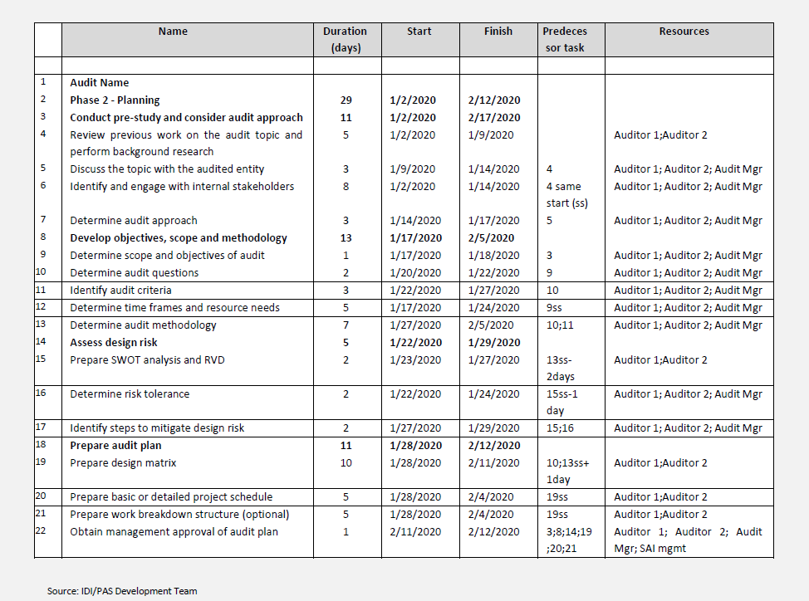
Sample Appendix Tools: Detailed project schedule

Slide 19
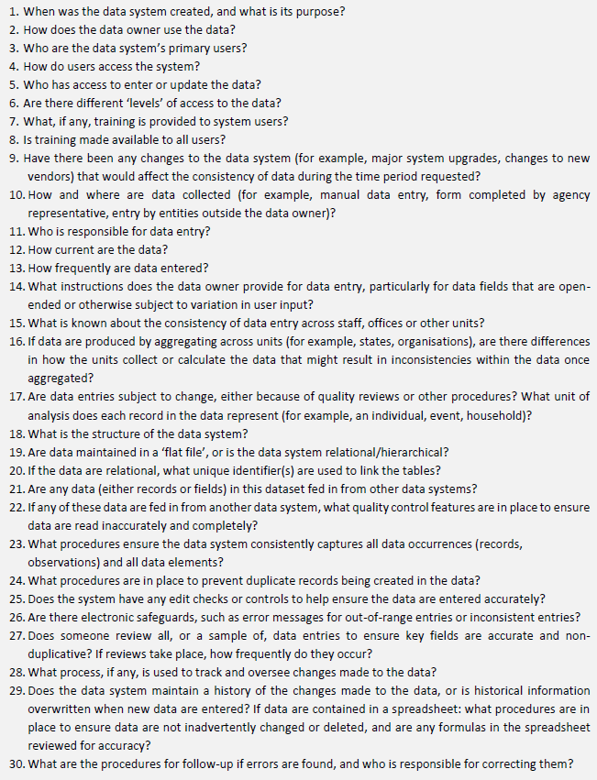
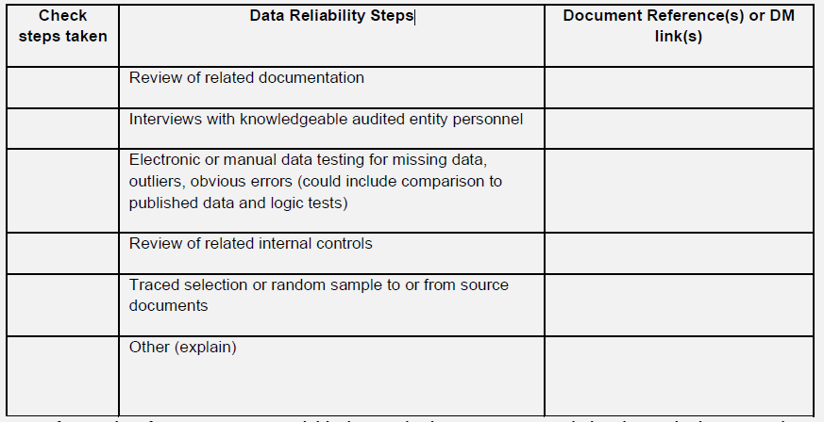
Sample Appendix Tools:
Data Reliability

Slide 20
Questions?
Contacts: Cathy Berrick, US GAO at berrickc@gao.gov
Maria Lucia Lima, IDI at Maria.lima@idi.no
Handbook available on the INTOSAI Development Initiative (IDI) website at Performance Audit ISSAI Implementation Handbook (idi.no)
20

