Slide 1
First Nations peoples’ involvement in audits of Indigenous land councils
Christine Chalmers
Executive Director
Performance Audit Services Group

Slide 2
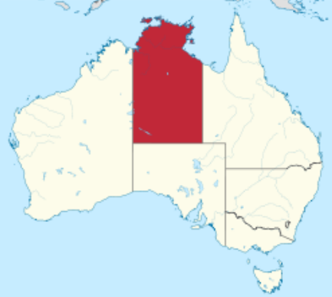
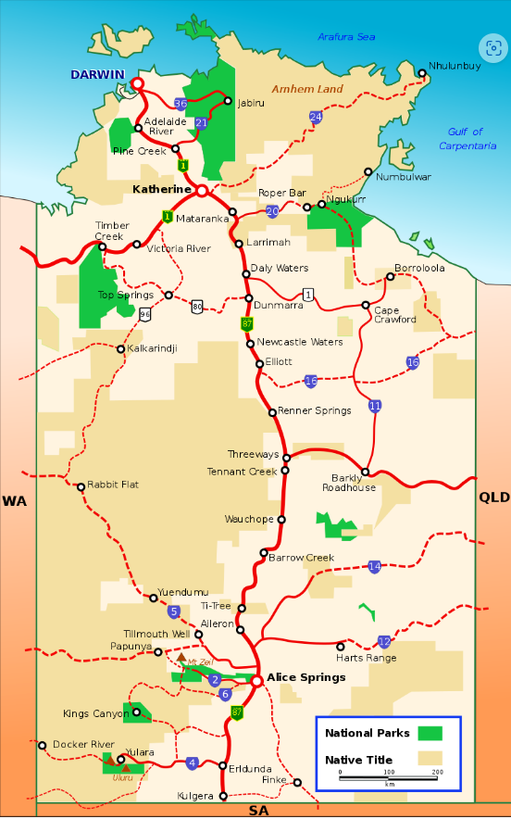
Northern Territory land councils

Slide 3




Northern Territory land councils
Northern
Anindilyakwa
Tiwi
Central

Slide 4
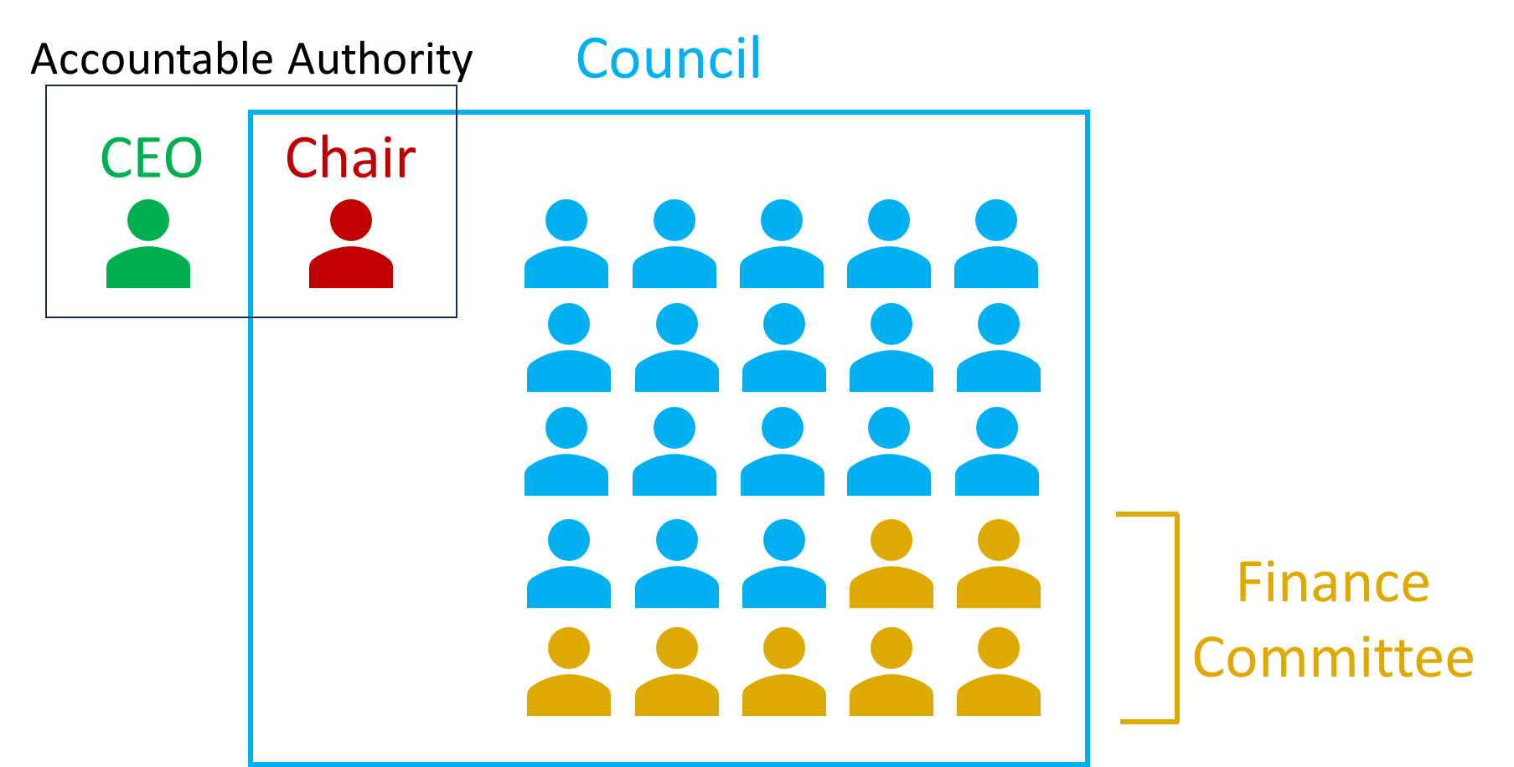
Northern Territory land councils

Slide 5
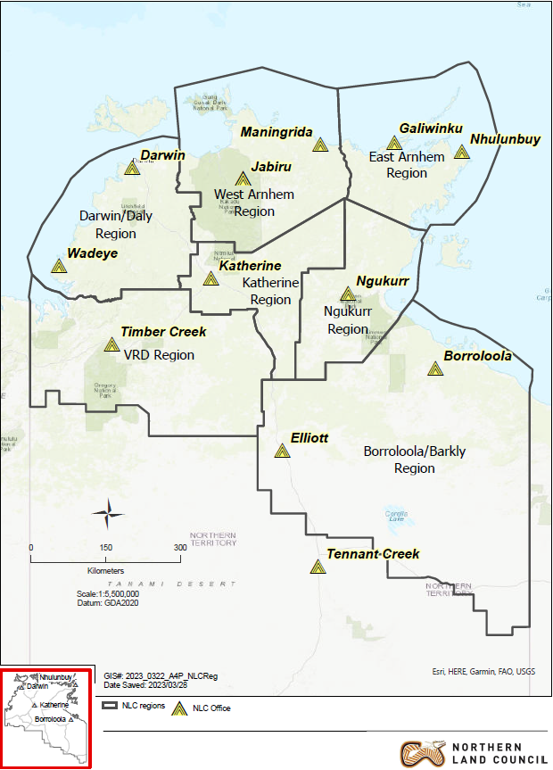
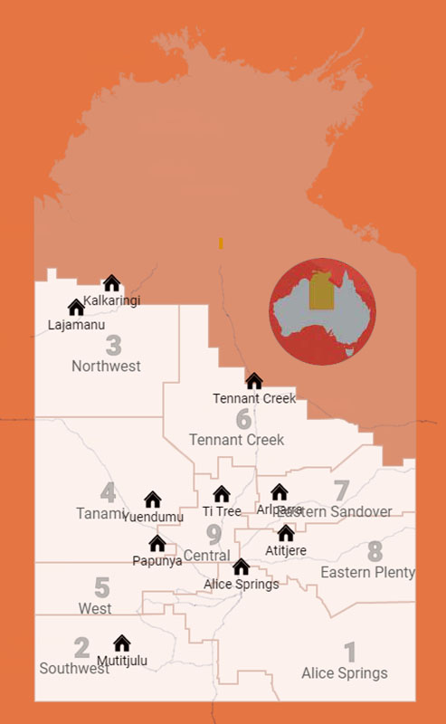
Northern Territory land councils

Slide 6
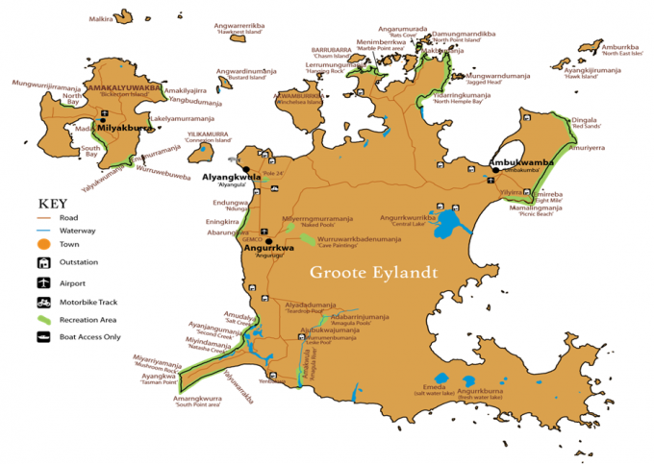
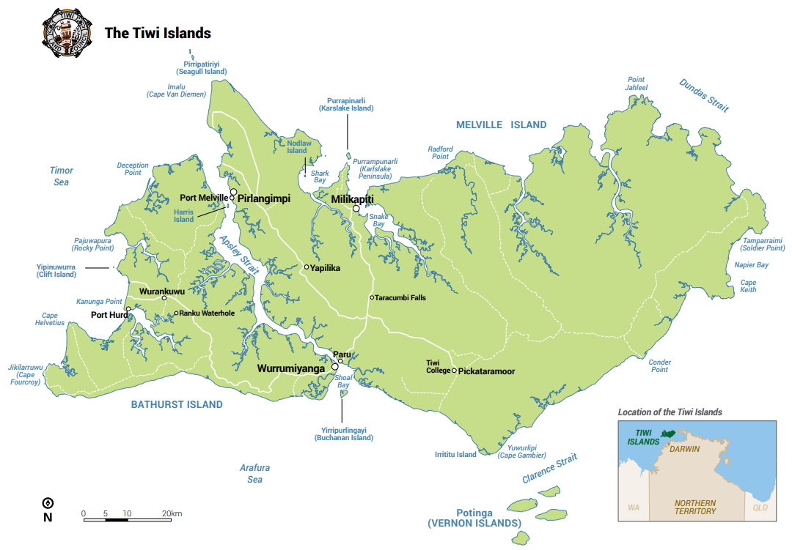
Northern Territory land councils

Slide 7
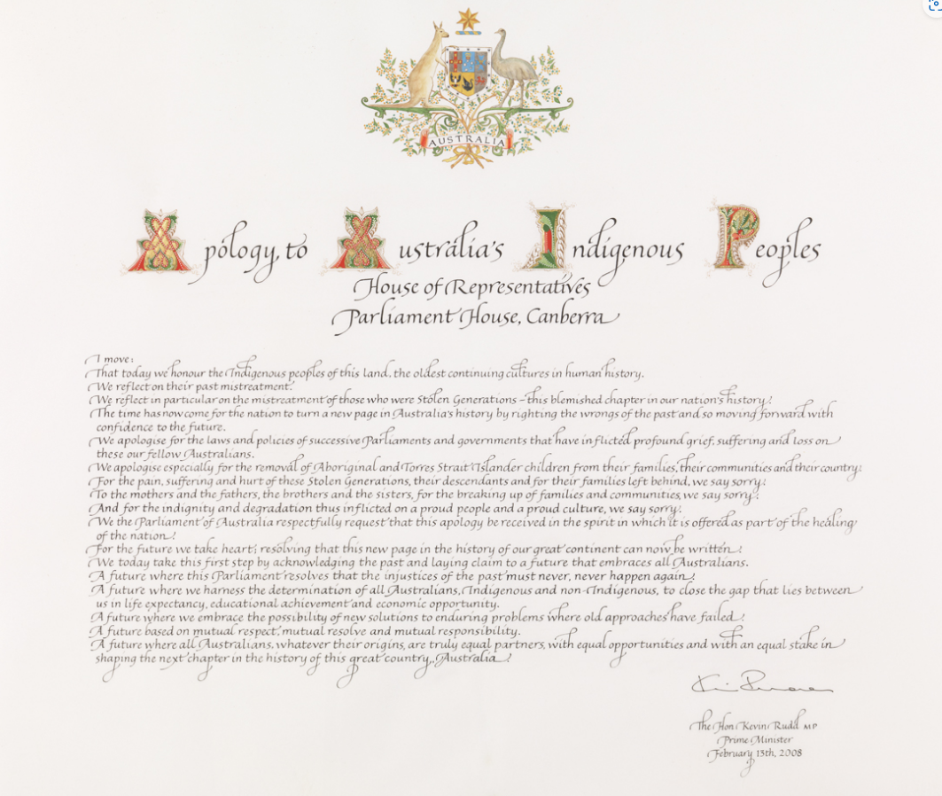


Auditing challenges
1967
2008
2023

Slide 8
Auditing challenges
Credibility and cultural competency of a Canberra-based team
Historical lack of trust towards government entities
Balancing quality fieldwork with budget and time constraints
Balancing engagement and independence
Combining Western and Indigenous laws and customs
Format of English-language ANAO reports to Parliament

Slide 9
NT Land Councils: Audit rationale
The audit was conducted to provide independent assurance to the Australian Parliament that the Land Councils’ governance arrangements are effective in meeting legislative obligations under the Aboriginal Land Rights Act, the Native Title Act and the Performance, Governance and Public Accountability Act.
Land Councils play an important role in securing rights and realising benefits for Aboriginal constituents. Many external stakeholders, including government entities, non-government organisations, and Indigenous and non-Indigenous businesses, rely on the efficient and effective operation of the Land Councils.

Slide 10
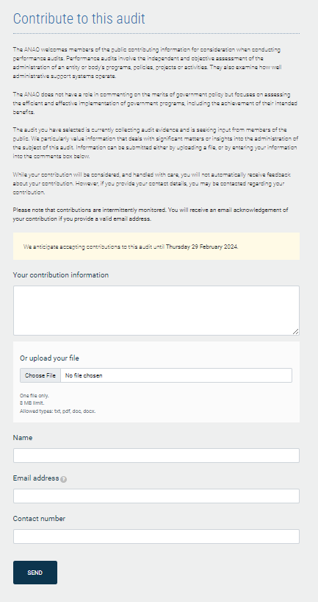
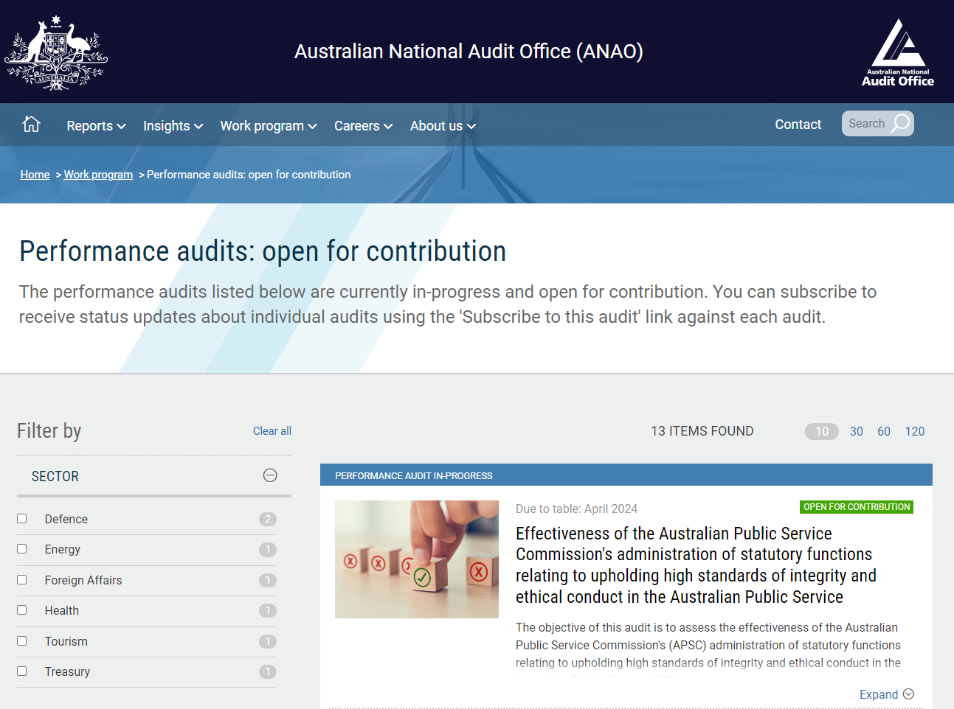
Citizen involvement

Slide 11
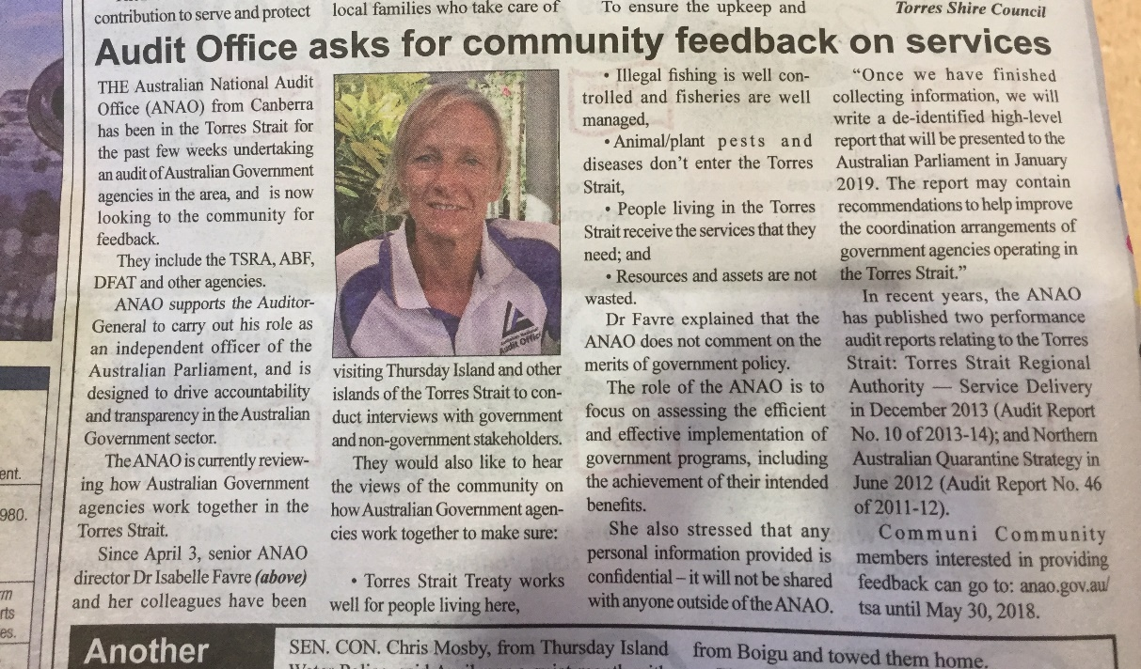
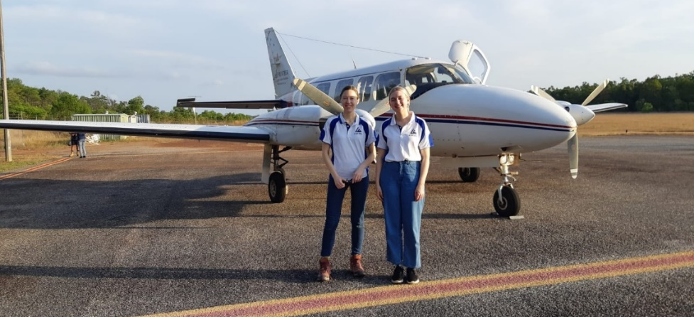
Pre-fieldwork engagement

Slide 12
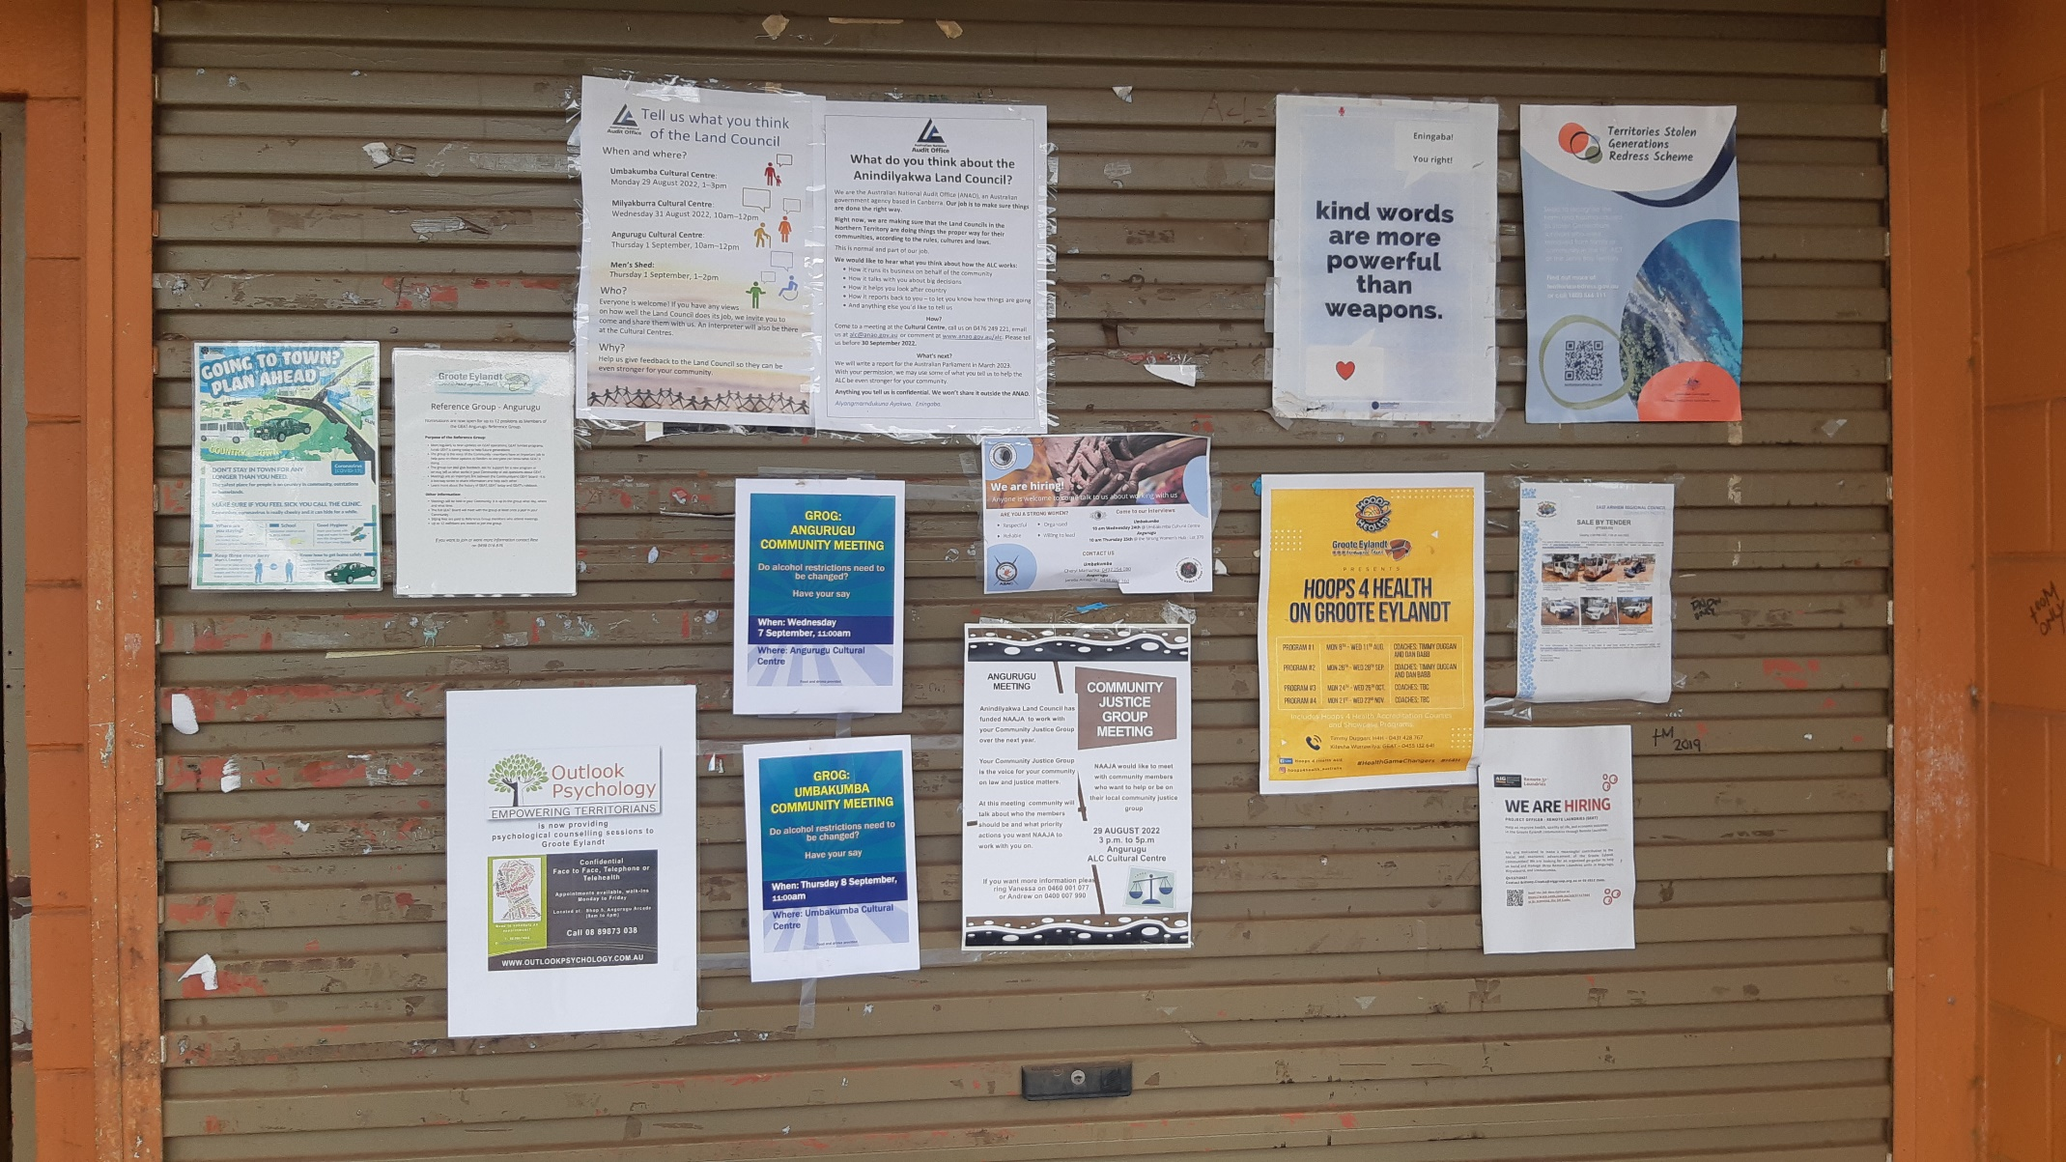
Pre-fieldwork engagement

Slide 13



Slide 14
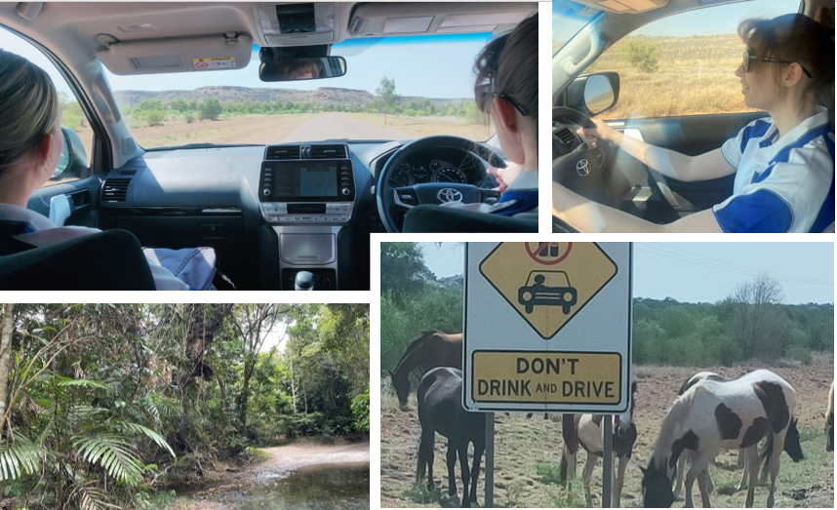
Site visits

Slide 15
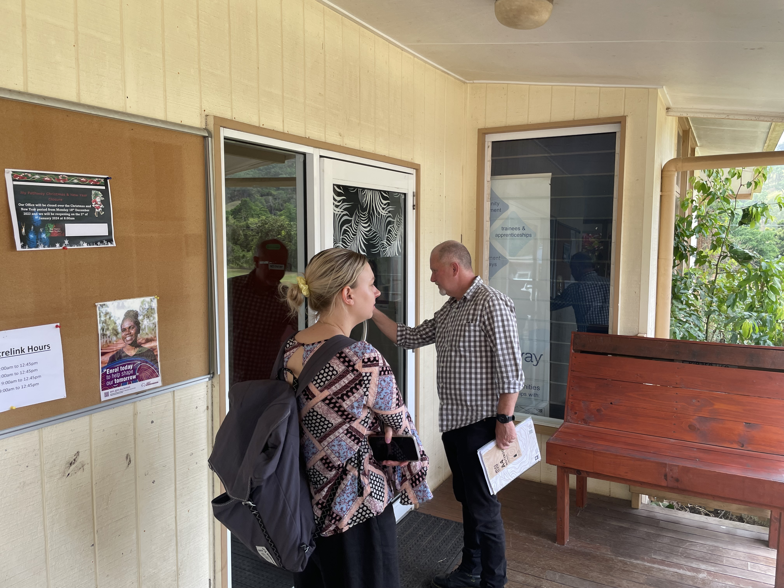
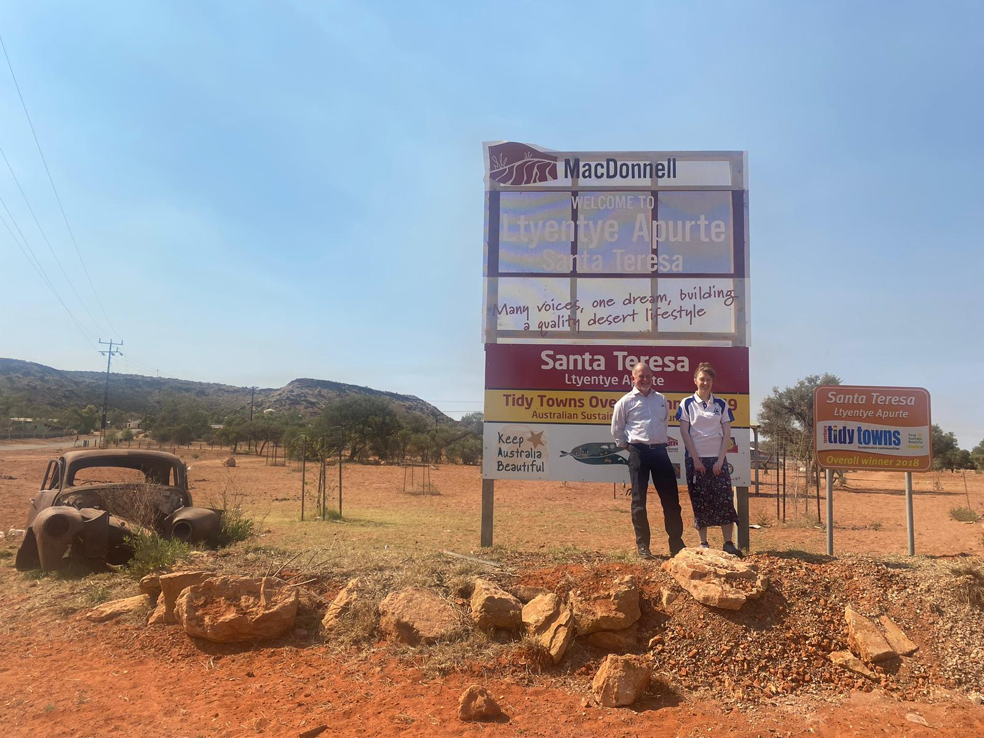
Site visits
Audit fieldwork in Santa Teresa (Ltyentye Apurte)
Audit fieldwork in Wujal Wujal

Slide 16
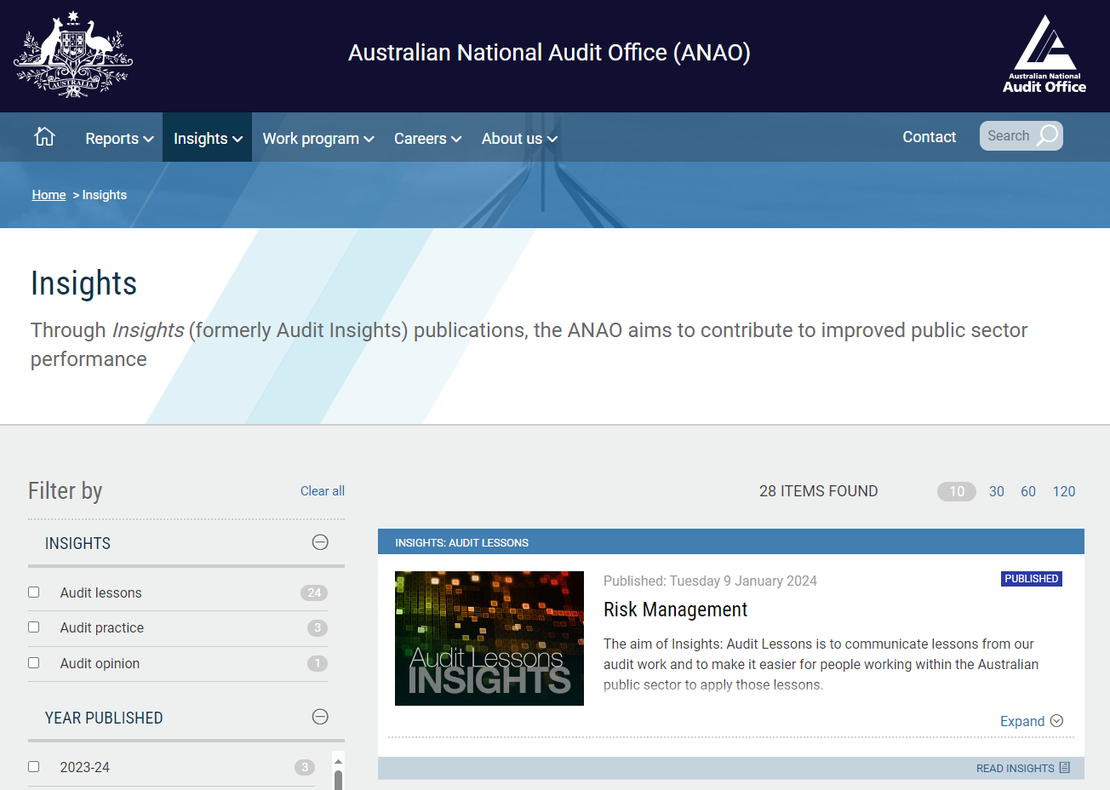
Reporting back

Slide 17
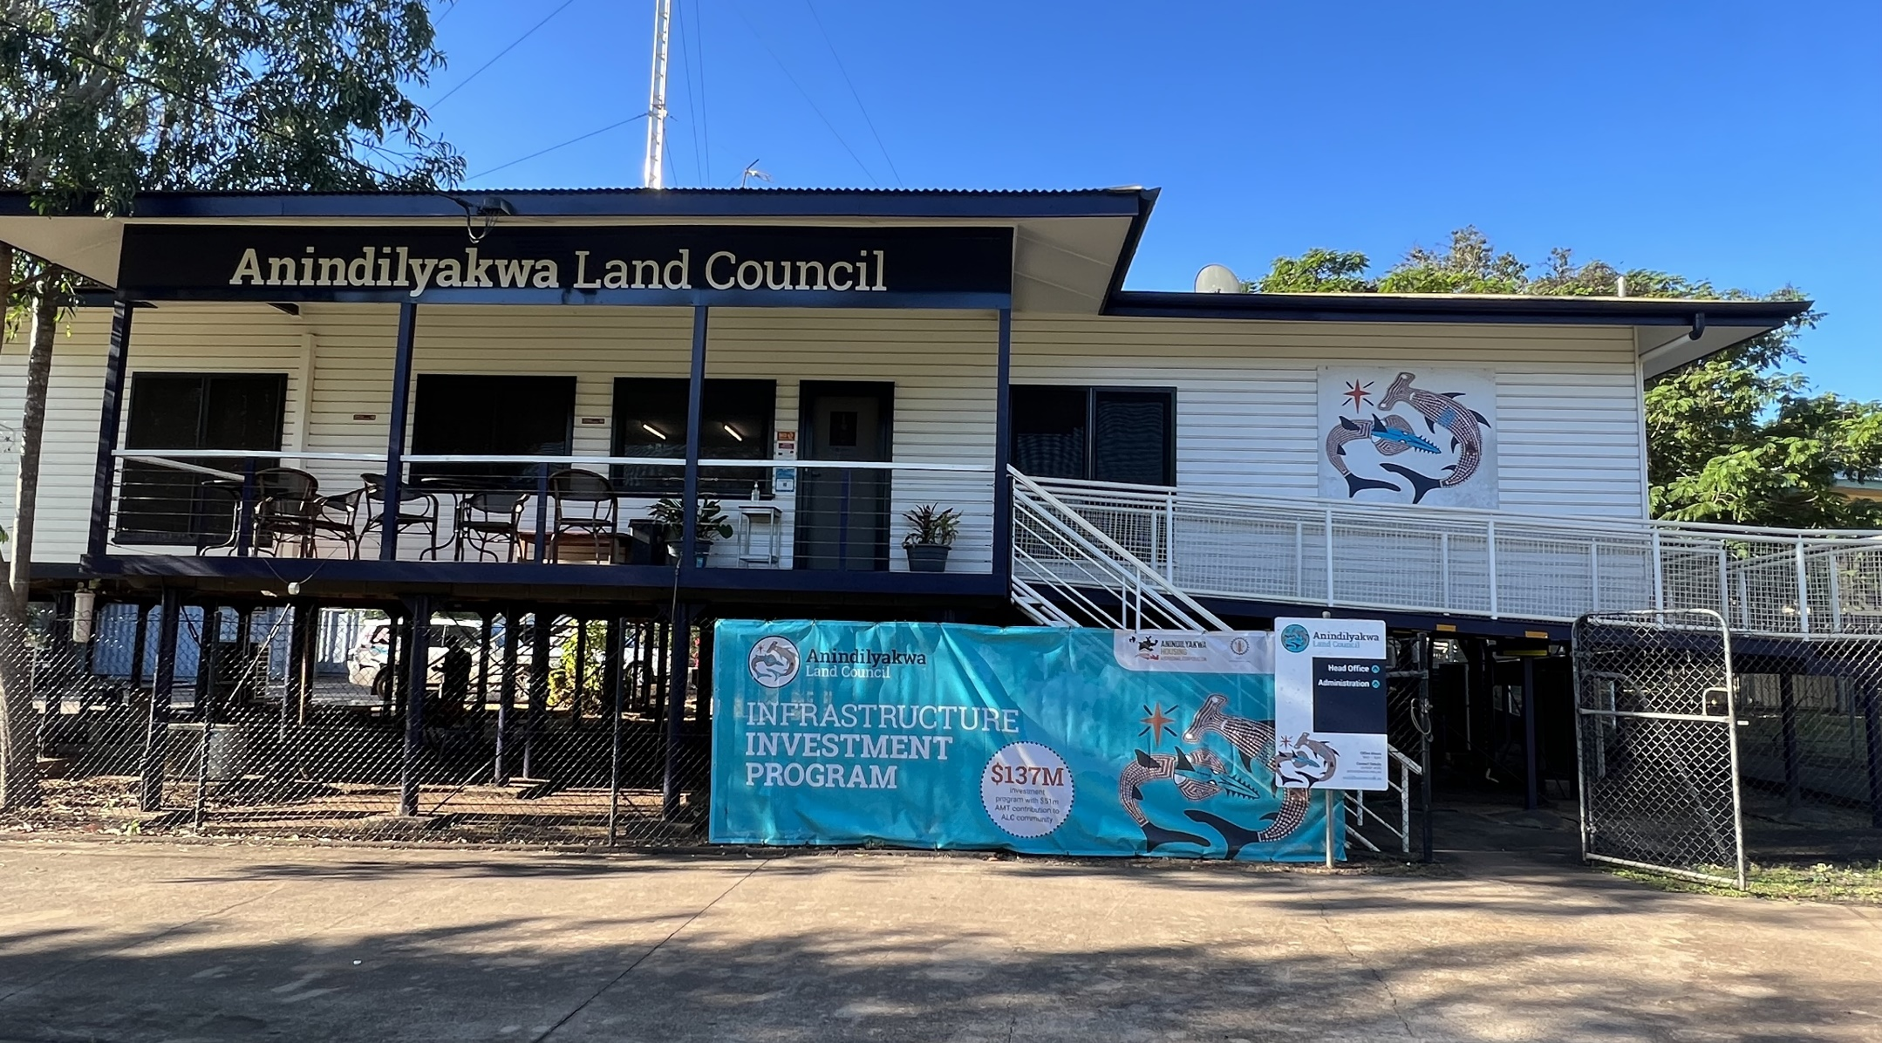
Reporting back to the Groote Strong Women’s Group

Slide 18
Figure 4.1: Relationships between ALC, AAAC, GHAC and Winchelsea Mining, 2021-22
Source: Auditor-General Report No. 29 of 2022-23

Slide 19
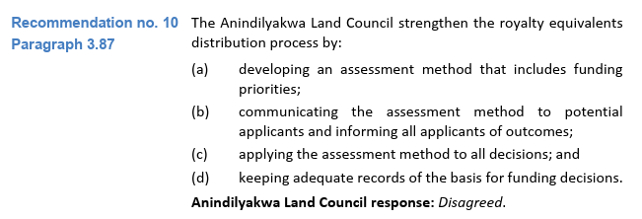
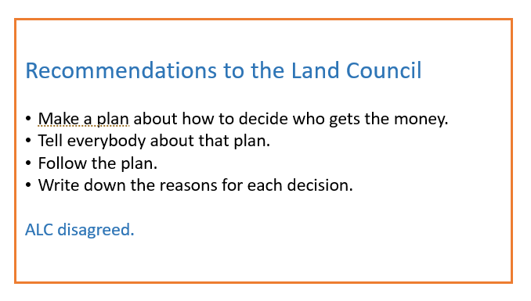
Reporting back to the Groote Strong Women’s Group

Slide 20
Managing the risks of citizen engagement
Managing expectations
Setting the parameters of performance audit work
Preserving independence, neutrality and objectivity

Slide 21
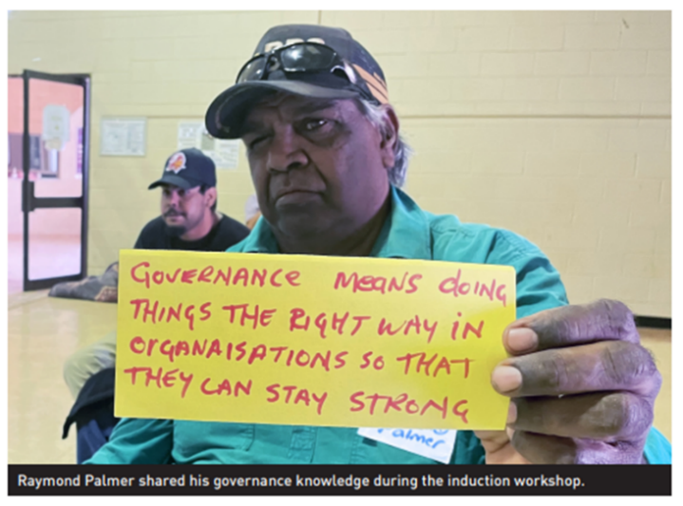
Questions
Source: CLC Council News, April 2022.

