Slide 1

16th INTOSAI Performance Audit Subcommittee annual meeting
Romanian Court of Accounts, Bucharest, 1-2 April 2025
Alan Findlay,
INTOSAI Professional Standards Committee,
European Court of Auditors, Luxembourg

Slide 2
Content
Implementing our Strategic Development Plan
Revision of due process
Planning our future
SCEI

Slide 3
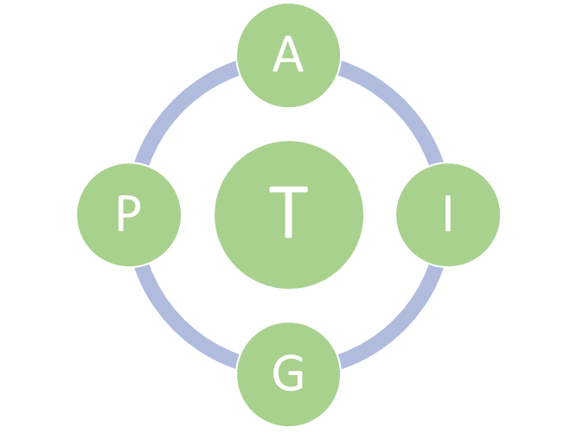
The IFPP’s SDP Strategic development plan for the INTOSAI Framework of Professional Pronouncements in 2023-2028
The ‘A’ initiative – Improving accessibility of the framework
The ‘T’ initiative – Developing a clear and consistent terminology for the IFPP.
The ‘P’ initiative – Updating the content and presentation of the INTOSAI Principles.
The ‘I’ initiative – Ensuring clarity of the ISSAIs
The ‘G’ initiative – Developing a better approach to providing guidance.

Slide 4
The IFPP’s SDP Strategic development plan for the INTOSAI Framework of Professional Pronouncements in 2023-2028
Set-up of project groups
mid-2024
Adoption of project proposal
mid-2025
Substantial completion
2028
INTOSAI GB approval
2028
Scoping Papers completed March 2025

Slide 5
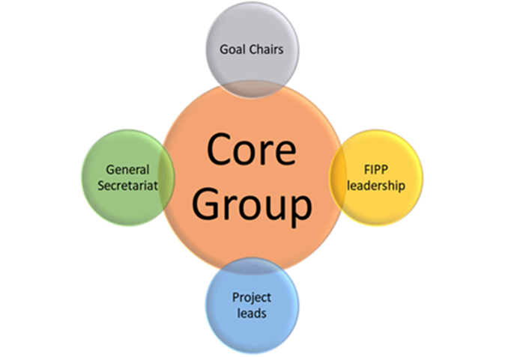
The IFPP’s SDP Strategic development plan for the INTOSAI Framework of Professional Pronouncements in 2023-2028
9 meetings held to date
Main decisions:
Adopt concept papers
Adopt Core Group Terms of Reference
Goal Chair supervision of projects
ISSAI 140

Slide 6
Revision of due process
Progress of the review
Circulation of position paper for comments
Comments received from Goal Chairs, PSC sub-committees
and General Secretariat
Launch call to form an ad hoc working group and negotiate scope
and deadlines

Slide 7
Revision of due process
Supervisory role of Goal Chairs
Goal Chairs must give assurance at the final pronouncement stage that,
“… on a project-by-project basis, … due process has been followed in all respects”.
Supervisory role of Goal Chairs

Slide 8
Revision of due process
Basis for Conclusions
Recap the factors considered during the development of the exposure draft,
Explain the objectives of the new or revised standard,
Explain the implications of the standard,
Identify which sections have not been fully reviewed and the extent to which they have been updated,
Enumerate FIPP’s viewpoints on the changes,
Summarise the significant departures that are made from other IFPP pronouncements and the reasons for such departures.
cf. Practices by the International Integrated Reporting Council (IIRC), IFAC, et al.
Conclusions are drawn by FIPP as a basis for approval of the endorsement version

Slide 9
Revision of due process
Essential to the image of INTOSAI
Aids implementation
Current practice: translations are made after approval by FIPP … but this is not without its problems.
Translating the pronouncements

Slide 10
Revision of due process
Current practice:
The working group notifies all INTOSAI members and other relevant stakeholders,
Announcement in the INTOSAI Journal,
Social Media and NICO network.
But feedback is often disappointingly low.
How to remedy this situation?
Feedback on exposure drafts

Slide 11
Revision of due process
The issue:
Due process mandates that working groups decide on an appropriate frequency at which a regular review shall be carried out to ensure appropriate maintenance of the pronouncements.
The reality:
  Many pronouncements do not contain an indication of when a revision would be appropriate,
  information is not available on website(s)
If the working group which originally drafted the pronouncement no longer exists, there is a risk of abandoned pronouncements with no one responsible for their future well-being.
Maintenance of standards

Slide 12
Revision of due process
The issues:
“Stage 0”
Initiating projects outside the SDP
Main areas for discussion

Slide 13
Revision of due process
The issue:
FIPP must give approval to documents during at least three key stages during due process:
    the project proposal,
    the exposure draft, and
    the endorsement version.
What happens if there is an intractable disagreement between the FIPP and the project group with neither side willing to back down on their position for good and justified reasons?
Referral mechanism for major disagreements

Slide 14
Planning our future
Each committee/working body should prepare a work plan, including a timetable and resources […].
The work plan should be aligned with INTOSAI’s Strategic Goals and Crosscutting Priorities and approved by the respective Goal steering committee and Goal Chair.
Steering committees have the responsibility to:
a. provide strategic direction […];
b. monitor the progress of the committees/working bodies and their chairs on the implementation of their work plans […]
Handbook for INTOSAI Committees (Nov 2022)

Slide 15
Planning our future
Collective PSC workplans expire end 2025
INTOSAI Strategic Plan goes to end 2028
Provisional timing:
Brainstorming April – September
Strategic input: PSC-SC September
Finalisation: September – December
Adoption: Early 2026 (written procedure)
A way forward for the PSC

Slide 16
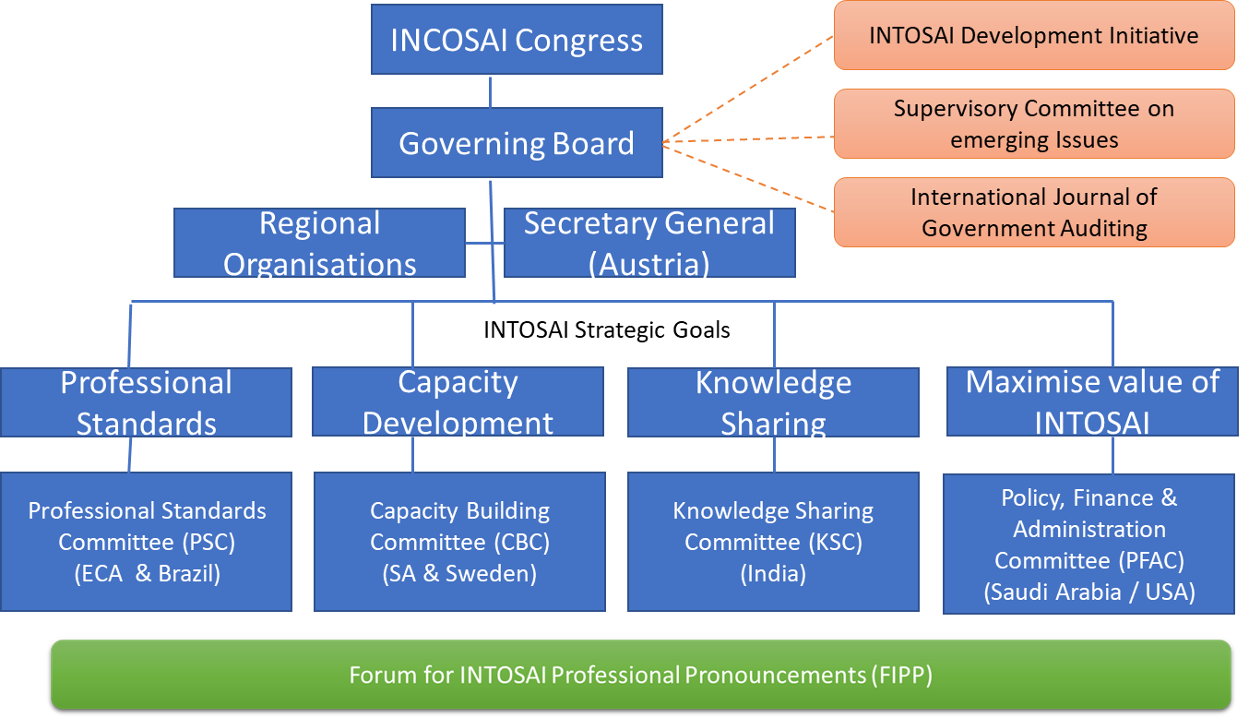
Supervisory Committee on Emerging Issues

Slide 17
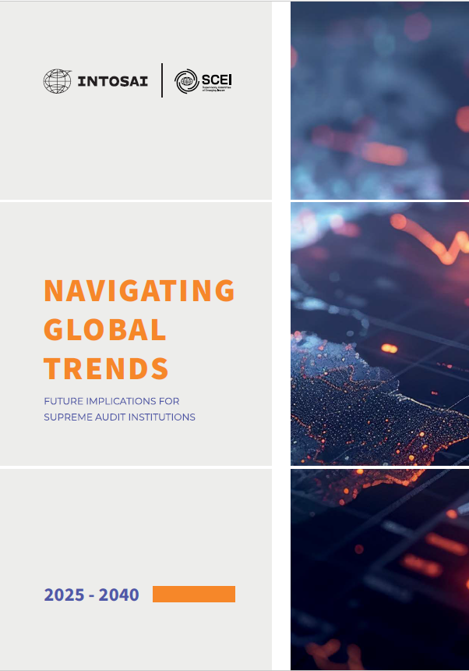
Supervisory Committee on Emerging Issues
“This report highlights seven global mega-trends that will shape the world from2025 to 2040, presenting both challenges and opportunities for SAIs.”

Slide 18
Supervisory Committee on Emerging Issues
Methodology of the Global Trends Report
Sources Analysed: The report draws on 16 foresight reports from leading global institutions and think tanks with foresight expertise.
Trends Identified: From these reports, 142 trends were extracted using AI to identify and cluster related trends.
7 global megatrends most relevant to SAIs.
Erosion of Trust in Institutions
Economic Challenges and Debt
Digital Transformation
Climate Change and the Triple Planetary Crisis
The Widening Demographic Gap
Global Migration
Rising Inequalities

Slide 19
Supervisory Committee on Emerging Issues
The SCEI and the PAS
INTOSAI’s Role in Shaping the Future
INTOSAI plays a key role in fostering innovation, capacity-building, and strategic foresight among SAIs.
By integrating foresight and collaboration into its global agenda, INTOSAI ensures that SAIs remain relevant, proactive, and prepared for the future.

Slide 20
Thank you

