Slide 1
CIVIL PROTECTION SHELTERS
BETWEEN REALITY AND NECESSITY
The lack of conditions necessary to protect the population in a situation of armed conflict indicates the need to redesign the national shelter system
PAS Annual Meeting
April 1-2, 2025, Bucharest, Romania

Slide 2
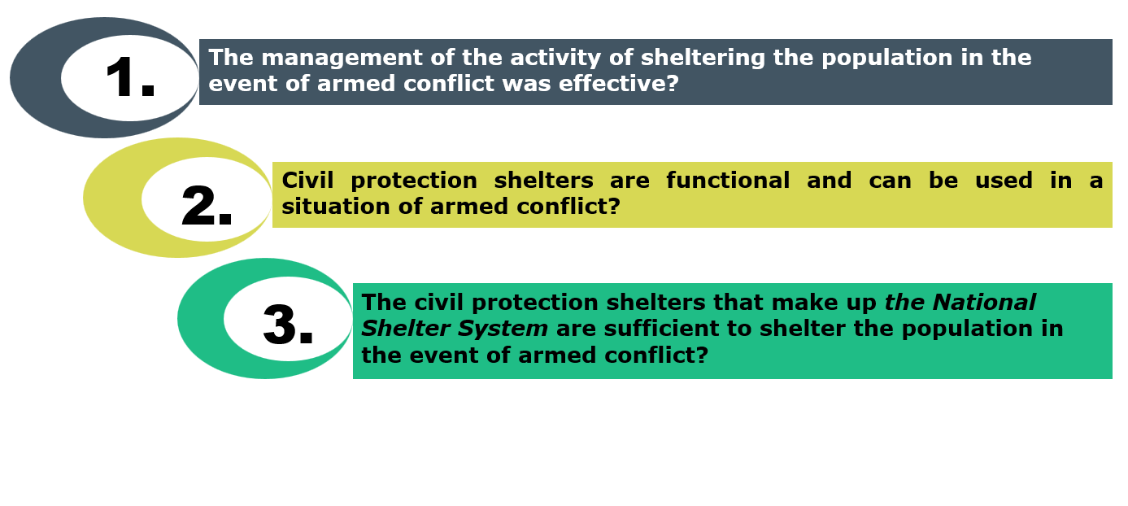
Performance audit objectives

Slide 3
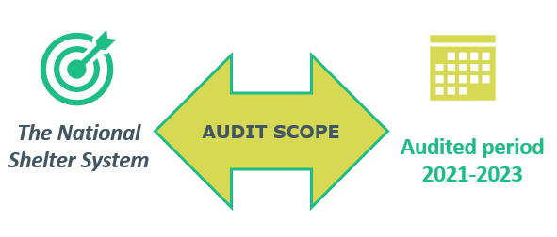
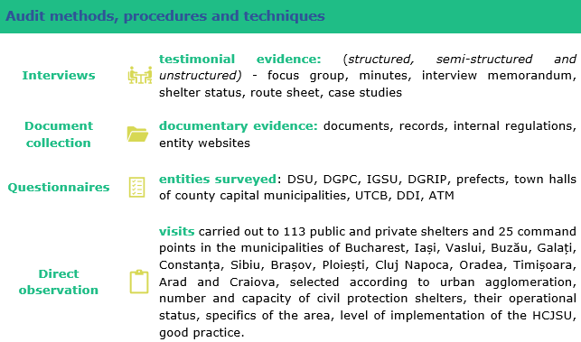

Audit methodology
Entity from where they were data collected | Central public administration level
 | MAI and subordinate or coordinating structures : DSU, DGRIP, IGSU, 42 Prefect Institutions (41 prefects)
 | MApN (DDI and ATM), ANRSPS, INS, Metrorex
 | Local public administration level
 | 40 town halls of county capital municipalities and the municipality of Bucharest (40 town halls of county capital municipalities and 7 town halls of Bucharest)
 | University environment
 | Technical University of Civil Engineering Bucharest
Notes:
The planning and execution of the audit were carried out during the period April-November 2024 , in accordance with the audit objectives, in order to obtain sufficient and appropriate evidence to provide a reasonable basis for findings and conclusions .
The audit methodology used was in accordance with the International Standards of Supreme Audit Institutions and its own regulations.
Interviews - testimonial evidence: ( structured, semi-structured and unstructured) - focus group, minutes, interview memorandum, shelter status, route sheet, case studies
Document collection - documentary evidence: documents, records, internal regulations, entity websites
questionnaires entities surveyed : DSU, DGPC, IGSU, DGRIP, prefects, mayors of county capital municipalities, UTCB, DDI, ATM
Direct observation visits carried out at 113 public and private shelters and 25 command points in the municipalities of Bucharest, Iași, Vaslui, Buzău, Galați, Constanța, Sibiu, Brașov, Ploiești, Cluj Napoca, Oradea, Timișoara, Arad and Craiova, selected according to urban agglomeration, number and capacity of civil protection shelters, their operational status, specifics of the area, level of implementation of HCJSU, good practice.

Slide 4
1. Was the management of the population shelter activity in case of armed conflict effective? - Findings
Some components of the SNMSU did not ensure efficient management of the activity of sheltering the population in the event of armed conflict.
Shelter, as a component of civil protection in Romania, is insufficiently regulated, and existing legislation must be adapted to the current context.

Slide 5
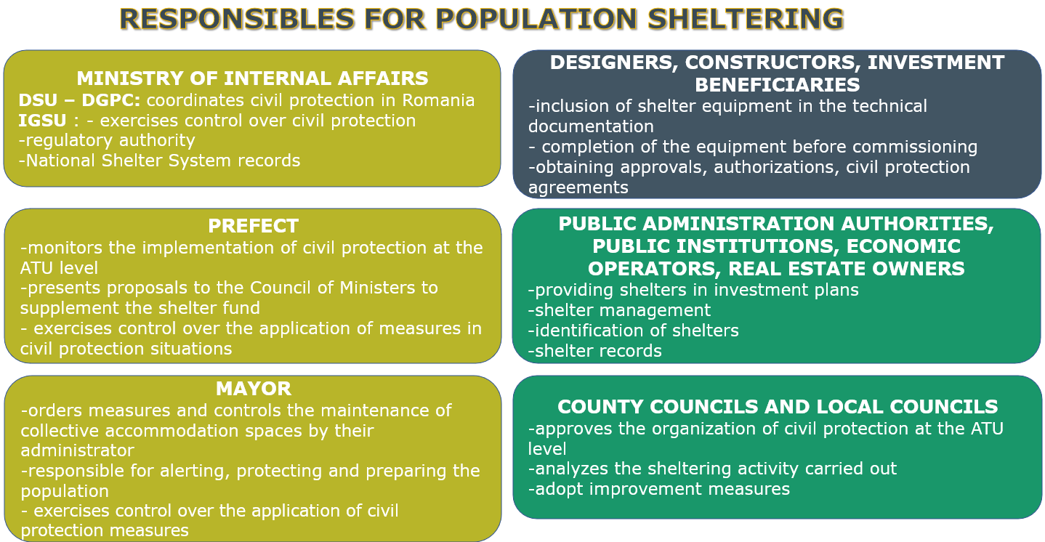
1. Was the management of the population shelter activity in case of armed conflict effective? Findings

Slide 6

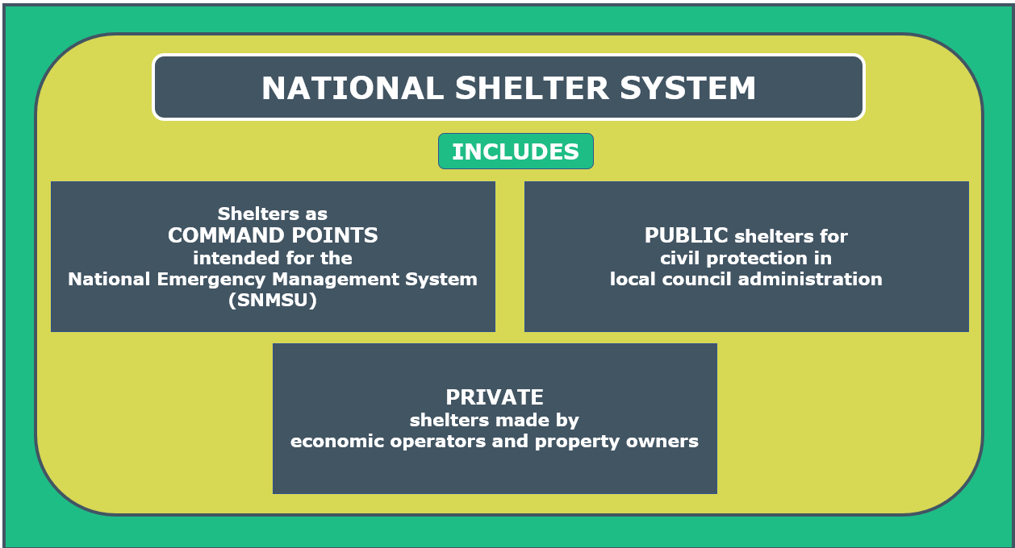
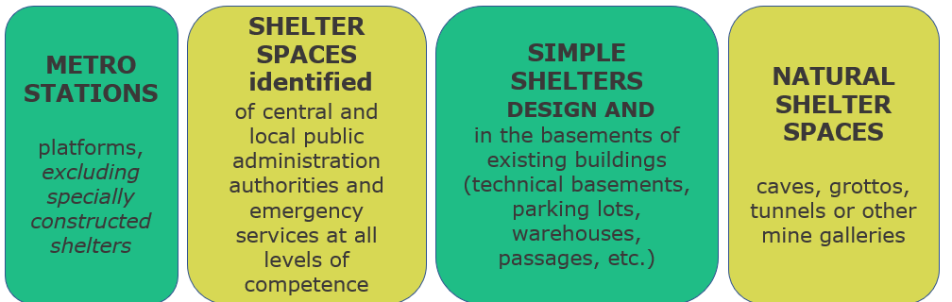
1. Was the management of the population shelter activity in case of armed conflict effective? Findings
611,922 people
is complemented by other accommodation spaces :
72,730 people
165,466 people
unidentified
Specially built and equipped shelters
with specific installations
Simple shelters
Notes:
Shelter is one of the specific measures to protect the population, material goods, cultural and heritage values, during military hostilities and emergency situations, against their effects.
Regarding the terminology used, confusion is often created between the two concepts of " civil protection shelters " (local anti-aircraft defense - ALA ) and " nuclear shelters " (nuclear bunkers).

Slide 7
2. Are civil protection shelters functional and can they be used in situations of armed conflict? Findings
Over half of the number of civil protection shelters do not meet functionality requirements.

Slide 8
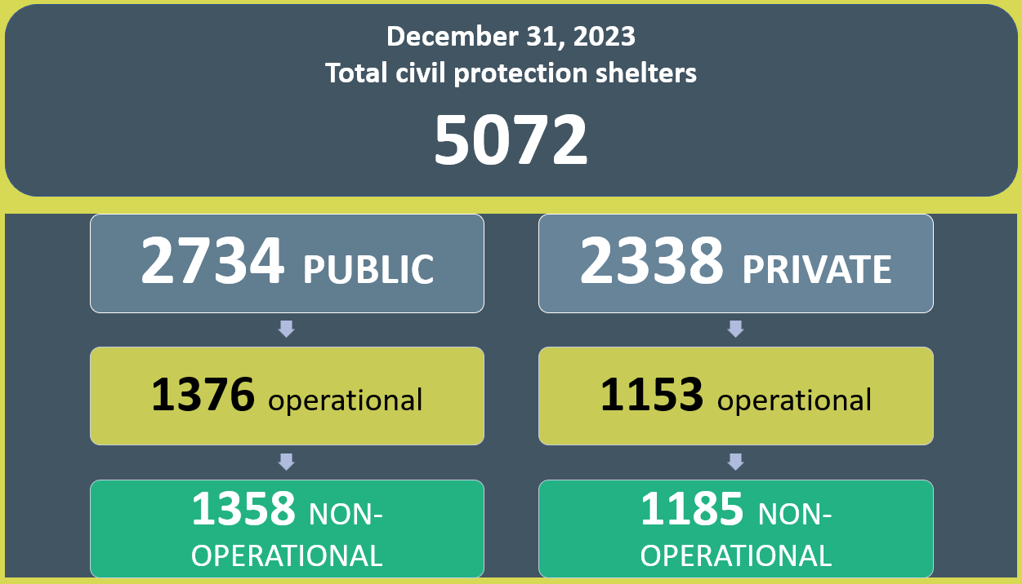
2. Are civil protection shelters functional and can they be used in situations of armed conflict? Findings
Type of shelter | Total related capacity (people)
Civil protection shelters – public and private ( old and new constructions ) | 611,922
Shelters – command points | -
Simple shelters | unidentified*
Shelters – other spaces: tunnels, passages, parking lots, caves, grottos, etc. | 72,730
Shelters – other spaces: metro and other spaces at the metro | 165,466
Shelter capacity related to approved and unauthorized constructions | 139,389
Total accommodation capacity | 989,507
* the capacity of simple shelters has not been determined as there is no record of them at the local level
Notes:
.

Slide 9
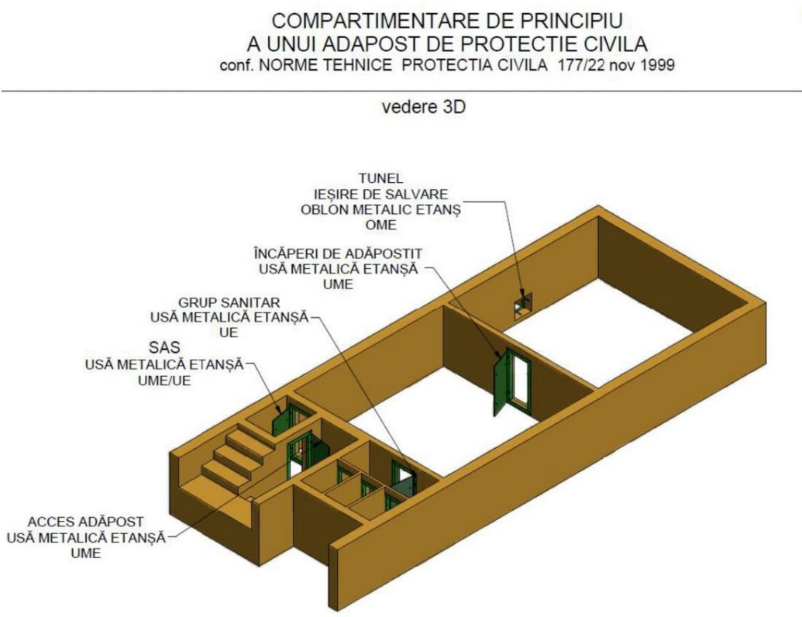
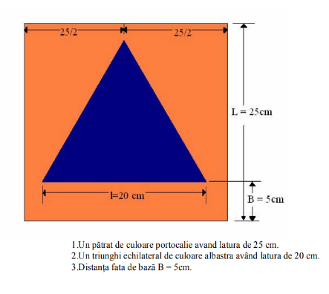
2. Are civil protection shelters functional and can they be used in situations of armed conflict? Findings

Slide 10
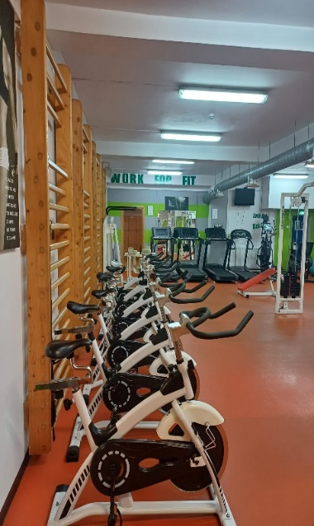
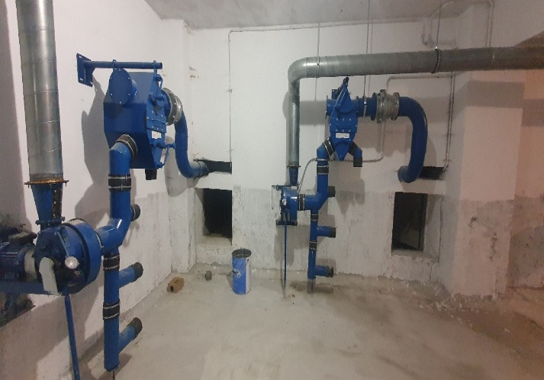
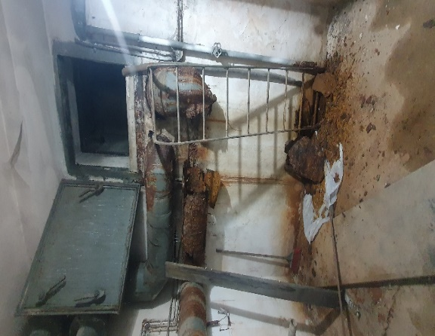

2. Are civil protection shelters functional and can they be used in situations of armed conflict? Findings
Ministry of Transport - deficiencies in the filter-ventilation installation, emergency exit
Faculty of Economic Sciences and Business Administration in Cluj Napoca

Slide 11
3. Are civil protection shelters sufficient in case of armed conflict? Findings
The capacity of existing civil protection shelters in Romania is insufficient compared to the resident population that must be sheltered in the event of an armed conflict.
The records regarding the shelter fund are incomplete and are based only on the situations prepared by IGSU of specially built civil protection shelters equipped with specific facilities.

Slide 12
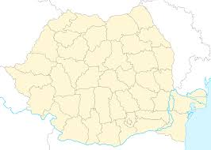
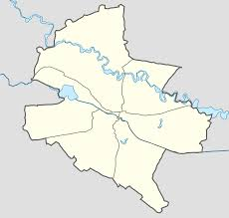
3. Are civil protection shelters sufficient in case of armed conflict? Findings
The shelter capacity in civil protection shelters (specially built and equipped with specific facilities) is 3.21% (611,922 people)
Total shelter capacity (of specially built shelters equipped with specific facilities and other shelter spaces) - 5.19% (989,507 people).
For the municipality of Bucharest, the total shelter capacity is 22.87% (392,961 people)
Notes:
Compared to the total resident population of 19,053,815 people , the total shelter capacity at the national level increases from 3.21% (611,922 people) to 5.19% (989,507 people).
For the municipality of Bucharest , the accommodation capacity calculated taking into account the accommodation capacity of the metro is 392,684 people , respectively 22.87%, compared to the resident population of 1,716,961 people .

Slide 13
For more details you can consult the report in English on the following link:
Thank you for your attention!

