Slide 1
Focus on integrity in Performance Audit
Ms Corinne Horton, Executive Director, Performance Audit Services Group

Slide 2
What is integrity? - 3 perspectives
Australian Public Service Commission
IntoSAINT
(Integrity Self Assessment for Supreme Audit Institutions)
Australian National Audit Office (ANAO)
“Integrity in the Australian Public Service is the pursuit of high standards of professionalism – both in what we do and in how we do it. It is the foundation of trust on which public service effectiveness is built.”
https://www.apsc.gov.au/working-aps/integrity
“The term integrity is derived from the Latin in-tangere, meaning untouched. It refers to virtue, incorruptibility and the state of being unimpaired. Integrity not only refers to the absence of fraud and corruption, but it also entails common decency and proper behaviour. In this way it is a positive and broad concept, that is strongly related to ethical principles and culture.”
https://www.intosaicbc.org/wp-content/uploads/2016/12/2013_1a-MANUAL-IntoSAINT_def.pdf
“The ANAO defines integrity as the practice of demonstrating honesty and uncompromising adherence to strong ethical principles. We expect our people to demonstrate integrity in their behaviours – as auditors, public servants, officials and professionals.”
https://www.anao.gov.au/work/corporate/anao-integrity-framework-2024-25

Slide 3
How does the ANAO consider integrity in its performance audits?
ANAO’s performance audits assess economy, efficiency, effectiveness and ethics (‘the four Es’), as well as legislative and policy compliance – integrity is related to both ethics and compliance
ANAO has developed a methodology for auditing ethics
(see https://www.anao.gov.au/work/speeches-and-papers/sai-australia-develops-methodology-auditing-ethics)
The ethics methodology applies to ANAO performance audits:
on effectiveness of ethical frameworks (e.g., Australian Public Service Commission’s Administration of Integrity Functions),
with specific ethical criteria (e.g., Governance of Artificial Intelligence at the Australian Taxation Office), and
that include consideration of ethics in findings (e.g., Digital Transformation Agency’s Procurement of ICT-Related Services)

Slide 4
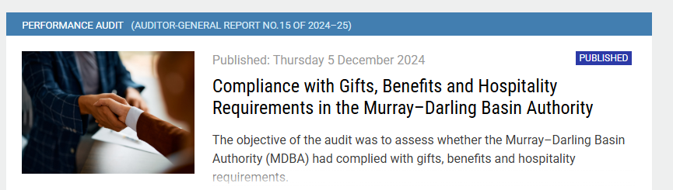
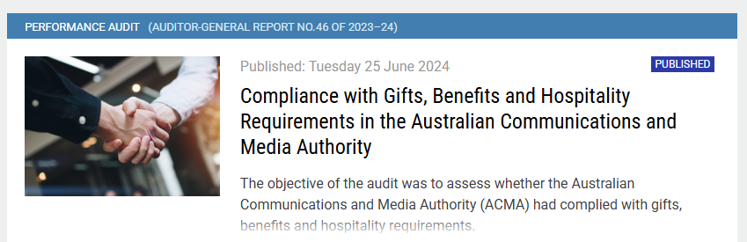
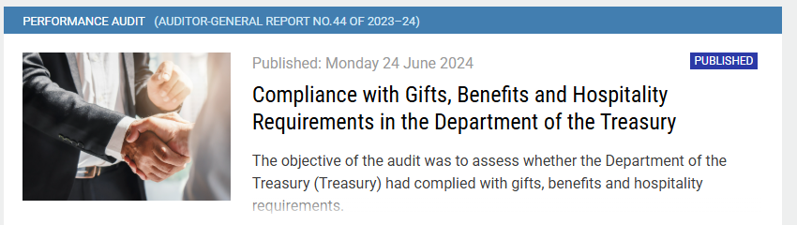
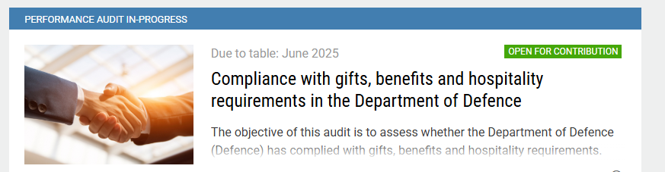
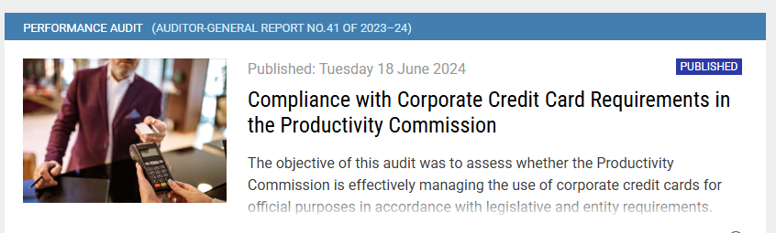
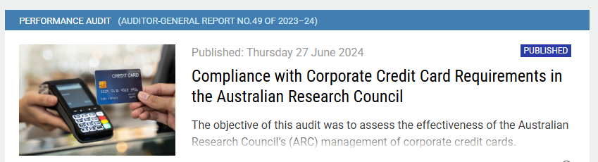
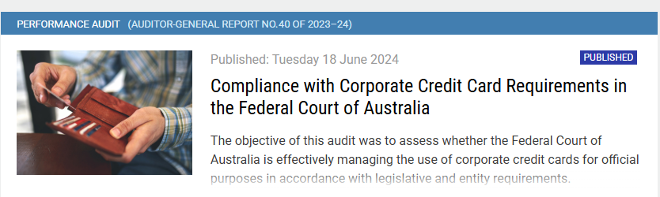
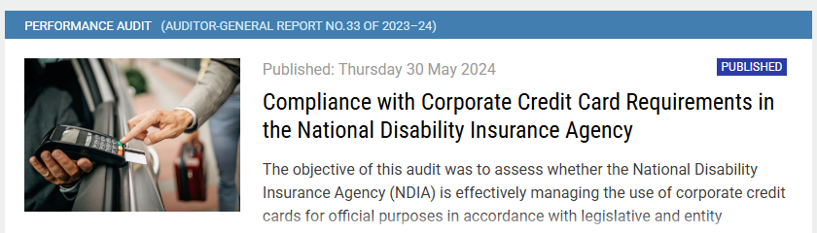
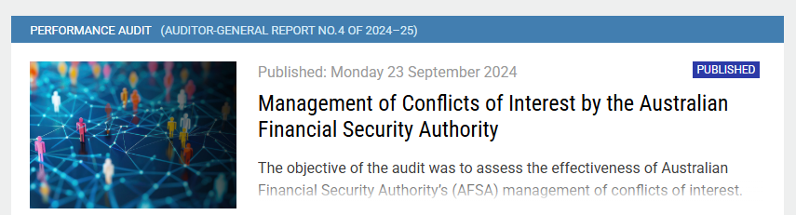
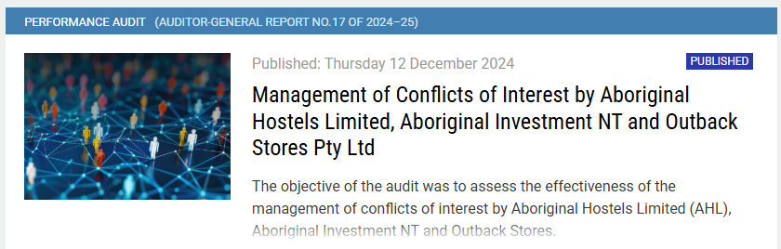
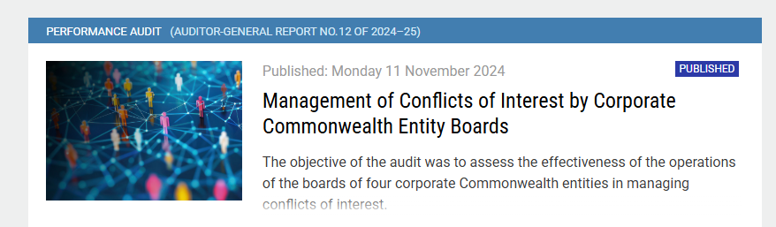
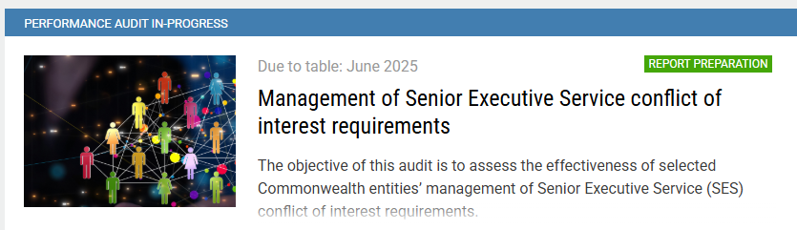
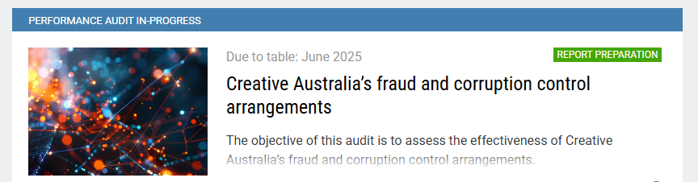
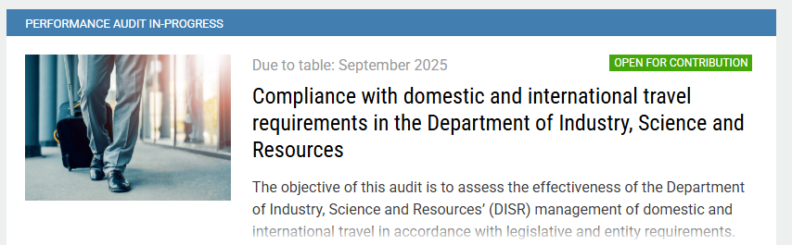
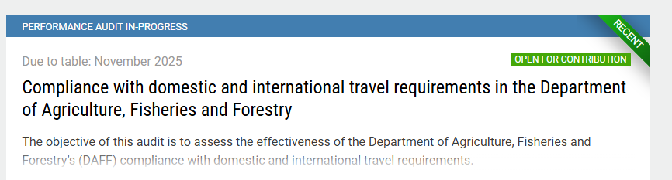
What have we audited?
ANAO has also been conducting performance audits focusing on compliance with integrity requirements in selected entities – each topic has 3-4 performance audits.
  Compliance with gifts, benefits and hospitality requirements
  Compliance with corporate credit card requirements
  Management of conflicts of interest
  Management of Fraud and Corruption control arrangements
  Compliance with domestic and international travel requirements

Slide 5

Audit Lessons
The aim of Audit Lessons is to communicate themes from our audit work to make it easier for people working within the Australian public sector to apply the lessons.
Gifts, benefits and Hospitality is targeted at those responsible for implementing internal policies and controls on the receipt of gifts, benefits and hospitality in Australian Government entities
Management of corporate credit cards is intended for officials working in financial management or governance roles with responsibility for the management of corporate credit cards.

Slide 6
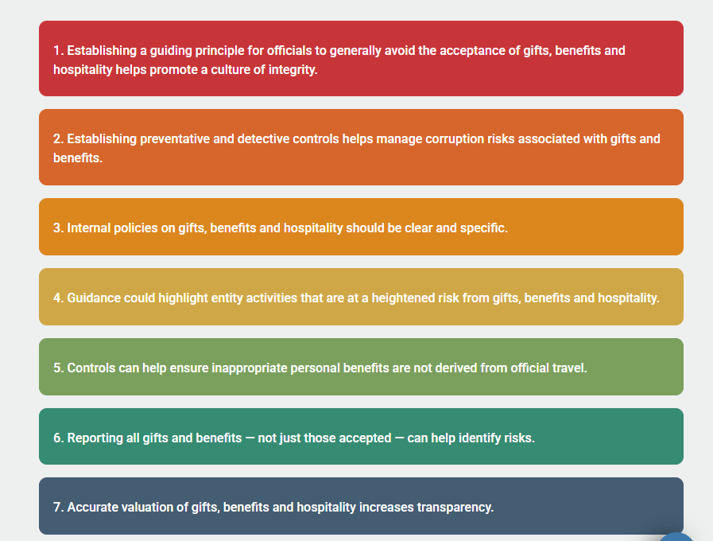



Lessons on compliance with gifts, benefits and hospitality requirements

Slide 7

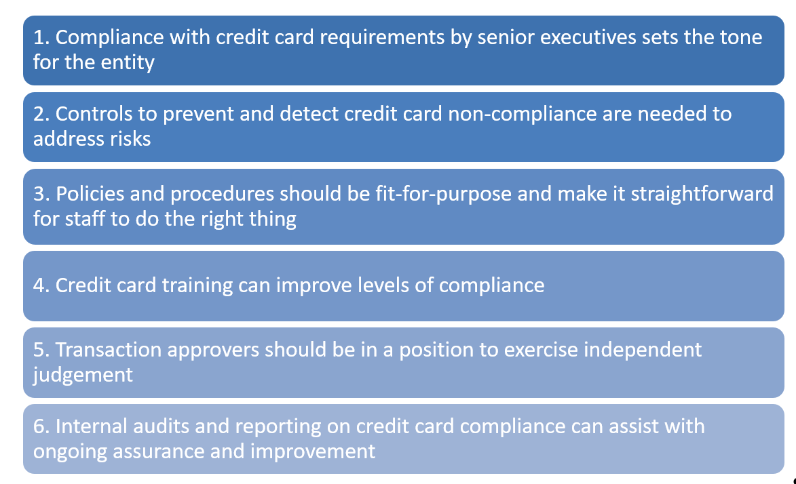

Lessons: Management of corporate credit cards

Slide 8
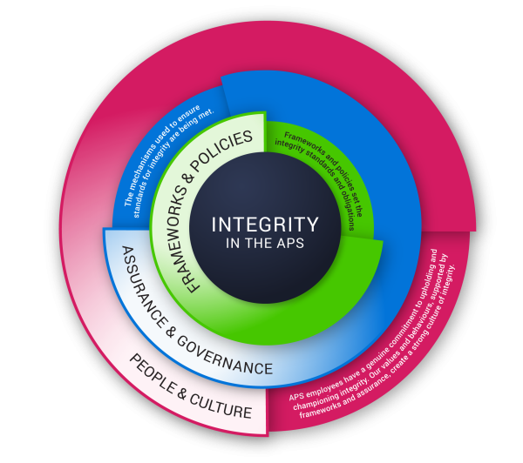
ANAO Integrity Framework
The Integrity Framework provides an overarching structure to the ANAO integrity control system, supporting our institution’s integrity. The framework will serve to assist in ethical decision making and risk, fraud and misconduct management.
The framework consolidates our integrity controls system – including policies, procedures and guidelines – outlining the expected behaviours of staff as representatives of the ANAO.

Slide 9
Link to our audits
Compliance with gifts, benefits and hospitality requirements
Department of the Treasury (June 2024)
Australian Communications and Media Authority (June 2024)
Murray-Darling Basin Authority (December 2024)
Department of Defence (due to table June 2025)
Compliance with corporate credit card requirements
National Disability Insurance Agency (May 2024)
Federal Court of Australia (June 2024)
Productivity Commission (June 2024)
Australian Research Council (June 2024)
Management of conflicts of interest
Australian Financial Security Authority (September 2024)
Corporate Commonwealth Entity Boards (November 2024)
Aboriginal Hostels Ltd, Aboriginal Investment NT and Outback Stores Pty Ltd (December 2024)
Senior Executive Service officers (due to table June 2025)
Compliance with domestic and international travel requirements
Department of Industry, Science and Resources (due to table September 2025)
Department of Agriculture, Fisheries and Forestry (due to table November 2025)

