Slide 1
PROVISION OF SAFE DRINKING WATER
AN INTERVENTION TO ERADICATE GUINEA WORM DISEASE.
PRESENTATION BY
LAWRENCE AYAGIBA-
DEPUTY AUDITOR GENERAL
(PERFORMANCE AND SPECIAL AUDITS)
SAI GHANA

Slide 2
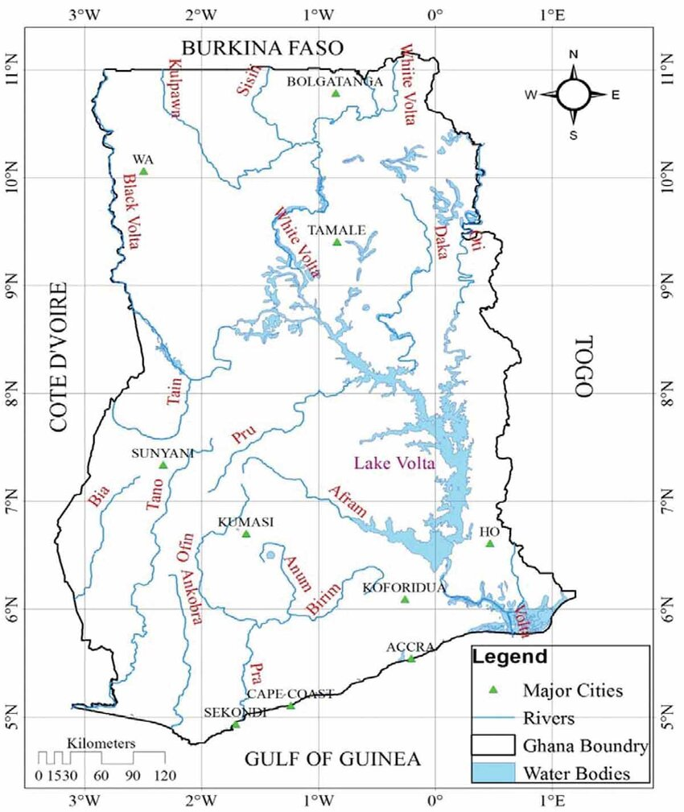
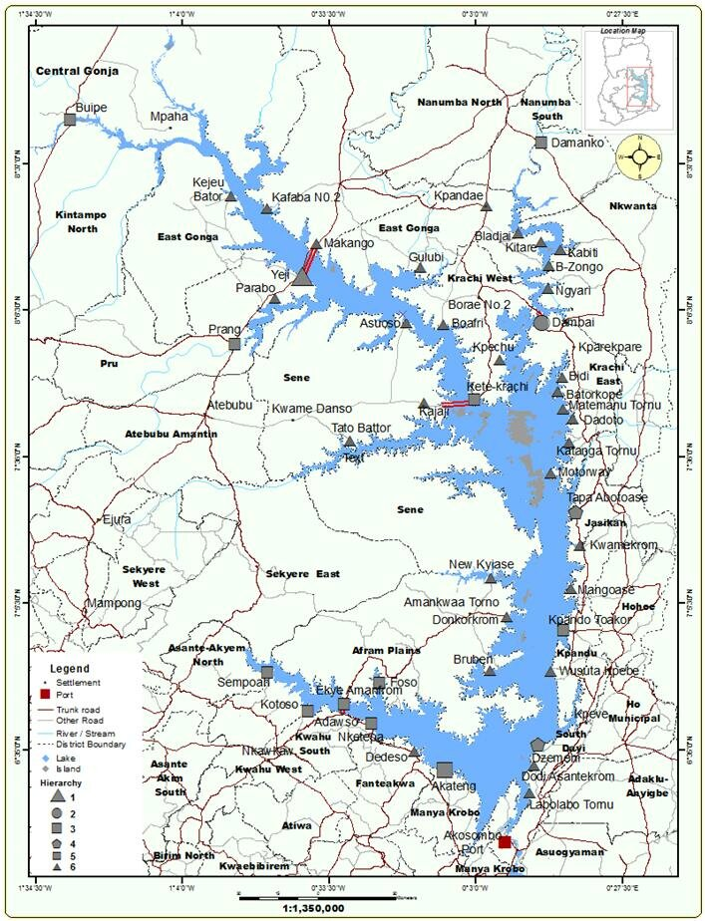
THE LAKE VOLTA AND THE SETTLEMENTS

Slide 3
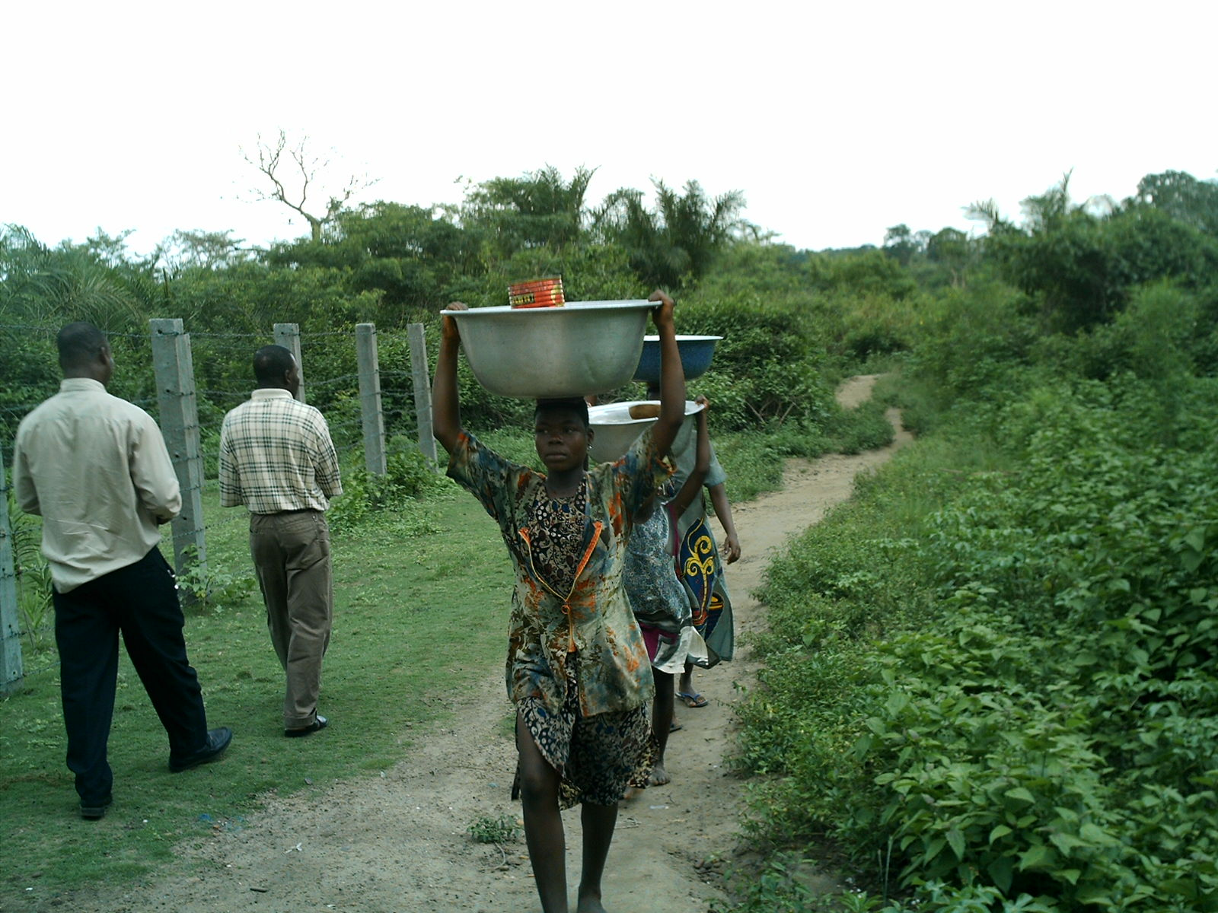
WHY THE AUDIT WAS CARRIED OUT
US $500 Million spent as at the time of audit with little to show
Targeted coverage of 85% was 46.4% for the period of the program
Snake bites recorded in rural communities
School children spend long hours fetching water without going to school
one borehole per 300 people within a radius of 15 kilometers, usually a 20-minute walk was not met.

Slide 4
FUNDING SOURCES
  Government of Ghana through the Highly Indebted Poor Country (HIPC) initiatives;
  Canadian International Development Agency (CIDA);
  International Development Agency (IDA);
  African Development Bank (ADB);
  Danish International Development Agency (DANIDA);
  German Technical Service (GIZ);
  European Union (EU);
  United Nations International Children’s Emergency Fund (UNICEF);
  KFW; and
  District Assemblies and beneficiary communities.
  President Jimmy Carter Foundation

Slide 5
FINDINGS
Unavailability of ground water in some communities makes it difficult to provide boreholes while in other communities the available ground water is saline and not good for consumption;
Community contribution of 5% to capital cost of water facilities has been difficult to achieve;
Some NGOs in water and sanitation delivery do not conform to the standard guideline set under the programme;
Despite provision of boreholes in some communities, increasing cases of guinea worm infestation are still recorded; and
Tradition, beliefs and attitudes hamper the programme.

Slide 6
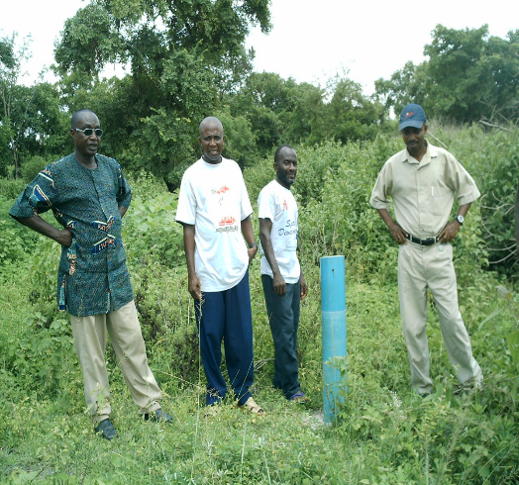
A.
The unavailability of groundwater in some communities makes it difficult to provide boreholes while in other communities the available groundwater is saline and not good for consumption.
GEOTECHNICAL ROCK FORMATION
VERY LOW WATER TABLE

Slide 7
MONEY SPENT ON DRY BOREHOLES
Irrespective of the outcome of the drilling exercise, the consultants are paid an average of ¢8 million ($888 @9000/$) per borehole for the service.
Out of the 238 boreholes drilled in the Nkwanta District in 6 years, 48 were plugged as dry boreholes and (US$42,624)
as a result, the cost of providing boreholes in this area increased by ¢384 million.

Slide 8
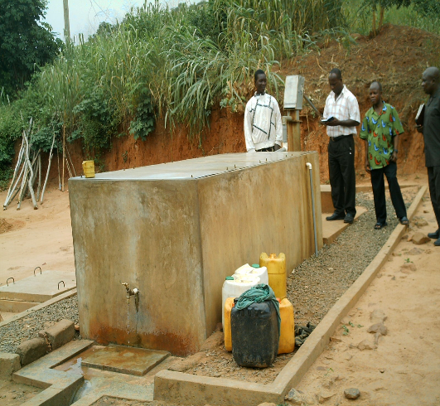
B.
Community contribution of 5% to the capital cost of water facilities has been difficult to achieve
COST OF AVERAGE BOREHOLE
Item | Option of Water system available to community | Capital cost of facility | 5% contribution of community | 2.5% contribution
1 | Bore hole | ¢70 million | ¢3.5million | …….
2 | Hand Dug Well with hand pump | ¢30 million | ¢1.5million | ……
3 | Small Town Water System | ¢2 billion | ……….. | ¢50million
4 | Bore Hole fitted with Iron treatment plant | ¢ 85million (US$9,444) | ¢4.25million (US$472) | ……..
5 | Spring Catchments | ¢ | ¢ | ……

Slide 9
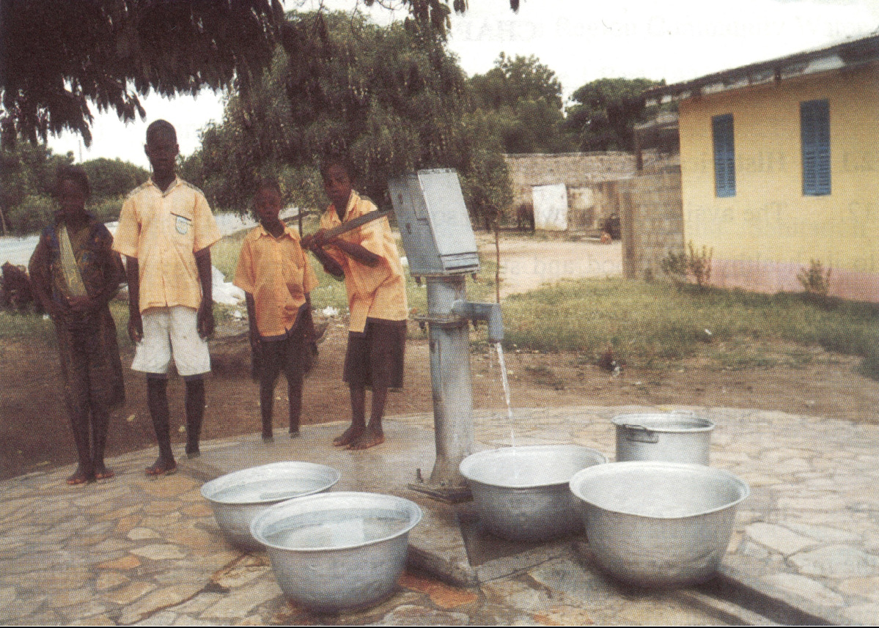
C.
Some NGOs in water and sanitation delivery do not conform to the standard guideline set under the programme.
GHANA MODIFIED INDIA MARK II
AFRIDEF
VEGNET
NIRA

Slide 10
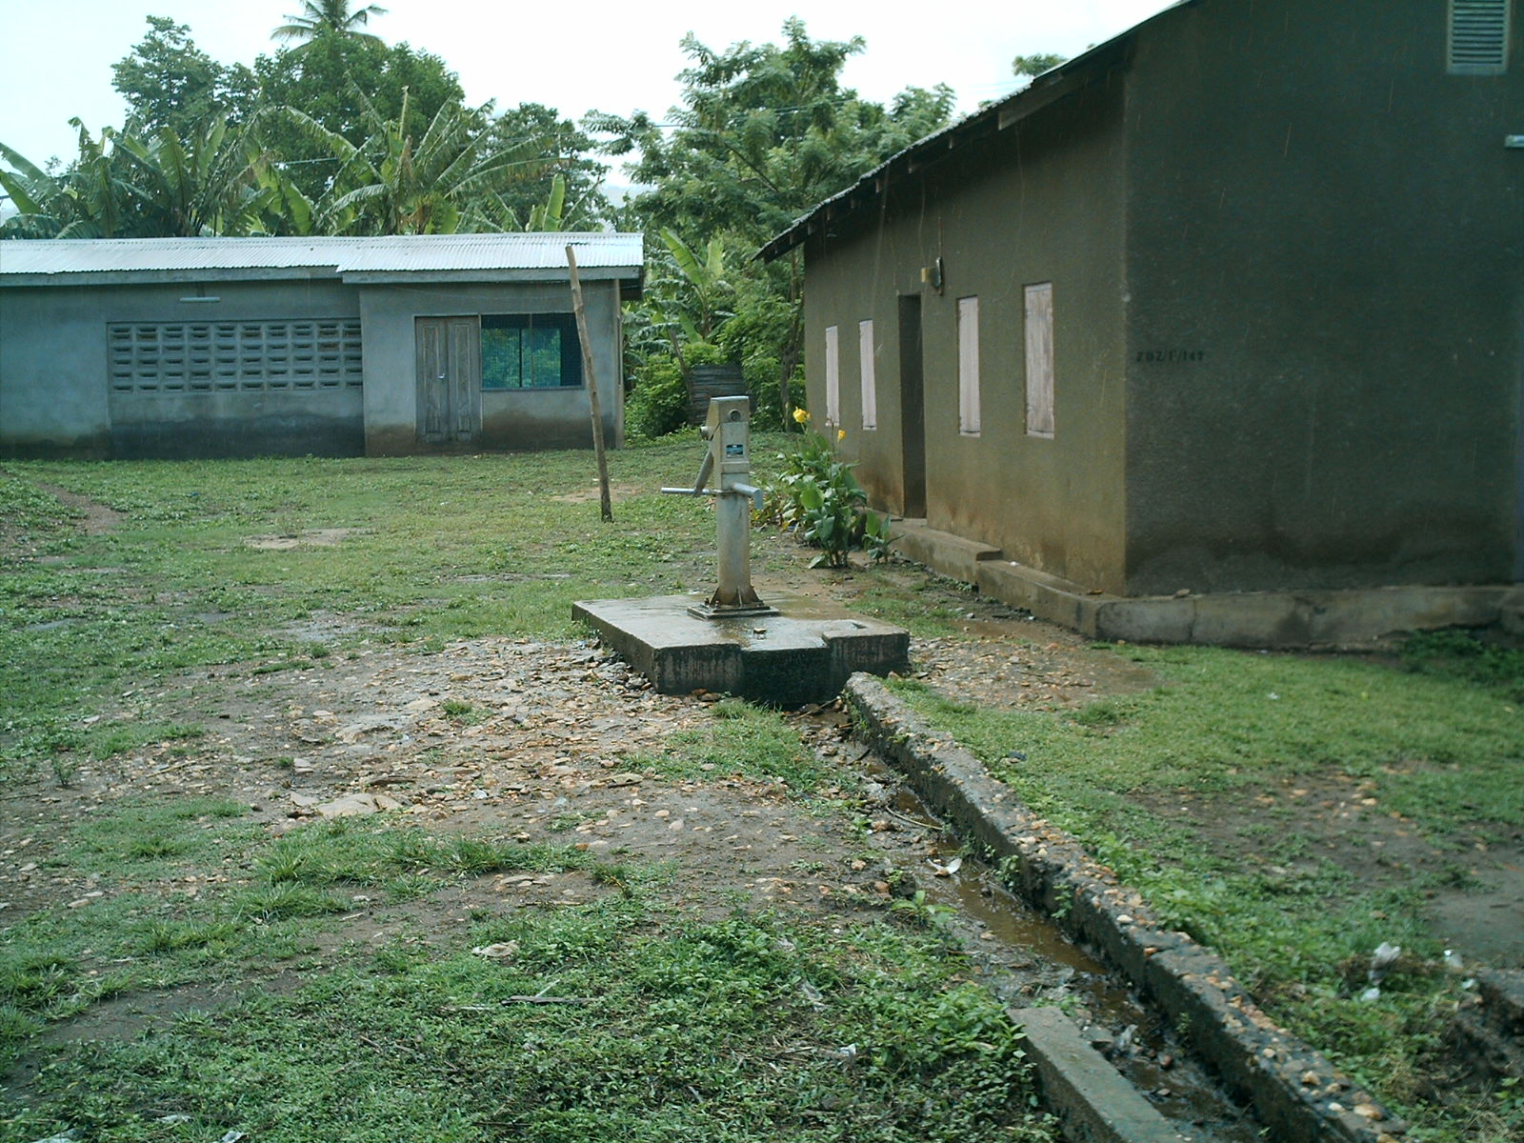
C.
Some NGOs in water and sanitation delivery do not conform to the standard guideline set under the programme.
SUBMERGED PIPE
GALVANISED PIPES INSTEAD PVC
CONCRETE ENVIRONS TO GUARD AGAINST SEEPAGE

Slide 11
D.
Despite the provision of boreholes in some communities, increasing cases of guinea worm infestation are still recorded
FARMERS GOING TO FARM FAR AWAY FROM HOME.
STAYING DAYS ON THE FARMS WHERE THE ONLY SOURCE OF WATER IS THE RIVER.

Slide 12
E.
Tradition, beliefs and attitudes hamper the programme.
THE BELIEVE THAT THE WATER HAS NO TASTE, COLOUR OR SMELL MAKE THEIR FOOD NOT TASTE NICE

Slide 13
OUR RECOMMENDATIONS
PAY a 1/3 FOR DRY BOREHOLES
INCREASE EDUCATIONAL AWARENESS
A FLAT COST OF BOREHOLE REGARDLESS OF ANY TREATMENT PLANT
THE GOVERNMENT SHOULD ABSORB THE DIFFERENCE
ENSURING ALL BOREHOLE PROVIDERS KEEP TO A GIVEN STANDARD

Slide 14
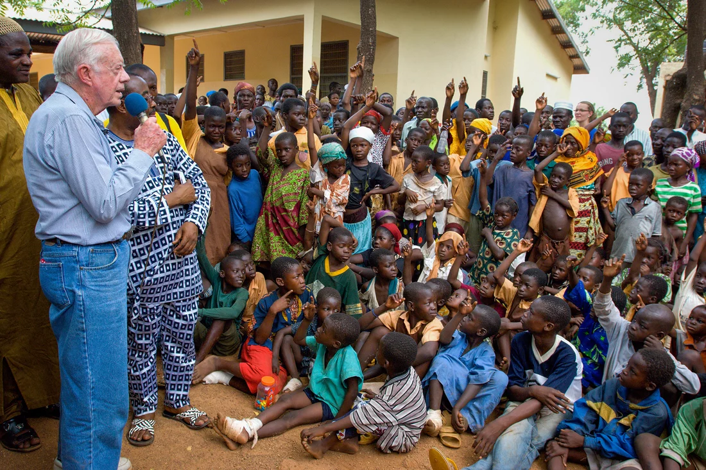
JIMMY CARTER TOOK ON THE AWFUL GUINEA WORM WHEN NO ONE ELSE WOULD — AND HE TRIUMPHED
February 23, 2023, 12:35 PM ET Jason Beaubien
"C:\Users\Lawrence Ayagiba\Desktop\jimmy-carter-took-on-the-awful-guinea-worm-when-no-one-else-would-and-he-triumph.htm"

Slide 15

ERADICATION OF THE GUINEA WORM DISEASE
THE DISEASE WAS IRRADICATED TWO YEARS AFTER THE RECOMMENDATIONS OF THE AUDIT WERE IMPLEMENTED IN 2008
INCLUDING THE INTERVENTION OF THE WORLD BANK TO FUND THE SMALLTOWN WATER SYSTEMS.
President Carter in Ghana in 2007
In a community in the Northern Region
Were guinea worm disease was endemic

Slide 16


