Slide 1
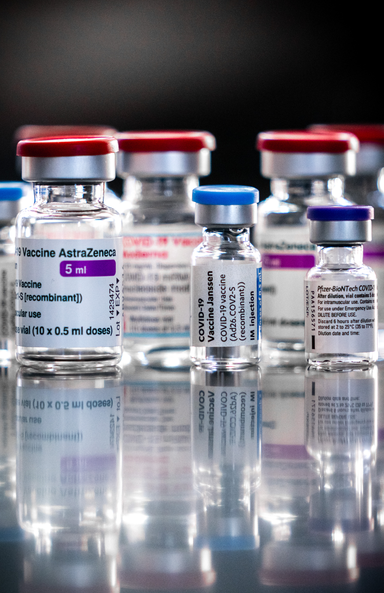
Pathway out of the pandemic
Audit of COVID-19 vaccine procurement

Slide 2
Why this audit?
Social impact: vaccines were ‘pathway out of the pandemic’
Procurement of vaccines within EU framework was a first
Large sums of money and risk-sharing
Negotiation process was opaque
The Netherlands fulfilled a leading role

Slide 3
What did we audit?
How did the Netherlands deal with the procurement of Covid-19 vaccines, and did its approach meet the requirements that can reasonably be set?
To what extent did the procurement contracts signed take sufficient account of the public interests that could be expected to be protected?
Are there any indications that the Netherlands exerted influence on the procurement of vaccines that were ultimately purchased through the European Commission?

Slide 4
Main findings
The Netherlands was not well prepared, but acted quickly
Meaningful contribution to European vaccine purchases
The Netherlands purchased sufficient and safety-tested vaccines as quickly as possible
Not a fair distribution across the world, although the Netherlands donated 23 million vaccines
Insufficient expertise in-house
Sloppiness, but no major mistakes
Insufficient attention to avoiding (the appearance of) conflict of interests

Slide 5
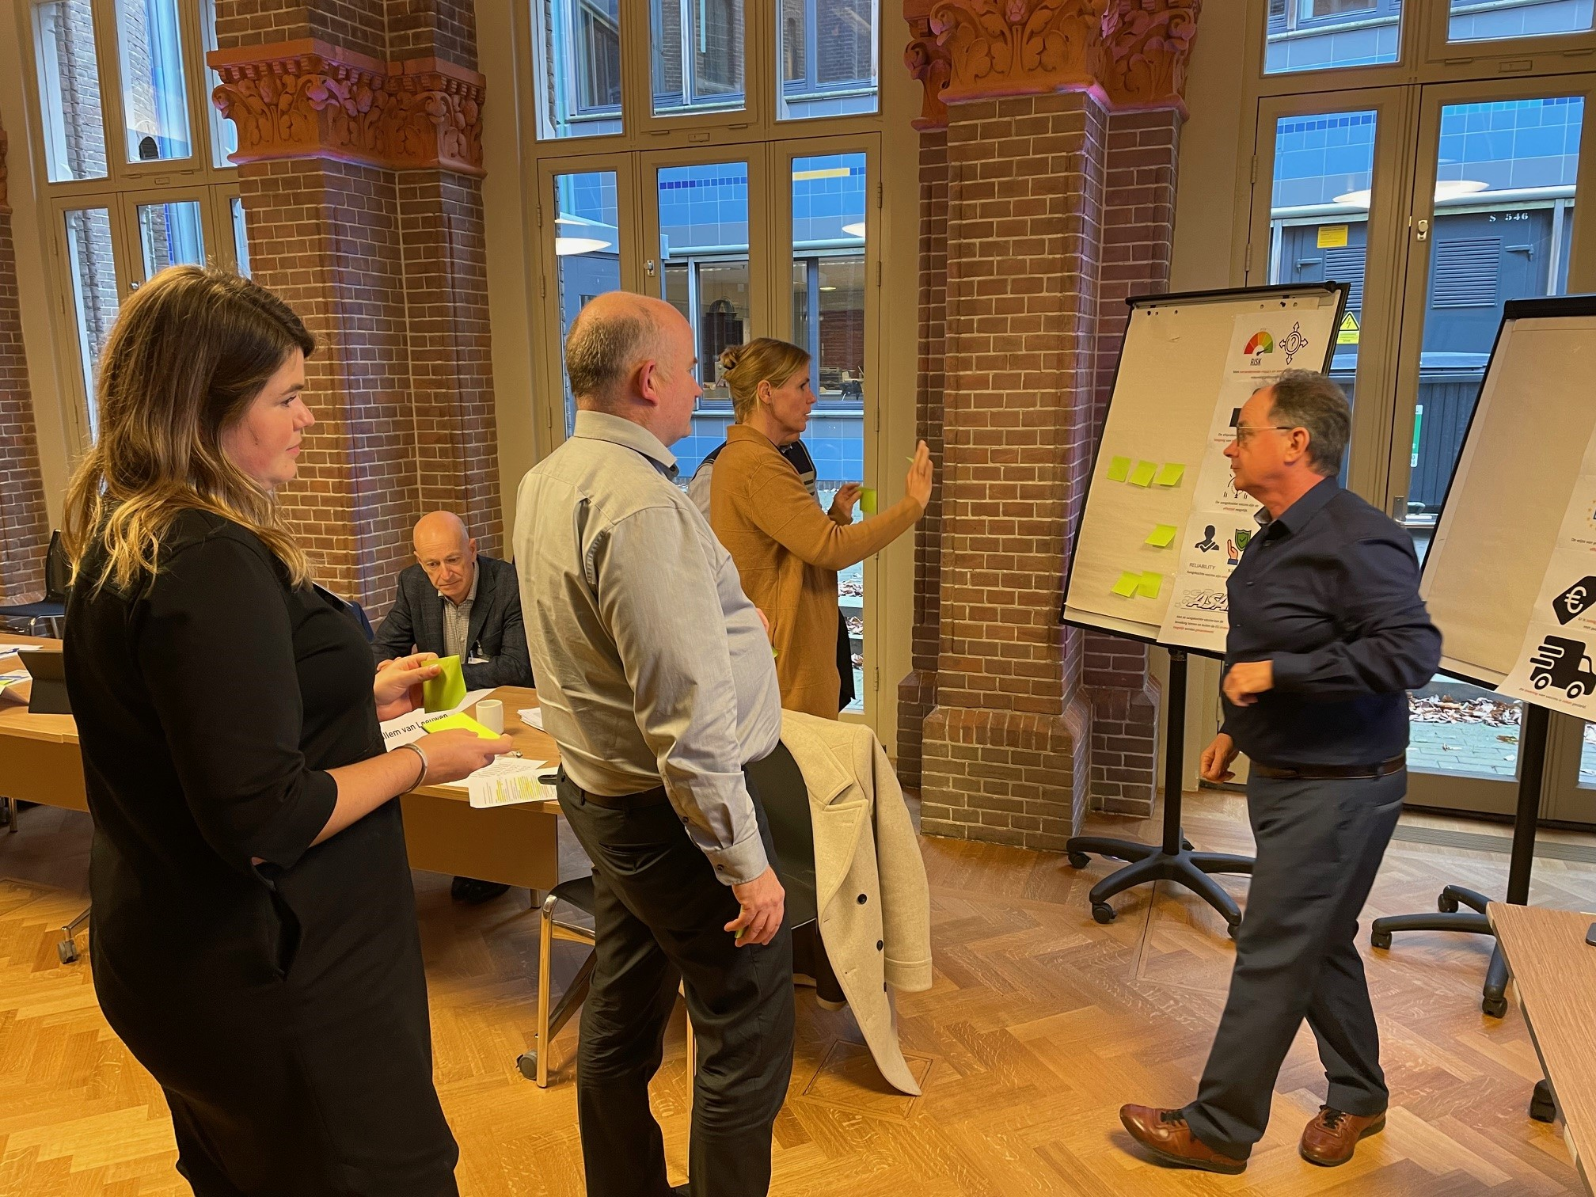



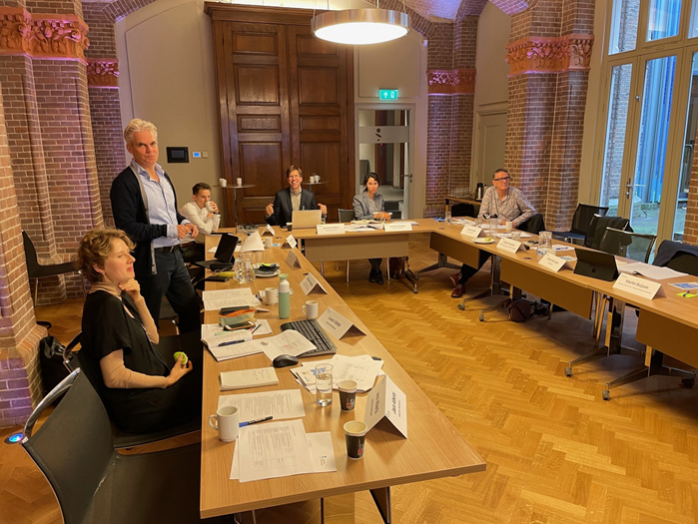
Challenge 1:
Developing audit criteria for times of crisis
Taking the crisis situation into account:
  In our evaluation of performance against criteria?
  In the audit criteria themselves?
Developing suitable criteria through expert meetings
Still, some criteria seemed overly strict in hindsight:
  ‘Consequences of differing efficacy’
  ‘Presence of a demarcated negotiating strategy’
Weighing the audit criteria: taking the Dutch aims as our starting point
Notes:
Policymaking is different in times of crisis!

Slide 6
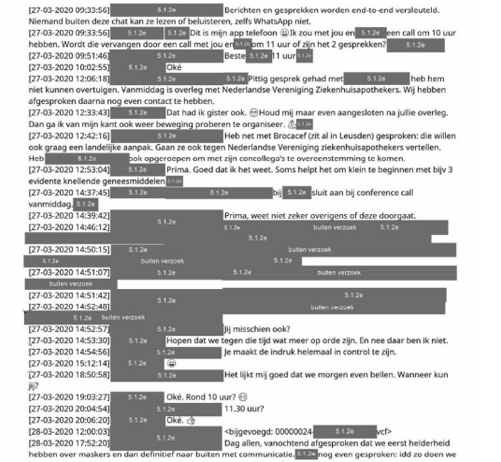
Challenge 2:
Lack of documentation and decision-making by app
No or very unstructured documentation
‘Decision-making by app’
Using Elasticsearch to look through tens of thousands of documents
Blacking out of information by the Ministry of Health, Welfare and Sport
Notes:
Policymaking is different in times of crisis!

Slide 7
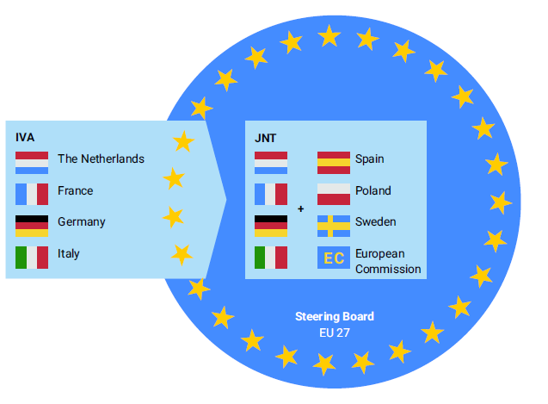
Challenge 3:
Establishing influence
How does one establish influence within a multi-party, multi-level process like the procurement of the vaccines?
Followed up interviews and document analysis with interviews with ‘external parties’ to test our hypotheses, e.g. DG SANTE, EC legal expert, Swedish and Spanish negotiators
Notes:
Policymaking is different in times of crisis!

Slide 8


