Slide 1
The new IIA Global Internal Audit Standards: Towards Integrated Assurance
Enhancing Performance Audits Through Coordinated Assurance
  Katleen Seeuws, CIA, CGAP, CRMA, CISA, CFE
©2025, The Institute of Internal Auditors. All rights reserved. For individual personal use only

Slide 2

Introductions
  Kat Seeuws, CIA, CGAP, CRMA, CISA, CFE
  Vice President – Standards & Guidance.
  Previously the CEO of The IIA-Belgium.
  Held positions in the field of internal control and internal audit, mainly in the public sector.
  Consultant at Grant Thornton.
  Several international collaboration and support projects in the field of public administration reform, directed by the European Commission, OECD, and The World Bank.
©2025, The Institute of Internal Auditors. All rights reserved. For individual personal use only.
2

Slide 3

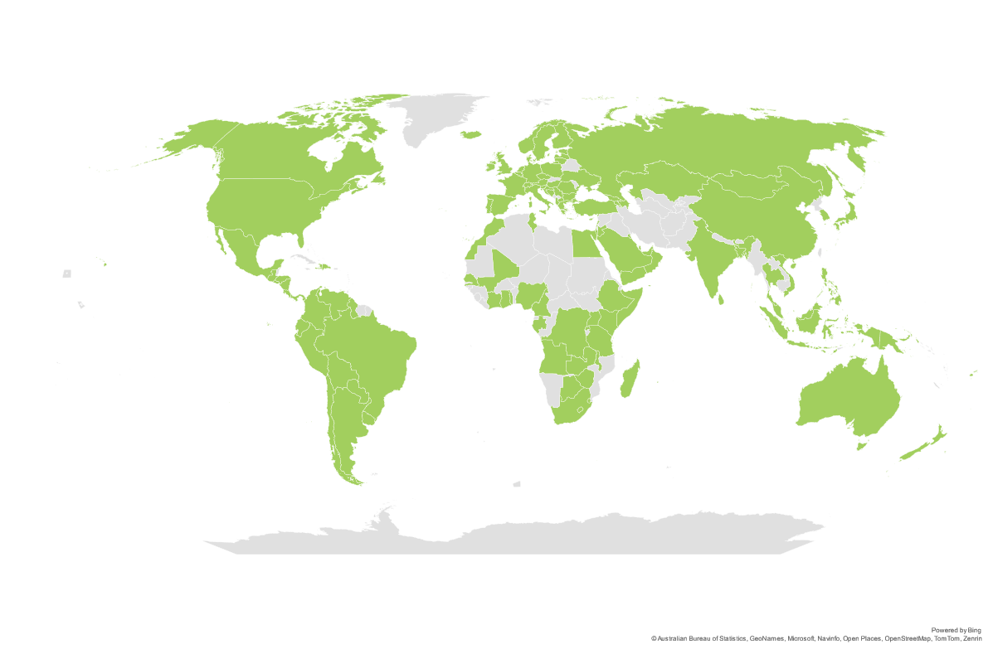
GLOBAL FOOTPRINT
260,000+
Members
200,000+
CIAs Awarded
170+
Countries & Territories
NORTH AMERICA
CENTRAL & SOUTH AMERICA
EUROPE
117
AFRICA
ASIA PACIFIC
Institutes Worldwide
MIDDLE EAST
©2025, The Institute of Internal Auditors. All rights reserved. For individual personal use only

Slide 4
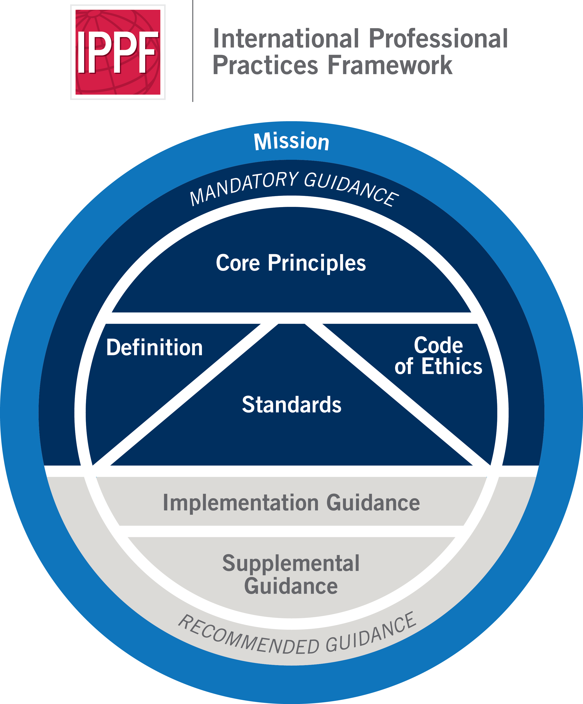
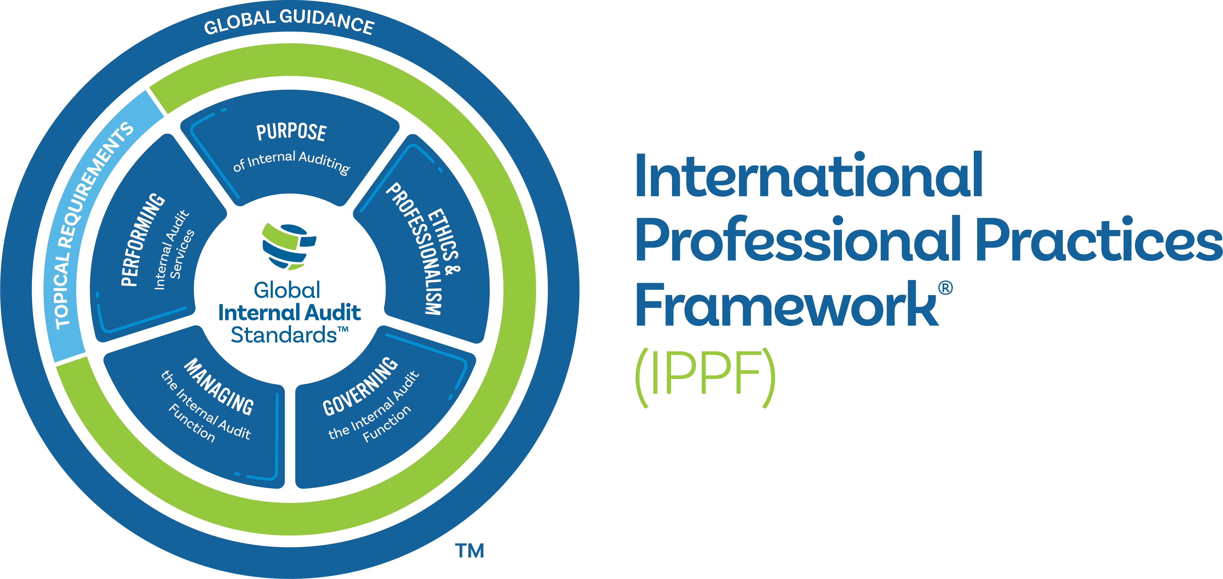
2017
2024
Global Internal Audit Standards
Topical Requirements
Global Guidance
©2025, The Institute of Internal Auditors. All rights reserved. For individual personal use only

Slide 5
The Value of Internal Audit in Performance Audits
Independent and Objective Assurance: Internal audit provides independent oversight of governance, risk management, and control processes, ensuring accountability.
Strengthening Public Trust: By improving economy, efficiency, and effectiveness, internal audit supports transparency in public sector performance audits (ISSAI 300, 2019)​.
Leveraging Organizational Insight: Internal audit possesses deep institutional knowledge that enhances the relevance and impact of performance audits.
Alignment with INTOSAI Standards: ISSAI 300 emphasizes that performance auditing should promote economy, efficiency, and effectiveness in governance​.
©2025, The Institute of Internal Auditors. All rights reserved. For individual personal use only.
5

Slide 6
What is Integrated Assurance?
Definition: Integrated assurance involves the coordinated efforts of multiple assurance providers to improve efficiency and effectiveness in audit activities.
Key Benefits:
  Avoiding duplication and eliminating assurance gaps.
  Strengthening governance, risk management, and accountability.
  Enhancing collaboration among internal audit, external audit, and other oversight functions.
  Aligning with the Three Lines Model, where internal audit operates as the independent third line, providing objective assurance while coordinating with management and governance structures.
©2025, The Institute of Internal Auditors. All rights reserved. For individual personal use only.
6

Slide 7
GIAS Standard 9.5: Coordination and Reliance
Requirements:
  Internal audit must coordinate with external auditors and other assurance providers to enhance assurance effectiveness.
  Identify opportunities to rely on work performed by others while maintaining objectivity and independence.
  Ensure clear and structured communication channels between internal and external audit functions.
Supporting Principles:
  Global Internal Audit Standards (2024) highlight that coordinated assurance optimizes the assurance function.
  ISSAI 300 supports cooperation between internal audit and SAIs while maintaining distinct mandates​.
©2025, The Institute of Internal Auditors. All rights reserved. For individual personal use only.
7

Slide 8
GIAS Standard 9.5: Coordination and Reliance
Key Implementation Steps:
  Establish formal coordination agreements with external auditors and oversight bodies.
  Conduct periodic joint meetings to align risk assessments and methodologies.
  Develop an assurance map to identify reliance areas and avoid duplication.
  Ensure compliance with professional independence requirements (per Three Lines Model, IIA 2024)​.
Benefits:
  Reduces audit fatigue and increases efficiency in performance audits.
  Supports more effective resource allocation across assurance providers.
  Enhances credibility and reliability of audit results.
©2025, The Institute of Internal Auditors. All rights reserved. For individual personal use only.
8

Slide 9
Comparison of ISSAI and GIAS
Aspect | ISSAI (External Audit) | GIAS (Internal Audit)
Objective | Focuses on public accountability, economy, efficiency, and effectiveness in government programs (ISSAI 300) | Provides independent assurance on governance, risk management, and controls to enhance organizational success
Independence | SAIs are independent from the government entities they audit (ISSAI 100, 300) | Internal audit reports functionally to the board or audit committee but operates within the organization (GIAS 2023)
Audit Scope | Covers financial, compliance, and performance audits (ISSAI 3000-3899) | Covers risk-based, operational, compliance, and advisory audits (GIAS Performing Internal Audit Services)
Collaboration | Encourages reliance on internal audit when objective criteria are met (ISSAI guidance on using internal audit work) | Encourages coordination with external auditors to maximize assurance coverage (GIAS Standard 9.5)
©2025, The Institute of Internal Auditors. All rights reserved. For individual personal use only.
9

Slide 10
Collaboration in Combined Assurance
Core Aspects of Combined Assurance:
  Risk Assessments and Assurance Mapping: Sharing insights on key risks to align assurance efforts.
  Coordinated Audit Scope: Reducing redundancy by leveraging each provider’s expertise.
  Leveraging Internal Audit Work: External auditors and oversight bodies can use internal audit reports where appropriate, provided independence is safeguarded (GIAS 9.5)​.
  Strengthening Reliance Mechanisms: Encouraging reliance on internal audit’s work without compromising external audit independence​.
Best Practices:
  Formalizing memorandums of understanding (MOUs) with external assurance providers.
  Establishing joint assurance reporting structures where appropriate.
©2025, The Institute of Internal Auditors. All rights reserved. For individual personal use only.
10

Slide 11
Key Takeaways and Next Steps
  Integrated Assurance Enhances Audit Effectiveness: A structured coordination framework strengthens public accountability.
  Collaboration Between Internal and External Audit is Essential: Aligning audit scopes enhances audit quality while reducing overlap.
  ISSAI and GIAS Alignment Supports Assurance Coordination: Encouraging Supreme Audit Institutions (SAIs) to leverage internal audit’s work where possible.
  Next Steps:
    Promote formalized collaboration between internal and external audit functions.
    Encourage periodic review of coordination mechanisms to enhance efficiency.
©2025, The Institute of Internal Auditors. All rights reserved. For individual personal use only.
11

