Slide 1


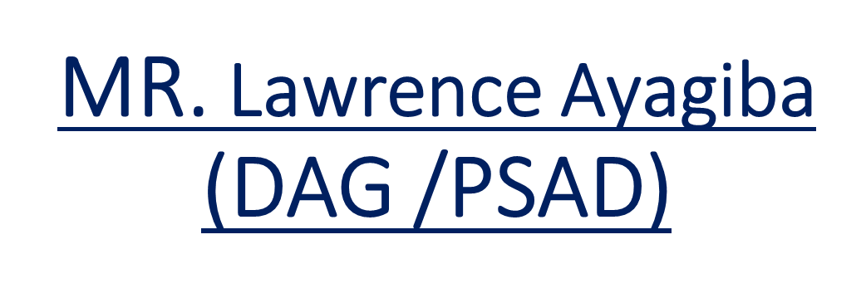
PRESENTATION BY

Slide 2
IFPP REQUIREMENT OF INTOSAI
INTOSAI Framework of Professional Pronouncements (IFPP), requires that INTOSAI Guidance documents (GUIDs) are developed by INTOSAI to support SAIs and individual auditors in:
  Putting the ISSAIs into practice in financial, performance and compliance audits
  Putting the ISSAIs into practice in other engagements
  Understandingspecific subject matter and how to apply the relevant ISSAIs1

Slide 3
WHY THE G -INITIATIVE
According to the IFPP Global Survey, 83% of respondents reported that their staff and departments use and reference GUIDs, highlighting their practical value.
However, SAIs have varying perspectives on several aspects of the GUIDs, including whether they should be elective or mandatory, the need for a stronger link with INTOSAI-Ps and ISSAIs, the robustness of the current methodology for adopting GUIDs, and issues around accessibility

Slide 4
PURPOSE OF THE G-INITIATIVE
The purpose of the ‘G’ initiative is to strengthen the professionalism of INTOSAI community by ensuring that SAIs have access to the necessary authoritative guidance on implementing the ISSAIs, giving them greater clarity on how to apply standard auditing practices.
The ‘G’ initiative will aim to ensure that the INTOSAI community has easy access to relevant and high-quality guidance material regardless of the history of its development, and that specific guidance on implementing the ISSAIs is refined to help SAIs do just that.

Slide 5
SCOPING OF THE G-INITIATIVE PROJECT
1. Review of existing processes
2. Propose updated and relevant criteria for determining the scope and nature of GUIDS
3. Propose criteria for placement of GUIDs within IFPP
4. Development of a New Approach for GUID Creation
5. Improving Accessibility of GUIDs
6. Propose way forward for ensuring a smooth transition to new approach for developing guidance on ISSAIs
(In consultation with SDP core group, FIPP, All SAIs INTOSAI regions, working groups, task forces, subcommittees etc.)

Slide 6
Expected deliverables
Review Report
GUIG Creation Framework
Strategies for improving Accessibility of GUIDs
Dissemination Strategy
Interdependencies with other Projects. (“TI” Developing clear and consistent terminology for the IFPP & “AI” Improving the accessibility of the pronouncement)
Implementation Plan (To be improved and finalized upon approval of proposed document)

Slide 7
Timelines
February 2025 Meeting with FIPP (accomplished)
10. March 2025 Scoping paper ready.(accomplished)
May 2025. Hybrid FIPP meeting.
June 2025 project proposal should be ready for FIPP approval
End 2028 SDP conclusion
Submitted by project lead: SAI INDIA

Slide 8


