Slide 1

SDP 2023-2028 ‘P’ initiative
PAS Annual Meeting
April 1-2, 2025, Bucharest, Romania

Slide 2

Background information
The results of Component 1 analysis has identified four qualities the IFPP framework and its content should meet:
clarity - easily understood, unambiguous and not open to misinterpretation;
relevance - covers key organisational issues and professional tasks that many/most SAIs are required to undertake;
robustness - technically strong, thereby leading to reliable results when
implemented; and
accessibility - available to users at all levels in ways that suit their needs

Slide 3
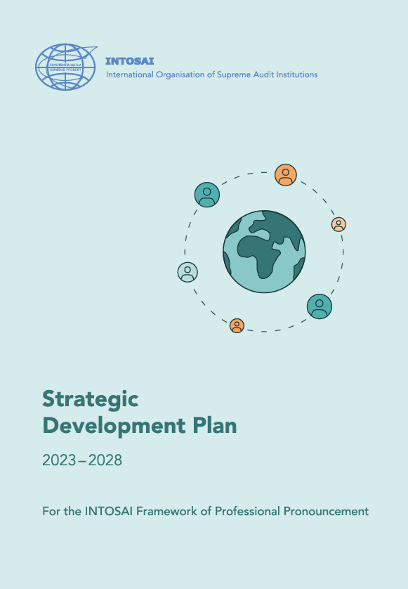
Background information
SDP 2023-2028 includes a review of INTOSAI-P through the following initiative:
The ”A” initiative – Improving accessibility to the pronouncements
The ”T” initiative – Developing clear and consistent terminology for the IFPP
The ”P” initiative – Updating the content and presentation of the INTOSAI principles
The ”I” initiative – Ensuring the clarity of the ISSAIs
The ”G” initiative – Developing a better approach to providing guidance

Slide 4
”P” Initiative
The INTOSAI Principles (INTOSAI-Ps) address the role and function of SAIs, and form the basis for their legal, institutional and organisational framework.
Documents covered by the P-initiative:
INTOSAI-P 1 – the Lima Declaration
INTOSAI-P 10 – the Mexico declaration on SAI independence
INTOSAI-P 12 – the value and benefits of Supreme Audit Institutions
INTOSAI-P 20 – principles of transparency and accountability
INTOSAI-P 50 – principles of jurisdictional activities of SAIs

Slide 5
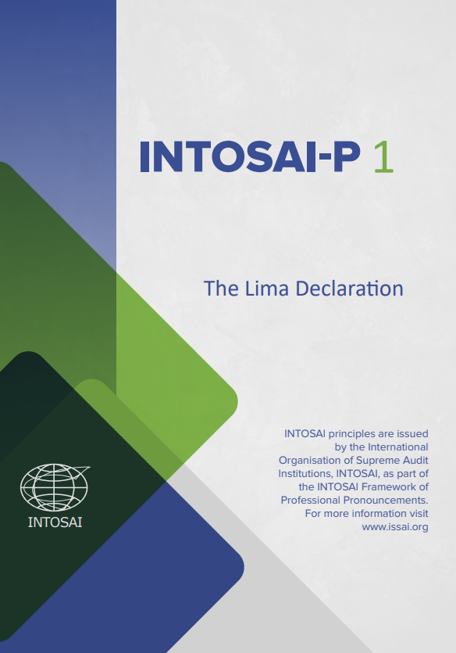
P-1 Lima Declaration – Guideline of Auditing Precepts
Serves as Magna Carta of public sector auditing. The Lima Declaration is intended to provide criteria to ensure the independence and effectiveness of government auditing.

Slide 6
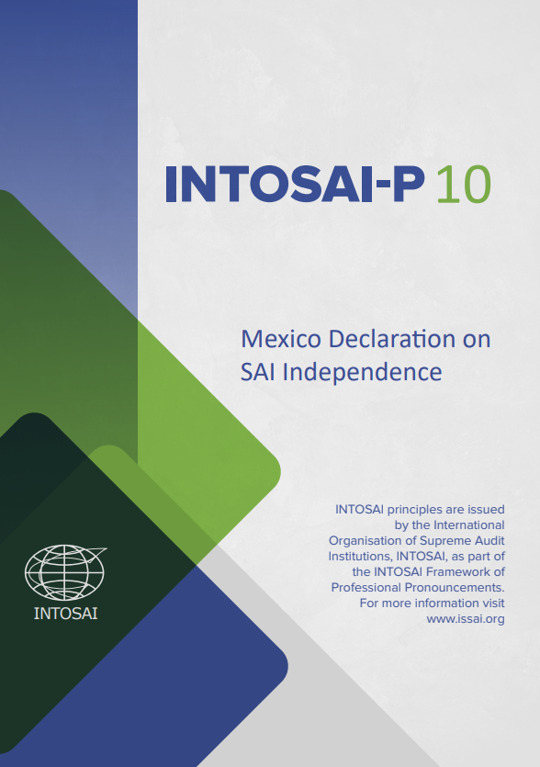
P-10 Mexico Declaration on SAI Independence
Defines eight core principles on SAI independence that flow from INTOSAI-P1, as an essential requirement for proper public sector auditing

Slide 7
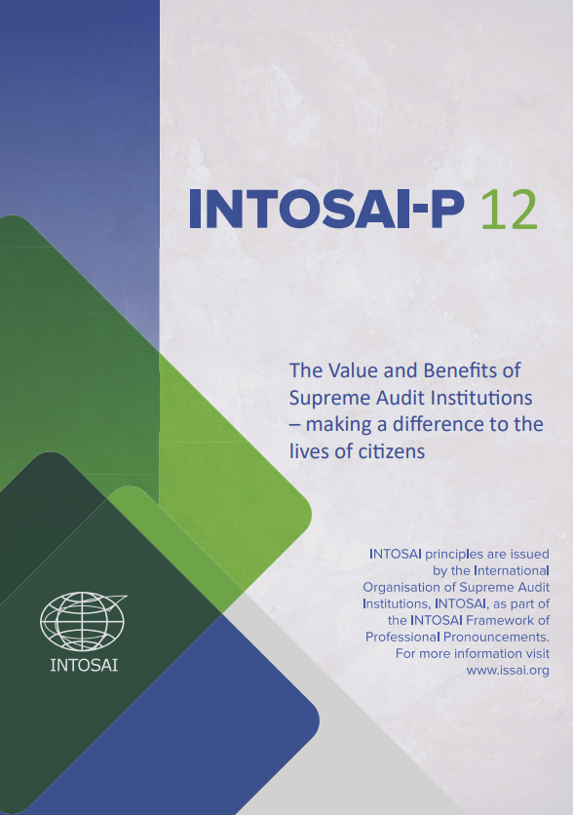
P-12 The value and benefit of SAIs – making a difference to the lives of citizens
INTOSAI-P12 contains the objectives and principles towards which SAIs should strive to communicate and promote the value and benefits they can bring to the democracy of the society of which they are a part.

Slide 8
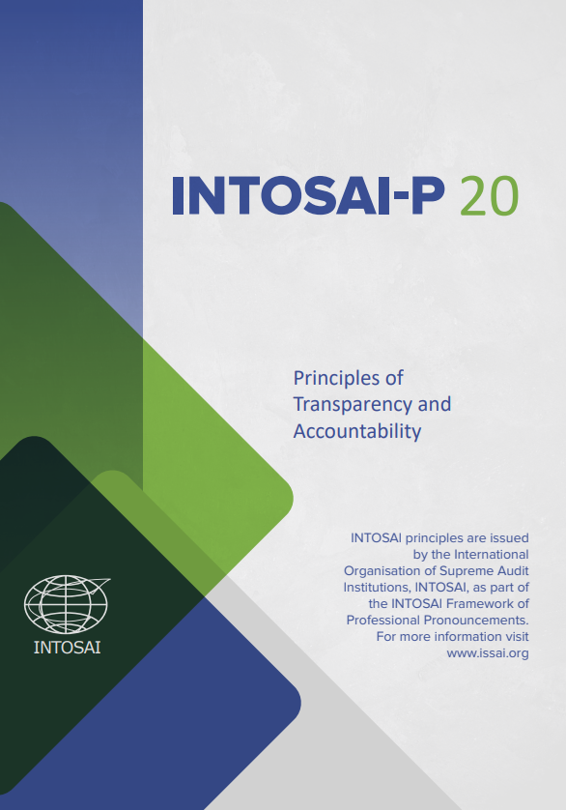
P-20 Principles of Transparency and Accountability
Outlines the principles of transparency and accountability for SAIs to assist them in leading by example in their own governance and practices.

Slide 9
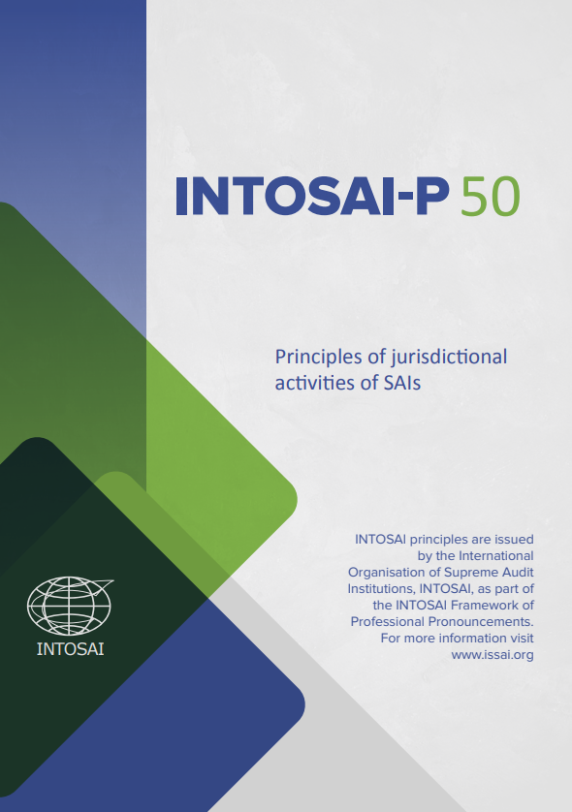
P-50 Principles of jurisdictional activities of SAIs
INTOSAI-P50 contain principles to suit the specific context of jurisdictional activities of SAIs empowered with those missions.

Slide 10
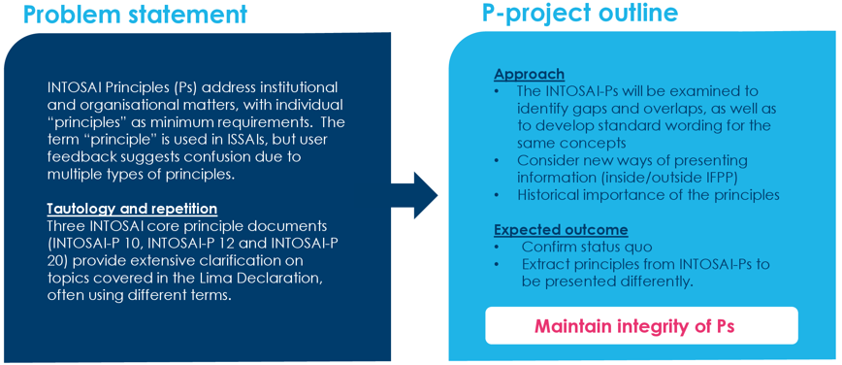
Why will we look into this?
The 2023-2028 Strategic Development Plan includes a revision of the current structure of the INTOSAI-Ps. The aim is to obtain a clear set of principles presented in a way that is easily accessible for users both inside and outside INTOSAI.

Slide 11
Who is involved?
Stakeholders with close ties to the IFPP, such as the INTOSAI bodies and regional organisations, the UN and private-sector auditors (especially IFAC).
Other relevant actors, such as legal advisors and academics.

Slide 12
Previous and upcoming meetings
20 Nov 2024 – First meet and greet
17 Jan 2025 – Reflection and survey
3 Feb 2025 – A sub-group was appointed to assess the survey results for the P-project
31 Mar 2025 – Initial FIPP proposal
May 2025 – Working group

Slide 13
Reflection on the INTOSAI-Ps
Are the Ps clear in terms of their objective?
Are the Ps clear in terms of implementation? What are the areas of improvement?
Are the Ps aligned and relevant to current context? What are the areas of improvement?
What are the top three challenges we foresee? What do we see as possible solutions?
What are our considerations relating to terminology used in the Ps?
Who are the other stakeholders that need to be consult as part of the process and why?

Slide 14
Expected deliverables
Clear definition of principles in conjunction with the ‘I’ initiative
Optimal positioning of the INTOSAI-Ps.
There is an overwhelming argument for maintaining the integrity of these documents in their original format
Reinforcement of the value of the INTOSAI-Ps
Conforming amendments to the INTOSAI-Ps arising from the ISSAI 140 revision will be considered

Slide 15
Expected scenarios
Confirm status quo – leave INTOSAI-Ps where they currently are in the IFPP, with no modifications.
Extract the principles from the INTOSAI-Ps and present them in a different way or format, while also maintaining the integrity of the original INTOSAI-Ps so they are readily and publicly accessible.

Slide 16
Thank You!

