Slide 1
Accessibility initiative
Alan Findlay on behalf of Spyros Pilos (project lead - ECA)

Slide 2
Agenda
SDP-A initiative project team
Organisation and activities
Scoping document
Purpose (Context, initial assessment and objectives)
Scope (Short term / Longer term)
Key Deliverables (Outputs and time)
Quality Processes (Dependencies etc.)
Next steps

Slide 3
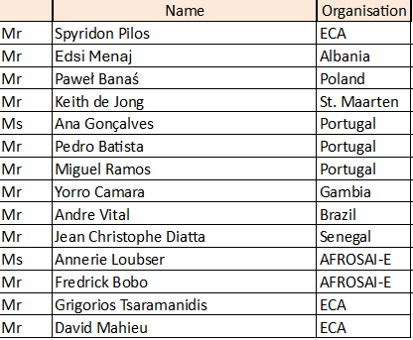
Project team organisation and activities
Created and use collaboration space on Teams
Setup internal support team at the ECA
(website service manager, expert auditor)
Online project group meetings
Project lead participated in all FIPP-SDP core group meetings
PT colleagues contacted the issai.org provider in Brazil
Drafted the scoping document
Meetings with liaison officer team

Slide 4
Scoping document – purpose (1)
issai.org website = the tool
the official repository for IFPP pronouncements, including principles, standards, and guidance, as well as background information relating to standard-setting.
The project questions:
Is the tool sufficient for what it is intended to do?
If not, how can we improved it and/or what could replace it?

Slide 5
Scoping document – purpose (2)
Initial assessment:
Status of issai.org - information collected from provider:
Platform = WordPress with rather simple implementation
Issue analysis:
  extensive work in component 1 report and concept paper is sufficient
  ➔ no further user feedback needed before project proposal
  SDP-A Project team put already some additional ideas on the “wish list”

Slide 6
Scoping document – two parallel strands
Short term strand: Improve the existing
Within the current tool’s full capabilities, what else could be implemented that would significantly boost the site’s present usefulness?
Long term strand: Move to a digital platform
What tools (potentially different from the current one) could be adopted or created and what would be the best choice in order to make the dissemination of ISSAI knowledge more effective, efficient and useful to all users around the globe?

Slide 7
Quality assurance
The project is essentially an IT project for improving usability and accessibility to information.
We are going to use standard quality assurance methods (requirement validation, testing, performance etc) and KPIs.
We will also monitor closely the dependencies of Accessibility with other initiatives.

Slide 8
Dependencies - T
The ‘A’ initiative should
be involved | when setting the framework for the Terminology discussion, so that we can use the same terms to denote the same concepts
give input | in case the ‘A’ initiative specifies a modular way of presenting the information
expect input | in case ‘T’ decides on hierarchy of terms that is relevant for structuring the information or as metadata. They should also inform ‘A’ when terms are confirmed in one or more languages, especially higher-level ones which may be useful to structure the content.
(analysis based on: https://www.intosaifipp.org/3072-2/ )

Slide 9
Dependencies - P
The ‘A’ initiative should
be involved | when discussing the structure of the Principles and their relations with ISSAIs (from ‘I’) and guidance (from ‘G’)
give input | in case the ‘A’ initiative specifies a module way of presenting the information
expect input | in case the ‘P’ initiative decides on a structure and relations with Guidance and ISSAIs, the ‘A’ initiative should be able to support it.
(analysis based on: https://www.intosaifipp.org/3072-2/ )

Slide 10
Dependencies - I
The ‘A’ initiative should
be involved | when discussing the structure of the ISSAIs and their relations with Principles (from ‘P’) and Guidance (from ‘G’)
give input | in case the ‘A’ initiative specifies a modular way of presenting the information
expect input | in case the ‘I’ initiative decides on a structure and relations with Principle and Guidance, the ‘A’ initiative should be able to support it.
(analysis based on: https://www.intosaifipp.org/3072-2/ )

Slide 11
Dependencies - G
The ‘A’ initiative should
be involved | when discussing the structure of the Guidance material and its relations with Principles (from ‘P’) and ISSAIs (from ‘I’), but also with guidance beyond the IFPP.
give input | in case the ‘A’ initiative specifies a modular way of presenting the information
expect input | In case the ‘G’ initiative decides on a structure and relations with Principles and ISSAIs, as well as with information beyond the IFPP, the ‘A’ initiative should be able to support it.
(analysis based on: https://www.intosaifipp.org/3072-2/ )

