Slide 1


e-Control: Innovation and Integration
Driving the future of the Brazilian SAI (TCU)
PAS - Bucharest / 2025

Slide 2
Complexity of audit and oversight processes.
Increasing volume of data requiring precise analysis.
Need for integration between different systems and information sources.
Expectations of transparency and citizen participation.
Challenges of TCU
Limited use of new technologies for predictive analysis and detection of irregularities.

Slide 3
What is e-Control?
It is a project aimed at modernizing and optimizing the management of audit and oversight processes, providing greater efficiency and transparency in external control operations.
e-Control
e-Control: Innovation and Integration.
Driving the future of the Brazilian SAI (TCU)

Slide 4
e-Control
The e-Control strategy is based on three fundamental pillars
Digitization and Centralization of Information
Automation and Artificial Intelligence
Interoperability and Transparency

Slide 5

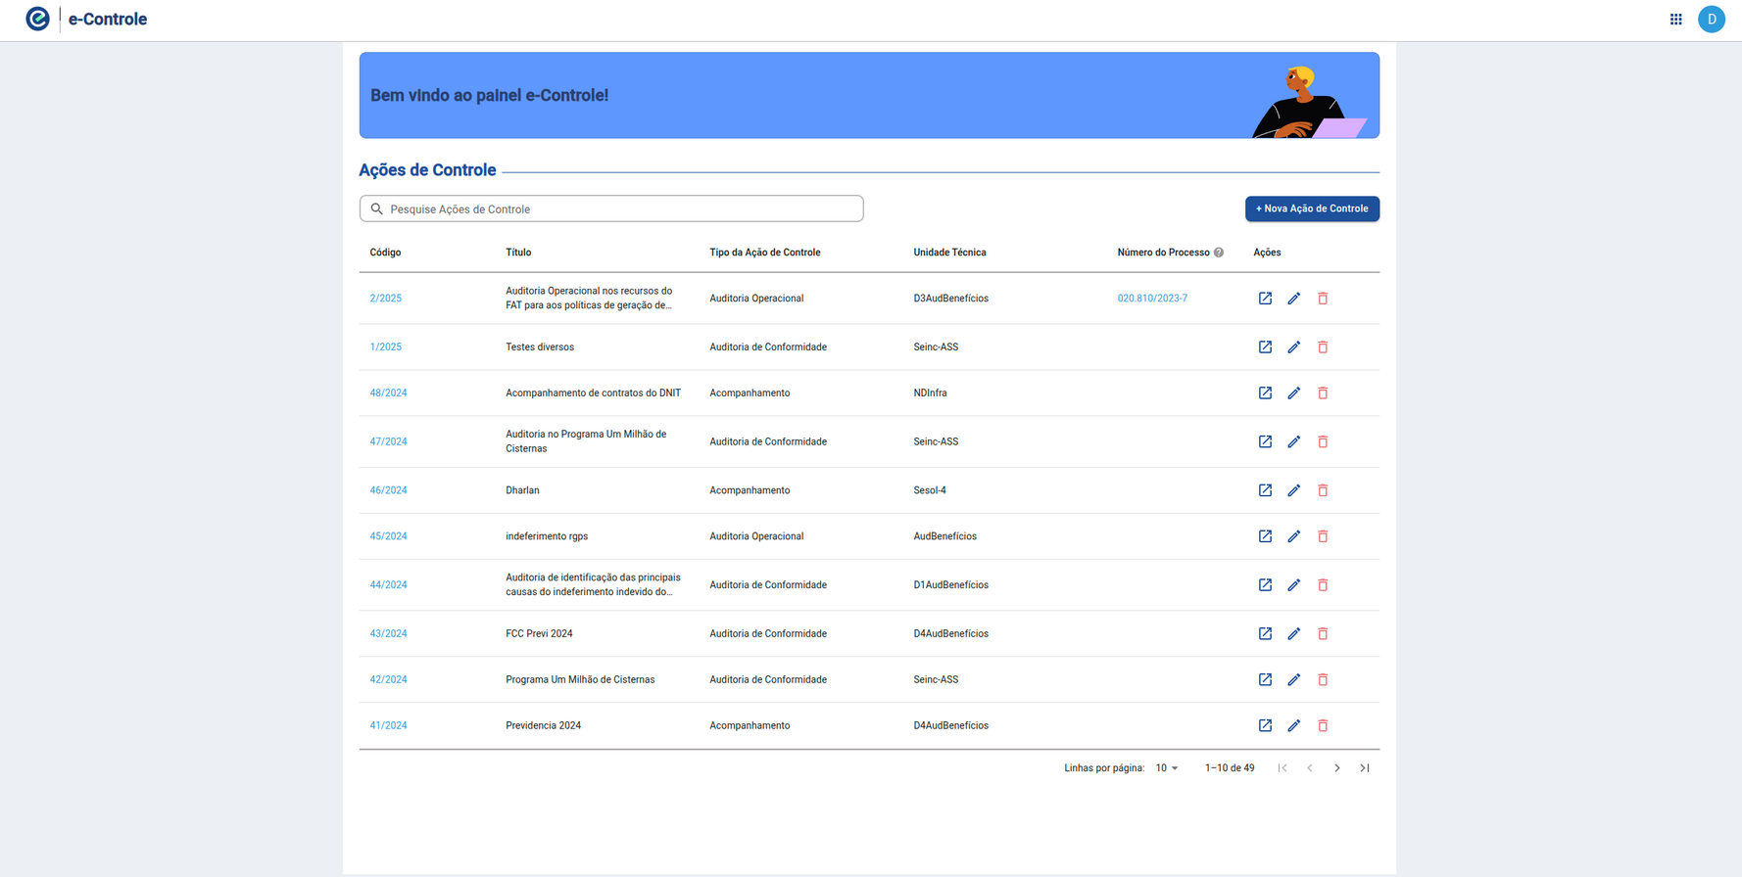
Digitization and Centralization of Information
Interoperability and Transparency
Unified vision of TCU's fronts
e-Control
e-Control: Innovation and Integration.
Driving the future of the Brazilian SAI (TCU)

Slide 6
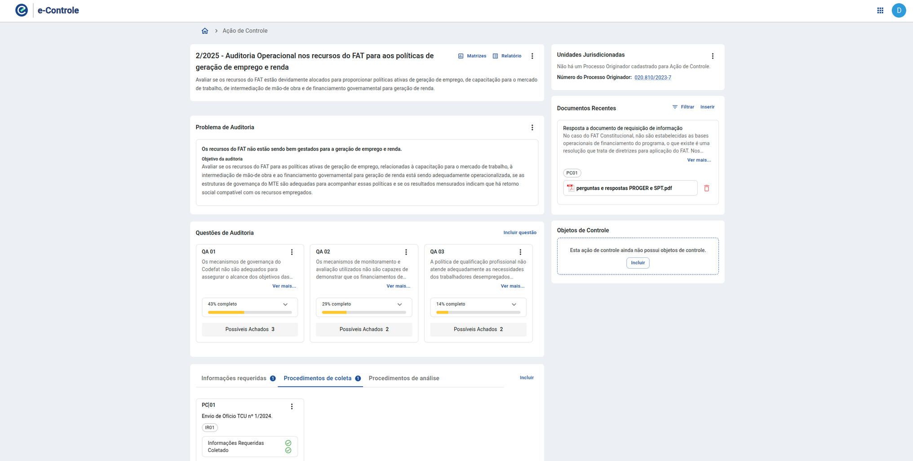

Digitization and Centralization of Information
Recording information in an organized and integrated manner
e-Control
e-Control: Innovation and Integration.
Driving the future of the Brazilian SAI (TCU)

Slide 7

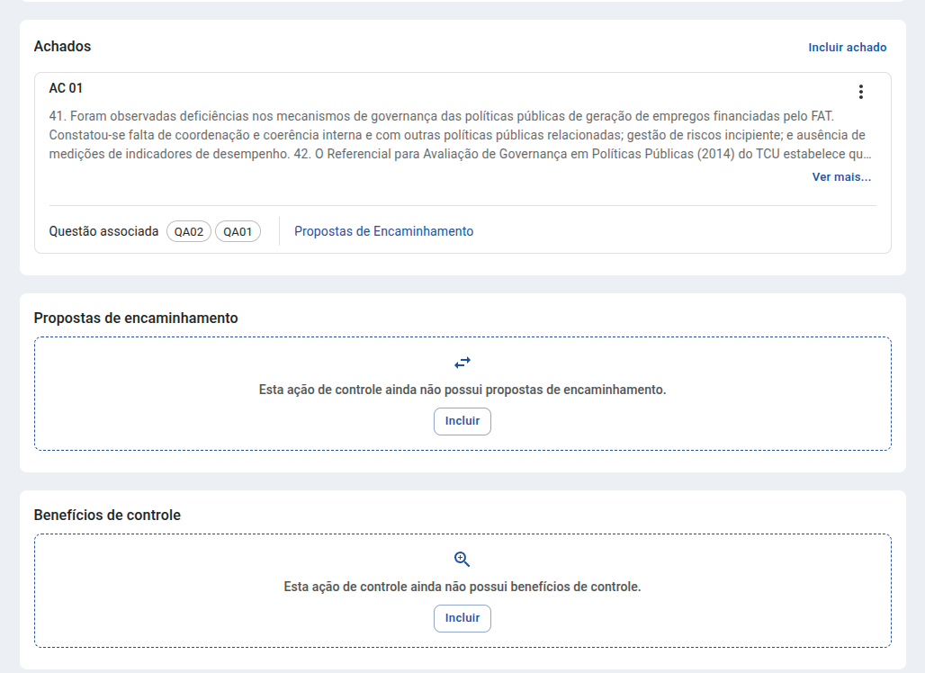
Automation and Artificial Intelligence
Digitization and Centralization of Information
Interoperability and Transparency
A flexible system with a simple and objective interface
e-Control
e-Control: Innovation and Integration.
Driving the future of the Brazilian SAI (TCU)

Slide 8

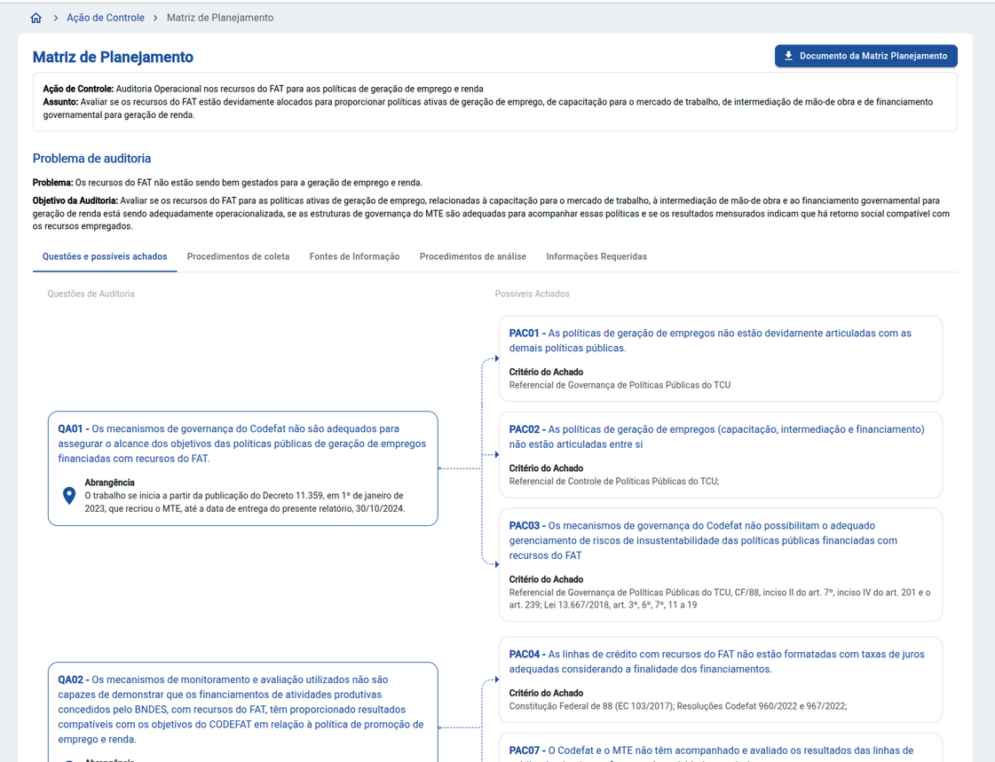
Automation and Artificial Intelligence
Digitization and Centralization of Information
Interoperability and Transparency
Visual aids to assist during the oversight process
e-Control
e-Control: Innovation and Integration.
Driving the future of the Brazilian SAI (TCU)

Slide 9
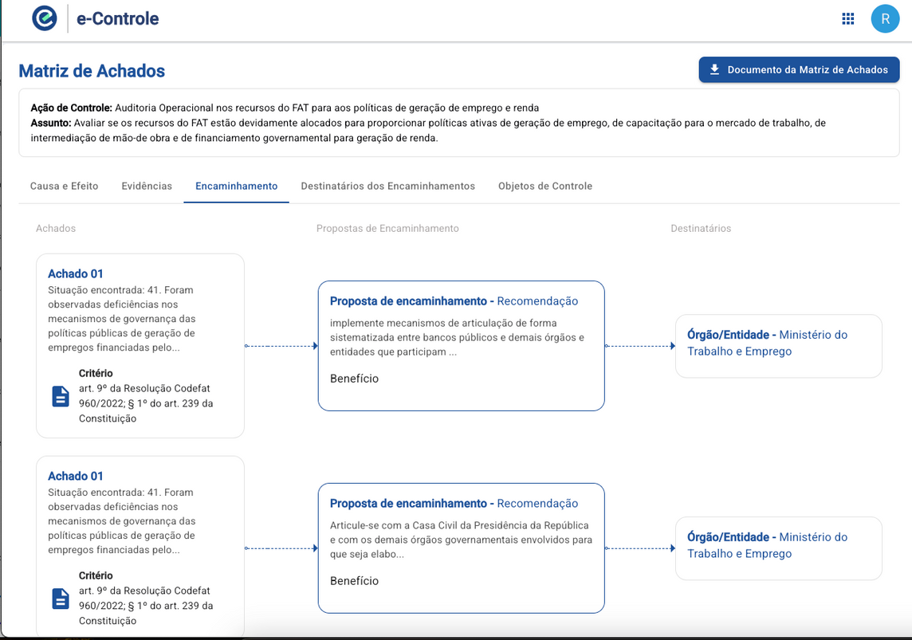
Automation and Artificial Intelligence
Digitization and Centralization of Information
Interoperability and Transparency
Visual aids to assist during the oversight process
e-Control
e-Control: Innovation and Integration.
Driving the future of the Brazilian SAI (TCU)

Slide 10
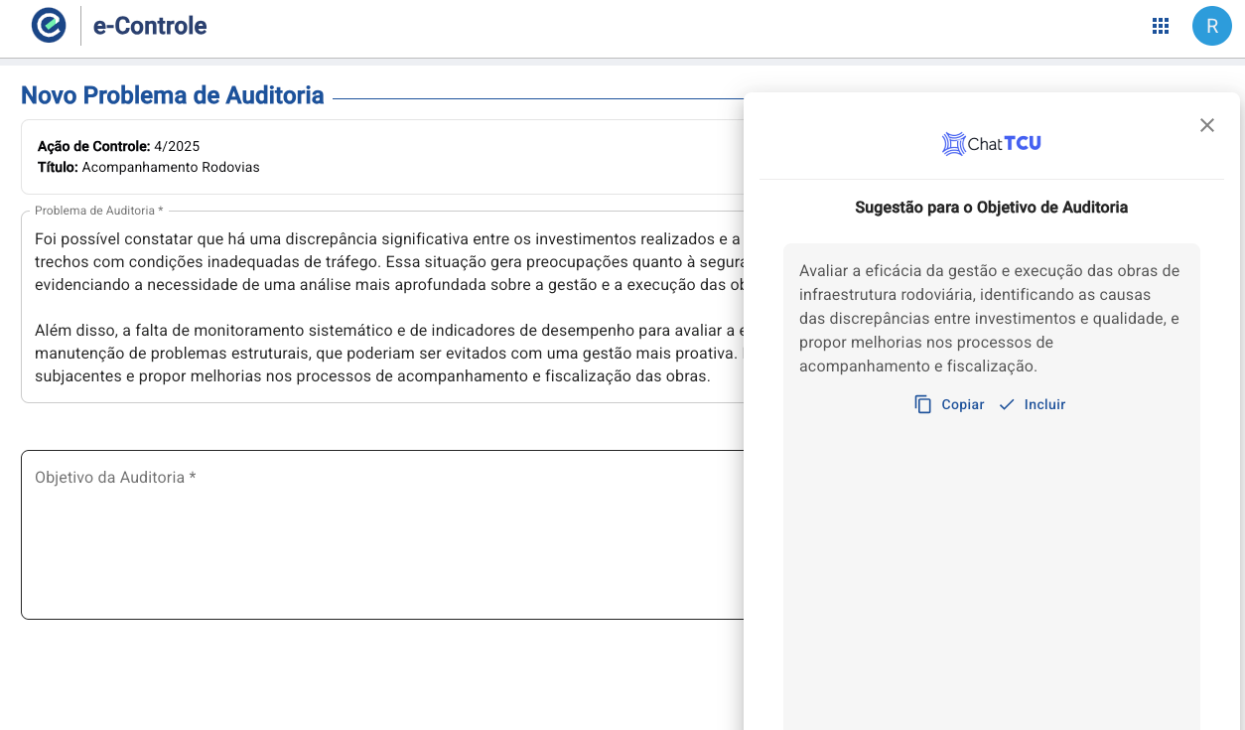
Automation and Artificial Intelligence
Digitization and Centralization of Information
Interoperability and Transparency
AI within the auditor's work process
e-Control
e-Control: Innovation and Integration.
Driving the future of the Brazilian SAI (TCU)

Slide 11
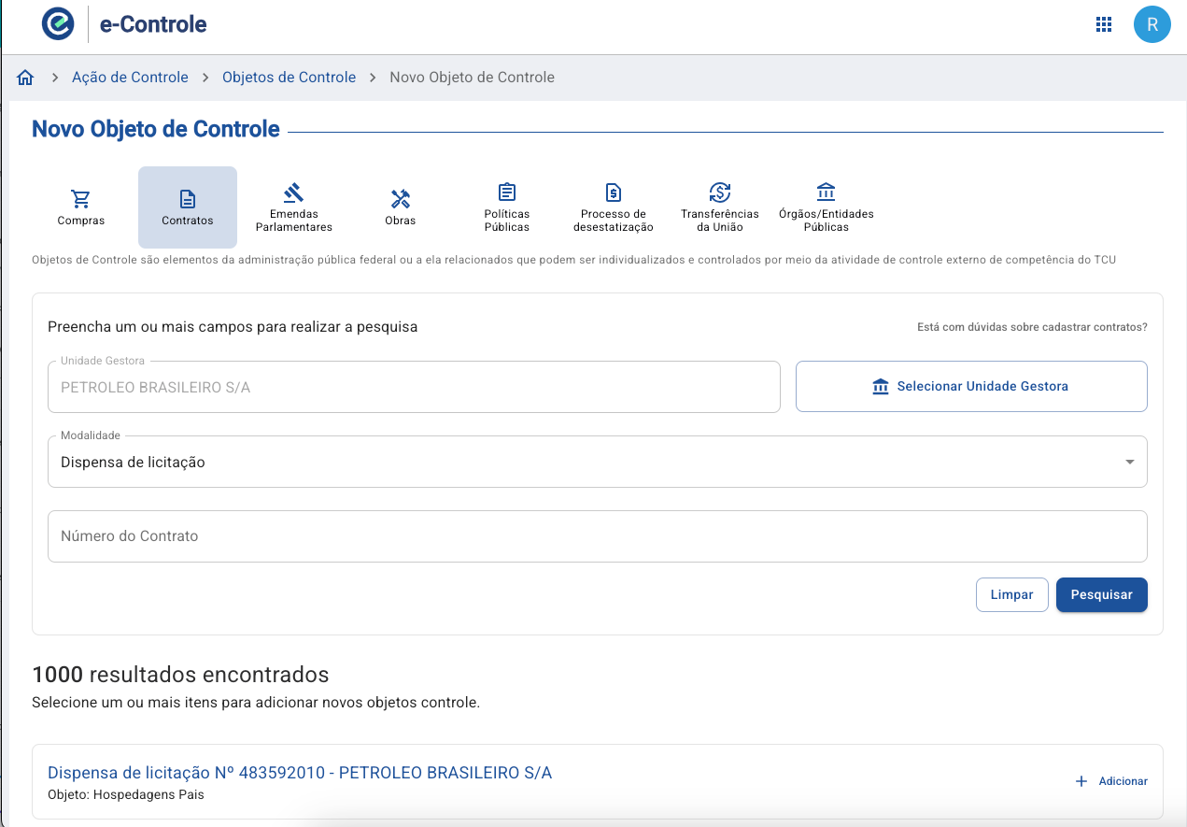
e-Control
Objects of Control
They facilitate oversight by providing focus and efficiency, making the process more organized and transparent.
They allow for an accurate evaluation of programs and policies, contributing to improvements in public administration.
They make it easier to search for and locate specific actions, streamlining audits and oversight activities.

Slide 12

Risk Module
The Risk Module of e-Control is designed to identify, assess, and monitor risks associated with external control activities. This module allows TCU to prioritize its oversight actions based on a thorough analysis of risks, ensuring that resources are allocated efficiently to areas with higher potential impact. The module helps anticipate problems and implement preventive measures, contributing to more proactive and effective control.
Available
Modules

Slide 13
Planning Module
The Planning Module is essential for organization and coordination of activities of TCU. It facilitates the development of detailed action plans, aligned with the strategic objectives of the Court. This module allows the integration of information from sources, helping to define priorities and allocate resources in an optimized way. In addition, the module supports the creation of automated planning matrices, which are essential for efficient execution of audits
Available
Modules

Slide 14
Execution Module
The Execution Module of e-Control is responsible for managing the implementation of planned audits and inspections. It provides tools for real-time monitoring of activities, ensuring that processes are conducted in accordance with established standards and within defined deadlines. This module also facilitates the documentation and recording of findings, enabling a detailed analysis of results and the generation of reports that support decision-making. Process automation within this module helps reduce repetitive tasks, allowing auditors to focus on more strategic activities.
Pre-availabe Modules

Slide 15
Merit Module
Construction Oversight Module
TCE (Special Account Module)
Next
Modules

Slide 16
With the high-quality data the system will have, we will be able to leverage AI for:
  Automatic detection of inconsistencies and suspicious patterns in large data volumes
  Classification and prioritization of audits, allowing auditors to focus on the most relevant cases
  Predictive analysis to anticipate risks and fraud
  Natural Language Processing (NLP) to facilitate information extraction from documents and reports;
  Automation of repetitive tasks, freeing up time for more strategic analyses.
The Role of Artificial Intelligence in e-Controle

Slide 17
Thank you
  vitormf@tcu.gov.br

