Slide 1
International benchmarking in performance audit
16th INTOSAI Performance Audit Subcommittee annual meeting
1 – 2 April 2025
Bucharest, Romania

Slide 2
Dagsorden
International benchmarking as methodology
Two audit reports using international benchmarking
  Authorization process for foreign health personnel
  Maritime pilotage

Slide 3
1. International benchmarking as methodology

Slide 4

Benchmarking studies according to INTOSAI
Basic question: Are things being done in accordance with best practices?
“ Benchmarking is a process for comparing an organization’s methods, processes, procedures, products, and services against those of organizations that consistently distinguish themselves in the same categories.
  Performance Audit Guidelines.pdf (auditorgeneral.gov.tt)

Slide 5
Our pros and cons connected with doing international benchmarking
Difficult to ensure comparability of entities
Voluntary participation from international entities required
Ability to measure performance of nationally unique entity
Showcase methodology relevant to auditee’s own management information
Auditee may feel that comparison is unfair
Difficult to check data quality of data from international entities
Develop realistic audit criteria
Identify best practices and provide recommendations

Slide 6
2. Two audit reports using international benchmarking

Slide 7


We have completed 2 audits using international benchmarking
Benchmarking speed of authorization process when foreign health personnel apply to work in either Denmark, Sweden or Norway
(September 2024)
Benchmarking efficiency of national maritime pilotage providers in Denmark, Sweden, Norway and Finland
(December 2022)

Slide 8
Benchmarking speed of authorization process for foreign health personnel

Slide 9



Foreign health personnel
Shortage of personnel in health sector of Nordic countries
One national entity in Denmark, Sweden and Norway responsible for the authorization process
Comparable legislation across countries
Worries that a slow and inflexible authorization process may cause foreign health personnel to opt out of applying for authorization in the country

Slide 10
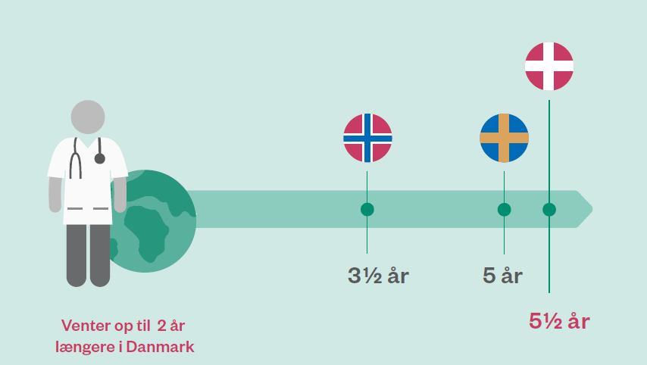
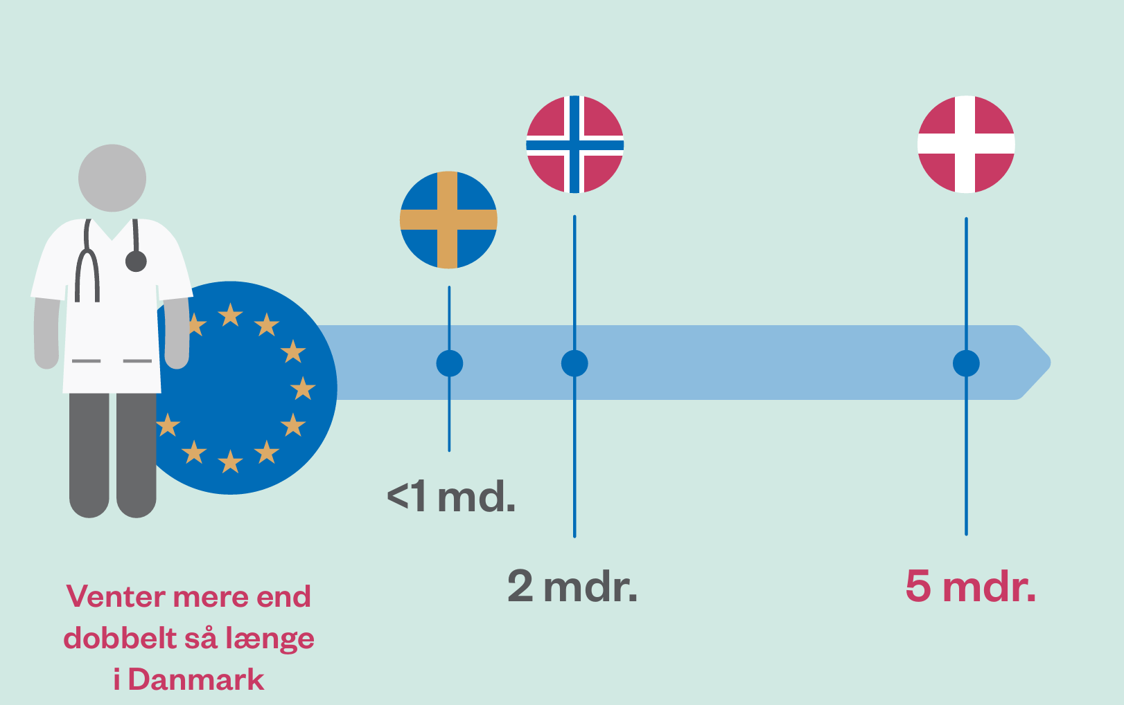
Results
Applicants from third countries
Applicants from EU-countries
years
years
month
years
months
months

Slide 11
Benchmarking efficiency of maritime pilotage

Slide 12
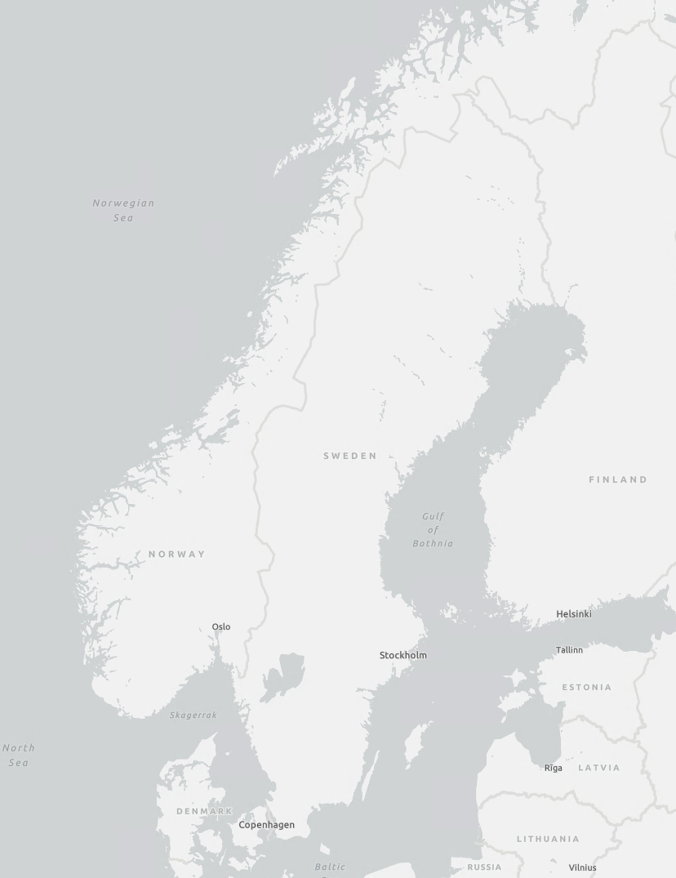

Maritime pilotage
The Scandinavian waters have heavy traffic, and treacherous passages.
Experienced mariners (pilots) helps ships by guiding the ship’s passage to avoid accidents which could lead to loss of life or pollution of e.g. oil, chemicals and nuclear waste.
Denmark, Sweden, Norway and Finland each have one primary provider of maritime pilotage

Slide 13
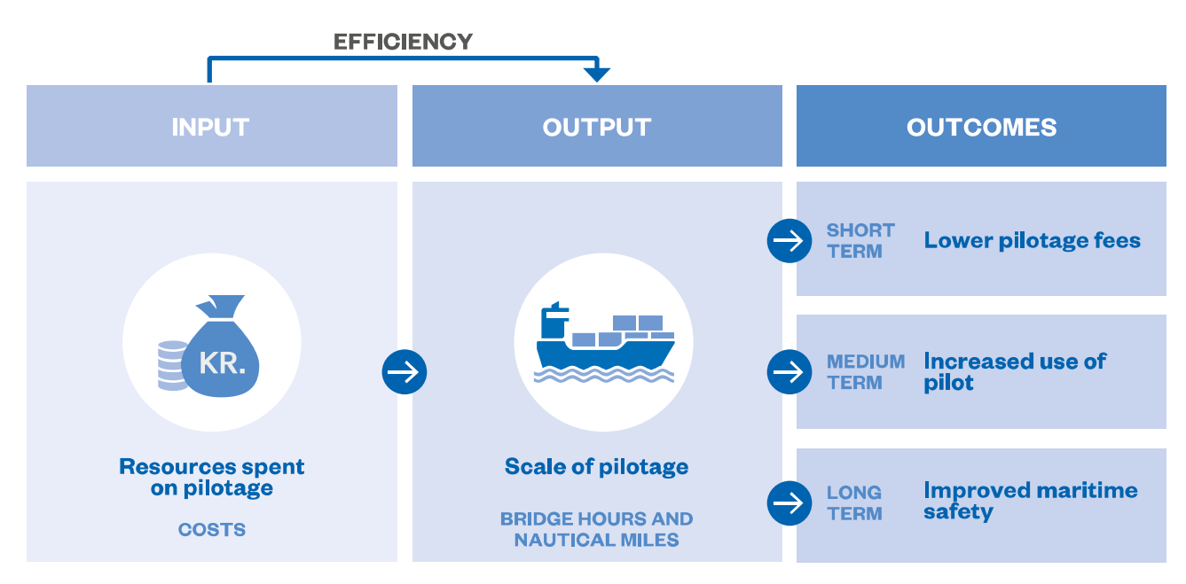

Measuring efficiency
$$Efficiency=\frac{Costs}{Bridge hours }$$

Slide 14
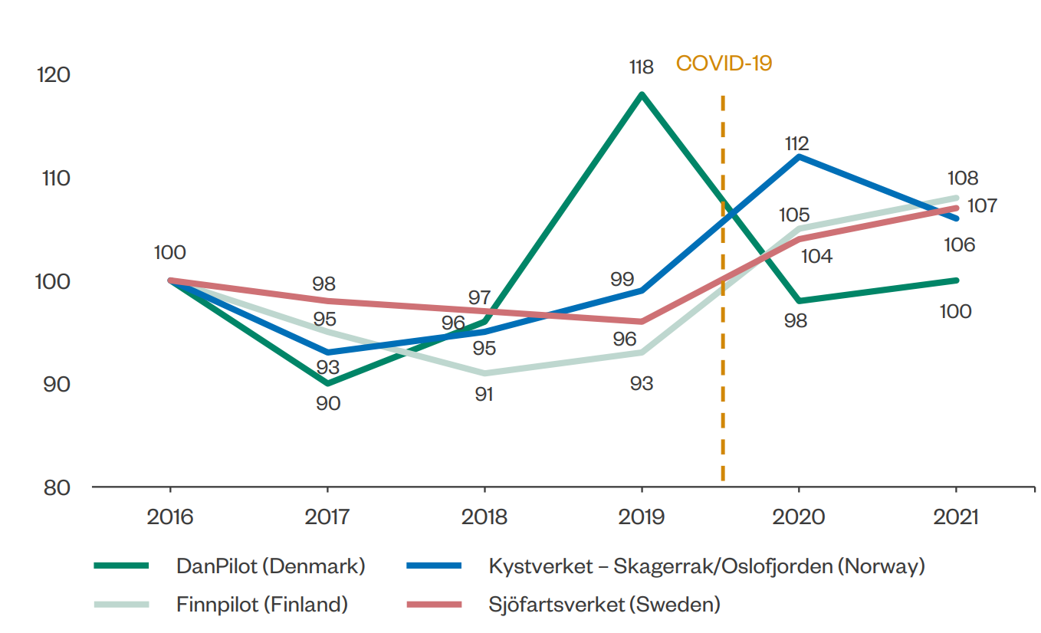
Results

Slide 15
Experience: pros outweighs cons
Difficult to ensure comparability of entities
Voluntary participation from international entities required
Ability to measure performance of nationally unique entity
Showcase methodology relevant to auditee’s own management information
Auditee may feel that comparison is unfair
Difficult to check data quality of data from international entities
Develop realistic audit criteria
Identify best practices and provide recommendations

Slide 16
Don’t hesitate to reach out…
Mette Lund Niels Kjøller Petersen
Tlf.
Tlf. +45 3392 8494
+45 3392 8611
E-mail:
E-mail: nkp@rigsrevisionen.dk
melu@rigsrevisionen.dk

