Slide 1
Professional Education for SAI Auditors (PESA)
Professional qualification for public sector audit professionals in financial, performance and compliance audits

Slide 2
PESA has in place every element of a professional qualification
Competency Framework
Syllabus
Development and Delivery Mechanisms
Assessment of knowledge & skills
Continuing Professional Development
Practical Experience
Notes:
1.PESA has in place every element of a professional qualification. – As a professional qualification, PESA is based on a competency framework, articulates learning outcomes through a syllabus, provides for extensive education and work experience, offers assessment exams and certification on passing the exams and provides for continuing professional development.

Slide 3
Framework for Professional Qualification
Competency Framework
INTOSAI Competency Framework for SAI Auditors
Developed with TFIAP
Aligned with ISSAIs for Performance Audit
Laddered in 2024

Slide 4
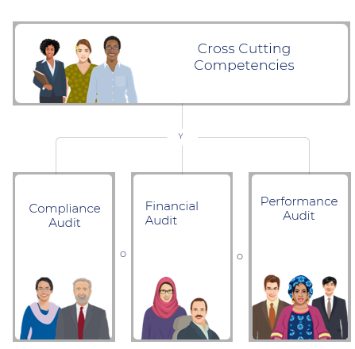
Framework for Professional Qualification
Syllabus
PESA provides education based on a syllabus designed to grow people towards the competencies outlined in INTOSAI’s Competency framework for Public Sector Audit Professionals at Supreme Audit Institutions.
A group of audit experts from across the community collaborated with IDI for the syllabus design.

Slide 5
Framework for Professional Qualification
Development and Delivery Mechanisms
170 hours of digital education
Instant feedback
Access to the help desk
Mentors and case studies from SAI Context
Based on the IDI ISSAI Implementation Handbook developed with support from PAS
Notes:
3. PESA contents is tailored to the SAI context – PESA education contents and exams are tailored to the unique context of SAIs. They provide opportunities for SAI auditors to reflect on and exercise professional judgement in applying standards in the local SAI context.

Slide 6
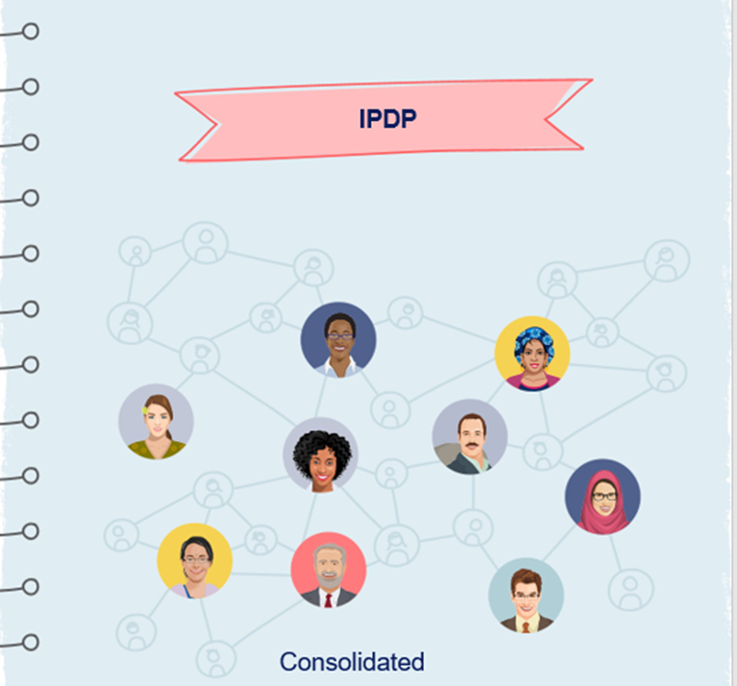
Framework for Professional Qualification
Practical Experience
Initial Professional Development Portfolio
Partnership with SAI
Apply ISSAIs to SAI Context
Principle-based standards

Slide 7
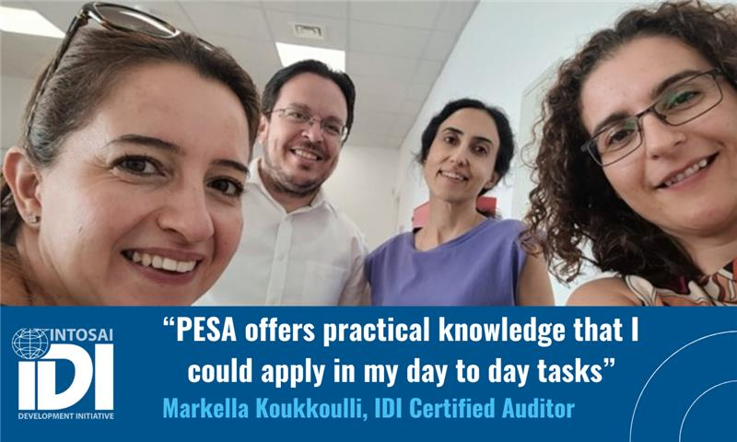
Framework for Professional Qualification
Assessment of knowledge and skills
Exams offered twice a year
Cross Cutting Competencies
Functional Competencies
Application based

Slide 8
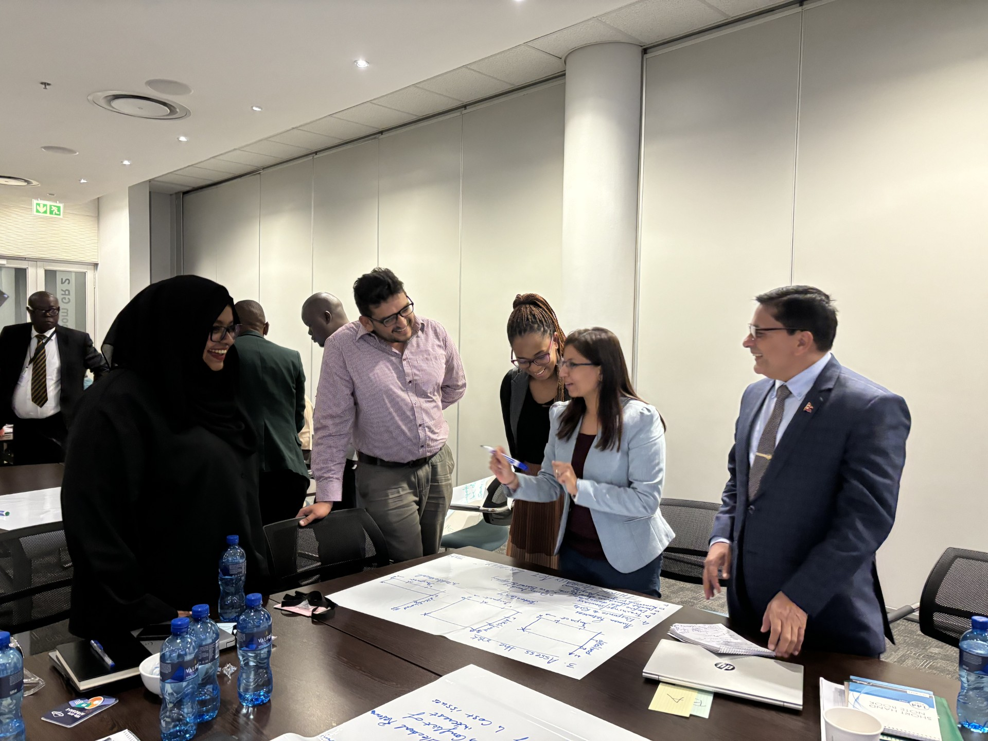
Framework for Professional Qualification
Continuing Professional Development
PESA Circle
CPD Opportunities e.g updates on standards, data analytics etc

Slide 9
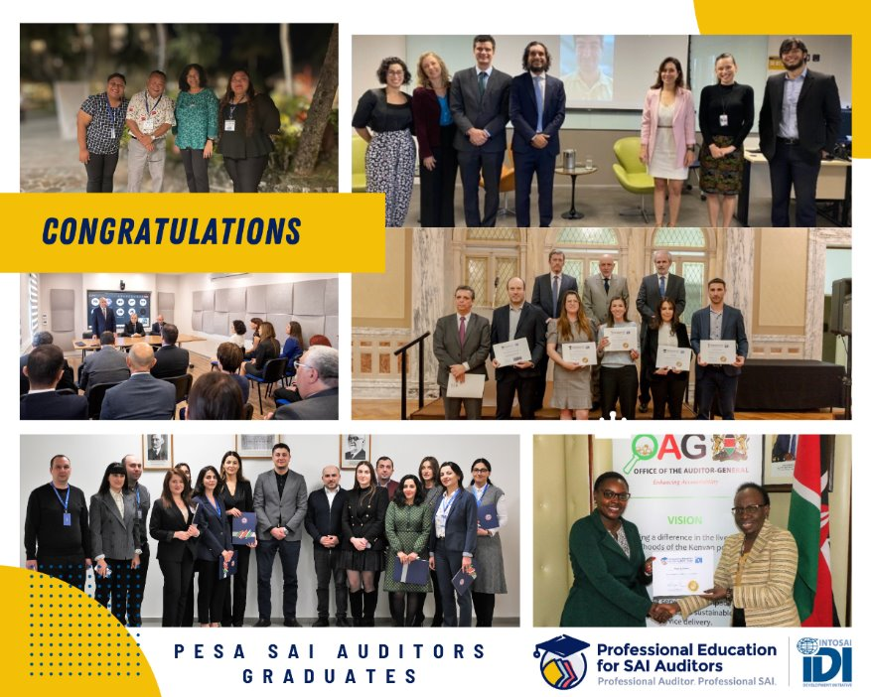
PESA Graduates
408 graduates (51% female) from 75 countries
111 Compliance Auditors
137 Financial Auditors
174 Performance Auditors

Slide 10
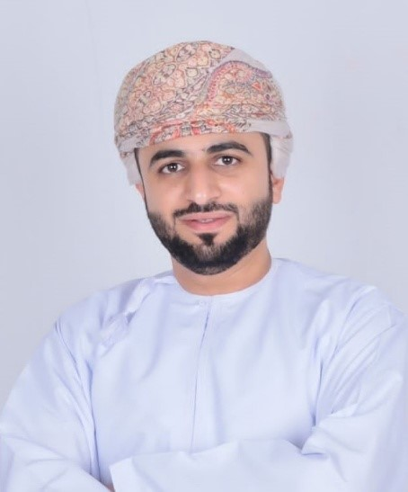
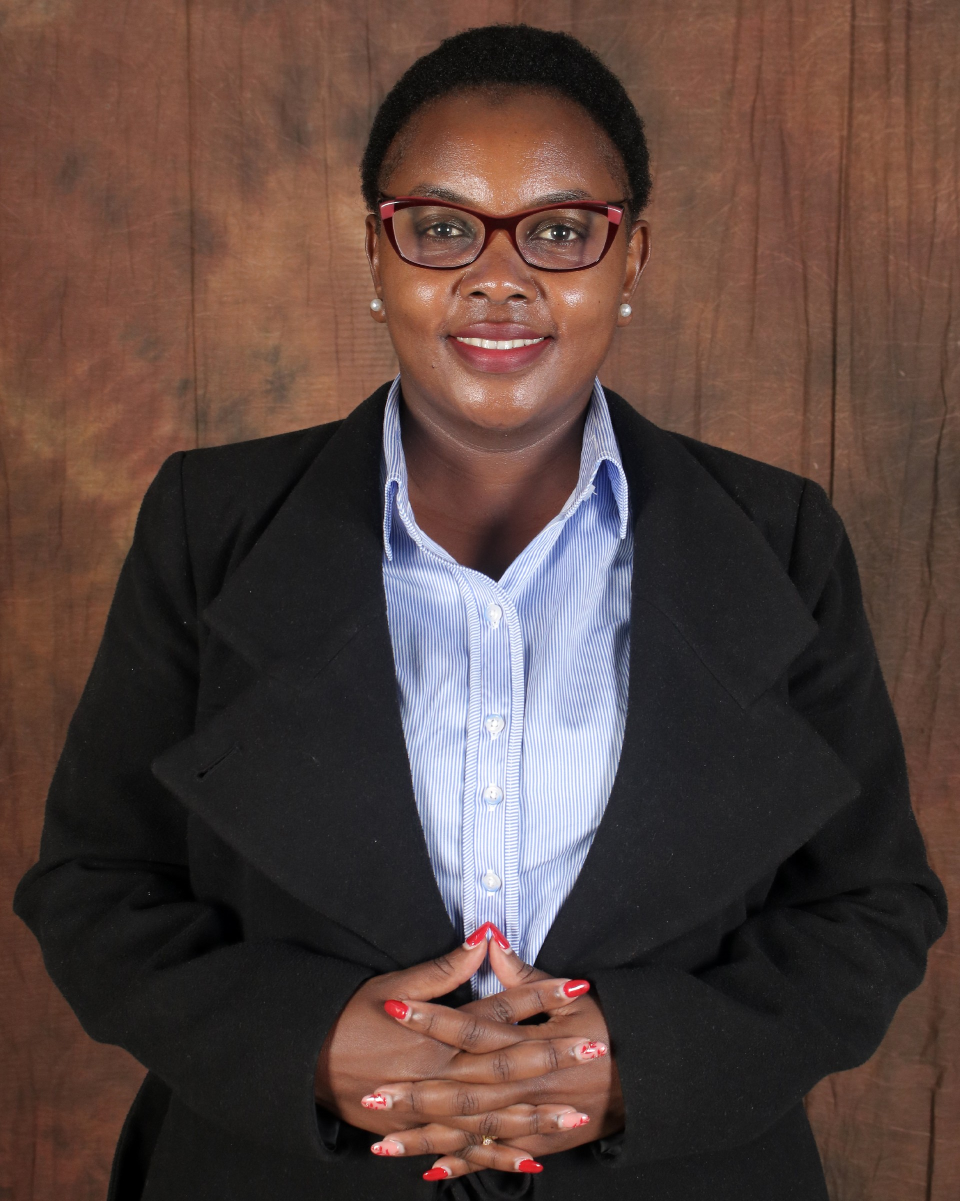
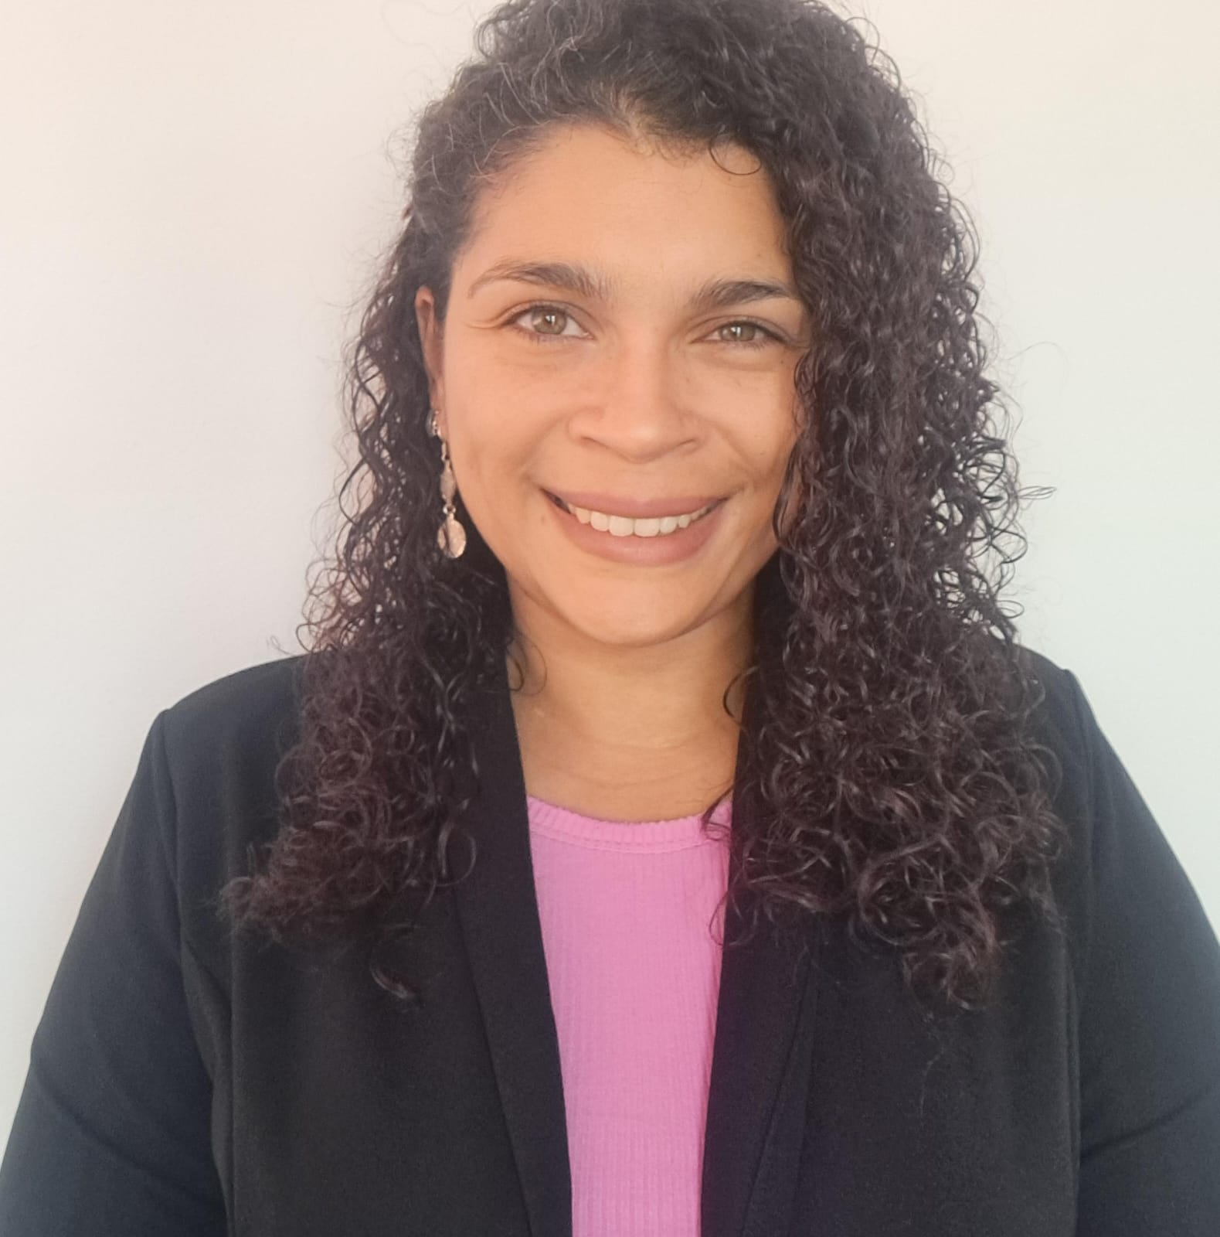
Sultan Said Saif AL-Maawali. PESA Certified Performance Auditor
“PESA Certification has been a transformative experience for my professional auditing career. The comprehensive training provided through the program has significantly enhanced my ability to conduct effective and impactful audits. I highly recommend PESA Certification to any auditor looking to elevate their expertise and contribute meaningfully to their community”.

Slide 11
What are IDI’s future plans for PESA?

Slide 12
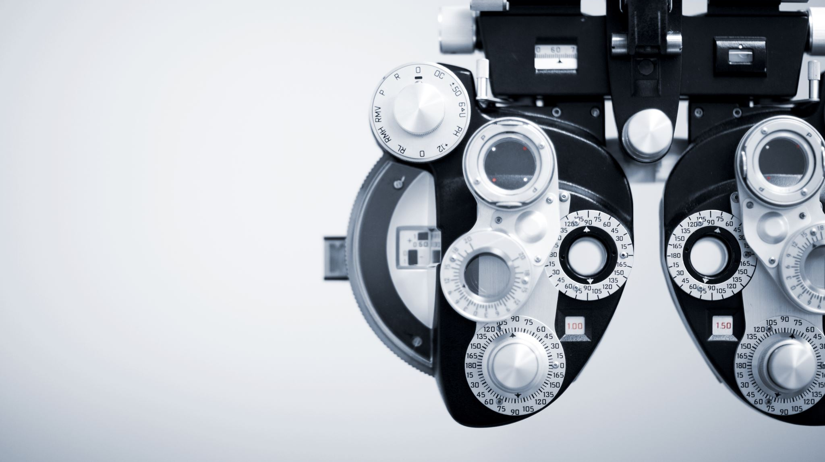
Vision
Professional Education for SAI Auditors (PESA) is a credible and well recognised professional qualification of choice for public sector audit professionals

Slide 13
PESA Accreditation
Even as PESA has been delivering value for the SAI community since 2020, the time is now right to start the process of getting externally accreditation for PESA.
Accreditation will provide independent assurance that the PESA qualification adheres to high standards of quality.
IDI’s main aim in seeking accreditation is to enhance the recognition, confidence and growth opportunities for PESA qualified SAI auditors.

Slide 14
INTOSAI Recognition
Motion to be presented at INCOSAI after due approval by the IDI Board and INTOSAI Governing Board. The motion will propose that:
INTOSAI recognises IDI’s Professional Education for SAI Auditors (PESA) as a valuable professional qualification for SAI audit professionals and supports IDI’s efforts for external accreditation to enhance the professional credentials of the PESA qualification.
Create ‘champions’ for PESA such as PAS who will provide an opportunity for awareness raising around PESA for example by allowing for regular updates in meetings.
Encourage Heads of SAIs and other INTOSAI bodies to champion PESA as a professional qualification.
Awareness raising and advocacy for PESA before and after INCOSAI:
Organise a side event at INCOSAI with PSC.

Slide 15
SAI Recognition
Actions to raise awareness of PESA within SAIs in addition to the above:
Regional-level discussions including high-level dialogues on professionalisation in OLACEFS, CREFIAF and ARABOSAI in 2025.
Presentations within individual SAIs on request
Encourage experience sharing by Heads of SAI
Yvonne Jones, Director of Audit St. Lucia

Slide 16
Any questions?

