Slide 1








SAI Thailand: Innovation in Performance Audit
Using GIS and Technology
APRIL 1-2, 2025
Dr. Matulee Yokee
Assistant Auditor General
State Audit Office of the Kingdom of Thailand

Slide 2

DATA ANALYTICS

Slide 3




COMPENSATION PAYMENTS TO PEOPLE
AFFECTED BY THE COVID-19
Cr. Audit team in PA office No.1

Slide 4

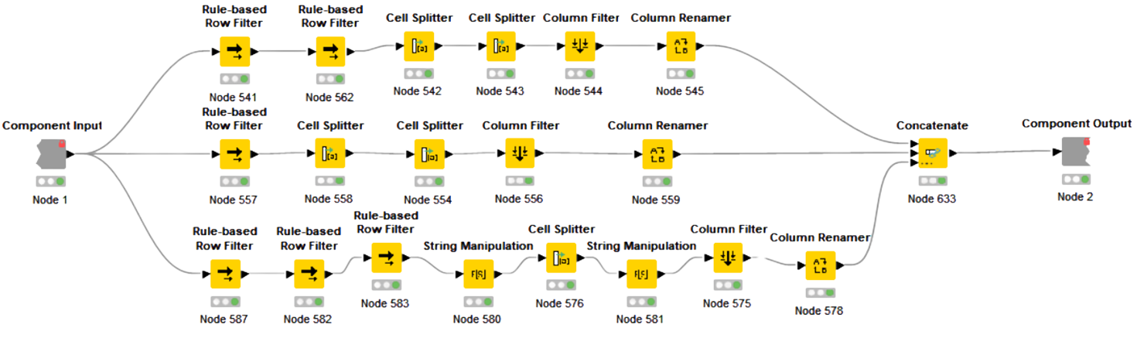
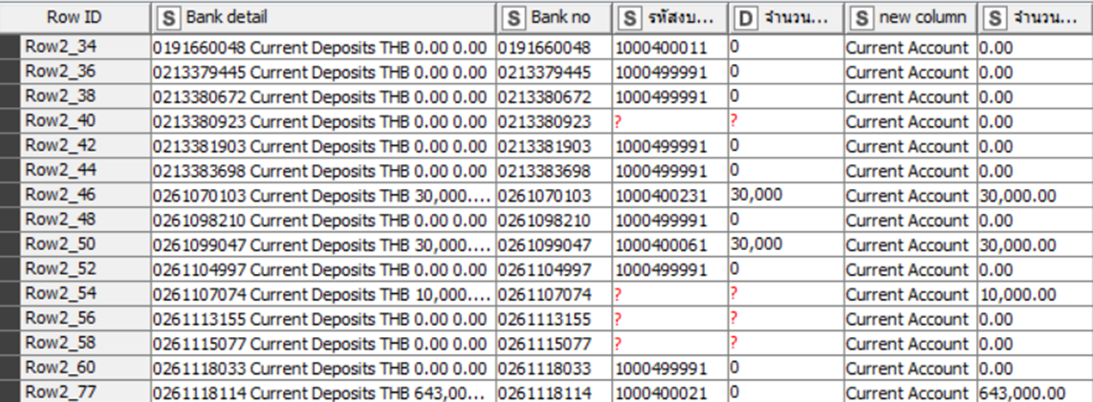

Slide 5
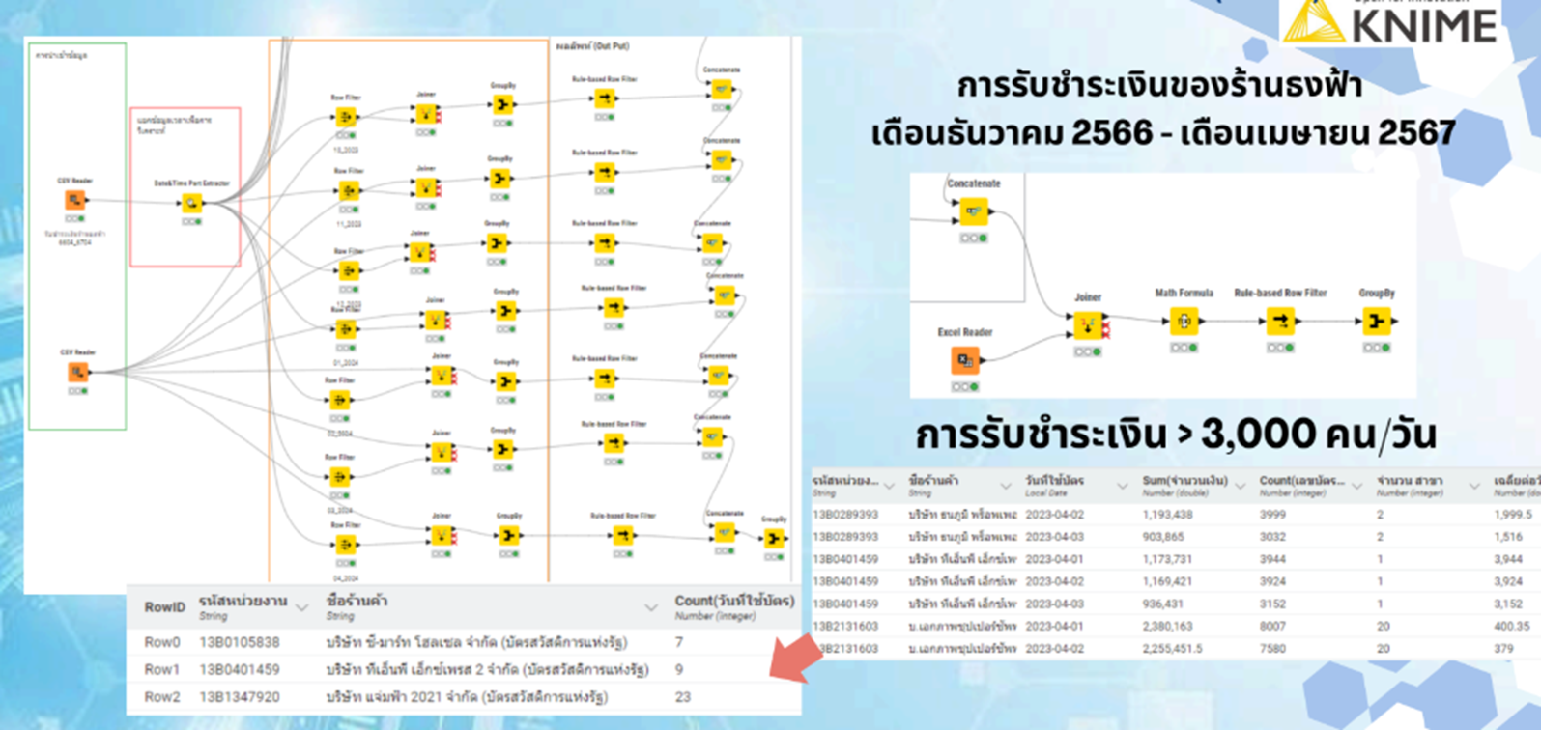
Cr. Audit team in FA office No.4

Slide 6



GIS
IN AUDITING

Slide 7
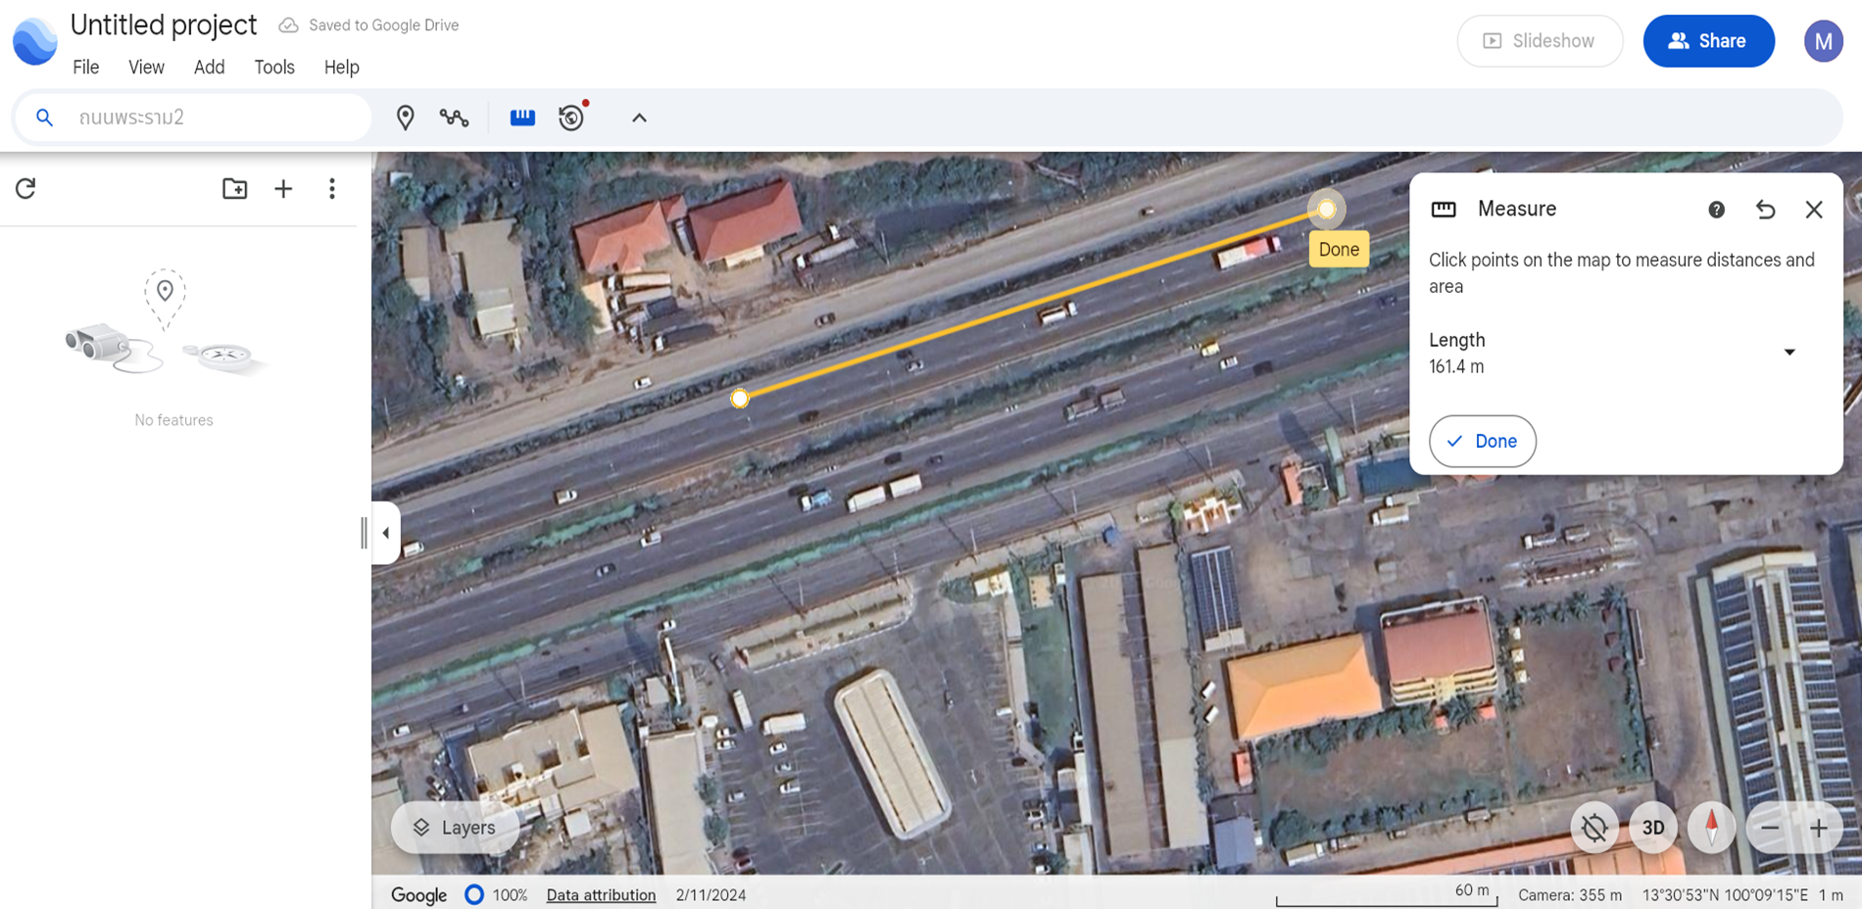

Geographic Information System (GIS)
THE IMAGE SHOWS
A distance measurement along the length of
the road (the road's distance)
Distance Measurement

Slide 8
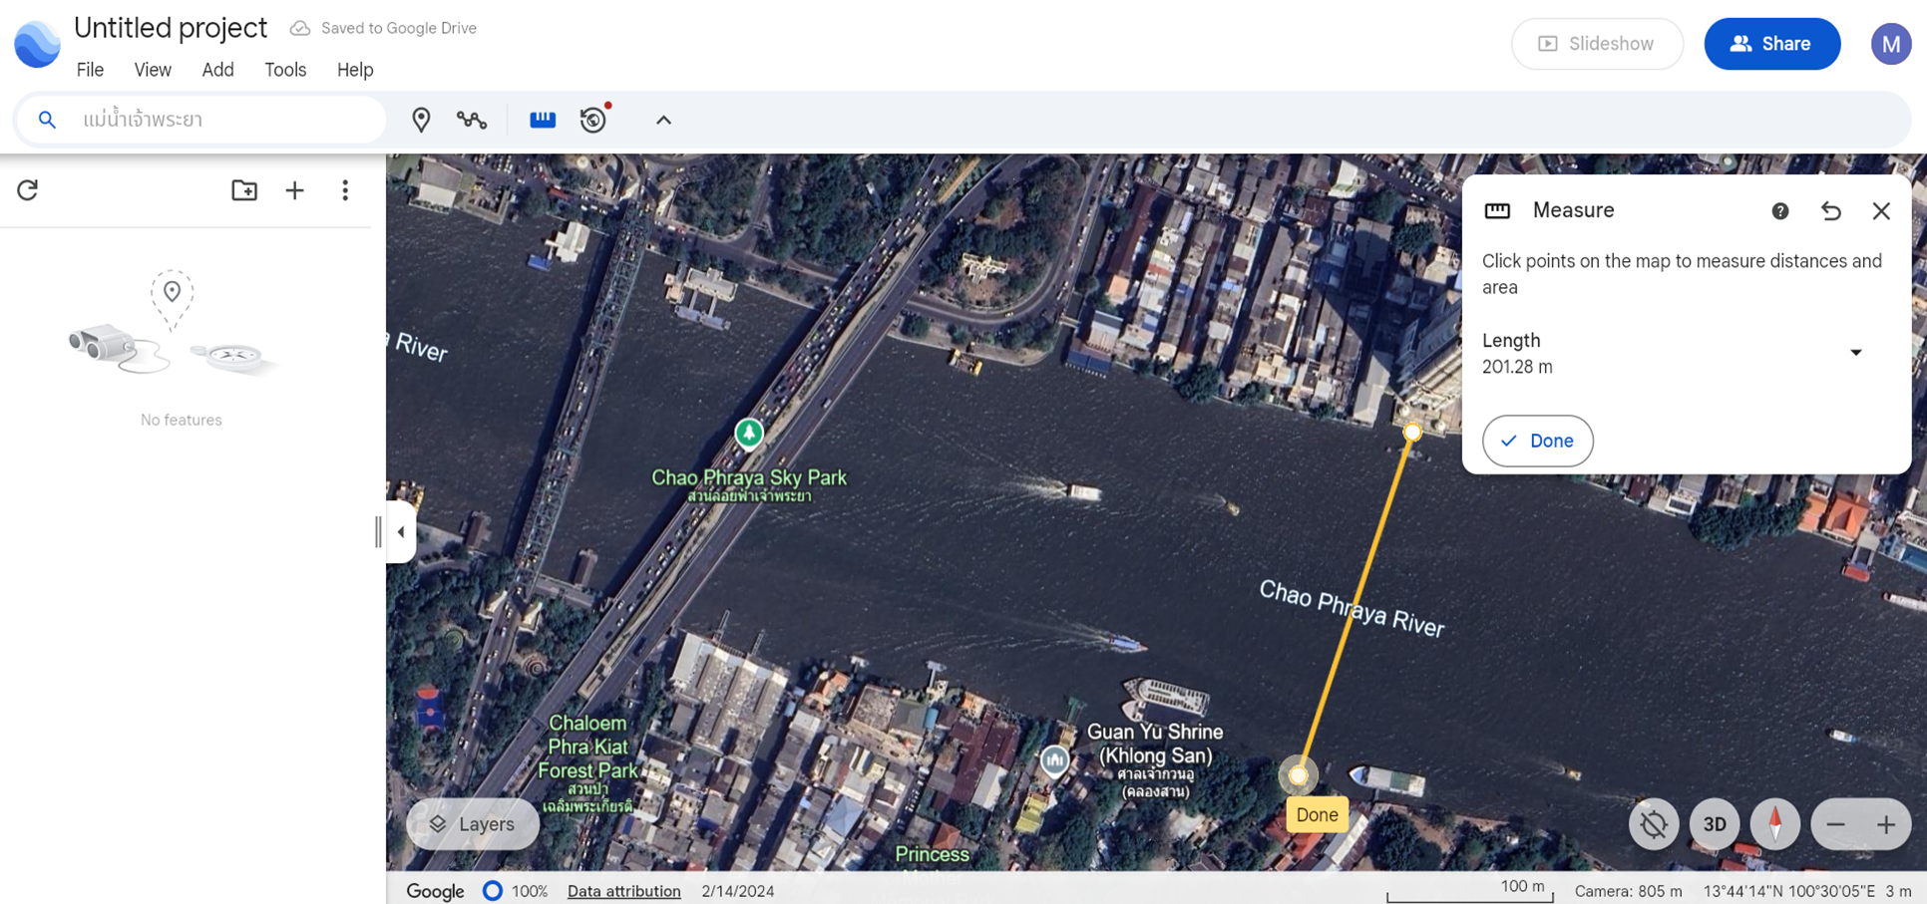
Geographic Information System (GIS)
THE IMAGE SHOWS
A distance measurement across the width of the river (the width of the Chao Phraya River)

Slide 9
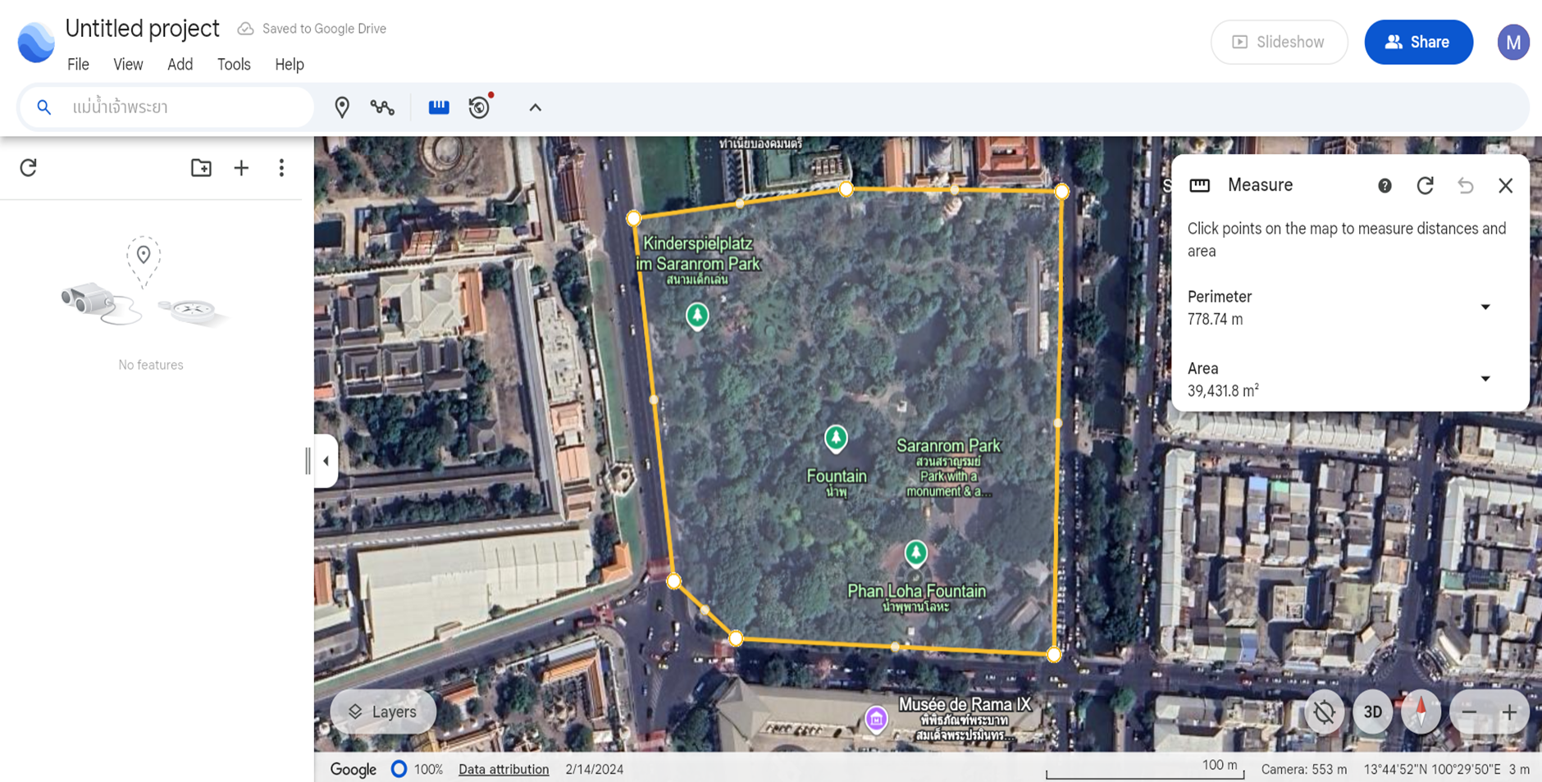
Geographic Information System (GIS)
THE IMAGE SHOWS
An area measurement from an aerial photograph
Area Measurement

Slide 10
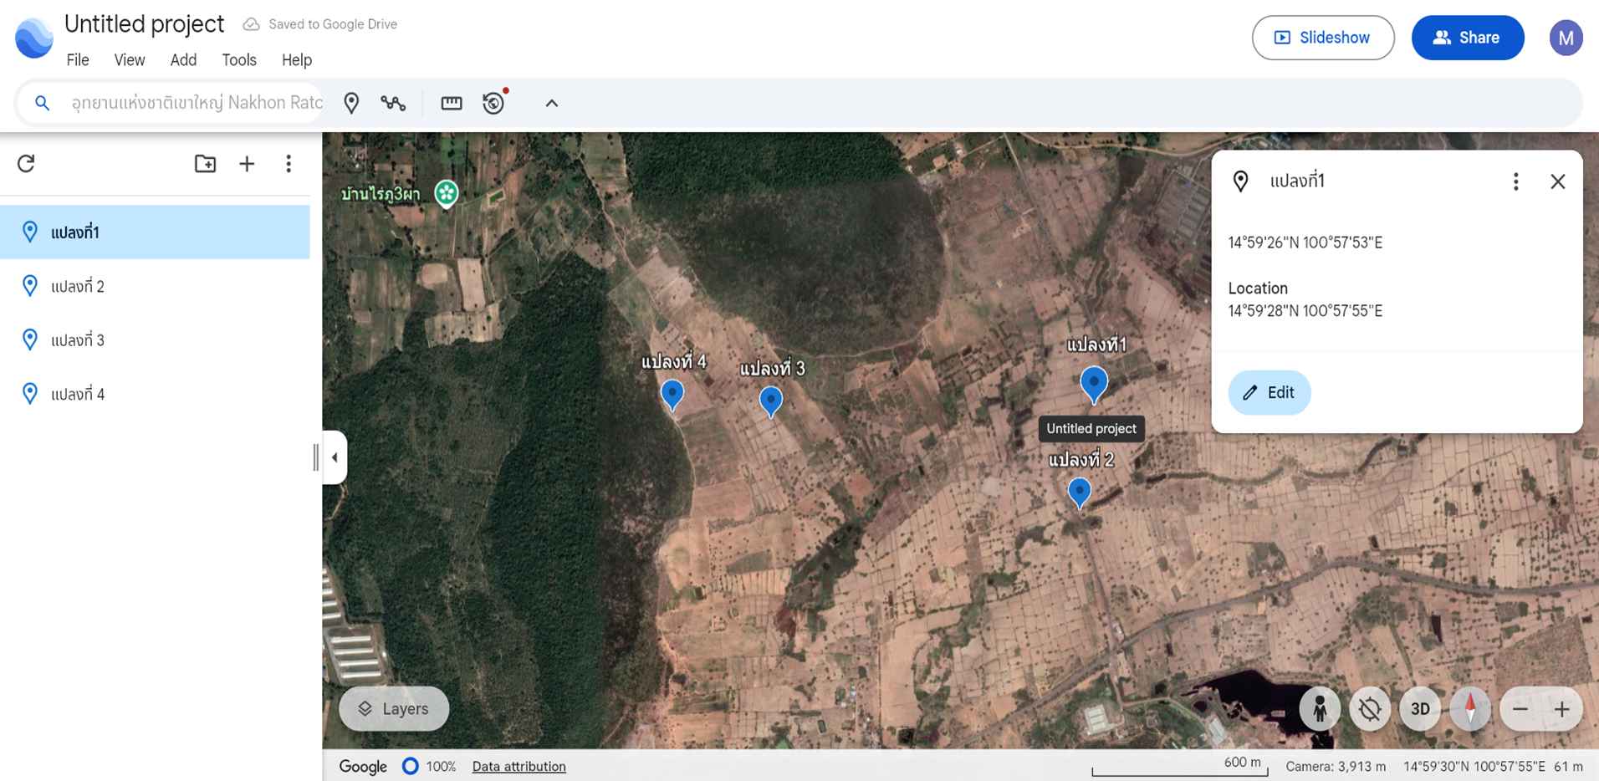

Geographic Information System (GIS)
THE IMAGE SHOWS
the use of aerial photography for planning inspections and defining areas for on-site surveys
Field Planning

Slide 11
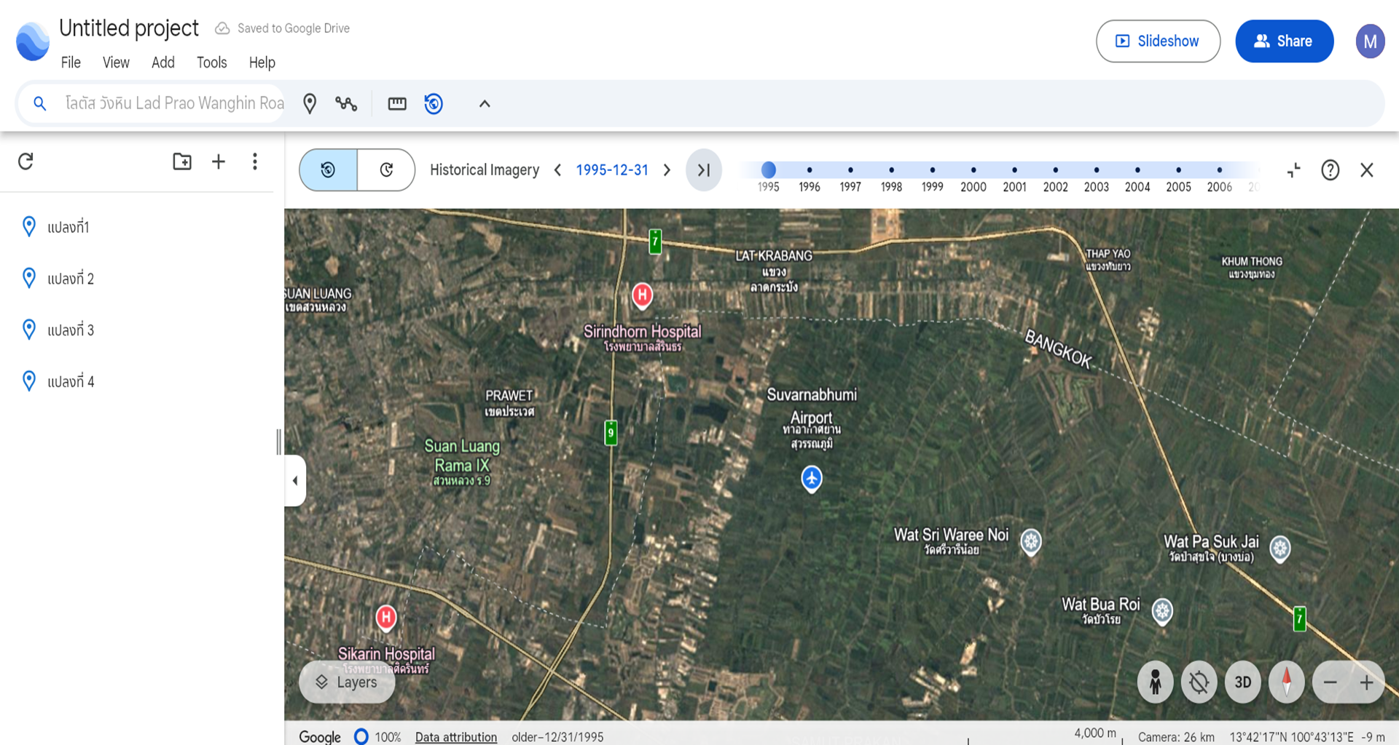
Geographic Information System (GIS)
THE IMAGE SHOWS
the use of aerial photography to monitor land use changes over time
Inspection of Land Use Conditions and Changes

Slide 12
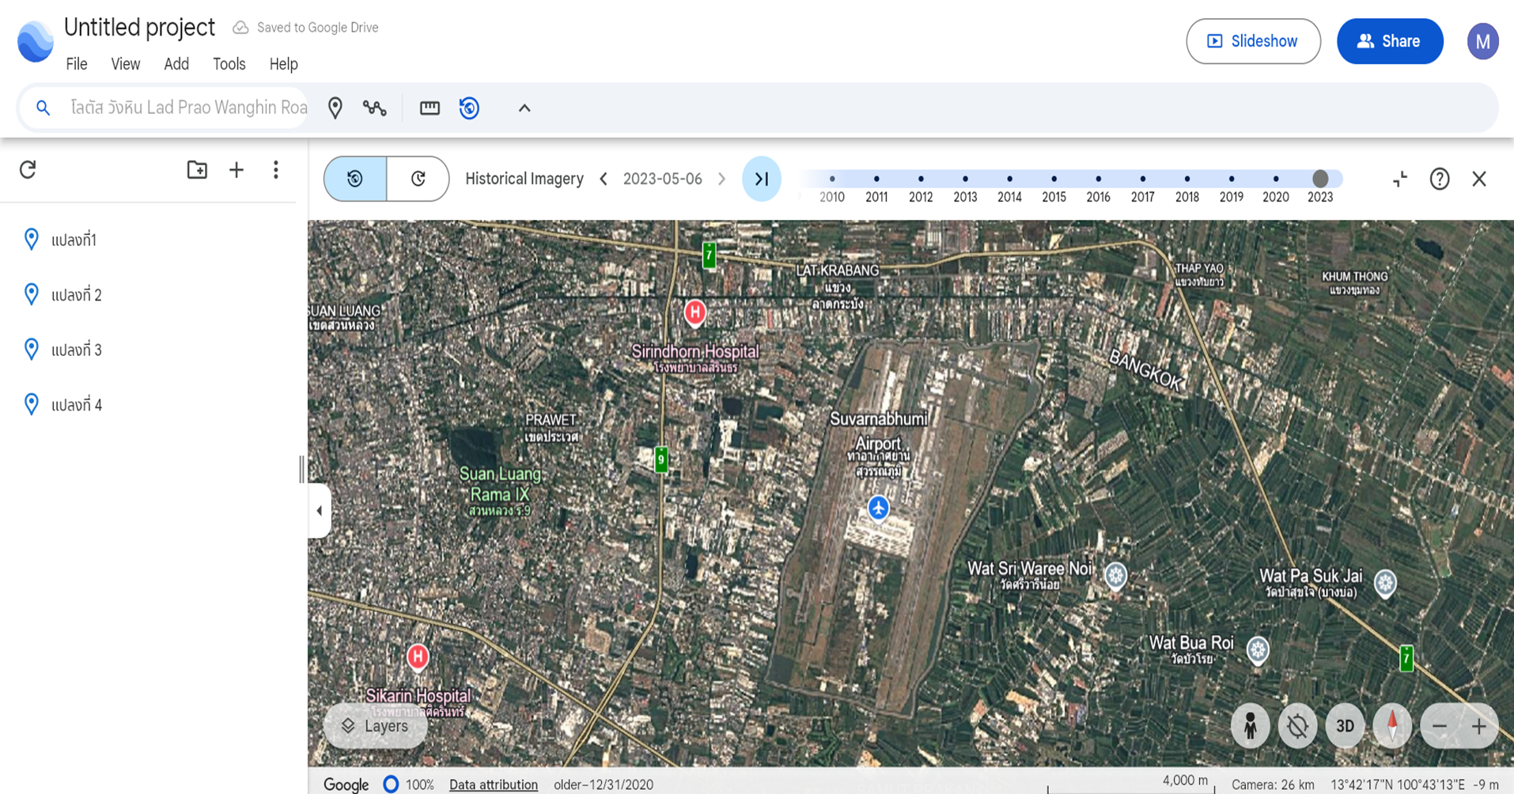
Geographic Information System (GIS)
THE IMAGE SHOWS
the use of aerial photography to monitor land use changes over time
Inspection of Land Use Conditions and Changes

Slide 13
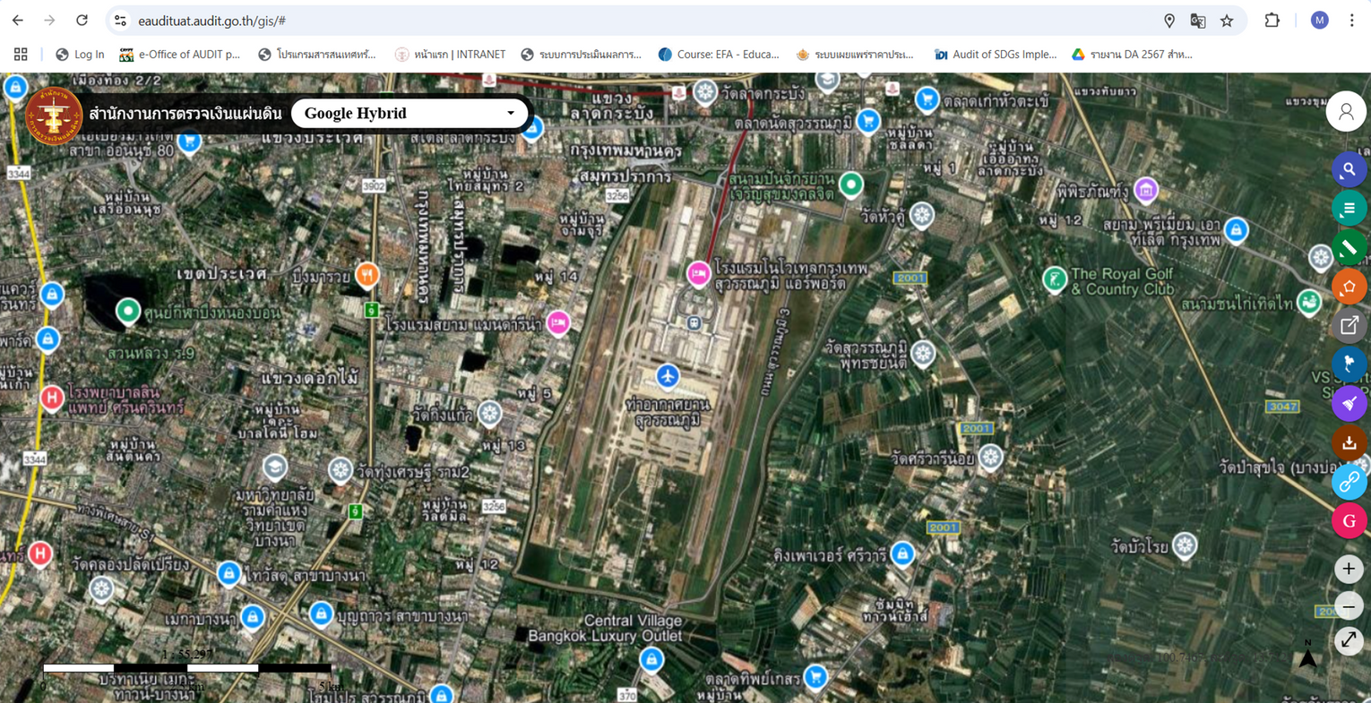
Geographic Information System (GIS)
THE IMAGE SHOWS
Inspection of Land Use Conditions and Changes
the use of aerial photography to monitor land use changes over time

Slide 14
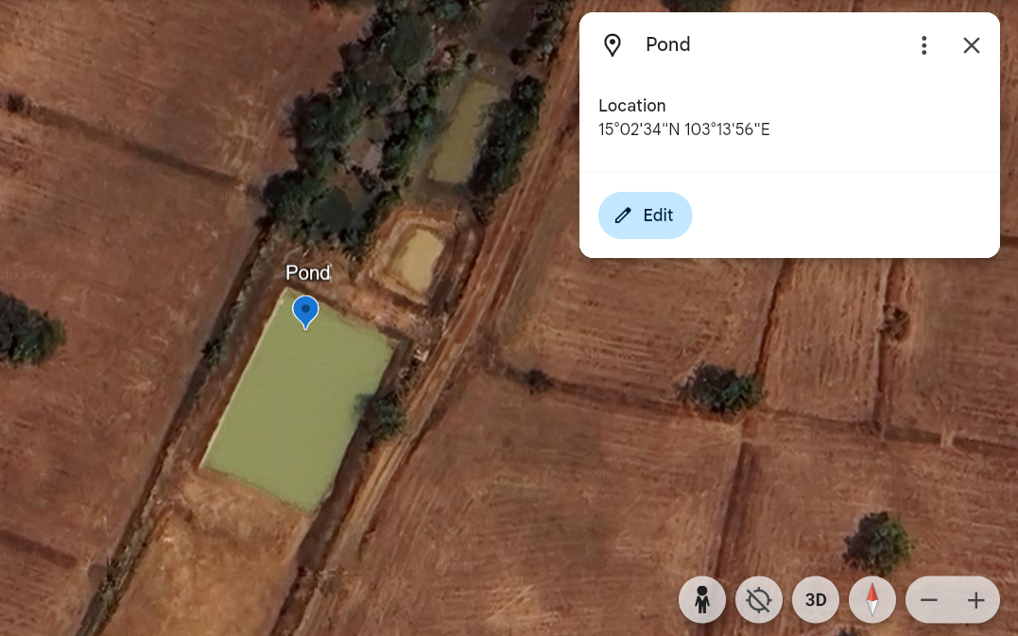
Geographic Information System (GIS)

Slide 15
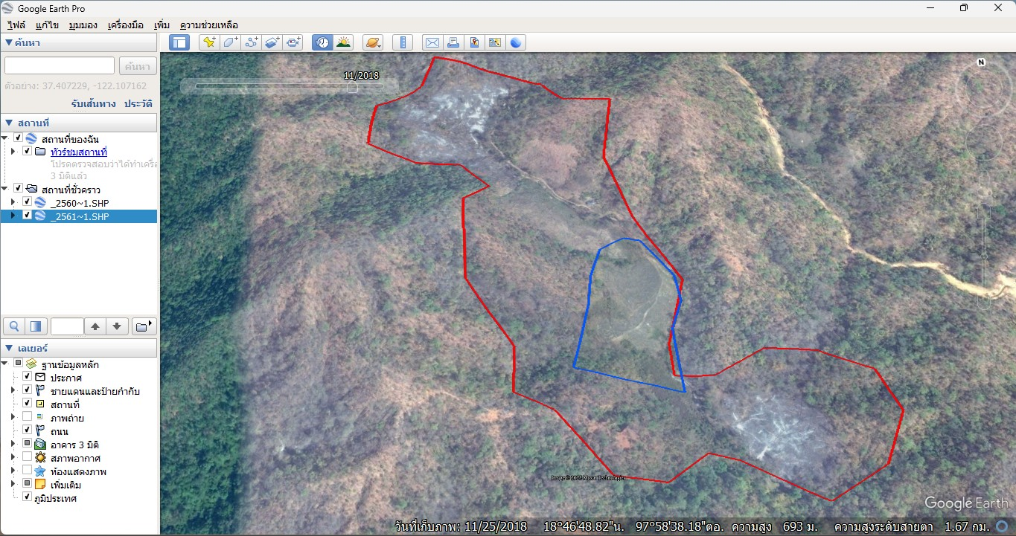
Geographic Information System (GIS)
In 2018

Slide 16
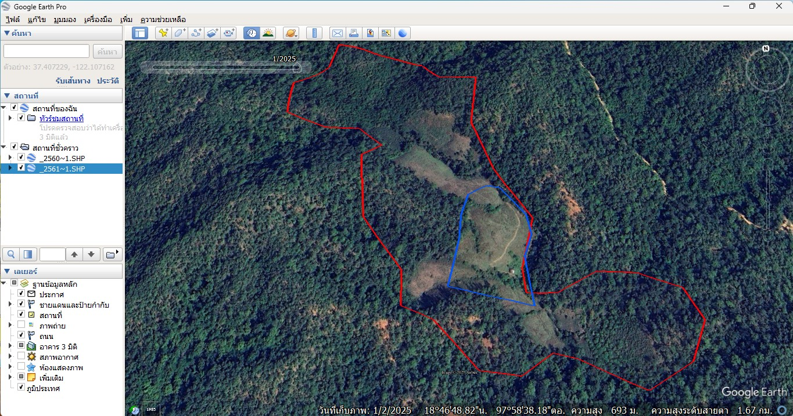
Geographic Information System (GIS)
In 2025

Slide 17
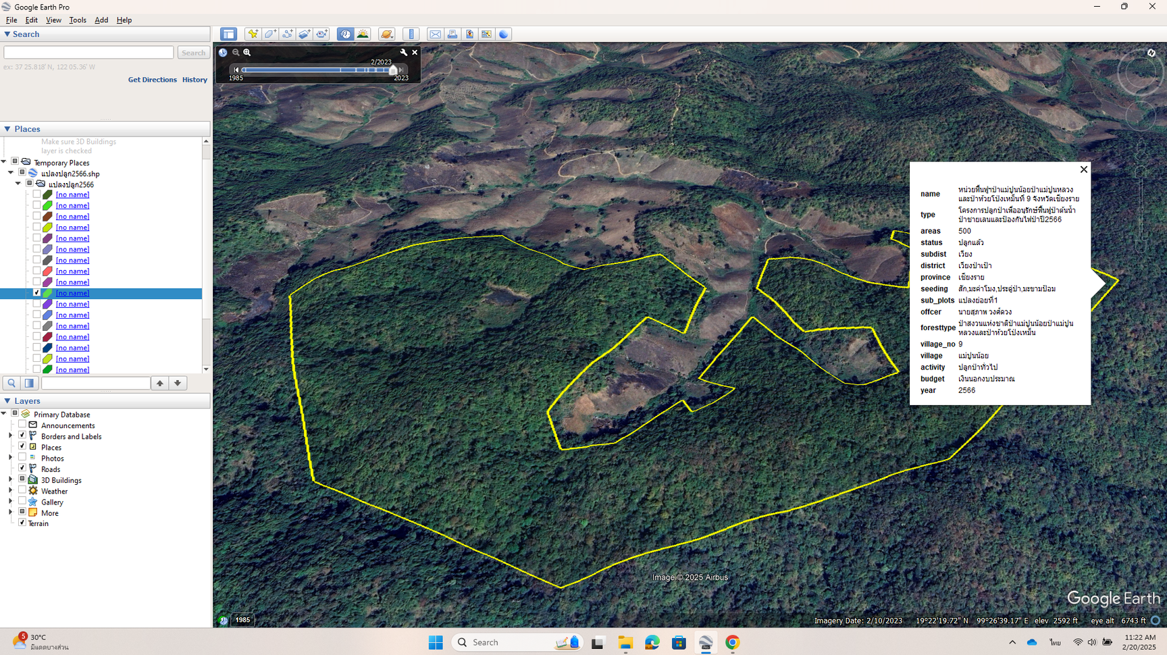
Geographic Information System (GIS)
In 2023

Slide 18
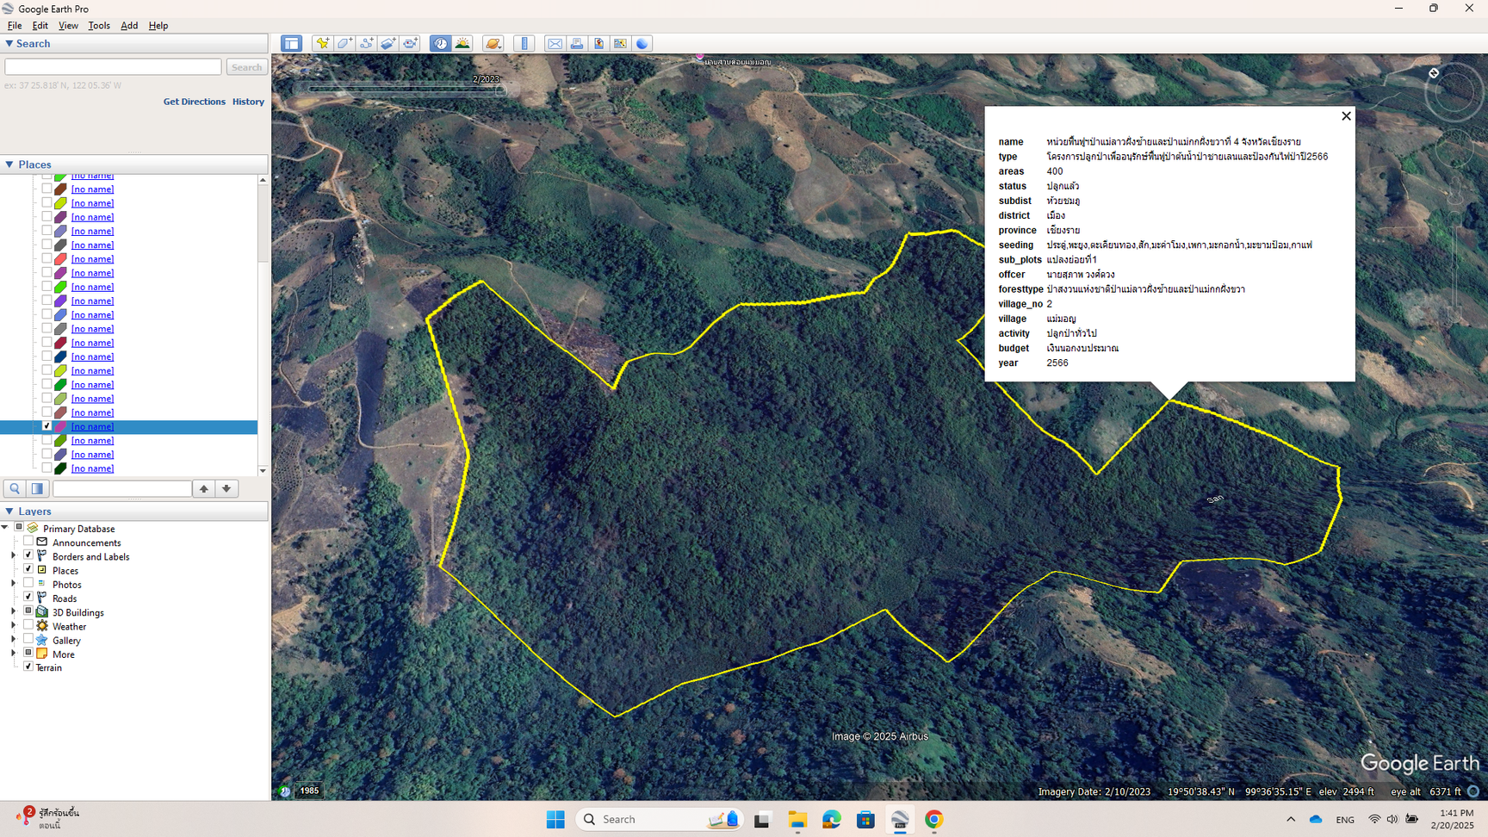
Geographic Information System (GIS)
In 2023

Slide 19
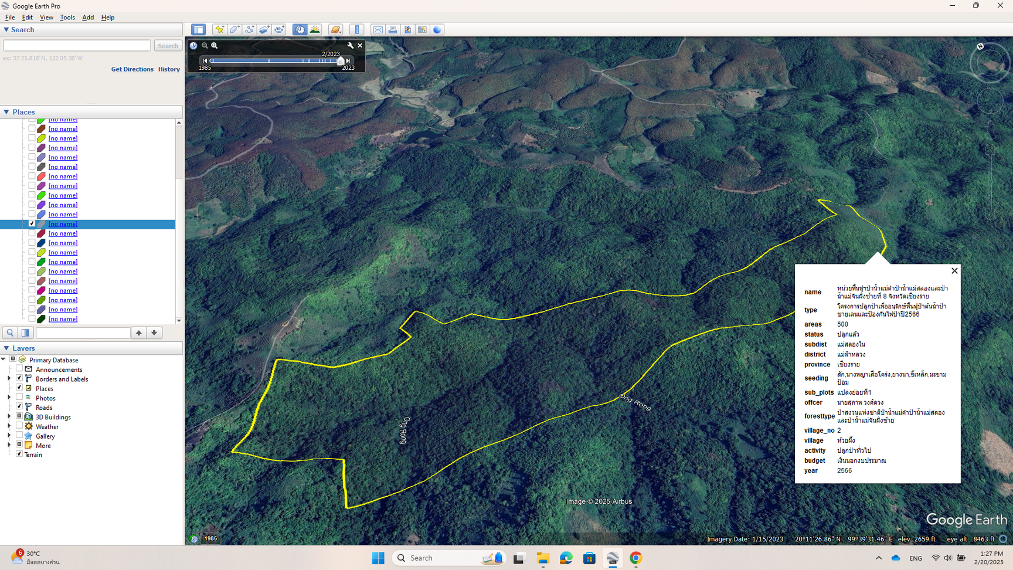
Geographic Information System (GIS)
In 2023

Slide 20
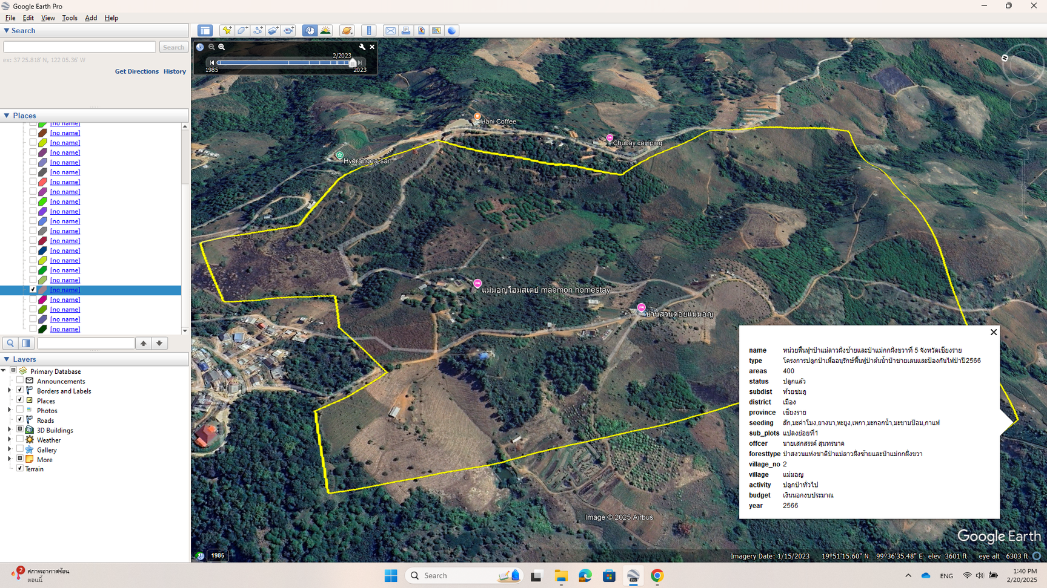
Geographic Information System (GIS)
In 2023

Slide 21
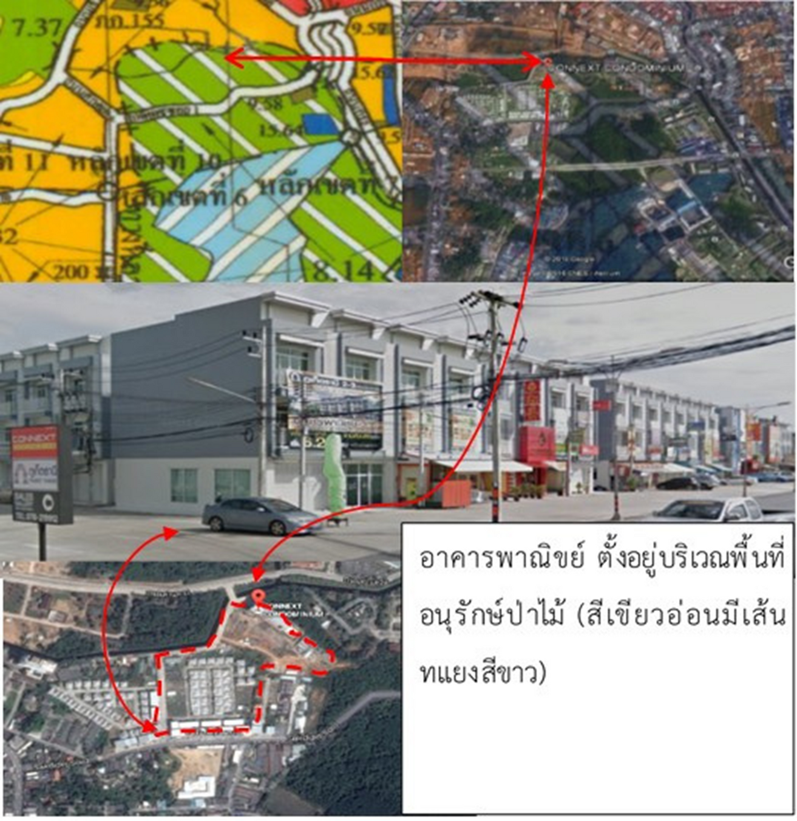
Geographic Information System (GIS)

Slide 22
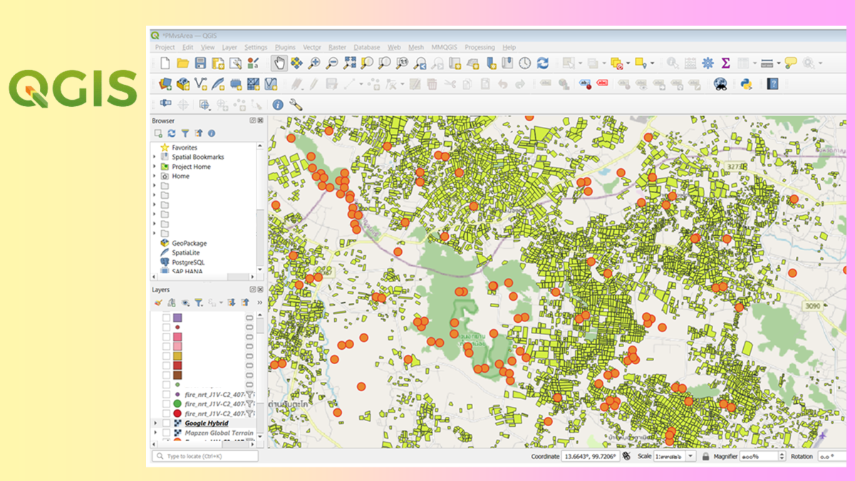

Slide 23



Unmanned Aerial Vehicle: UAV

Slide 24
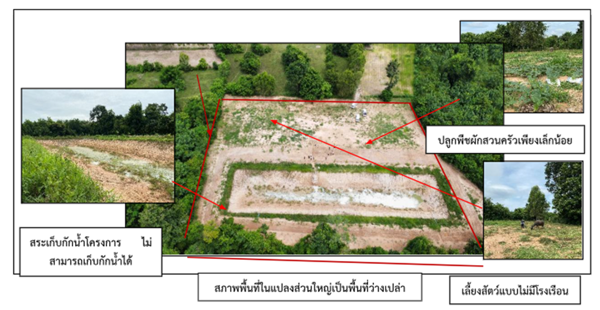
Unmanned Aerial Vehicle: UAV
A 5-Rai Agricultural Area
Implementing New Theory Agriculture

Slide 25
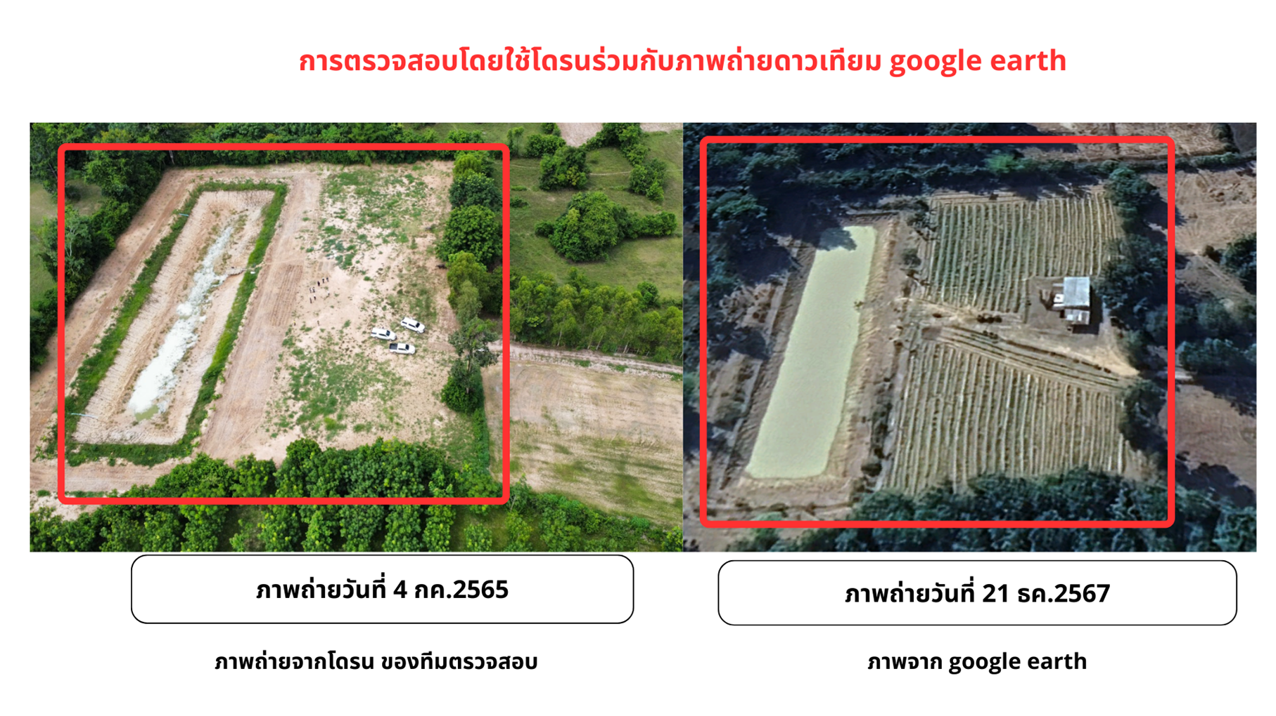
Unmanned Aerial Vehicle: UAV
Inspection using drones combined with satellite images from Google Earth
Photo taken on July 4, 2022
Drone image taken by the inspection team
Photo taken on December 21, 2024
Image from Google Earth

Slide 26




Dr. Matulee Yokee
Assistant Auditor General
State Audit Office of the Kingdom of Thailand
Email
matulee_y@oag.go.th

