Slide 1
Accessibility initiative
Spyridon Pilos (project lead - ECA)
Performance Audit Subcommittee, Budapest, 24.03. 2026​

Slide 2
Reminder: SDP 2023-2028
The Strategic Development Plan (SDP) is INTOSAI’s roadmap for developing and improving the INTOSAI Framework of Professional Pronouncements (IFPP) over the 2023–2028 period. Created by the INTOSAI Professional Standards Committee (PSC), the Forum for INTOSAI Professional Pronouncements (FIPP), and other stakeholders after extensive consultations.
It includes findings from the Component I Report “Review and Analysis of the IFPP”.
The SDP is structured around five thematic goals:
Check this FIPP page for an overview of SDP projects.
More information and the Project proposal for Accessibility Project is found here.
A Accessibility | T Terminology | P Principles | I ISSAIs | G Guidance

Slide 3
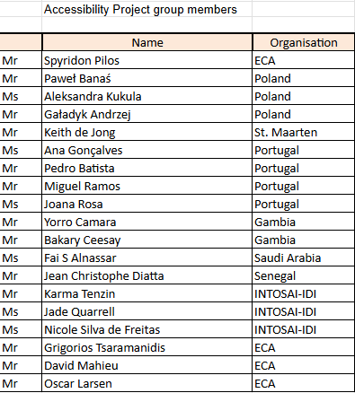
Accessibility Project - team organisation
14 members
4 from Portugal, 3 from Poland, 2 from Gambia, and 1 from Saudi Arabia, Senegal and St. Maarten.
3 for INTOSAI-IDI
3 from the ECA (including one IT technical expert and one experienced auditor, with great knowledge of standards)
Continuous collaboration on Microsoft Teams since December 2024 (team created and hosted by the ECA)
16 project meetings since the beginning (every 3-5 weeks)
PSC secretariat present at all project meetings (+ Core Group)
FIPP Liaison Officer: Monica Rajamanohar (India)
Project proposal approved in June 2025 (available here)

Slide 4

Accessibility project proposal
Decision point
Project proposal
Component I report
2025
2026
2027
2028
Improvements
Wishlist
Improvements requiring new digital platform
Tech
Long Term Strand
Concept paper
Improvements in existing issai.org
Short Term Strand
Additional
user input
Tech
Additional
user input
Additional
user input
issai.org website = the tool​
the official repository for IFPP pronouncements. Includes principles, standards, guidance, and background information on standard-setting. ​
​
The project questions:​
Is the tool sufficient for what it is intended to do? ​If not, how can we improve it and/or what could replace it? ​
Notes:
Accessibility project proposal:
Input was the component I report and the concept paper.
a wishlist with improvements was established, taking on board additional input by the project team
Taking into account the state of technology this was split into short and long term strands
The short term strand will start immediately as it is about improving the existing isssai.org
At the end of 2026 there will be a decision point on next steps. This will take into account additional input collected during the short term strand activities and technology evolution. The PSC steering committee will decide whether we keep the current issai.org or move to something else, taking into account cost and benefit.

Slide 5
Focus
Implement short term actions and decide if long term are needed at the end of 2026.
The information already collected on user needs is sufficient, i.e. no need for further actions on this.
Take into account that AI is disrupting the way to cover the needs.

Slide 6
Approach
Working with PDF is good enough at this stage. No need to move to a database approach.
Focus on implementation ➔ specifications & mock-up ready (delayed due to contractual problems with website provider)
Learn from experience of others.
Work together with other standard setters and users (e.g. on AI)

Slide 7
Highlights until today
Thematic workshop no.1 : KYS Workshop (Know-Your-Site) (October 25 - lead: colleagues from Portugal)
Interviews with IFAC, IDI and IIA (lead: colleagues from Saint Maarten, Poland and ECA)
Thematic workshop no.2 : New IDI Platform (March 26 - lead: colleagues from Portugal)
Addition of an AI expert to ECA team to support prototyping (a data scientist and an information management expert)
Proofs of concept of AI chatbots with ISSAI, IFAC and IDI content
In preparation: Thematic workshop: new IFAC platform for standards

Slide 8
Next steps
Decision on what should be in issai.org (by PSC SC)
Focus on standards and standard setting.
Move news, info on events and learning material elsewhere.
Decision on reorganisation and presentation of standards on the website (by PSC SC)
Implement changes to issai.org website
Continue exploring AI

Slide 9
Questions?

